Slide 1
MCE 466 – Introduction to Finite Element Methods
Instructor: David G. Taggart
Dept. of Mechanical, Industrial and Systems Engineering
University of Rhode Island
Fall 2021

Slide 2
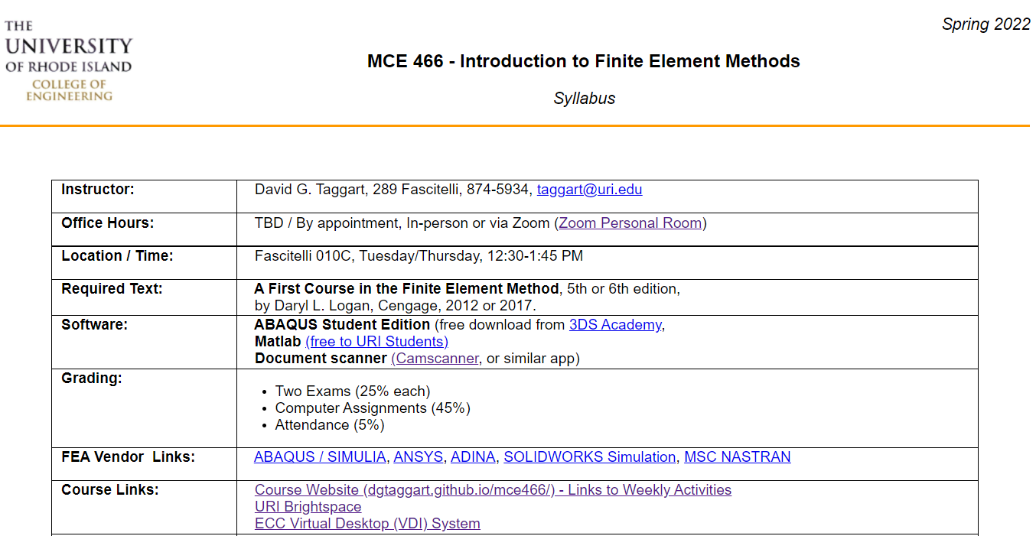
Syllabus
(Course Website: https://dgtaggart.github.io/mce466/)

Slide 3
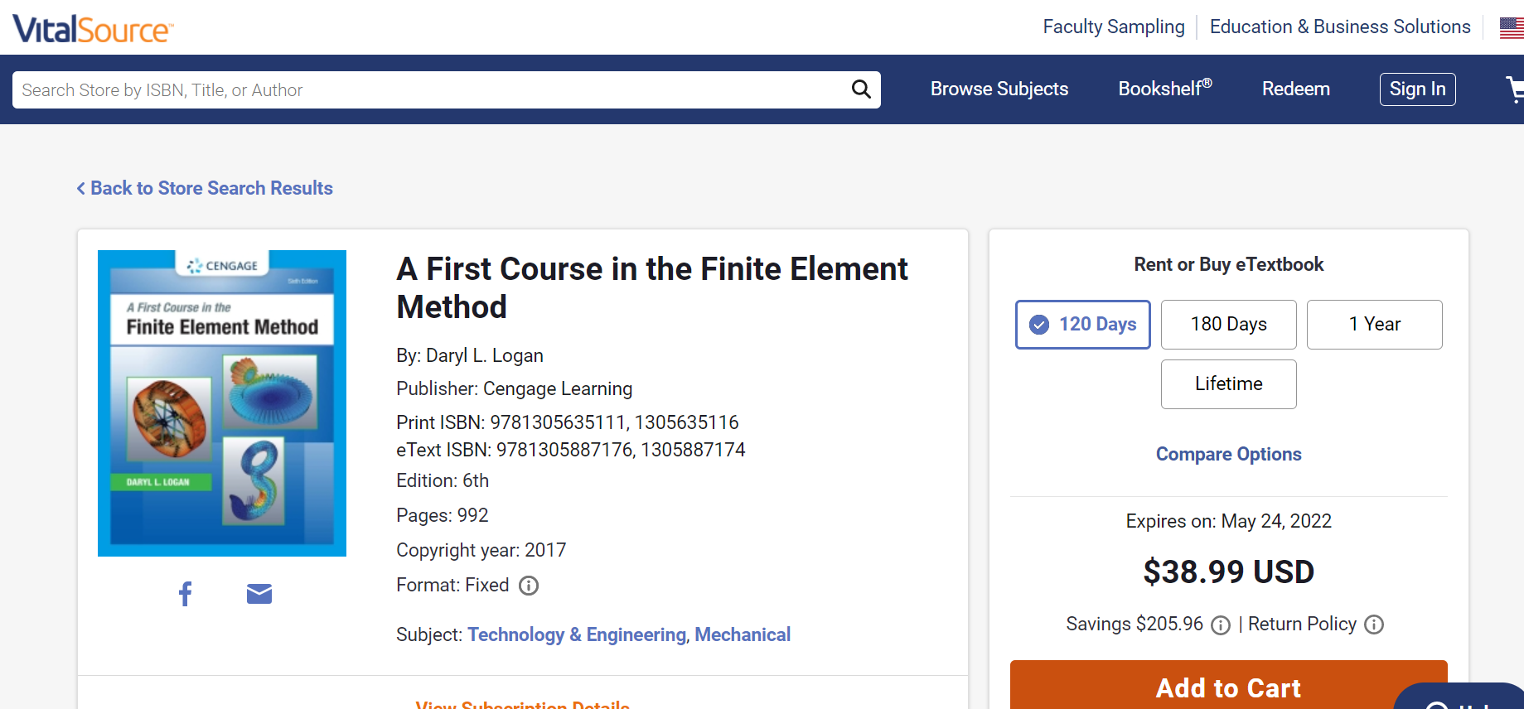
Textbook – VitalSource.com

Slide 4
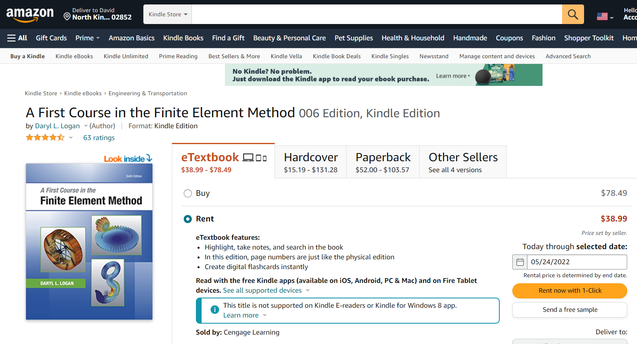
Textbook, 6th edition (Amazon)

Slide 5


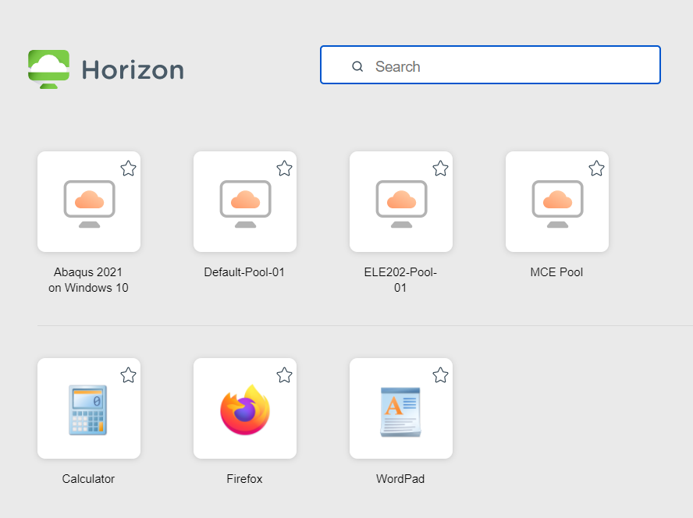
ECC Virtual Desktop (VDI) System
Remote access for running Abaqus: http://access.ecc.uri.edu/

Slide 6
Software
Abaqus Student Edition (may not be needed if VDI works)
Free download for students in FEA course
MS Windows only
Create account and download from:
http://academy.3ds.com/software/abaqus-student-edition/
Matlab (free to current URI students)
Download from:
https://web.uri.edu/research-computing/matlab/

Slide 7
Grading
Two Exams (25% each)
Computer Assignments (45%)
Attendance (5%)

Slide 8
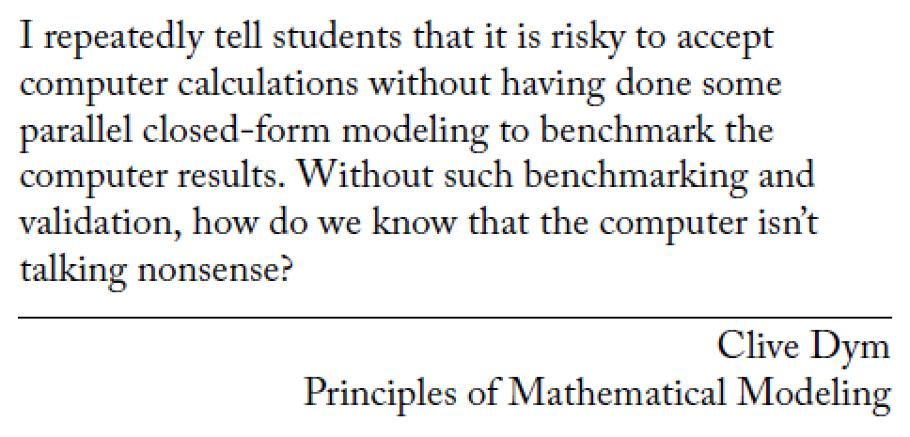
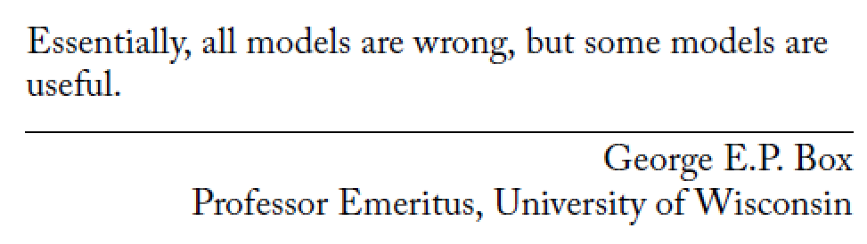
Recommended Reading
Warning: The Computed Answer May Be Wrong
Lying by Approximation: the Truth about Finite Element Analysis (text available online through URI library)

Slide 9
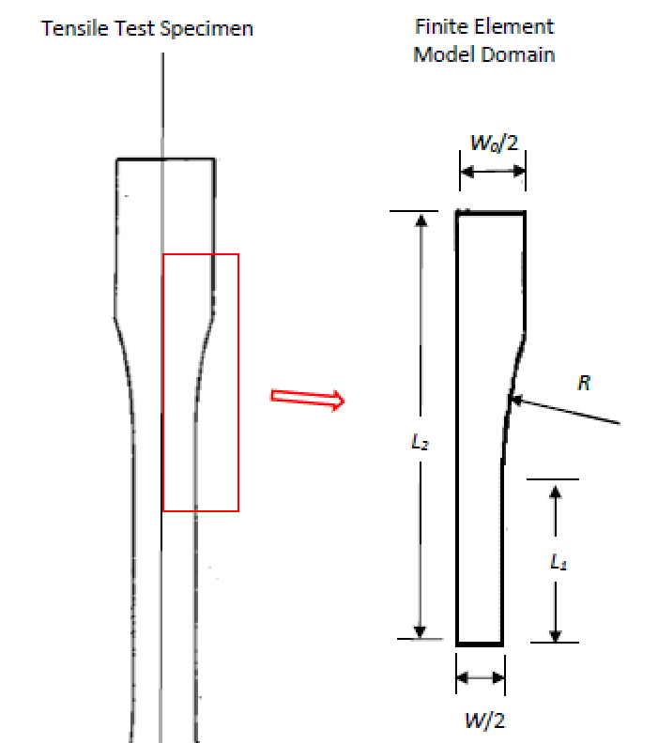
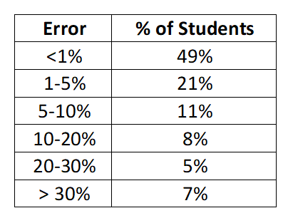
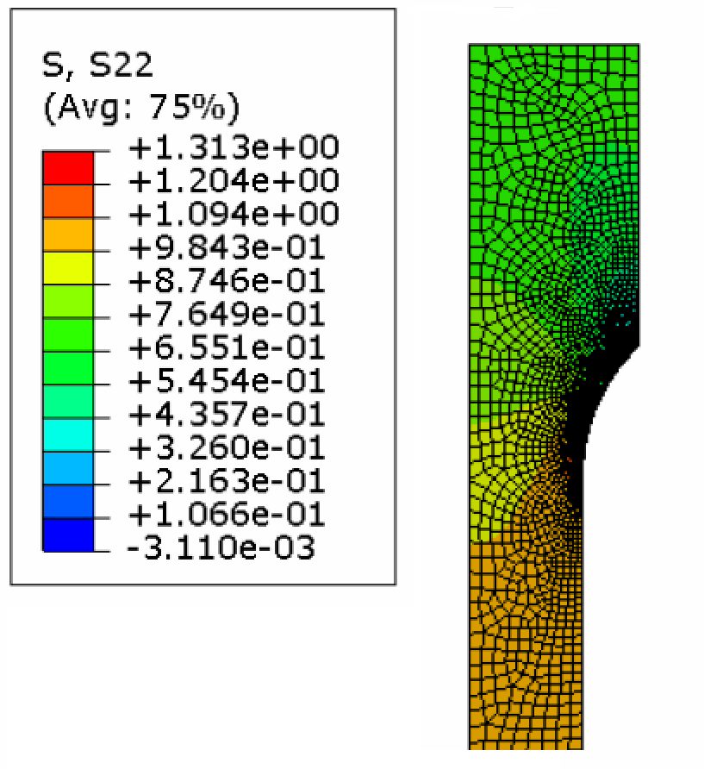
Example
MCE 301 Project

Slide 10
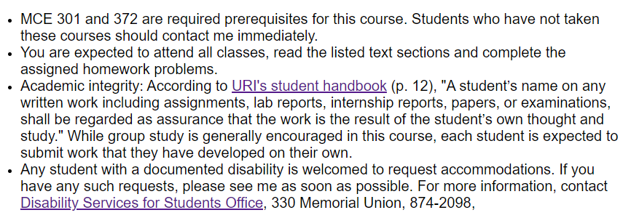
Course Policies

Slide 11
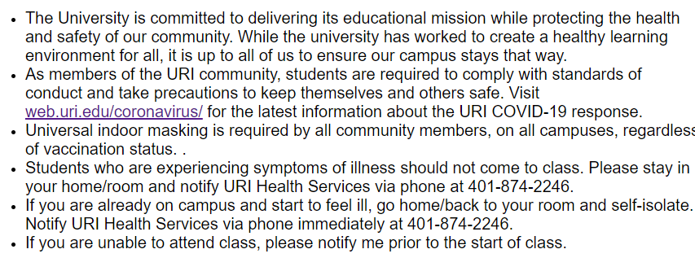
COVID Information

