Slide 1
EGR 106 Foundations of Engineering II
Week 9 Lecture - Part A
Announcements

Slide 2
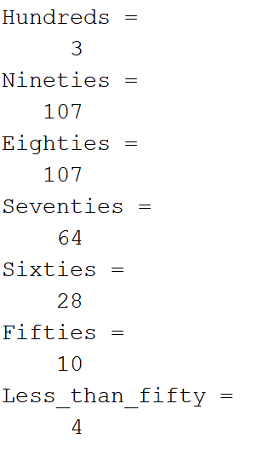
Exam 1 - Results

Slide 3
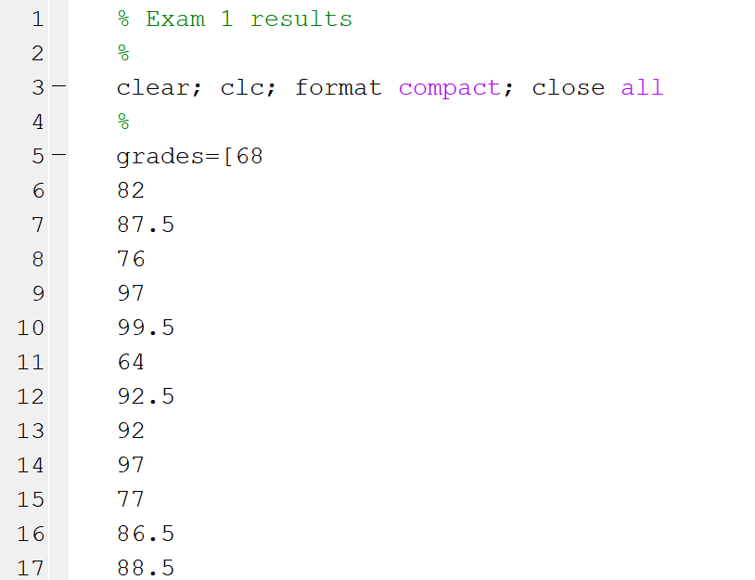
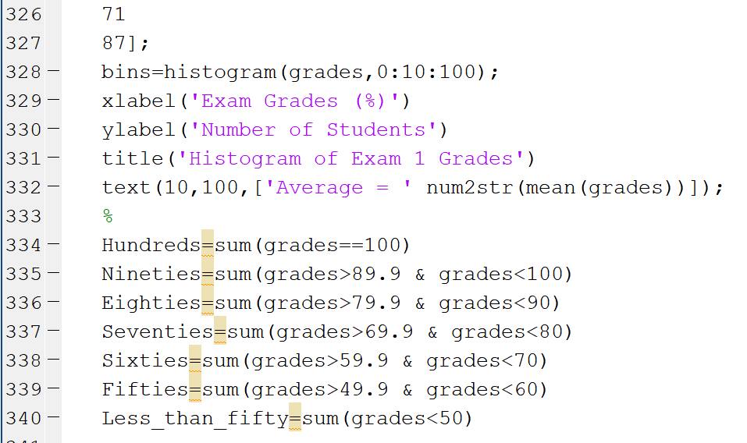
Script for Exam 1 Histogram

Slide 4
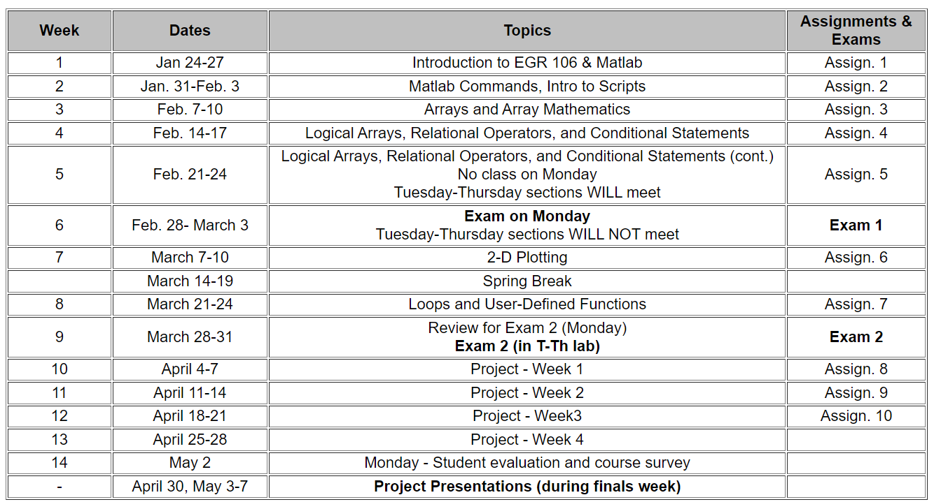
Plans for Upcoming Weeks

Slide 5
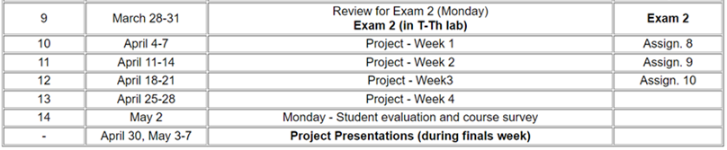
Plans for Upcoming Weeks (cont.)
Week 9 - March 28-31
Lecture – Design Project Introduction / Exam 2 Review
T-Th classes – Exam 2 (on computer using Matlab)
Weeks 10-13
Design project
Final Exam week
Design project presentations
Schedule to be announced

Slide 6
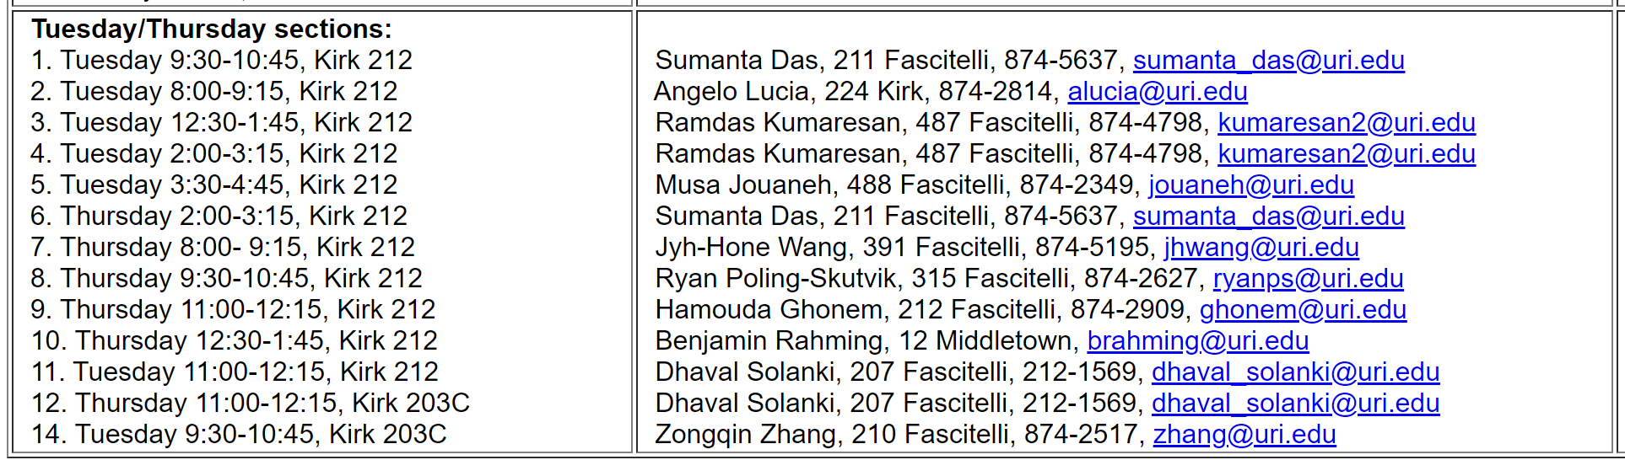
Exam 2 – In Class this Week on Tuesday / Thursday
Dates and times:
During Tuesday / Thursday meeting times

Slide 7
No Quiz this Week
Since there are no new topics being introduced this week, there will be no quiz. Quizzes will resume next week.

