Slide 1
Chapter 11 – Three-Dimensional Stress Analysis
Topics:
3-D Stress Analysis
Tetrahedral Elements (4 and 10 node)
Hexahedral (Brick) Elements (8 and 20 nodes)
Abaqus tutorial – 3-D Analysis

Slide 2
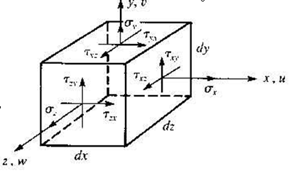
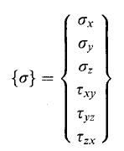
Stress Components – 3-D Problems

Slide 3
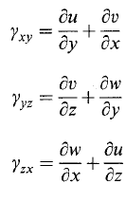

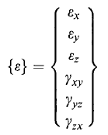
Strain Components – 3-D Problems

Slide 4

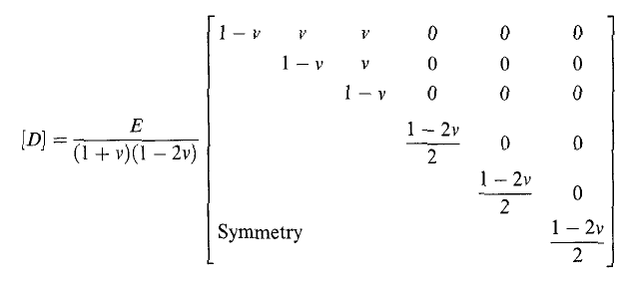
Stress-Strain Relations – 3-D Problems
6 x 1
6 x 6
6 x 1

Slide 5
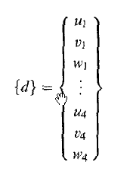
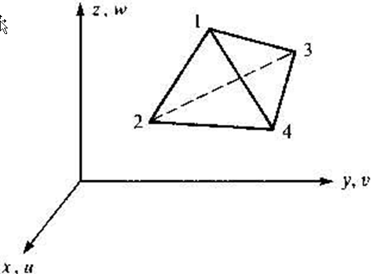
3-D Tetrahedral Element
Note: Direct extension of formulation for 3 node triangle for planar analysis
12 x 1

Slide 6
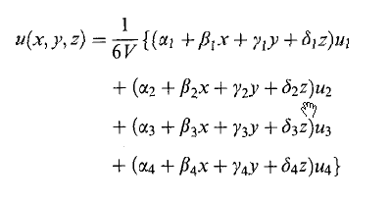
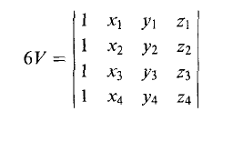
Tetrahedral Element – Linear Displacement Interpolation
Similar expressions for v(x,y,z) and w(x,y,z)

Slide 7
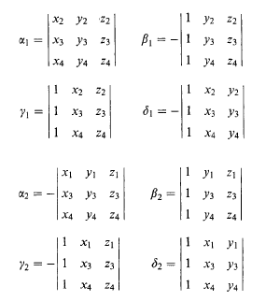
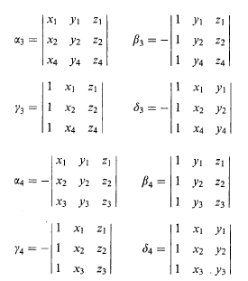
Displacement Interpolation (cont.)

Slide 8
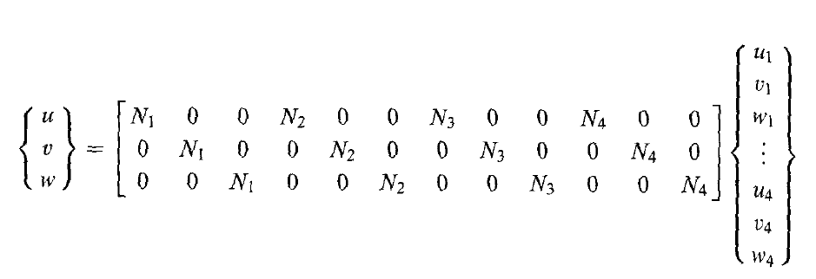
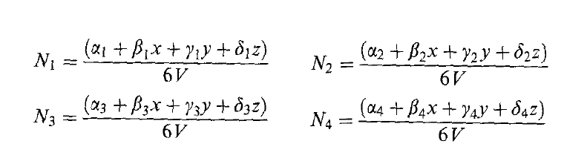
Displacement Interpolation (cont.)

Slide 9
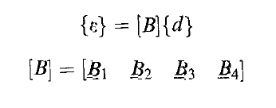
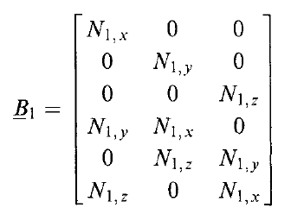
Strain - Displacement Relation (Tetrahedral Element)
6 x 12
6 x 3
6 x 3
6 x 3
6 x 3
Note: all terms are constant

Slide 10
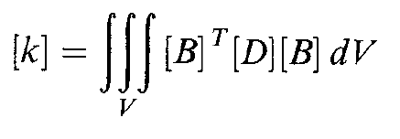

Element Stiffness Matrix (Tetrahedral Element)
12 x 12
12 x 6
6 x 6
6 x 12

Slide 11
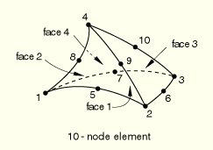
Tetrahedral Element – Quadratic Displacement Interpolation

Slide 12
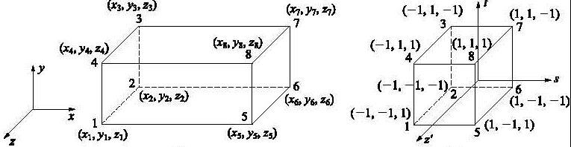
Linear Hexahedral Element (8 Node Brick)
Note: Direct extension of formulation for 4 node quad element for planar analysis
Isoparametric Formulation:

Slide 13
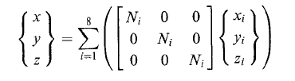
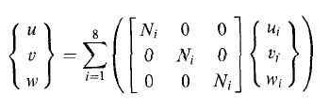

8 Node Brick Isoparametric Formulation (cont.)
Isoparametric Coordinate Transformation:
Displacement Interpolation:
where s_{i}, t_{i}, z_{i} = ±1

Slide 14


Element Stiffness Matrix – 8 Node Brick
Gaussian Quadrature (2 x 2 x 2)
where s_{i}, t_{i}, z_{i} = ± 0.57735

Slide 15
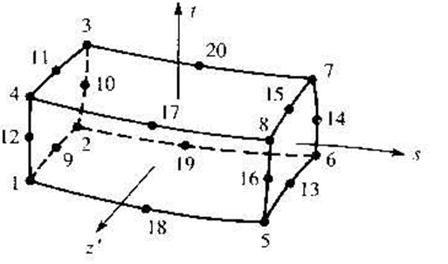
Quadratic Hexahedral Element (20 Node Brick)

Slide 16
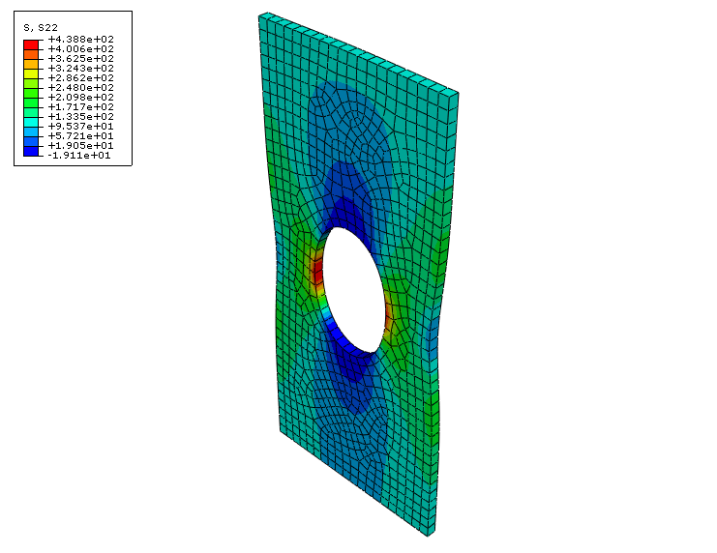
Abaqus Tutorial – 3-D Stress Analysis

