Slide 1
Additional Topics – Brief Overview
Plate Elements (Chapter 12)
Heat Transfer Analysis (Chapter 13)
Buckling Analysis (not in text)

Slide 2
Plate Bending Elements
Used to analyze thin wall structures such as pressure vessels and sheet metal components
2-D extension of beam in bending
Nodal degrees of freedom: transverse displacement and rotations about x and y-axes

Slide 3
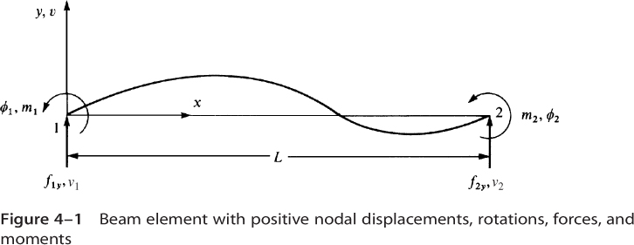
Recall Beam Element

Slide 4
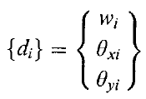
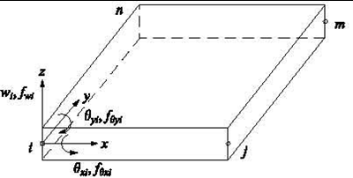


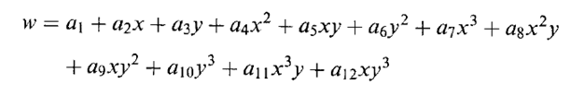
Plate Element Formulation (4 node quad plate element)
Nodal degrees of freedom:
12 x 1

Slide 5
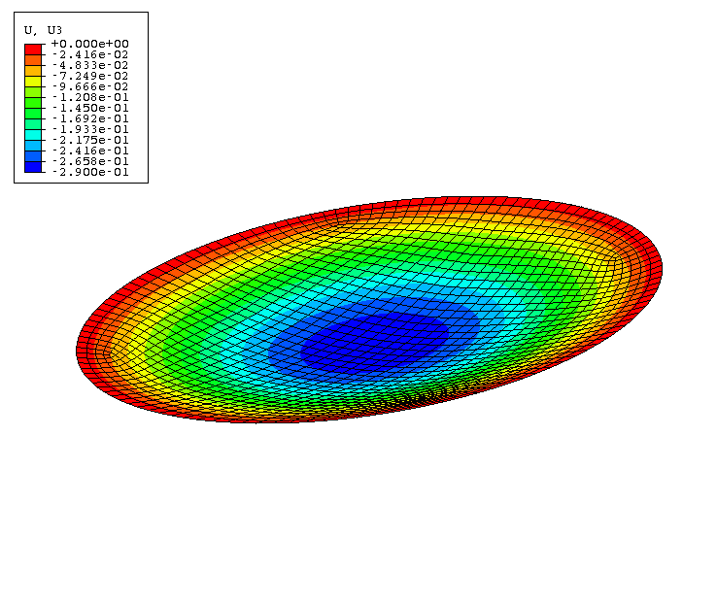
Plate Element
Demonstration – Simply supported circular plate subjected to pressure loading

Slide 6
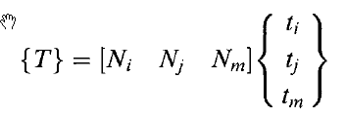
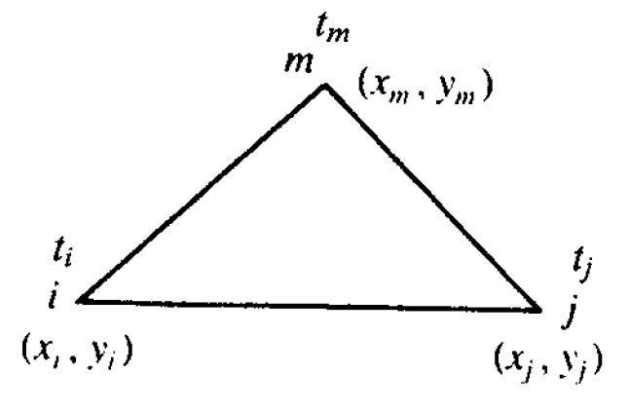

Heat Transfer Analysis (2-D Triangle – steady state solution)
Temperature
distribution
Nodal degrees
of freedom
Interpolation
functions:

Slide 7



Heat Transfer Element (cont.)
Temperature gradient, g (analogous to strain):
Heat flux, q (analogous to stress):
Conductivity matrix:

Slide 8

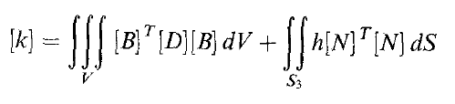
Heat Transfer Element (cont.)
Element equations:
Conduction
Convection

Slide 9


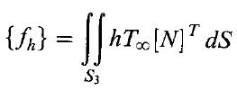
Heat Transfer Element (cont.)
Heat source / sink:
Heat flux at surface:
Surface convection:

Slide 10
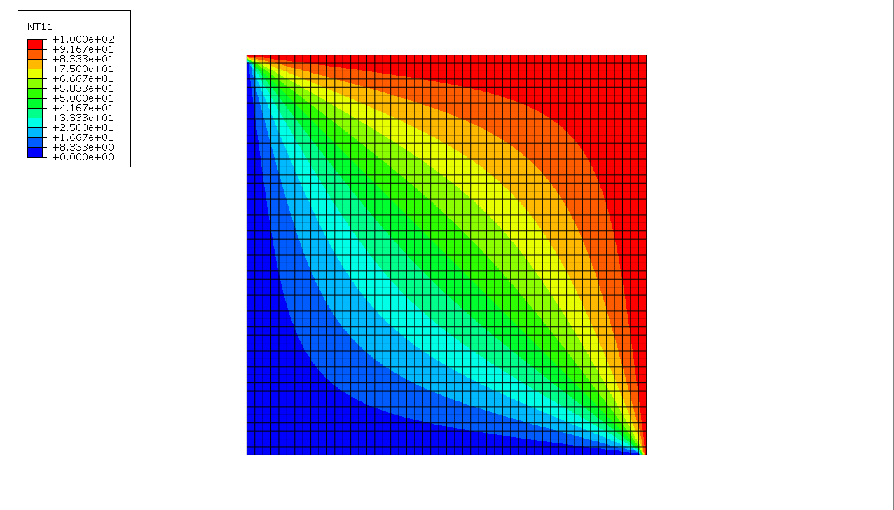
Heat Transfer Example #1
Steady state temperature distribution in a square plate
T = 100º
T = 100º
T = 0º
T = 0º

Slide 11
Heat Transfer Example #2
Transient temperature distribution in an infinite slab
T = 100º
T = 100º
Initial temperature = 0º

Slide 12
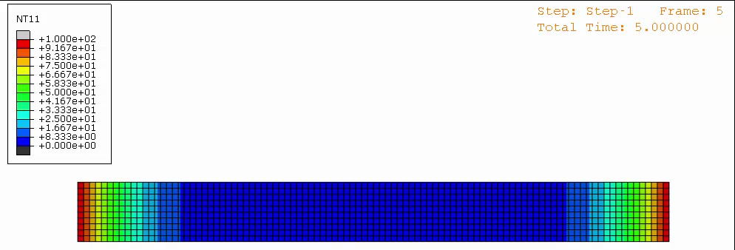
Heat Transfer Example #2 (cont.)
Finite element result:

Slide 13
Bifurcation Buckling Ref.: Concepts and Applications of Finite Element Analysis", 4th edition, by Robert D. Cook, David Malkus and Michael Plesha,
Consider compression loading of a column:

Slide 14
Bifurcation Buckling (cont.)
At low loads, one solution (uniform compression) exists
If non-linear terms are included in the strain-displacement relations, additional solutions become possible => loss of stability
Loss of solution uniqueness is referred to as “bifurcation”
The load levels at which additional solutions become possible correspond to the buckling loads

Slide 15
Finite Element Buckling Analysis
If non-linear strain-displacements are utilized, the non-linear terms give rise to the “stress stiffness matrix” => [K_{σ}]
Defining a reference load, {F}_{ref,}, the actual load is given by
The stress stiffness is given by
At the bifurcation point, two solutions become possible

Slide 16
Finite Element Buckling Analysis
At the bifurcation point, two solutions become possible
where δD corresponds to the buckled deformation. Subtracting these equation yields
which is an eigenvalue problem where solutions exist for certain values of λ =λ_{cr} (called “eigenvalues”)

Slide 17
Finite Element Buckling Analysis (cont.)
The smallest eigenvalue, λ_{cr}, corresponds to the critical buckling load,
P_{cr} = λ_{cr} P_{ref}
The corresponding solution, δD (called the eigenvector), provides the buckled mode shape
Example (see Abaqus tutorial)

