Slide 1
Chapter 7 - Practical Considerations in Modeling; Interpreting Results; and Examples of Plane Stress/Strain Analysis
Finite Element Modeling Advice
Equilibrium and Compatibility
Convergence
Interpretation of Stresses

Slide 2
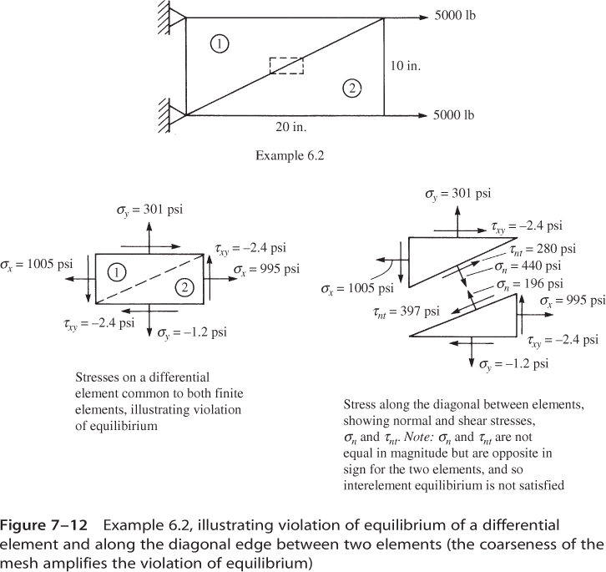
Discussion of Example 6.2:

Slide 3
Example 6.2 - discussion

Slide 4
Modeling Tips - Element Aspect Ratios
For best accuracy:
Keep aspect ratio close to 1
Keep corner angles close to 90º

Slide 5
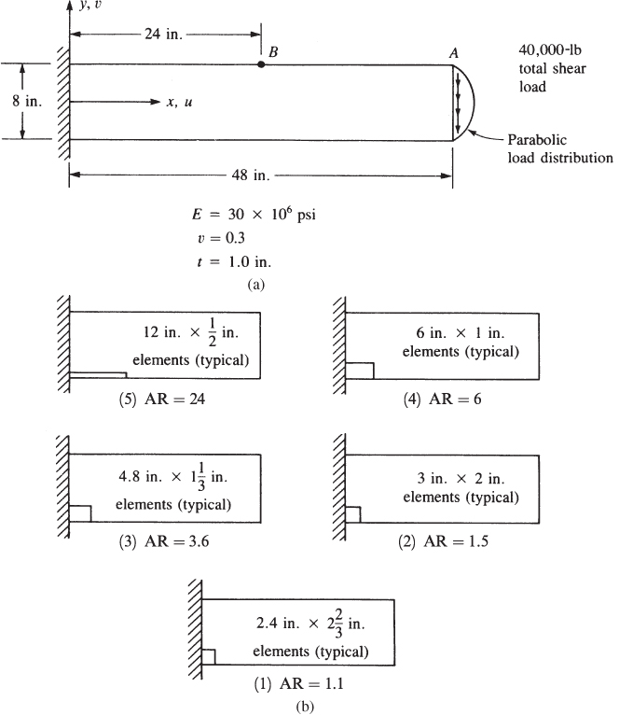
Effect of Element Aspect Ratio

Slide 6
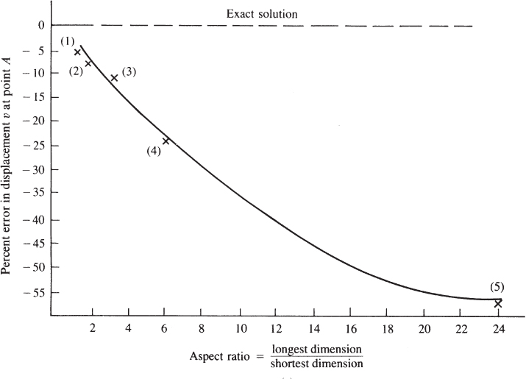
Effect of Element Aspect Ratio (cont.)

Slide 7
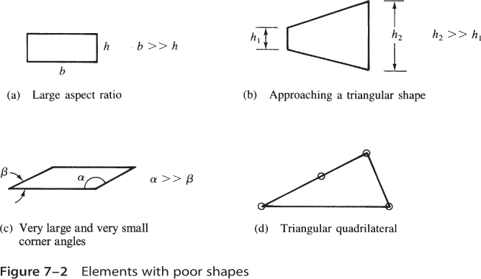
Poorly Shaped Elements

Slide 8
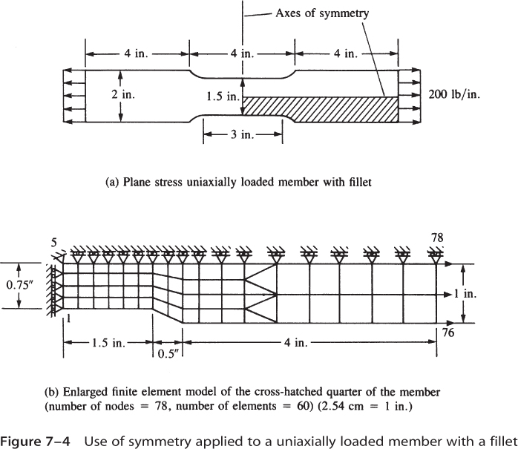
Modeling Tips – Use of Symmetry

Slide 9
Modeling Tips – Natural Subdivisions
Divide (or “partition”) mesh to assure nodes:
At concentrated loads
At changes in distributed loads
Along material interfaces

Slide 10
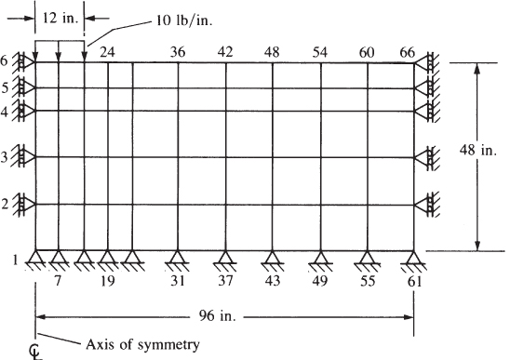
Modeling Tips – Infinite Medium
Make domain large enough so that stresses and displacements at boundary are neglible.

Slide 11
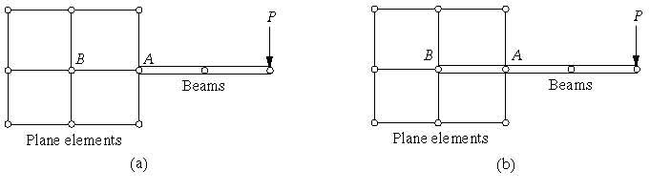
Modeling Tips – Mixed element types
When using mixed element types, take care in considering compatibility and different degrees of freedom
Approximates built-in support
Hinge connection – singular stiffness matrix

Slide 12
Modeling Tips – Mesh density
Use fine mesh near stress concentrations, coarse mesh in regions of uniform stresses (see plane stress tutorial)
Use triangles for transitioning (mixed quad/triangles)

Slide 13
Modeling Tips – Mesh refinement
h – method (“h” refers to element size)
Start with coarse mesh
Refine mesh by adding elements of same interpolation order
Use fine mesh near stress concentrations, coarse mesh in regions of uniform stresses (see plane stress tutorial)
h-method is the traditional approach for demonstrating mesh convergence

Slide 14
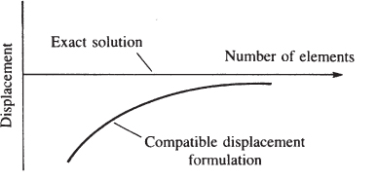
Mesh Convergence
Note: finite element solution is stiffer than exact solution

Slide 15
Modeling Tips – Mesh refinement
p – method (“p” refers to the order of the polynomial used for interpolation)
Start with coarse mesh
Improve accuracy by increasing the order of the polynomial
No need to remesh – iteration is done automatically
p-method is available in some commercial software
Solidworks Simulate – “Adaptive Meshing”
Creo Simulate (formerly Pro/MECHANICA)

Slide 16
Modeling Tips – Checking the Model and Results
Model verification is simplified by graphical pre- and post-processors
Visual display of loads and boundary conditions
Deformed mesh plots help verify loads and BC’s
Verify results by comparison to hand calculations, experimental data, or simpler numerical analyses

Slide 17
Equilibrium and Compatibility
Global equations ( {F}=[K] {d} ) gives equilibrium of nodal forces between adjacent elements
Equilibrium of stresses within and along element boundaries is satisfied
Stress discontinuities are “artificially” removed using stress smoothing during post-processing

Slide 18
Recall Example 6.2

Slide 19
Interpretation of Stresses
Primary unknowns in FEA are nodal displacements
Strains and stresses are secondary quantities
Possible locations for stress calculations
element centroid
element integration (or “Gauss”) points – Chapter 10
at nodes, averaging adjacent elements (stress averaging)

