Slide 1
Chapter 8 – Linear Strain Triangle (Overview)
Compare formulation of CST and LST
Comparison of element performance

Slide 2
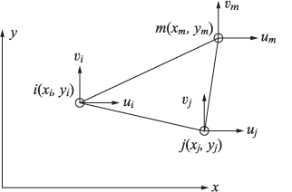
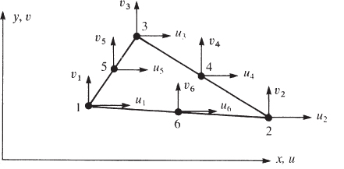
Comparison of CST and LST Formulations
CST:
Three nodes per element
6 DOF per element
LST:
6 nodes per element
12 DOF per element

Slide 3
Displacement Interpolation
CST:
LST:

Slide 4
Strains within each element
Recall:
CST:
LST:
ε ~ constant => Constant Strain Triangle (CST)
ε ~ at most linear in x & y => Linear Strain Triangle (LST)

Slide 5
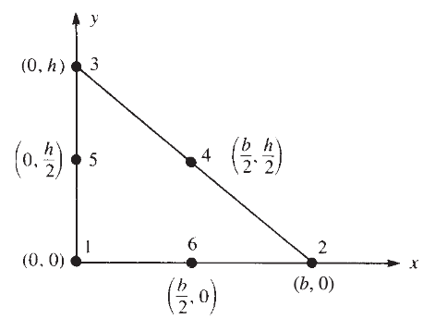
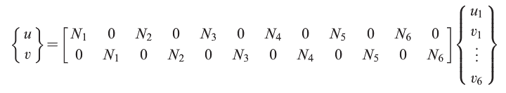
Example – LST Element
(text section 8.2)

Slide 6
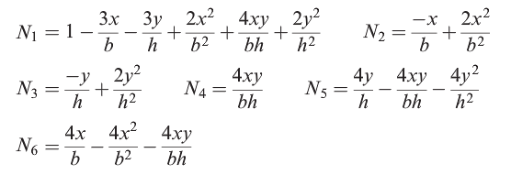
Example – LST Element
(cont.)

Slide 7

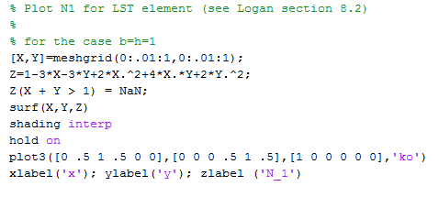
Example – LST Element
(cont.)

Slide 8
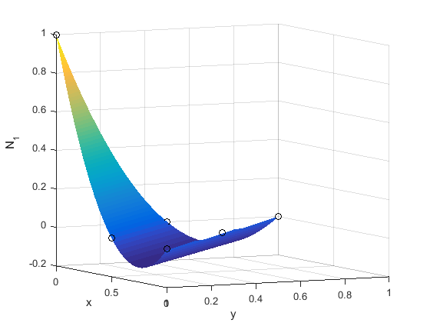
Example – LST Element
(cont.)

Slide 9

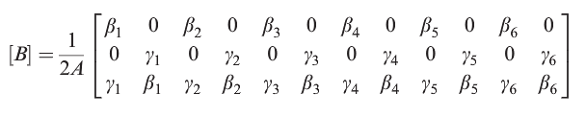
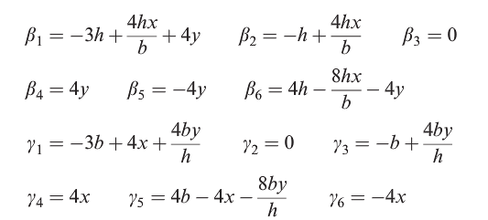
Example – LST Element
(cont.)
For our example:
Note: linear dependence on x and y => “LST”

Slide 10

Element Stiffness Matrix
CST:
LST:
Since B_{ij} terms depend on x & y, numerical integration is required (Chap. 10)
6x6
6x3
3x3
3x6
12x12
12x3
3x3
3x12

Slide 11
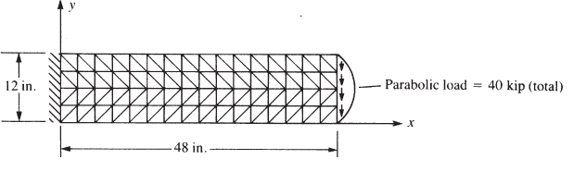
CST vs. LST – Performance Comparison
Consider the following plane stress analysis of a cantilever beam
“4 x 16” mesh

Slide 12
CST vs. LST – Performance Comparison (cont.)
Test Cases:
Mesh | Element | Case
4x16 | CST | A-1
4X16 | LST | B-2
8x32 | CST | A-2
2x8 | LST | B-1

Slide 13
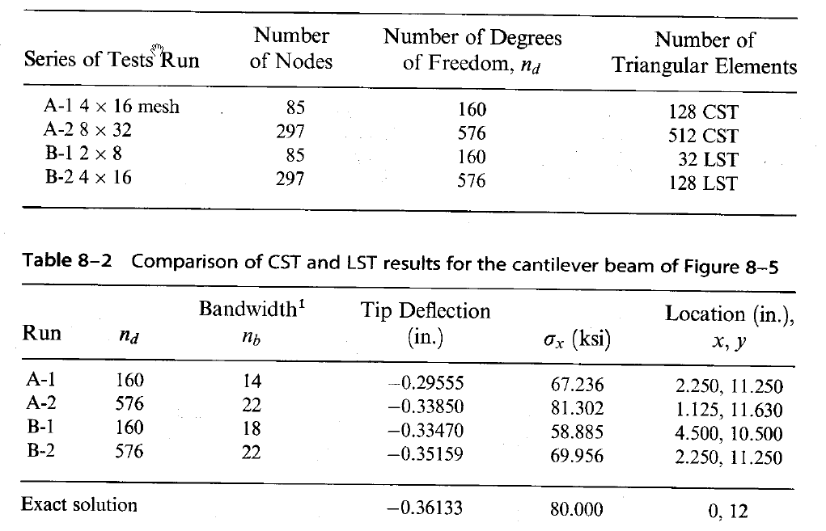
CST vs. LST – Performance Comparison (cont.)

