Slide 1

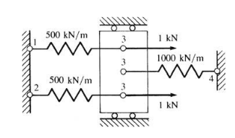
Chapter 2. Direct Stiffness Method (Applied to Systems of Springs)

Slide 2
Finite Element Approach
Develop a systematic procedure that can be used for any spring assemblage
Compute nodal displacements and the force in each spring
F > 0 – tension
F < 0 – compression
Objective – develop algorithm that can be implemented in general computer program

Slide 3
Steps in the Finite Element Method
Discretize the region and select element type
Select a displacement function
Define the strain/displacement and stress/strain relations
Derive the element equations
Direct Stiffness Method
Energy Methods
Method of Weighted Residuals (Galerkin’s method)
Assemble global equations and impose boundary conditions
Solve for unknown nodal displacements
Solve for element strains and stresses
Interpret results

Slide 4
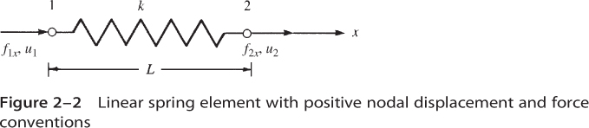
1. Discretize the region and select element type

Slide 5
Aside – Spring element formulation is nearly identical to other 1-D finite element
Bar under axial load
Torsion
Heat conduction

Slide 6
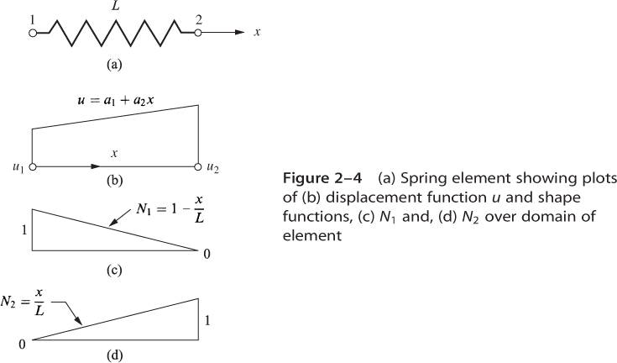
2. Select a displacement function

Slide 7
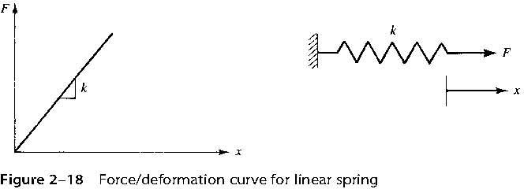
3. Define the strain/displacement and stress/strain relations

Slide 8
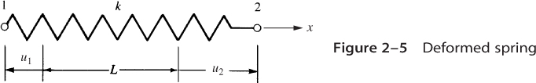
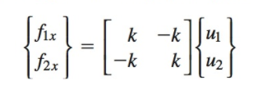

4. Derive the element equations

Slide 9
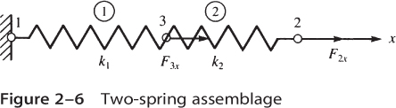
5. Assemble global equations and impose boundary conditions
Example:

Slide 10
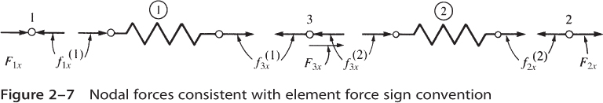
Assemble global equations – Impose equilibrium at nodes

Slide 11
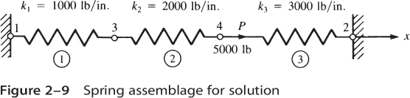
6. Solve for unknown nodal displacements 7. Solve for element strains and stresses (for springs => displacements and forces) 8. Interpret results Consider Example 2.1:
Remaining Steps

Slide 12
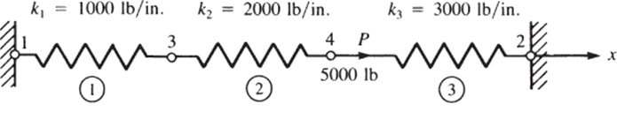
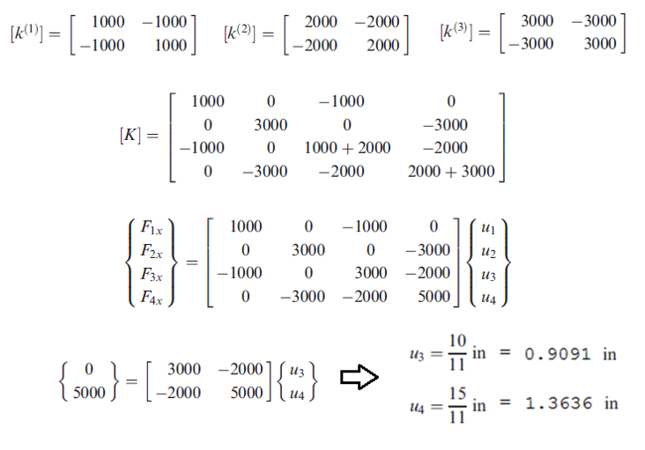
Example 2-1

Slide 13
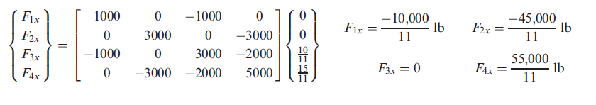
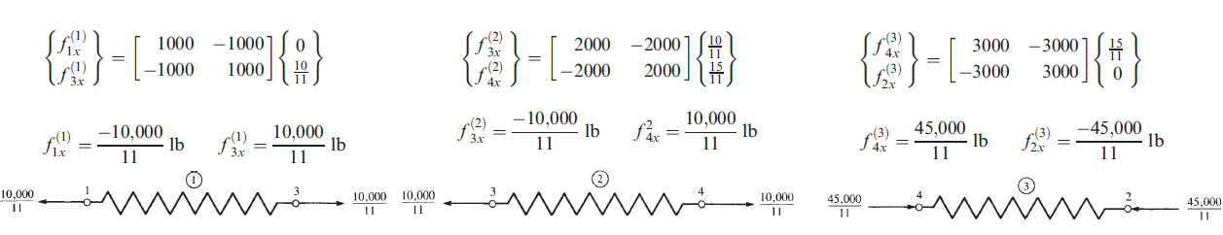
Example 2-1 (cont.)
Reaction Forces
Element Forces

Slide 14
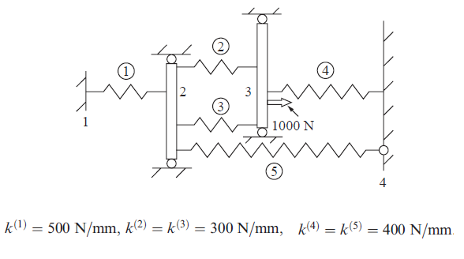
Problem 2-17

Slide 15
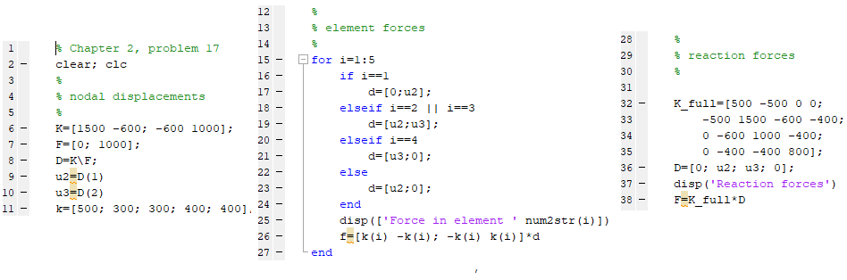
Problem 2-17 (cont.)
Matlab script

Slide 16
Potential Energy Approach (“Variational Method”)
Alternate approach for deriving element equations
Advantages over direct stiffness method:
More general – can be used to formulate more complicated elements (plane stress, plane strain, axisymmetric, plate bending, 3-D solid, etc.)
Can also be used to formulate other field problems (torsion, heat transfer, fluid flow)
Third approach – method of weighted residuals (Galerkin’s method – section 3.12)

Slide 17
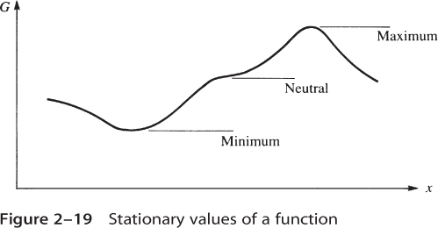
Principle of Minimum Potential Energy
Of all displacements which satisfy the boundary conditions, those which satisfy equilibrium also minimize the potential energy (or, at equilibrium the potential energy is “stationary”)

Slide 18
Potential Energy of a Spring
Potential energy
Strain energy
Potential energy of external forces

Slide 19
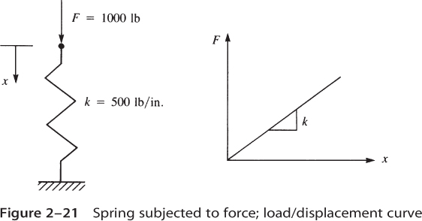
Applied to a Spring

Slide 20
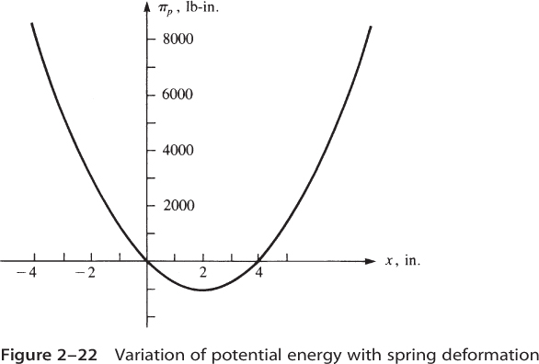
Potential Energy of a Spring
Recall the principle of minimum potential energy:
Of all displacements which satisfy the boundary conditions, those which satisfy equilibrium also minimize the potential energy

Slide 21
Potential Energy of a Spring using Finite Element Notation
U

Slide 22
Apply Principal of Minimum Potential Energy ⇒ Element Equations
Note: Same equations as from direct stiffness method

Slide 23
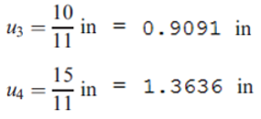
Applied to an Assemblage of Springs
Revisit example 2.1
Recall the solution:

Slide 24

Example 2.1 revisited
Impose B.C. u₁ = u₂ = 0

Slide 25
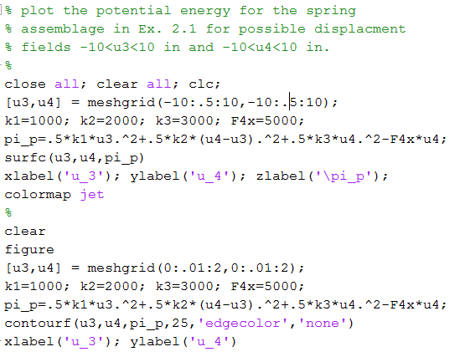
Example 2.1 revisited (cont.)

Slide 26
Example 2.1 revisited (cont.)

Slide 27
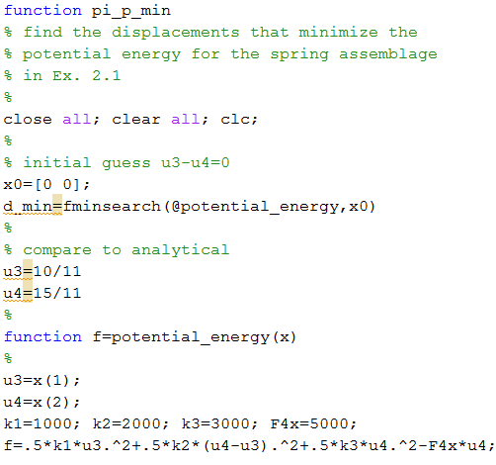
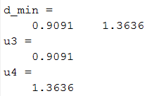
Example 2.1 revisited (cont.)
Command Window Output:

