Slide 1
Chapter 5. Frame and Grid Equations
Plane frame – structure made from rigidly attached slender members that lie in a single plane with loads applied in the plane.
Planar grid - structure made from rigidly attached slender members that lie in a single plane with loads applied normal to the plane.
Space frame - structure made from rigidly attached slender members forming a 3-D frame with loads applied in any direction.

Slide 2
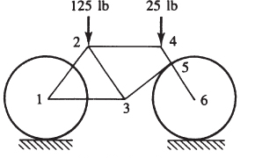
Plane frame
Example: bicycle frame
Note: multiforce members – combined axial and bending loads. Finite element formulation combines truss and beam element formulations

Slide 3
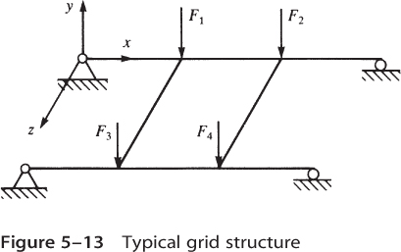
Planar Grid
Members must transmit bending and torsion loads (no axial loading)

Slide 4
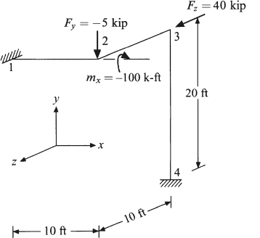
Space Frame
Members must transmit axial, bending and torsion loads

Slide 5
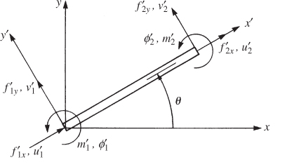
Plane frame analysis

Slide 6
Plane frame analysis: Local coordinates
where
or

Slide 7
Plane frame analysis: Global coordinates
where

Slide 8
Plane frame analysis: Global coordinates (cont.)

Slide 9
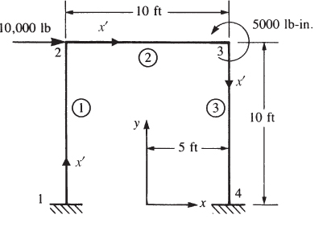
Plane Frame Example Problem 1

Slide 10
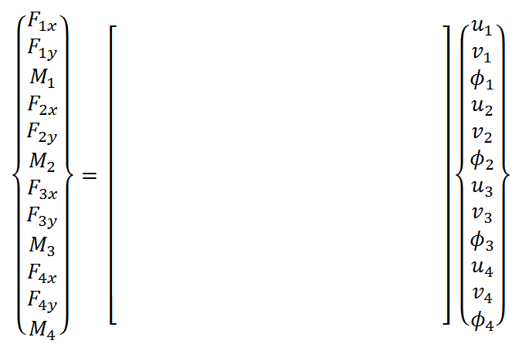
Plane Frame Example Problem 1 Global Equations
0
0
0
10,000
0
K
0
0
0
5,000
0
0
0
Solve six equations (eqs. 4-9)

Slide 11
Planar Grid
Members must transmit bending and torsion loads (no axial loading)

Slide 12
Grid Equations
Planar grid - structure made from rigidly attached slender members that lie in a single plane with loads applied normal to the plane.
Members must transmit bending and torsion loads (no axial loading)

Slide 13
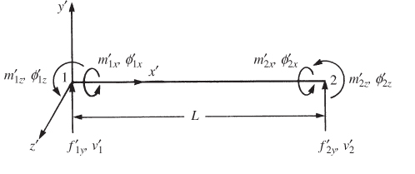
Grid Element: Local Coordinates
Nodal degrees of freedom:
Nodal loads / moments:
Note: Grid element deforms by bending in the x-y plane and torsion about the x-axis

Slide 14
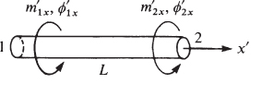
Grid Element: Local Coordinates (cont.)
Sign conventions for torque:

Slide 15
Grid element – bending deformation
From Chapter 4:
Note moments and rotations are about the z-axis

Slide 16
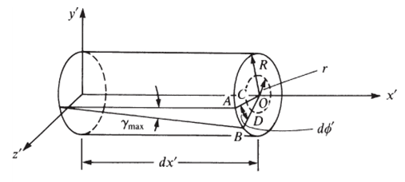
Grid element - Torsion
φ’ - angle of twist
Assume linear interpolation:

Slide 17
Grid element – Torsion (cont.)
Element equations (torsion):
where G – shear modulus, L – element length and J – torsional constant

Slide 18
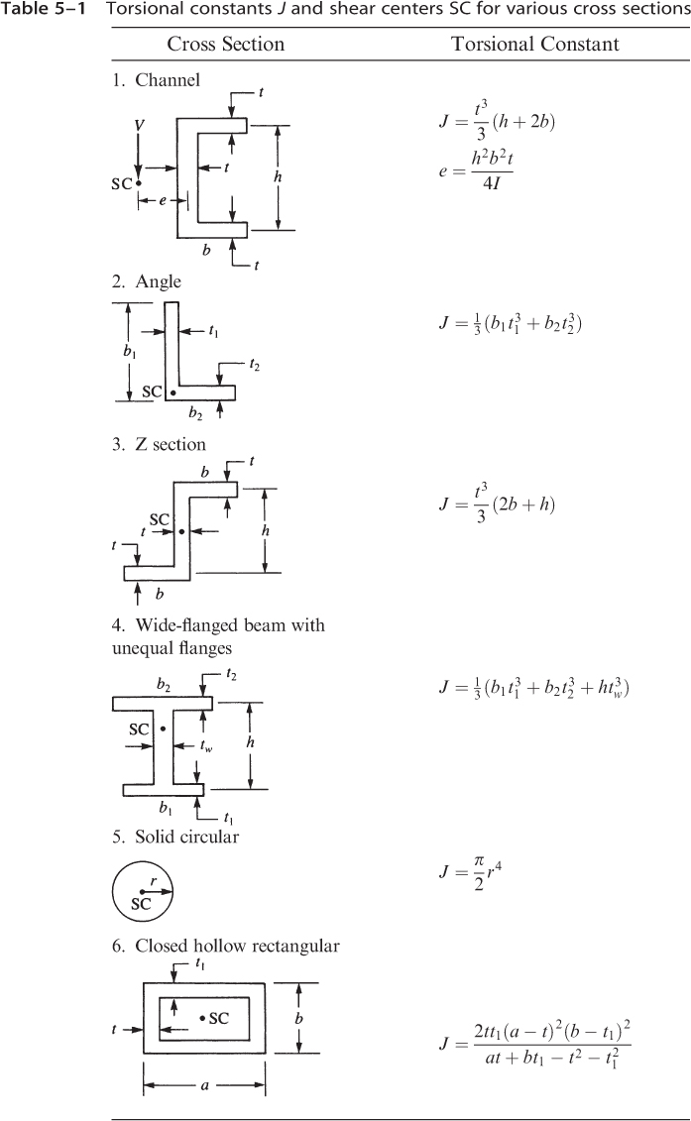
Torsional Constants (Table 5-1)

Slide 19
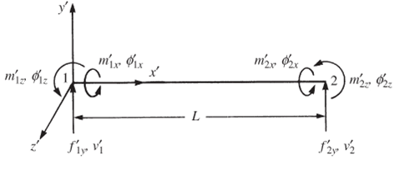
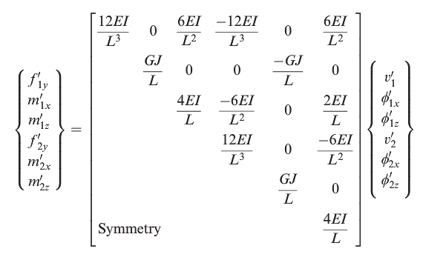
Grid element – element equations

Slide 20
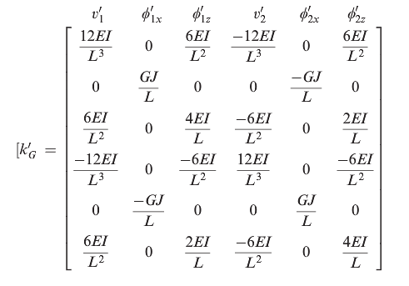
Grid element – element stiffness matrix

Slide 21
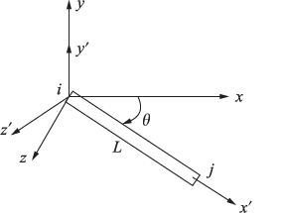

Grid Element: Global Coordinates
Coordinate transformation in x-z plane only:

Slide 22
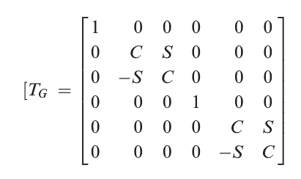
Grid Element: Global Coordinates

Slide 23
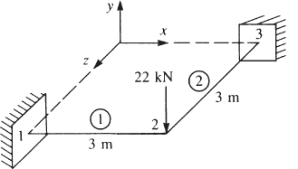
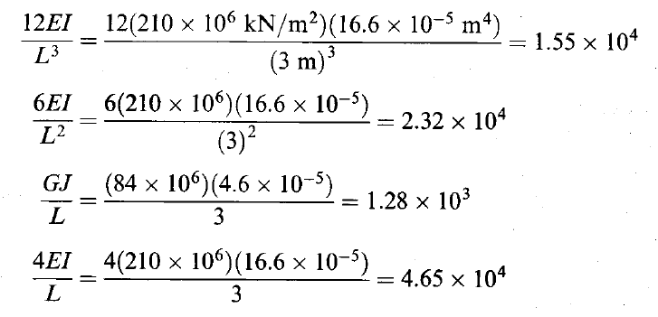
Grid Example Problem

Slide 24

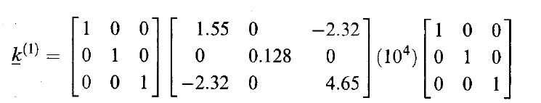
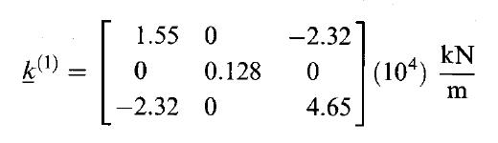
Grid Element: Example (cont.)
Element 1
Element stiffness matrix (node 2 degrees of freedom only)

Slide 25
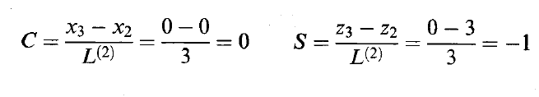
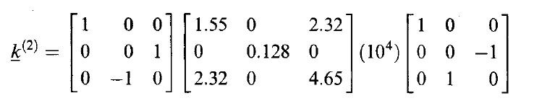
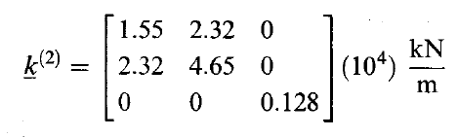
Grid Example (cont.)
Element 2
Element stiffness matrix (node 2 degrees of freedom only)

Slide 26
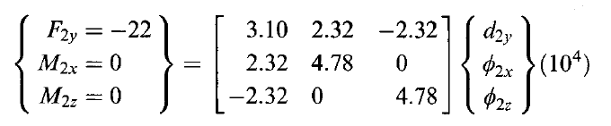
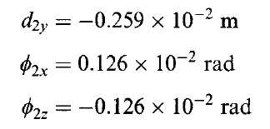
Grid Example (cont.)
Global Equations:
Solution:

Slide 27


Grid Example (cont.)
Element loads and moments:
Element 1
Element 2

Slide 28
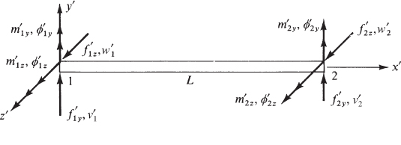
Space Frame (Beam element arbitrarily oriented in space)
Deformation modes:
Bending about y and z axes
Axial load in x direction (not shown in figure)
Torsion about x axis (not shown in figure)

Slide 29
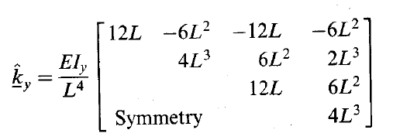
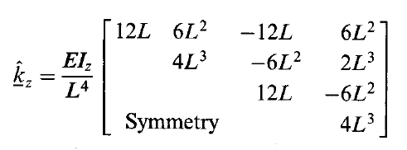
Space Frame (cont.)
Bending in the plane
Bending in the plane

Slide 30
Space Frame (cont.)
Axial load in x - direction
Torsion about the x – axis

Slide 31
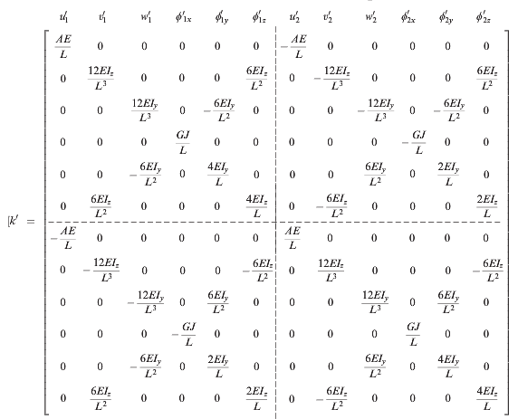
Space Frame (cont.)
Element stiffness matrix (local coordinates):

Slide 32
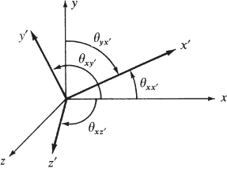
Space Frame: Transformation to Global Coordinates
Directions cosines:

Slide 33
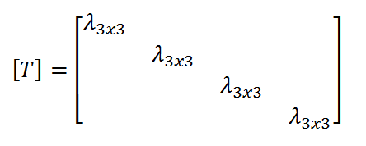
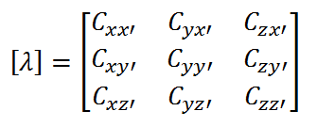
Space Frame: Transformation to Global Coordinates (cont.)
Element stiffness matrix (global coordinates)
where

Slide 34
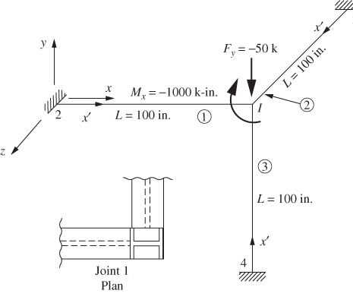
Space Frame Example

Slide 35
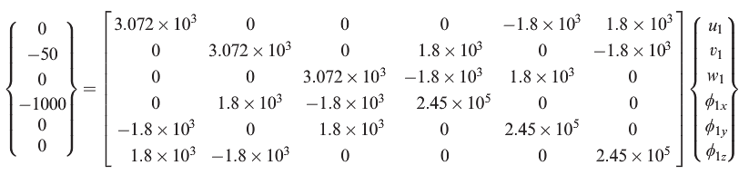
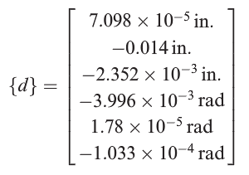
Space Frame Example (cont.)
Global equations (node 1 terms only)
Solution

Slide 36
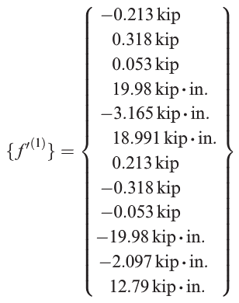
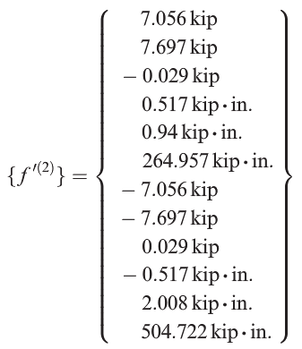
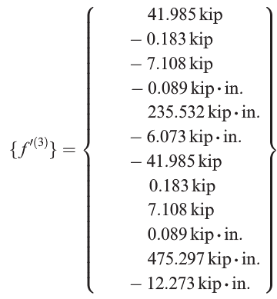
Space Frame Example (cont.)
Element loads & moments:

