Slide 1
Chapter 4. Development of Beam Equations
Recall:
Truss (or bar) elements are subjected to axial tensile or compressive forces only (no bending) and deform by change in length
Beam elements (Chapter 4) - deform by bending
Frame elements (Chapter 5) – combined axial, bending, and torsional deformation

Slide 2
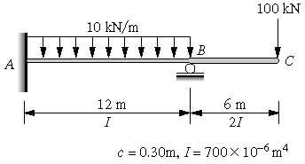
Typical problem:

Slide 3
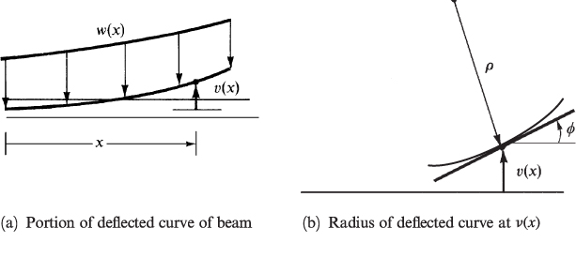
Review – Beam Theory
M – moment distribution
E – Young’s modulus
I – Moment of Inertia of cross-section
v – transverse displacement
V – shear load
w – distributed load

Slide 4
Beam Theory (cont.)
If EI = constant and only concentrated loads and moments are applied, i.e. w(x)=0
Solution (exact)

Slide 5
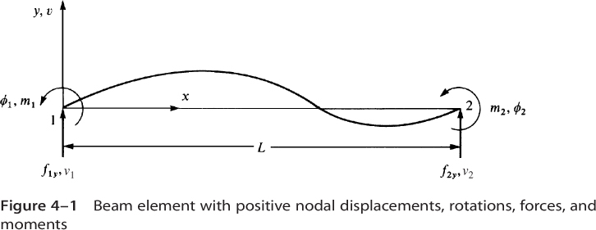
Beam Element - Definitions

Slide 6
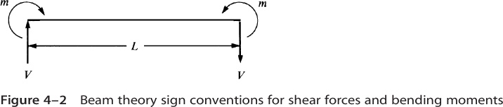
Sign Conventions – FEA formulation vs. Beam theory

Slide 7
Steps in the Finite Element Method
Discretize the region and select element type
Select a displacement function
Define the strain/displacement and stress/strain relations
Derive the element equations
Direct Stiffness Method
Energy Methods
Method of Weighted Residuals (Galerkin’s method)
Assemble global equations and impose boundary conditions
Solve for unknown nodal displacements
Solve for element strains and stresses
Interpret results

Slide 8
Step 1 – Select Element Type
Beam Element

Slide 9
Sign Conventions: FEA formulation vs. Beam theory

Slide 10
Step 2 – Select Displacement Function
Note:
Which satisfies the governing differential equation exactly if EI = constant and only concentrated loads and moments are applied. Otherwise, the finite element solution is an approximation.

Slide 11
Step 2 – Select Displacement Function (cont.)
Displacement parameters a₁, a₂, a₃ and a₄ have no physical meaning
Rewrite displacement function in terms of nodal displacements and rotations

Slide 12
Step 2 – Select Displacement Function (cont.)
Solve for a_{i}, i = 1,4
Substitute into:

Slide 13
Step 2 – Select Displacement Function (cont.)

Slide 14
Step 2 – Select Displacement Function (cont.)
Matrix form:

Slide 15
Beam Element Interpolation Functions
%
% Matlab code to plot beam interpolation functions
% D. G. Taggart
close all; clear all; clc;
%
L=1;
x=linspace(0,L,25);
N1=(2*x.^3-3*x.^2*L+L^3)/L^3;
N2=(x.^3*L-2*x.^2*L^2+x*L^3)/L^3;
N3=(-2*x.^3+3*x.^2*L)/L^3;
N4=(x.^3-x.^2*L)/L^3;
%
subplot(2,2,1)
plot(x,N1)
title('N_1(x)')
%
subplot(2,2,2)
plot(x,N2)
title('N_2(x)')
%
subplot(2,2,3)
plot(x,N3)
title('N_3(x)')
%
subplot(2,2,4)
plot(x,N4)
title('N_4(x)')

Slide 16
Step 3 – Strain-displacement & stress-strain relations
Kinematic assumption from beam theory – “plane sections remain planar and normal to the midplane”
Strain – displacement relation
Moment – displacement relation
Shear force – displacement relation (neglecting shear deformation)

Slide 17
Step 3 – Derive element equations (direct approach)
Recall
Consider f_{1y} and m₁

Slide 18
Step 3 – Derive element equations (cont.)
Similarly for f_{2y} and m₂
Matrix form

Slide 19
A Simple Example – Cantilever Beam
P
Beam theory:
FEA (single element):
=> =>

Slide 20
Timoshenko Beam Theory (includes transverse shear deformation)
See text for derivation
where
(k_{s}A) is the shear area and G is the shear modulus

Slide 21
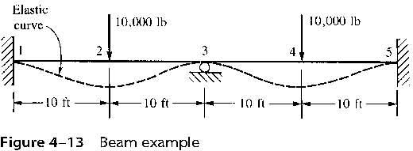
Steps 5-8 – Examples (several in text) Problem 4-2, p. 182
Note: Could use symmetry, consider full model first

Slide 22
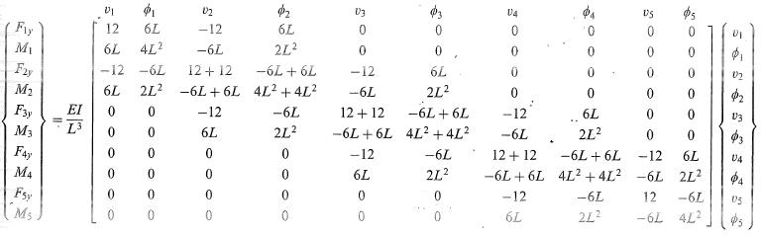
Example 4-2 - Global Equations
BC’s: v₁ = φ₁ = v₃ = v₅ = φ₅ = 0
Loads: F_{2y} = F_{4y} = -10,000 lb, M₂ = M₃ = M₄ = 0
Need to solve system of 5 equations

Slide 23
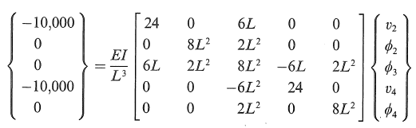
Example 4-2 (cont.)
Matlab:
E=30e6;
I=500;
L=10*12;
K=(E*I/L^3)*[24 0 6*L 0 0 ;
0 8*L^3 2*L^2 0 0 ;
6*L 2*L^2 8*L^2 -6*L 2*L^2 ;
0 0 -6*L^2 24 0 ;
0 0 2*L^2 0 8*L^2 ];
F=[-10000; 0 ; 0 ; -10000; 0];
d=K\F
Matlab Command Window output:
d =
-0.0480
-0.0000
0.0000
-0.0480
-0.0000
Note: φ₂ = φ₃ = φ₄ = 0

Slide 24
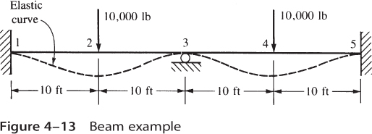
Example 4-2 (cont.)
Or, using symmetry:
φ₂ = φ₃ = φ₄ = 0
which yields
Solving
v₂=v₄=-.048 in

Slide 25
Example 4-2 (cont.)
Third approach
5,000 lb
10 ft

Slide 26
Example 4-2 (cont.)
Element loads and moments (element 1)
Note: equilibrium is satisfied
25,000 lb-ft
25,000 lb-ft
5000 lb
5000 lb

Slide 27
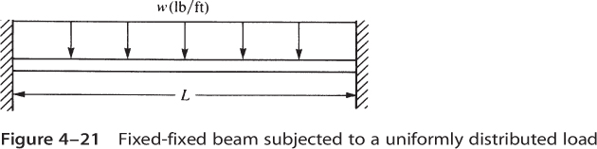
Beam Elements – Distributed Loading
Consider a beam with fixed supports subjected to a uniform distributed load

Slide 28
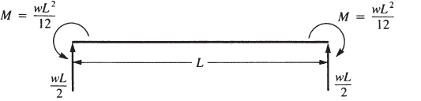
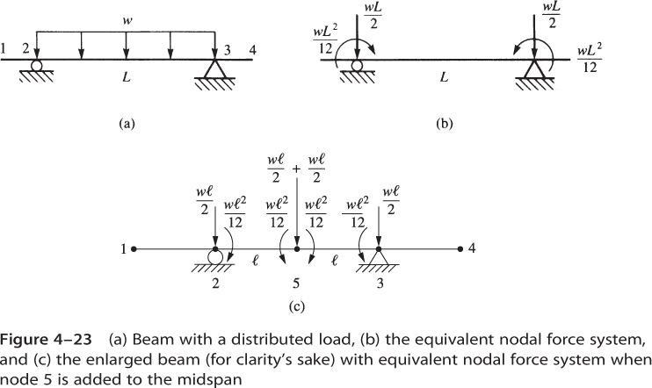
Beam with fixed supports & uniform distributed load
For this statically indeterminate beam, it can be shown that the reaction forces and moments are:
Hence, we can replace the distributed loading by an equivalent set of concentrated forces and moments:

Slide 29
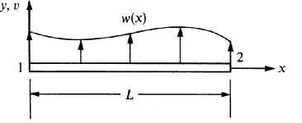
Work equivalent forces & moments
Work done by distributed loads:

Slide 30
Work done by distributed loads
Recall
For uniform loading:
Work done:
Equivalent concentrated forces and moments

Slide 31
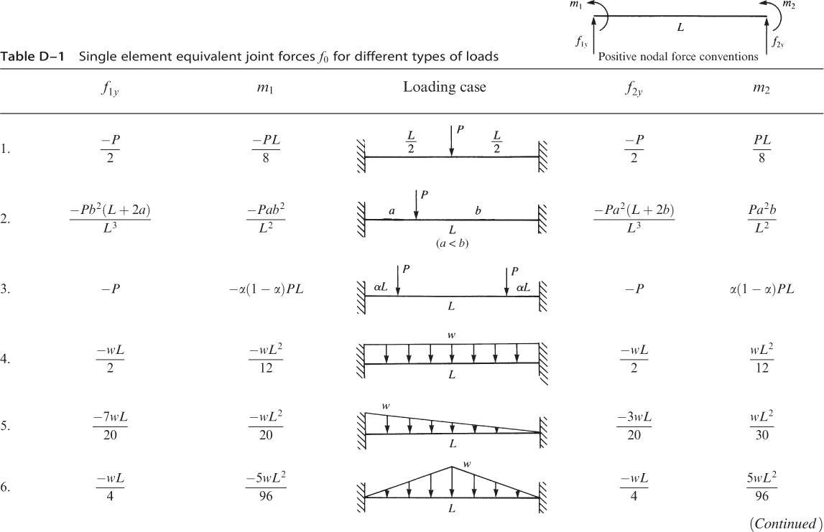
Work equivalent concentrated forces and moments (Appendix D)

Slide 32
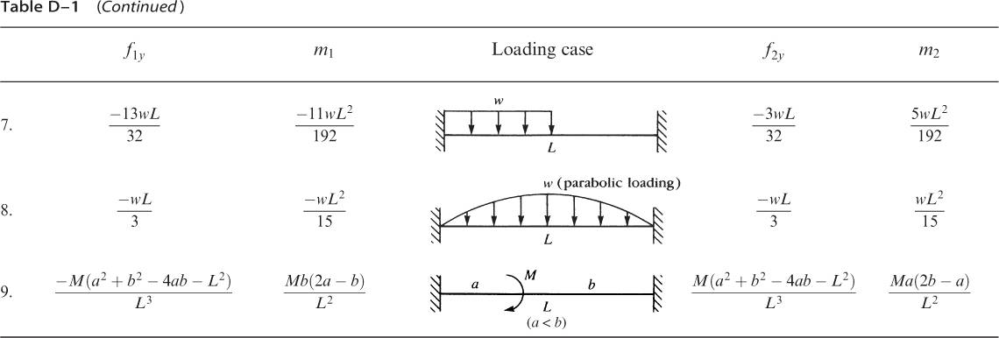
Work equivalent concentrated forces and moments (Appendix D – cont.)

Slide 33
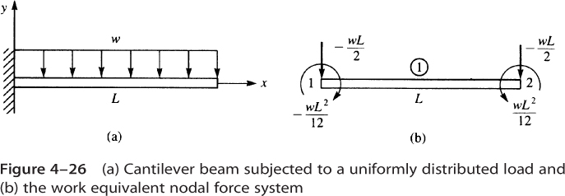
Example 4.6, p. 179
Single element solution with v₁ = φ₁ = 0

Slide 34
Example 4.6 (cont.)
Solving
Reaction forces:
Concentrated forces and moments due to distributed loads
Text calls this term F^{(e)} (effective global nodal forces)

Slide 35
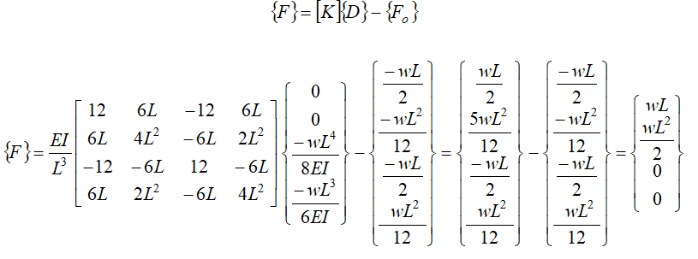
Reaction Forces and Moments (Example 4.6)

Slide 36
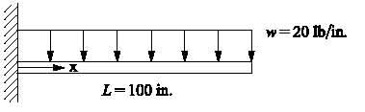
Comparison to Exact Solution
E = 30 x 10⁶ psi
I = 100 in⁴
Beam theory solution:

Slide 37
Finite element solution (one element)

Slide 38
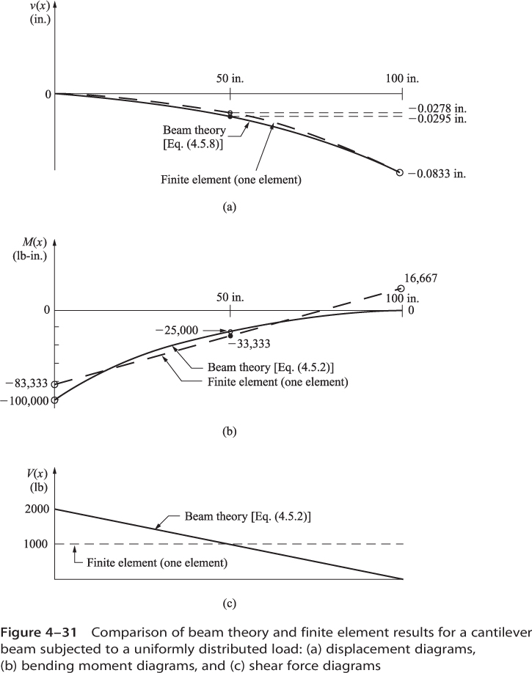
Comparison of beam theory to one element FEA: Displacement distribution

Slide 39
Comparison of beam theory to one element FEA: Moment distribution

Slide 40
Comparison of beam theory to one element FEA: Shear force distribution

Slide 41
Beam element equations derived using potential energy approach
Recall:
Potential energy
Strain energy
Potential energy of external forces

Slide 42
Strain Energy – including only bending stresses (neglects shear deformation)
where

Slide 43
Strain Energy – (cont.)
and
Strain energy:

Slide 44
Element Stiffness Matrix
Hence
(same result as from Direct Stiffness Method)

Slide 45
Potential energy of external forces
where
where
and

Slide 46
Potential energy of external forces (cont.)
Work equivalent concentrated forces and moments

Slide 47
Potential Energy – Beam Element
Minimization of π_{p} gives (see Appendix A, pp. 714 - 715)
where

