Slide 1
Linear Algebra / Solid Mechanics Review
Matrix Algebra - Appendix A
Solving Systems of Linear Equations - Appendix B
Solid Mechanics Theory - Appendix C, CVE 220 & MCE 301 texts

Slide 2
Review – Matrix Algebra
We will see that the finite element method requires solving large systems of linear equations using matrix algebra tools.
First, review matrix multiplication
In general
2x2
2x3
2x3
[A] [B] = [C]
m x n
n x p
m x p

Slide 3
Review – Matrix Algebra (see Appendix A)
To review some basic matrix algebra, consider the following system of equations
or
(x,y)= (1,4)

Slide 4
Matrix Algebra (cont.)
Matrix form:
Matlab output
a =
2 1
1 4
b =
6
17
determinant =
7
solution =
1.0000
4.0000
Matlab code
a=[2 1;1 4]
b=[6;17]
determinant=det(a)
solution=a\b
Note |a| ≠ 0

Slide 5
Matrix Algebra (cont.)
Now consider a different system of equations
or

Slide 6
Matrix Algebra (cont.)
Matrix form:
Matlab code
Matlab output
a=[4 2;2 1]
b=[16;6]
determinant=det(a)
solution=a\b
a =
4 2
2 1
b =
16
6
determinant =
0
Warning: Matrix is singular to working precision.
solution =
Inf
-Inf
Note |a| = 0

Slide 7

Matrix Algebra (cont.)
System of three equations (Matlab format)
Code:
a=[-1 1 2;3 -1 1;3 3 1]
b=[2;6;2]
solution=a\b
Output:
a =
-1 1 2
3 -1 1
3 3 1
b =
2
6
2
solution =
1
-1
2

Slide 8
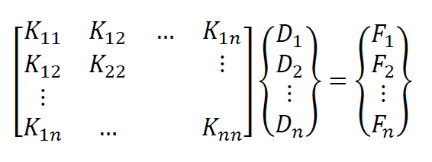
Matrix algebra applied to FEA
For displacement based stress analysis
Stiffness matrix - Symmetric since K_{ij} = K_{ji}
Nodal Forces
Nodal Displacements

Slide 9
Other Matrix Terminology
Banded matrix
If all non-zero terms are contained within a band along the diagonal, the matrix is said to be banded
Sparse matrix
If a matrix has relatively few non-zero terms (as is common in FEA), the matrix is said to be sparse
Singular matrix
If the determinant of the matrix equals zero, the matrix is said to be singular. As we saw, if [A] is singular, then the system of equations [A]{x}={b} has no unique solution.

Slide 10
Other Matrix Terminology (cont.)
Transpose
The transpose of a matrix is found by interchanging rows and columns, e.g.
Transpose of a product

Slide 11
Review – Solution of Linear Algebraic Equations (see Appendix B)
Gaussian Elimination - Example
Problem B.4 (p. 866)
Solved by hand in class

Slide 12
Solution of Linear Algebraic Equations (cont.)
Alternate – solve using Matlab
>> A=[2 1 -3;4 -2 3; -2 2 -1]
A =
2 1 -3
4 -2 3
-2 2 -1
>> b=[11;8;-6]
b =
11
8
-6
>> Ainv=inv(A)
Ainv =
0.1818 0.2273 0.1364
0.0909 0.3636 0.8182
-0.1818 0.2727 0.3636
>> A*Ainv
ans =
1.0000 0 0
0.0000 1.0000 -0.0000
-0.0000 0.0000 1.0000
>> Ainv*A
ans =
1.0000 0 0
-0.0000 1.0000 -0.0000
-0.0000 0 1.0000
>> det(A)
ans =
-22
>> x=A\b
x =
3
-1
-2
>> A*x
ans =
11
8
-6

Slide 13
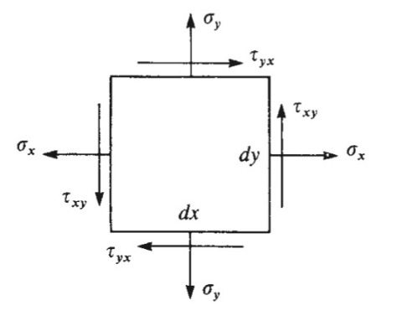
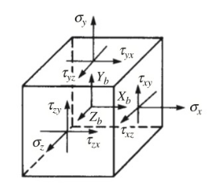
Solid Mechanics (Elasticity) Theory (see Appendix C, CVE 220 & MCE 301 texts )

Slide 14
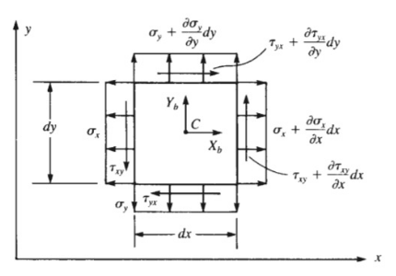
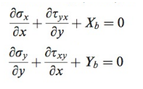
Equilibrium (2D Stress States)

Slide 15
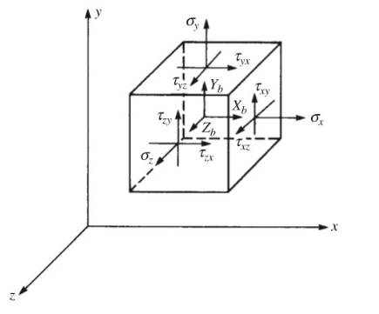
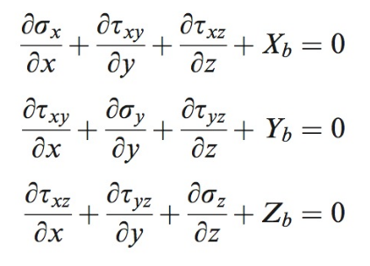

Equilibrium (3D Stress States)

Slide 16
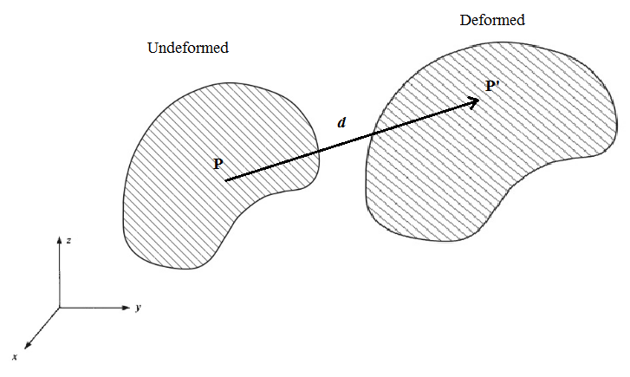
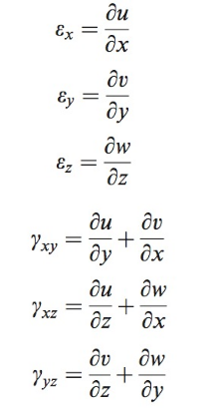

Displacement and Strains
Displacement vector
Strain components

Slide 17
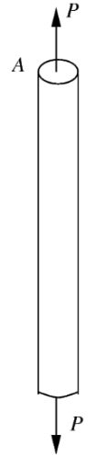
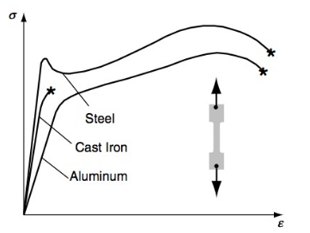
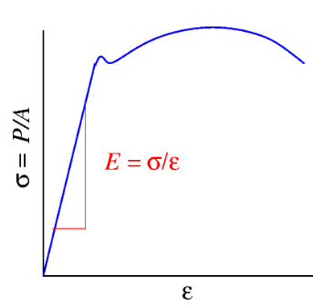
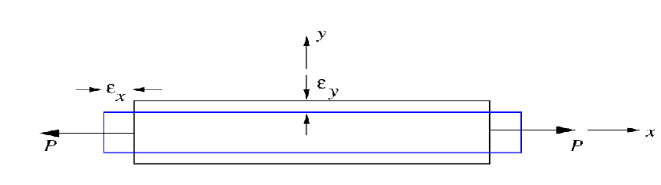

Elastic Material Properties – Uniaxial Tension
Young’s modulus, E
Poisson’s ratio, ν

Slide 18
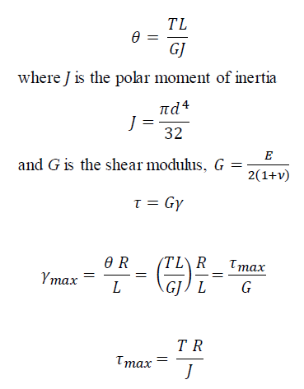
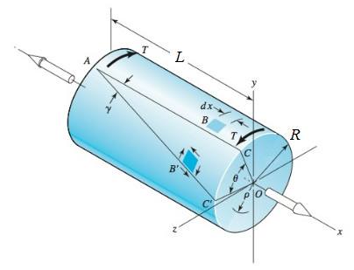
Elastic Material Properties – Torsion (Pure Shear)

Slide 19
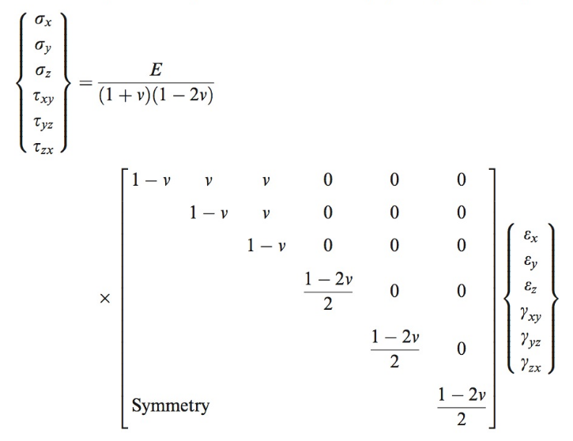
Multiaxial Stress States – Hooke’s Law
[D] - Constitutive Stiffness matrix (6X6)

Slide 20
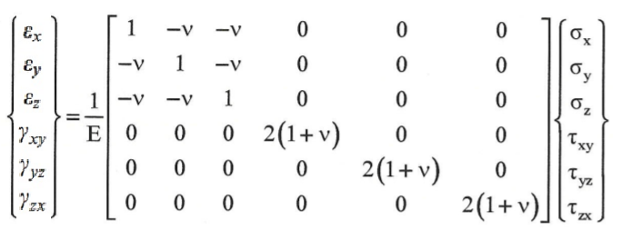
Multiaxial Stress States – Hooke’s Law
(cont.)
Constitutive Compliance Matrix (6X6) = [D]⁻¹

Slide 21
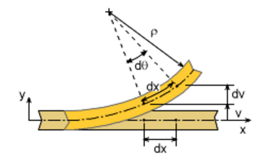

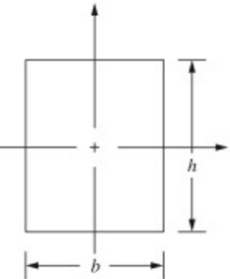

Beam Bending
Moment-curvature (κ) relation
Moment of Inertia (rectangular cross-section)

Slide 22
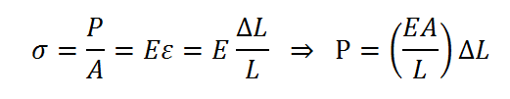

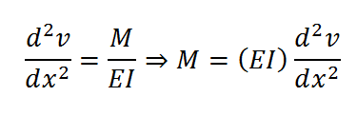
Structural Stiffnesses
Axial Stiffness
Torsional Stiffness
Bending Stiffness

