Slide 1
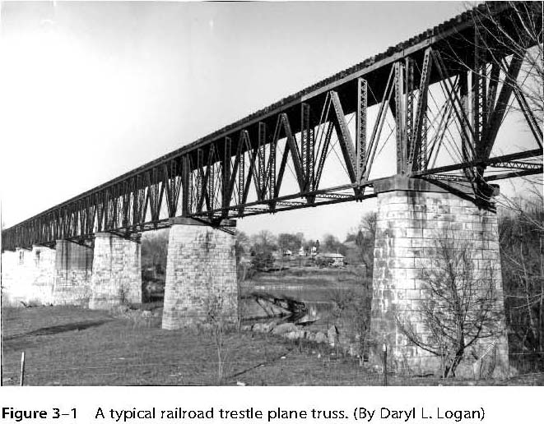
Chapter 3. Development of Truss Equations

Slide 2
Types of Structural Elements
Truss (or bar) elements are subjected to axial tensile or compressive forces only (no bending) and deform by change in length
Beam elements (Chapter 4) - deform by bending
Frame elements (Chapter 5) – combined axial, bending, and torsional deformation

Slide 3
Analogy between Spring and Bar
Spring
F
k
x
Bar
σ
E
ε

Slide 4
Governing Differential Equation (to be derived in class)

Slide 5
Steps in the Finite Element Method
Discretize the region and select element type
Select a displacement function
Define the strain/displacement and stress/strain relations
Derive the element equations
Direct Stiffness Method
Energy Methods
Method of Weighted Residuals (Galerkin’s method)
Assemble global equations and impose boundary conditions
Solve for unknown nodal displacements
Solve for element strains and stresses
Interpret results

Slide 6
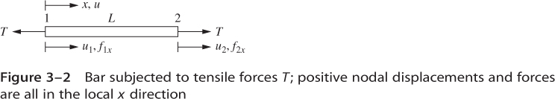
Discretize the region and select element type
Truss / Bar element

Slide 7
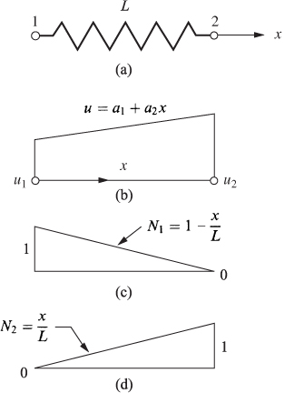
2. Select a displacement function
Recall spring displacement function:

Slide 8
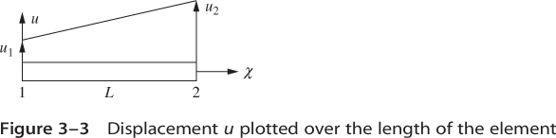
Displacement Interpolation – Truss Element

Slide 9
3. Strain–Displacement & Stress-Strain Relations

Slide 10
4. Element equations (to be derived in class)

Slide 11
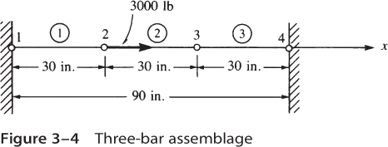
Remaining Steps
5. Assemble global equations and impose boundary conditions
6. Solve for unknown nodal displacements
7. Solve for element strains and stresses
8. Interpret results
Consider Example 3.1:

Slide 12
Comments on Approximation (Interpolation) Functions
Usually use polynomials
Should be continuous within the element
Should guarantee interelement continuity
Completeness – must allow for rigid body motion and a state of constant strain

Slide 13
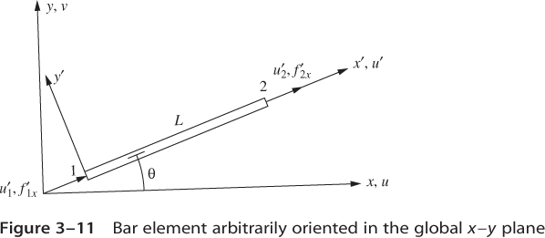
Extension to 2-D - Plane Truss (details to be derived in class)

Slide 14
Plane Truss Element Equations
where

Slide 15
Computation of Stress in Plane Truss Element

Slide 16
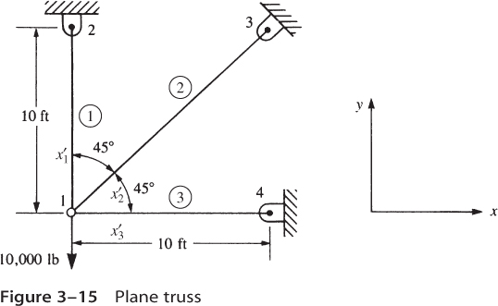
Consider Example 3.5

Slide 17
Example 3.5 – Element Equations
where

Slide 18
Ex. 3.5 - Element Stiffness Matrices

Slide 19
Ex. 3.5 – Global Stiffness Matrix
u₁ v₁ u₂ v₂ u₃ v₃ u₄ v₄

Slide 20
Ex. 3.5 Apply Load & B.C.’s and Solve
F_{1x} = 0 lb
F_{1y} = -10,000 lb
u₂ = v₂ = u₃ = v₃ = u₄ = v₄ = 0
Eqs. 1 & 2 (matrix form):
Solution:
u₁ = 0.414x10⁻² in, v₁ = -1.59x10⁻² in

Slide 21
Ex. 3.5 Stress Computation
Element 2 (θ₂=45°)
Elements 1 and 3

Slide 22
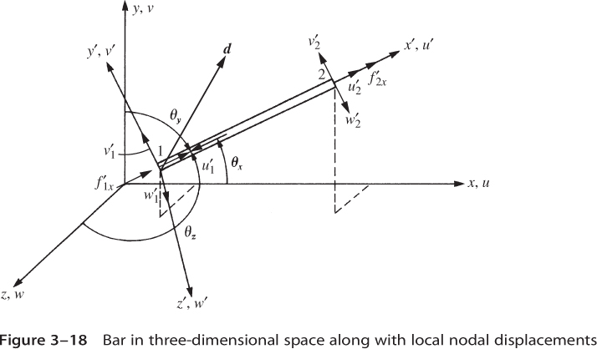
Extension to 3-D – Space Truss Analysis

Slide 23
Element Stiffness Matrix (3-D Truss Element)

Slide 24
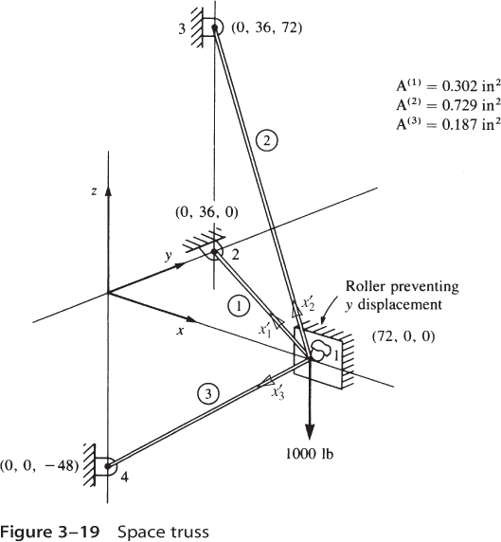
Space Frame Problem (Ex. 3.8)

Slide 25
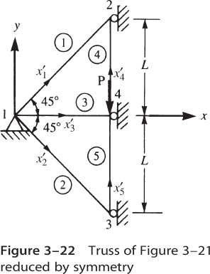
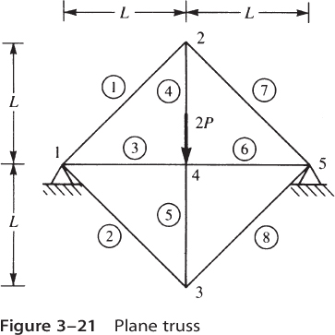
Taking Advantage of Symmetry

Slide 26
Potential Energy Approach: Applied to Truss Elements
Recall:
Potential energy
Strain energy
Potential energy of external forces

Slide 27
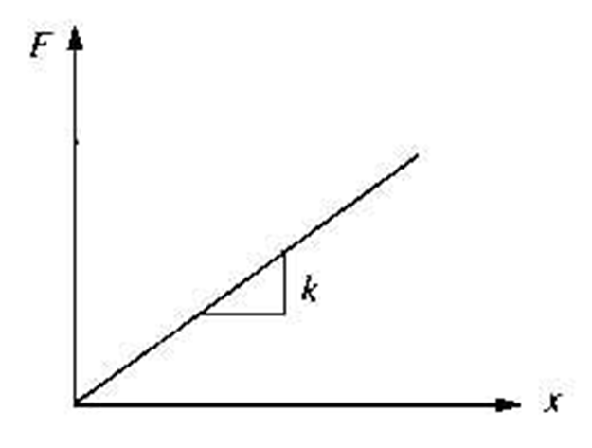
Potential Energy of a Spring

Slide 28
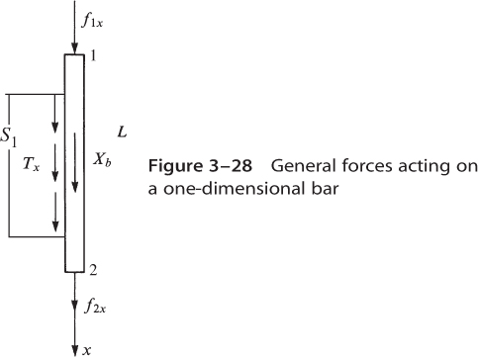
Potential Energy of a Truss Element

Slide 29
Truss Element – Strain Energy
Strain energy per unit volume
Volume

Slide 30
Strain Energy – Axial Loading

Slide 31
Truss Element Loading
Concentrated forces
Body force distribution
Surface traction distribution

Slide 32
Potential Energy of a Truss Element

Slide 33
Using Finite Element Notation: Strain Energy Term

Slide 34
Using Finite Element Notation: Applied Load Terms
Concentrated Forces:
Surface Traction:

Slide 35
Applied Load Terms (cont.)
Body Forces:
Work equivalent concentrated forces:

Slide 36
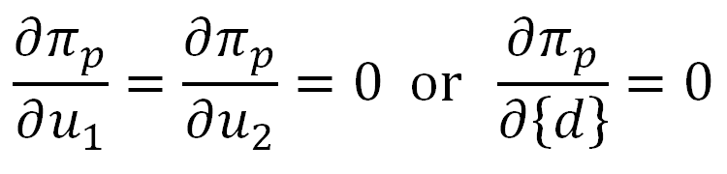
Potential Energy – Matrix Form
Theorem of Minimum Potential Energy

Slide 37
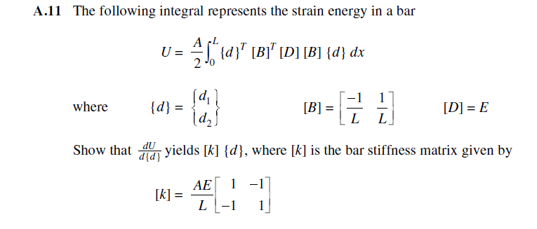
Text Problem A-11

Slide 38
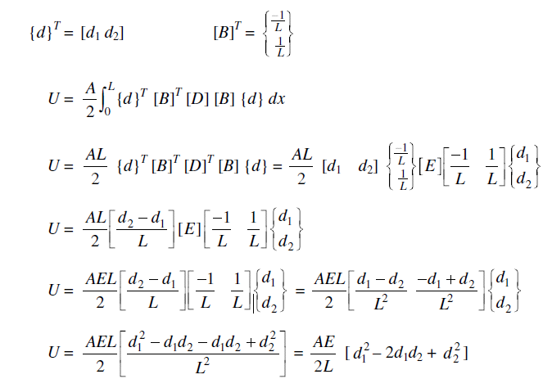
Text Problem A-11 (solution)

Slide 39
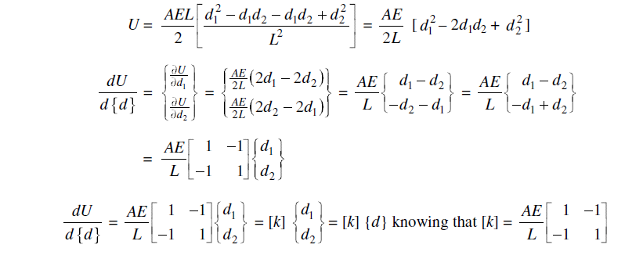

Text Problem A-11 (solution)

Slide 40
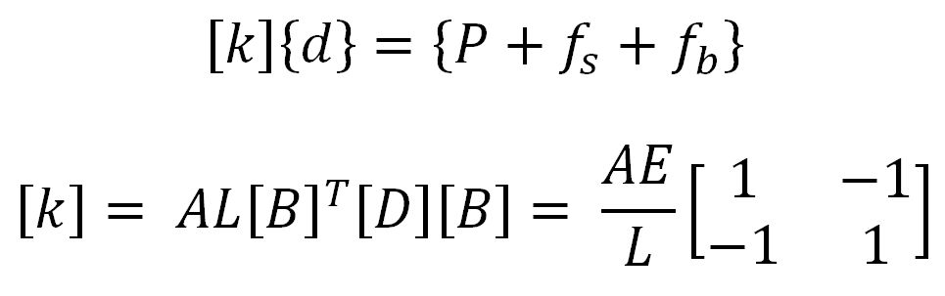
Element Equations
Same result as direct stiffness method

Slide 41
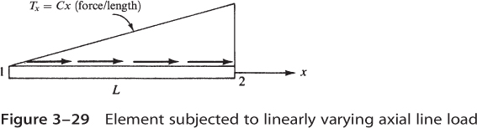
Linearly Varying Load

Slide 42
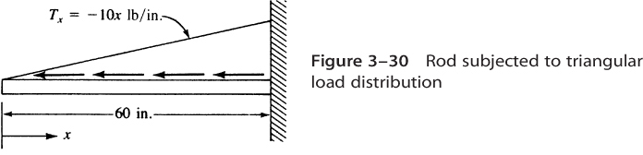
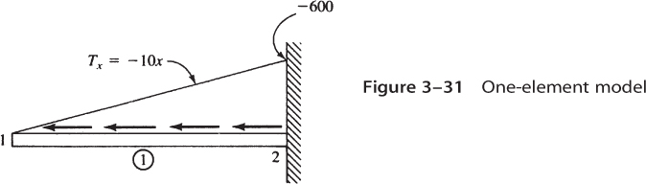
Mesh Refinement (example 3.13)

Slide 43
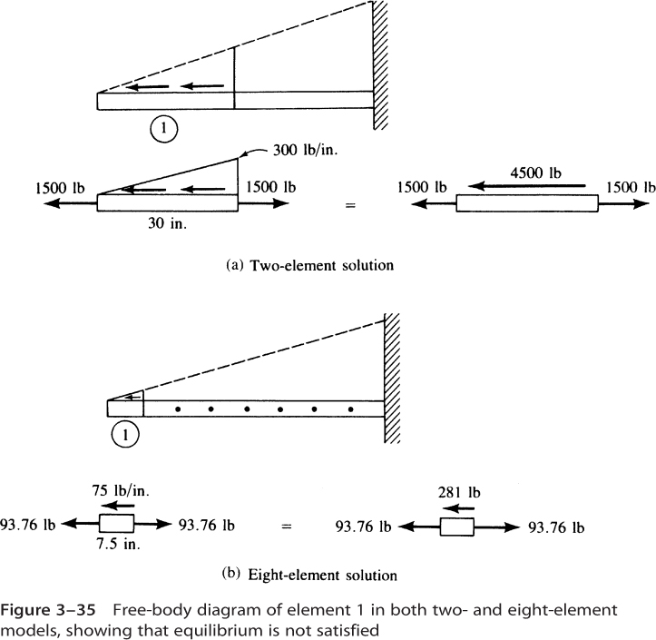
Mesh Refinement (cont.)

Slide 44
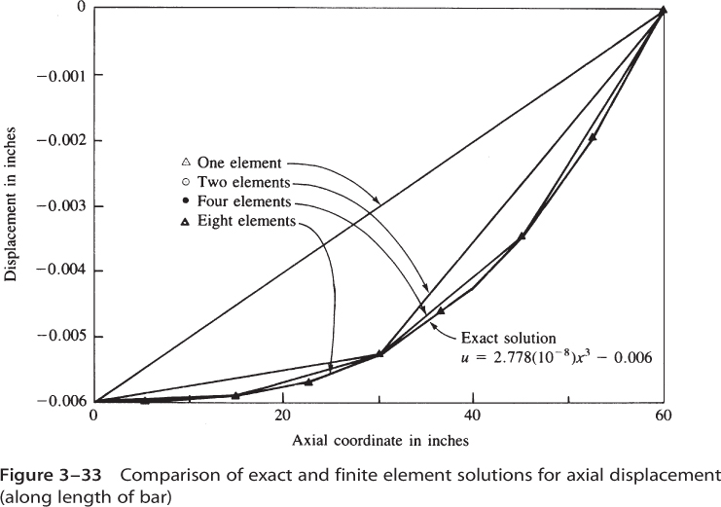
Mesh Refinement (cont.)

Slide 45
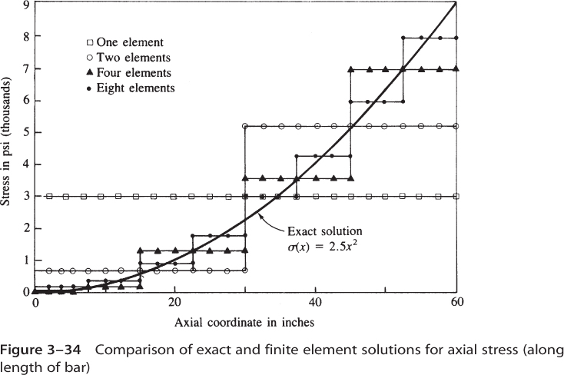
Mesh Refinement (cont.)

Slide 46
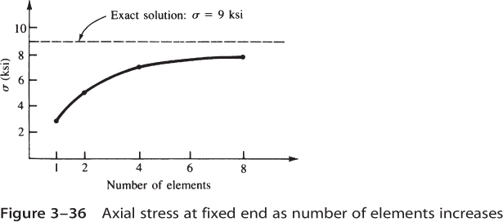
Mesh Refinement (cont.)

