Slide 1
Chapter 9 – Axisymmetric Elements
Examples of axisymmetric problems:
Pressure vessels
Cylindrical shaft with notch or filleted step
Stresses near a spherical void
Hertzian contact between spheres
Use of axisymmetric elements provides computational efficiency as compared to full 3-D analysis

Slide 2
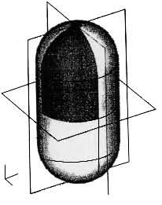
Axisymmetric Example – Pressure Vessel

Slide 3
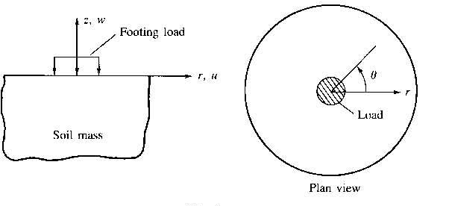
Axisymmetric Example – Soil Foundation

Slide 4
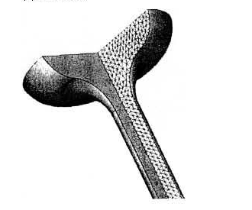
Axisymmetric Example – Valve Stem

Slide 5
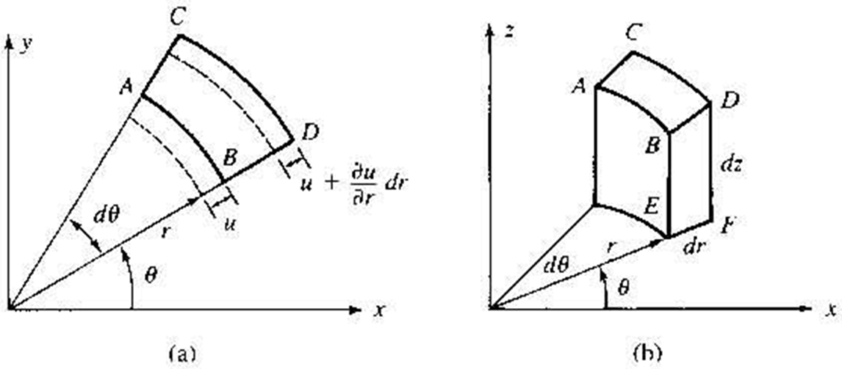
Axisymmetric Volume Element

Slide 6
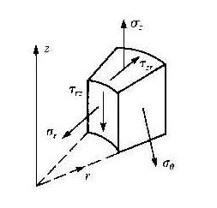
Stresses – Axisymmetric Problems
Non-zero stresses - σ_{r}, σ_{θ}, σ_{z}, τ_{rz}
τ_{rθ} = τ_{zθ} = 0 ( due to axisymmetry )

Slide 7
Strains – Axisymmetric Problems
Non-zero strains - ε_{r}, ε_{θ}, ε_{z}, γ_{rz}
γ_{rθ} = γ_{zθ} = 0 ( due to axisymmetry )
Stress – Strain Relations:
4x4

Slide 8
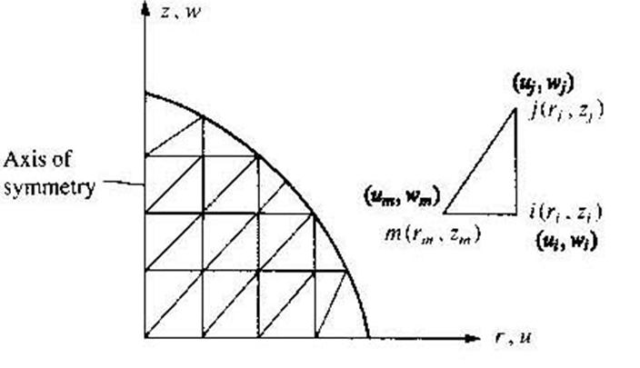
Formulation of 3 Node Triangular Axisymmetric Element

Slide 9
Axisymmetric Elements – Displacement Fields
Displacement fields:

Slide 10
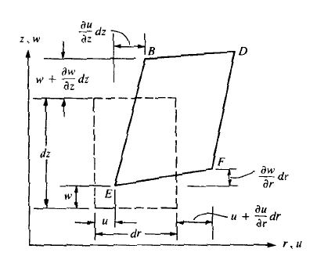

Axisymmetric strain components

Slide 11
Axisymmetric Stress-Strain Relations

Slide 12

Three node triangle (Note: not constant strain)
Assumed interpolation:
Nodal displacements:

Slide 13
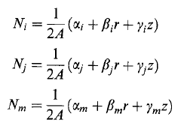
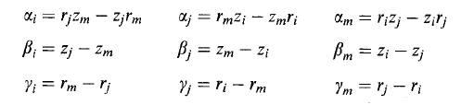
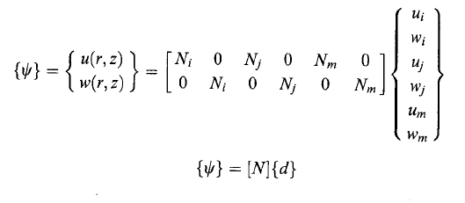
Interpolation functions Note: same as CST
where
matrix form:

Slide 14

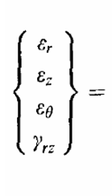
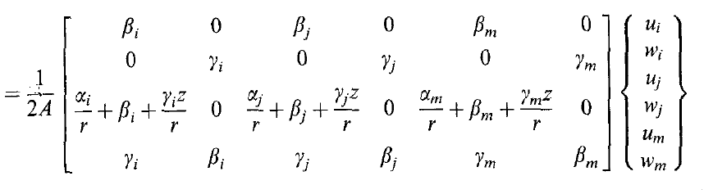
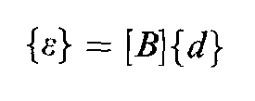
Strain-Displacement Relations
4 x 1
4 x 6
6 x 1

Slide 15
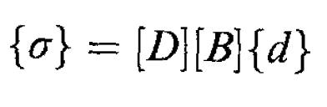
Stresses
4 x 1
4 x 4
4 x 6
6 x 1

Slide 16
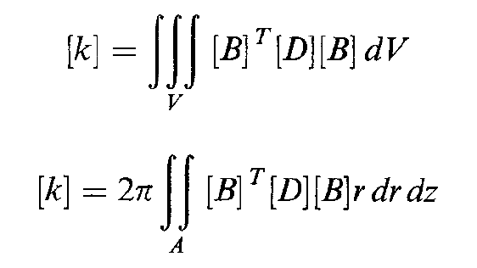
Element Stiffness Matrix

