Slide 1
Chapter 6. Plane Stress / Plane Strain Problems
Element types:
Line elements (spring, truss, beam, frame) – chapters 2-5
2-D solid elements – chapters 6-10
3-D solid elements – chapter 11
Plate / shell elements – chapter 12

Slide 2
2-D Elements
Triangular elements – plane stress/plane strain:
CST – “constant strain triangle” – chap. 6
LST – “linear strain triangle” – chap. 8
Axisymmetric elements – chap. 10
Rectangular quadrilateral elements
4-node element – chap. 6 (5th edition), chap. 10 (4th edition)
General quadrilateral (isoparametric) elements – chap. 10
4-node element (linear interpolation)
8-node element (quadratic interpolation)

Slide 3
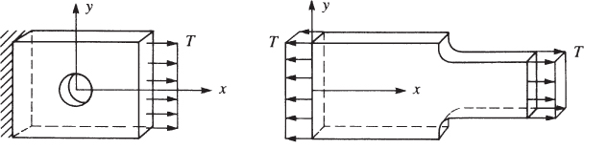
Plane stress

Slide 4
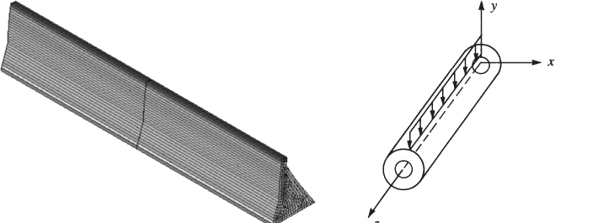
Plane Strain

Slide 5
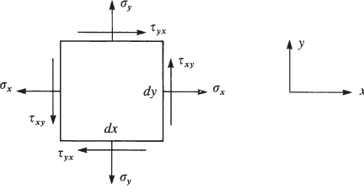
2-D Stress States
Matrix form:

Slide 6
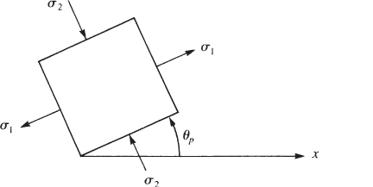
Principal Stresses

Slide 7

von Mises Effective Stress
Plane Stress
Uniaxial Tension

Slide 8
Displacements and Strains
Displacement field
Strains

Slide 9
Stress-Strain Relations
Recall:
E – Young’s modulus
- Poisson’s Ratio
G – Shear modulus

Slide 10
Stress-Strain Relations (cont.)
Plane stress
Plane strain
Note, in both cases

Slide 11
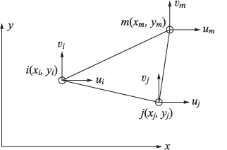
Derivation of “Constant Strain Triangle” (CST) Element Equations
Step 1 – Select element type
Note – x-y are global coordinates (will not need to transform from local to global

Slide 12
Displacement Interpolation
Assume “bi-linear” interpolation – guarantees that edges remain straight => inter-element compatibility

Slide 13
Displacement Interpolation (cont.)
As before, rewrite displacement interpolation in terms of nodal displacements (see text for details)
where

Slide 14
Displacement Interpolation (cont.)
and

Slide 15
Displacement Interpolation (cont.)

Slide 16
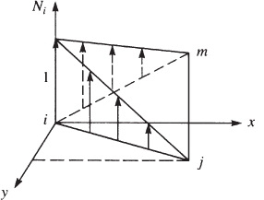
Displacement Interpolation (cont.)
Graphically:

Slide 17
Step 3 – Strain-Displacement and Stress-Strain Relations
From which it can be shown

Slide 18
Strain-Displacement Relations (cont.)
Note – the strain within each element is constant (does not vary with x & y)
Hence, the 3-node triangle is called a “Constant Strain Triangle” (CST) element

Slide 19
Stress-Strain Relations
3x1
3x3
3x6
6x1

Slide 20
Step 4 – Derive Element Equations
which will be used to derive
6x6
6x3
3x3
3x6

Slide 21
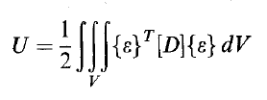

Derive Element Equations (cont.)
Strain energy:

Slide 22

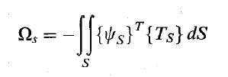



Derive Element Equations (cont.)
Potential energy of applied loads:

Slide 23
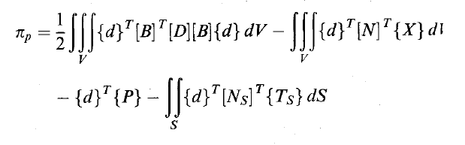
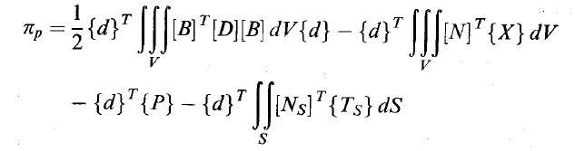
Derive Element Equations (cont.)
Potential energy:

Slide 24


Derive Element Equations (cont.)
Substitute
to yield

Slide 25
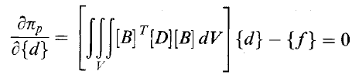

Derive Element Equations (cont.)
Apply principle of minimum potential energy
To obtain

Slide 26



Derive Element Equations (cont.)
Element stiffness matrix

Slide 27
Steps 5-7
5. Assemble global equations
6. Solve for nodal displacements
7. Compute element stresses (constant within each element)

Slide 28
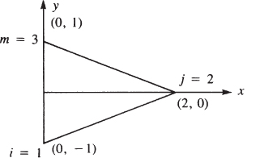
Example – CST element stiffness matrix

Slide 29
CST Element Stiffness Matrix
where
[B] – depends on nodal coordinates
[D] – depends on E, ν
See text for details

Slide 30

Body and Surface Forces
Replace distributed body forces and surface tractions with work equivalent concentrated forces.
{ f_{b} }
{ f_{s} }

Slide 31
Work Equivalent Concentrated Forces – Body Forces
For a uniformly distributed body forces X_{b} and Y_{b}:

Slide 32
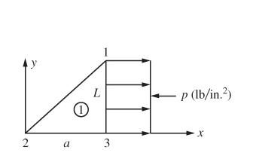
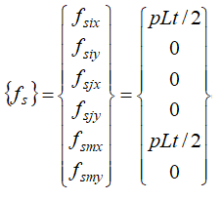
Work Equivalent Concentrated Forces – Surface Forces
For a uniform surface loading, p, acting on a vertical edge of length, L, between nodes 1 and 3:

Slide 33
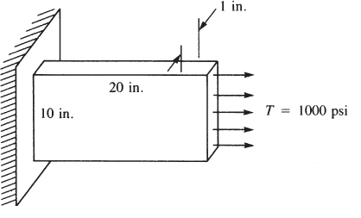
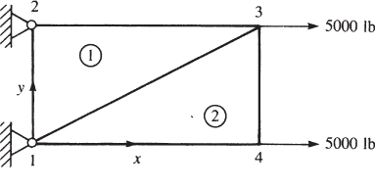
Example 6.2

Slide 34
Example 6.2 - Solution
Element 1
Element 2

Slide 35
In-class Abaqus Demonstrations
Example 6.2
Finite width plate with circular hole
(ref. “Abaqus Plane Stress Tutorial”)

Slide 36
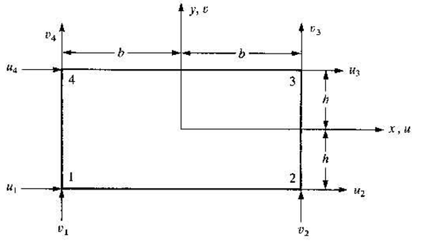
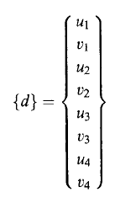
Rectangular Plane Stress Element (4-node)

Slide 37

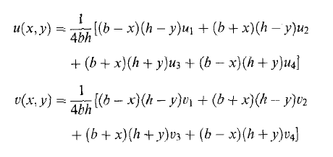
Rectangular Plane Stress Element (cont.)
Assumed displacement interpolation – bilinear
In terms of nodal displacements

Slide 38
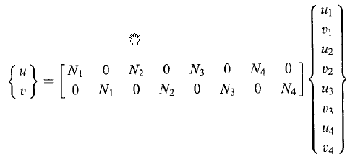
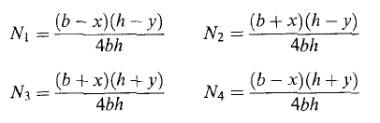
Rectangular Plane Stress Element (cont.)
Displacement interpolation (matrix form)
where

Slide 39
Interpolation functions (b=h=1)

Slide 40
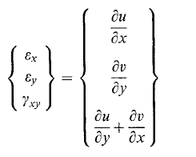
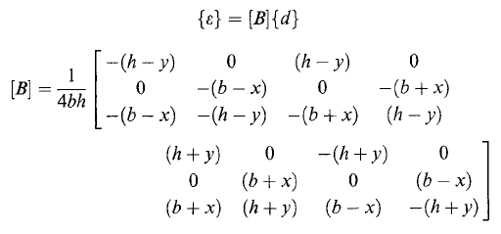
Rectangular Plane Stress Element (cont.)
Strain-displacement relation
Matrix form
Note: linear dependence on x & y

Slide 41
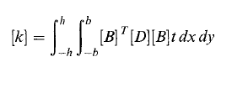


Rectangular Plane Stress Element (cont.)
Element stiffness matrix
Element force matrix
Element equations

Slide 42
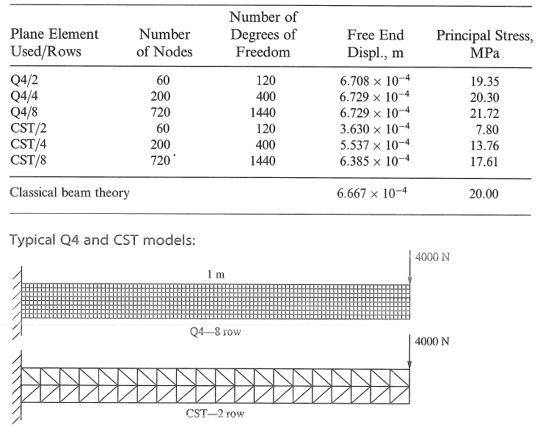
Rectangular Plane Stress Element Example

Slide 43
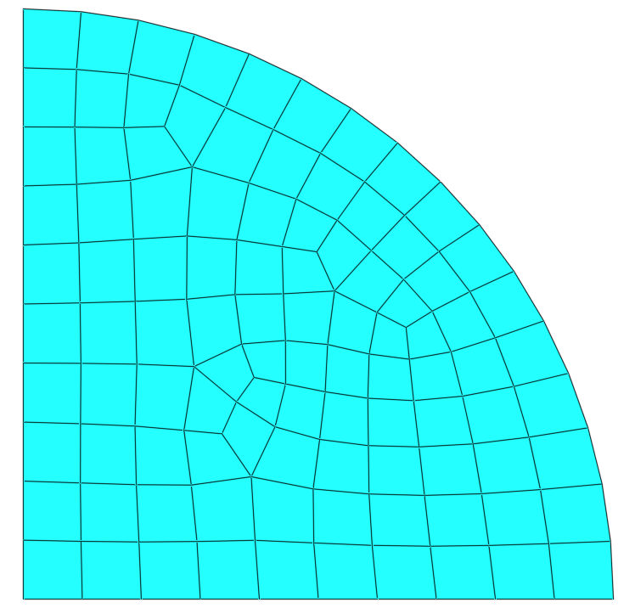
Non-rectangular Plane Stress Element (see isoparametric formulation - Chapter 10)

