Slide 1
Chapter 10 – Isoparametric Formulation
Isoparametric formulation is used for:
2-D non-rectangular quadrilateral elements (4 & 8 node)
3-D non-rectangular hexahedral (brick) elements (8 & 20 node)
Commonly used in commercial codes
Convenient for use with numerical integration
Can be used with linear and higher order displacement interpolation functions

Slide 2
The term “Isoparametric”
“iso” – same
“parametric” – parameters
Isoparametric – “same parameters” are used to describe the displacement interpolation and the coordinate transformation

Slide 3
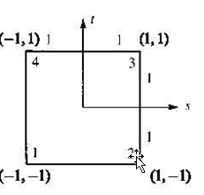
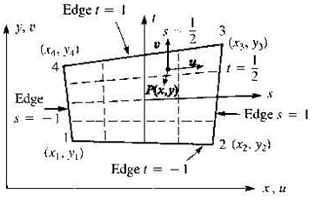
Coordinate Transformation
Global coordinate system
Natural coordinate system
⬄

Slide 4
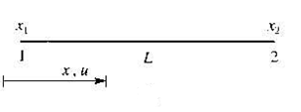

Isoparametric Formulation applied to a Bar Element
Global Coordinate – x
Natural Coordinate - s

Slide 5



Coordinate Transformation, x(s)
Note:
⬄

Slide 6
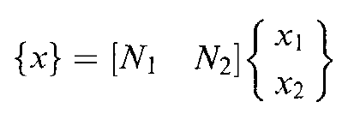
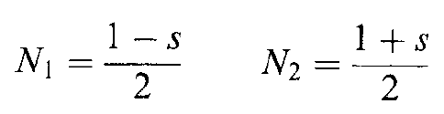
Bar Element Coordinate Transformation (cont.)
Matrix form
where

Slide 7
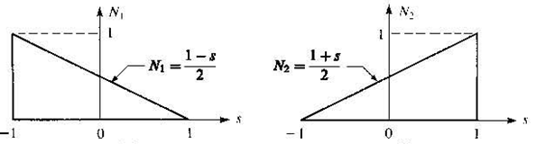
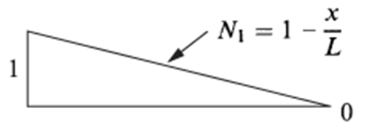
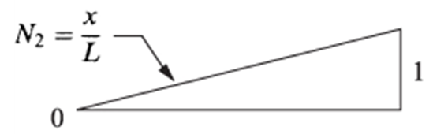
Bar Element Coordinate Transformation (cont.)
Recall bar element displacement interpolation functions:
Note: Same functions

Slide 8
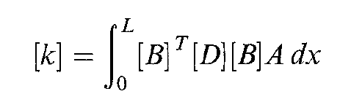
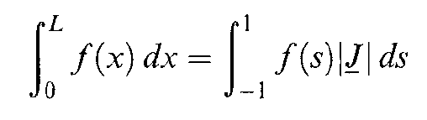
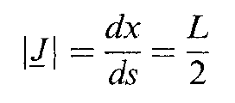
Element Stiffness Matrix
where
determinant of the Jacobian

Slide 9


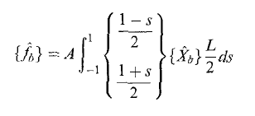


Body Forces

Slide 10


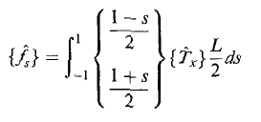

Surface Forces

Slide 11
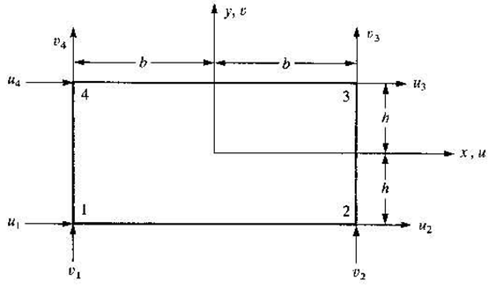
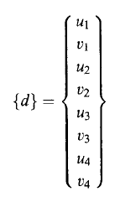
Rectangular Plane Stress Element (see Chap. 6, 5th edition, Chap. 10, 4th edition)

Slide 12

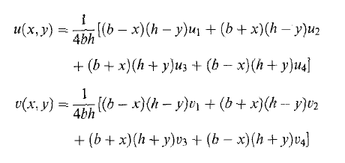
Rectangular Plane Stress Element (cont.)
Assumed displacement interpolation – bilinear
In terms of nodal displacements

Slide 13
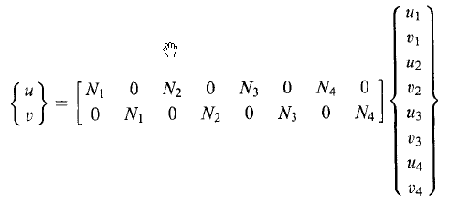
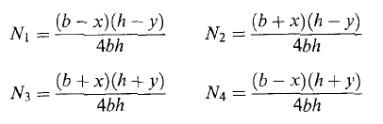
Rectangular Plane Stress Element (cont.)
Displacement interpolation (matrix form)
where

Slide 14
Interpolation functions (b=h=1)

Slide 15
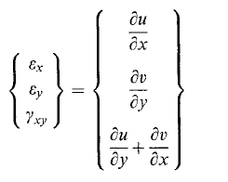
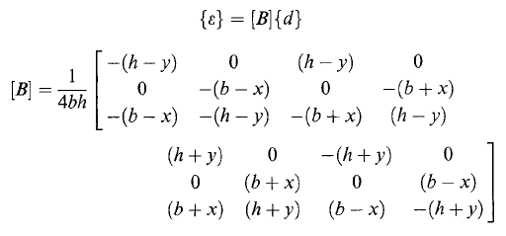
Rectangular Plane Stress Element (cont.)
Strain-displacement relation
Matrix form
Note: linear dependence on x & y

Slide 16
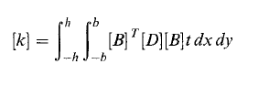


Rectangular Plane Stress Element (cont.)
Element stiffness matrix
Element force matrix
Element equations

Slide 17
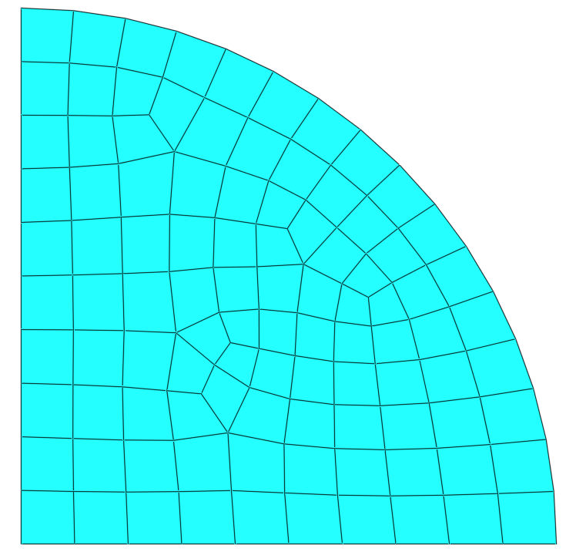
Non-rectangular Plane Stress Element

Slide 18
Isoparametric Coordinate Transformation
Global coordinate system
Natural coordinate system
⬄

Slide 19
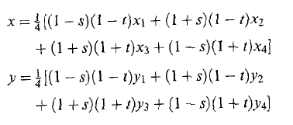
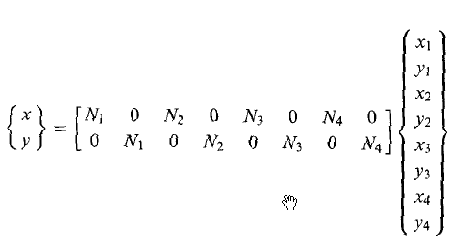
Isoparametric Coordinate Transformation (cont.)
Coordinate transformation functions (same as displacment interpolation)
Matrix form

Slide 20
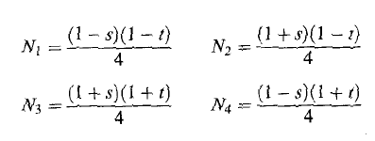
Isoparametric Coordinate Transformation (cont.)
Coordinate mapping functions

Slide 21



Isoparametric Element
Element stiffness matrix
In terms of isoparametric coordinates
Need B(s,t) and determinant of Jacobian

Slide 22
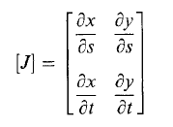
Isoparametric Element (cont.)
Jacobian matrix

Slide 23
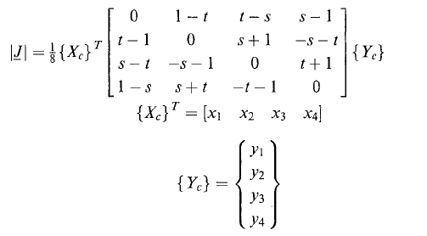
Isoparametric Element (cont.)
Determinant of Jacobian (see text for details)
Nodal coordinates

Slide 24

Isoparametric Element (cont.)
Evaluation of [k]:

Slide 25

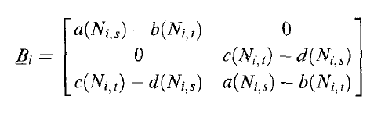
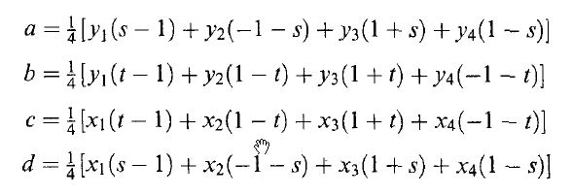

B(s,t) – 4 node quad element

Slide 26


Isoparametric Element (cont.)
Evaluation of [k]:
Requires numerical integration to evaluate double integral of the form:
=

Slide 27
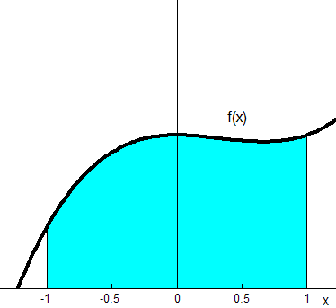
Gaussian Quadrature
Consider single integral of the form:
x

Slide 28
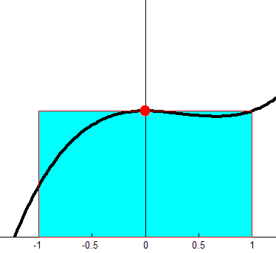
Gaussian Quadrature (cont.)
Approximate the integral by sampling the function at one point (n=1):
Weight factor, W₁ = 2
x₁ = 0 is the sampling point
Note: result is exact if y(x) is a first order polynomial

Slide 29
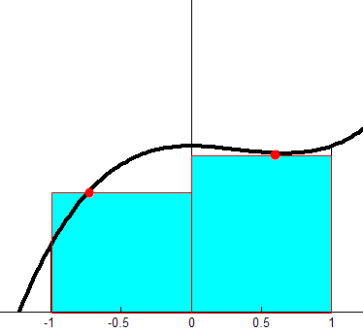
Gaussian Quadrature (n=2)
Note: result is exact if y(x) is a third order polynomial

Slide 30
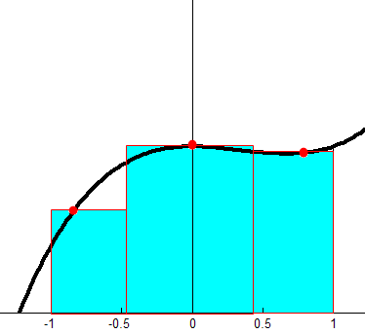
Gaussian Quadrature (n=3)
Note: result is exact if y(x) is a fifth order polynomial

Slide 31

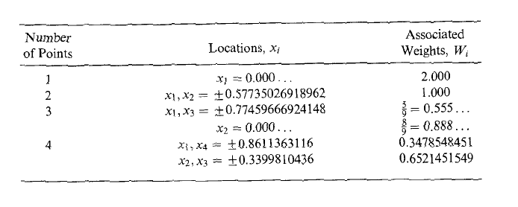
Gaussian Quadrature – General form

Slide 32
Example
Exact solution:

Slide 33
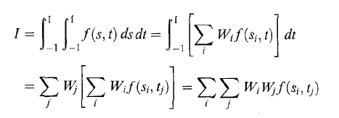
Gaussian Quadrature – Double Integrals

Slide 34
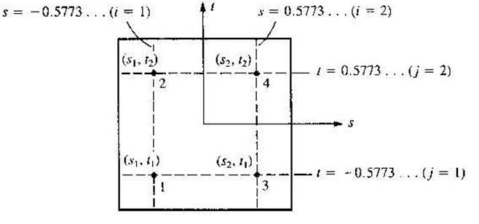

Double Integrals (cont.) 2x2 Gaussian Quadrature

Slide 35
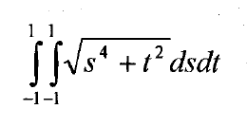
Double Integral - Example
Exact solution:
2.6613

Slide 36


Evaluation of Stiffness Matrix using Gaussian Quadrature

Slide 37
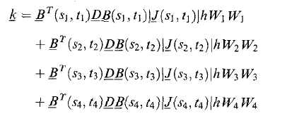
Evaluation of Stiffness Matrix (cont.)
For 4 node quad – 2 x 2 Full Integration
(Reduced Integration 1x1)
t
1
3
4
x
x
s
-1
1
1
2
x
x
-1
Gauss points or integration points
See text Example 10.4 for detailed example

Slide 38
Evaluation of Element Stresses
3 x 1
3 x 3
3 x 8
8 x 1
Options for computing stresses:
1) Compute stresses at centroid (s = t = 0)
2) Compute stresses at integration points
Extrapolate stress values to the nodes
No stress-averaging – plot color contours for each element
With stress-averaging – average stresses from adjacent elements at each node then plot color contours

Slide 39
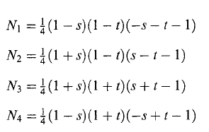
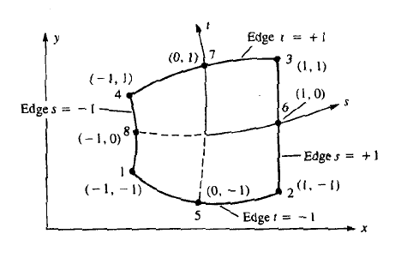
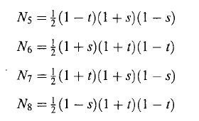
Higher order shape functions
8 node quadratic isoparametric quad element

Slide 40

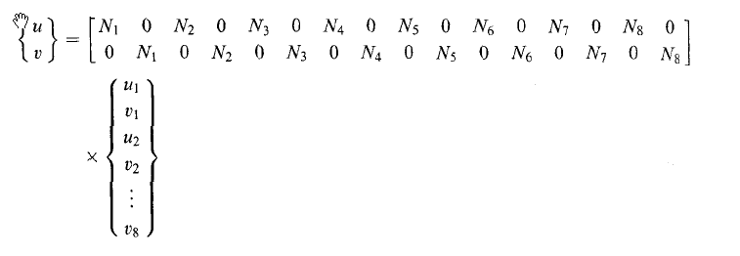
8 Node Isoparametric Quad Element (cont.)
Displacement interpolation:
2 x 1
2 x 16
16 x 1

Slide 41
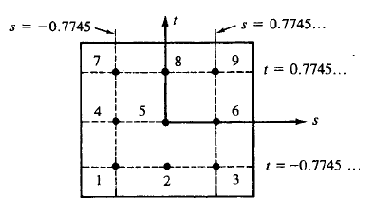
Element Stiffness Matrix
=
16 x 16
16 x 3
3 x 3
3 x 16
3 x 3 Gaussian Quadrature – Full Integration
(2 x 2 – Reduced Integration)

Slide 42
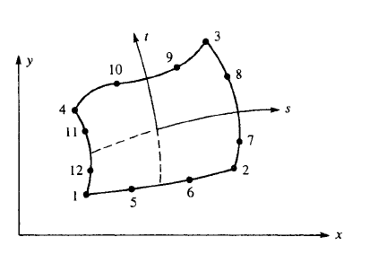
12 node Cubic Isoparametric Quad Element

