Slide 1
MCE 466 – Introduction to Finite Element Methods
Instructor: David G. Taggart
Dept. of Mechanical, Industrial and Systems Engineering
University of Rhode Island

Slide 2
Introduction
Finite Element Method – a numerical method for obtaining approximate solutions to field problems
Field Problems – A problem in which the behavior in a well defined region, R, is described by a governing set of differential equations with certain quantities prescribed on the boundary, C. (Also called a boundary value problem – BVP)

Slide 3
Introduction (cont.)
Boundary Value Problem:
Examples:
Stress analysis (includes system of springs, bars under axial loads, trusses, beams, frames, 2-D & 3-D continua, plate bending)
Stability analysis (buckling), structural dynamics, plasticity, viscoelasticity
Heat transfer
Fluid flow
General PDE problems
R
C

Slide 4
Finite Element Approach
Divide the region into may discrete sub-regions (discretization) of finite size (elements). Select certain points (nodes) at which the solution is desired. Assume a functional form for the solution between the nodes (interpolation)
element
nodes

Slide 5
Important points to remember
Finite element analyses provide approximate solutions in nearly all cases
Results can be very accurate or totally meaningless (easy to make mistakes)
Method is very susceptible to user error
Stress averaged results may conceal inaccuracies in the results
Modern commercial codes make it very easy to get answers
Responsibility of user:
Anticipate results (perform approximate calculations by hand)
Explain discrepancies
Be aware of limitations

Slide 6
One student’s reason for taking MCE466
“My company understands that FEA is a dangerous tool if the theory is not understood and it is used incorrectly. Only a select few of trained individuals are allowed to use FEA.”

Slide 7
MCE 466 – Course Structure
Appropriate balance of FEA theory and use of commercial codes (primarily Abaqus)
Text problems – hand calculations with support of Matlab as needed
Several Abaqus - based computer assignments

Slide 8
History of Finite Elements*
1943 – R. Courant (mathematician) proposed a torsion solution using triangular subregions (not implemented since no computers were available)
Early 50’s – digital computers which solved large systems of equations became available. Aerospace companies began solving structures problems (mostly unpublished)
1960 – term “Finite Element Method” first coined
Early 60’s – new elements formulated, method became accepted
Mid 60’s – Applied to heat transfer and fluid flow problems
Late 60’s, early 70’s – large general purpose programs became commercially available (NASTRAN, ANSYS, SAP)
Early 80’s – Interactive graphics made using FEA easier
Late 80’s – Inexpensive PC versions became available
90’s and beyond – Widespread application in numerous industries, Integration with CAD packages.
Most recent emphasis –multiphysics event simulation
* "Concepts and Applications of Finite Element Analysis," by R. D. Cook, D. Malkus and M. Plesha

Slide 9
Steps in the Finite Element Method
Discretize the region and select element type
Select a displacement function
Define the strain/displacement and stress/strain relations
Derive the element equations
Direct Stiffness Method
Energy Methods
Method of Weighted Residuals (Galerkin’s method)
Assemble global equations and impose boundary conditions
Solve for unknown nodal displacements
Solve for element strains and stresses
Interpret results

Slide 10
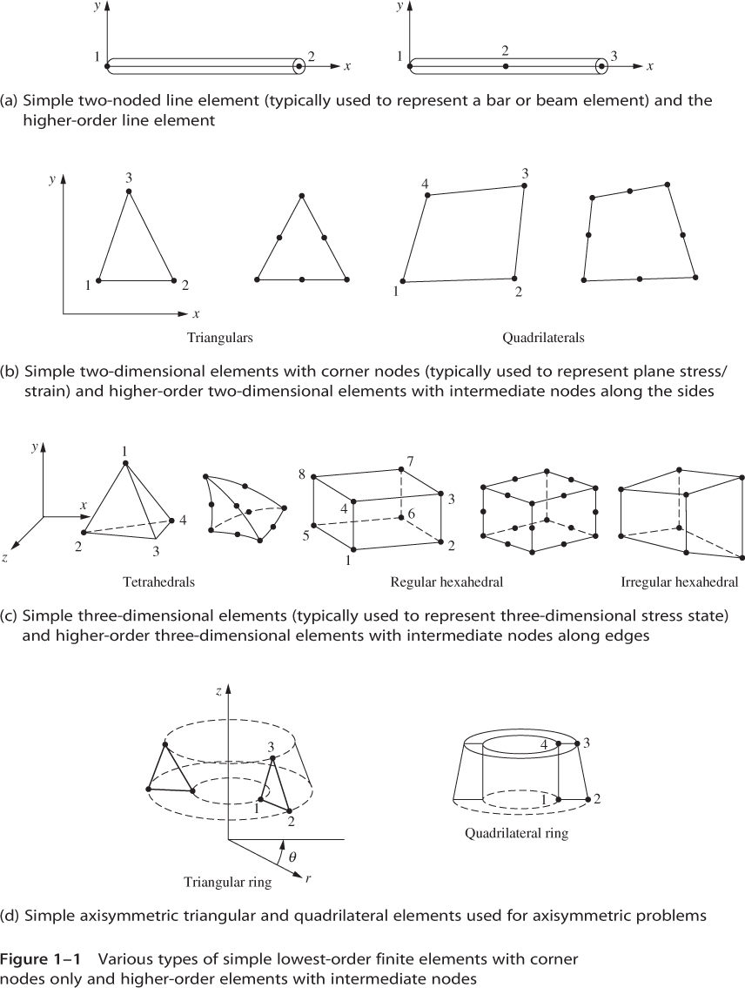
Types of Finite Elements

Slide 11
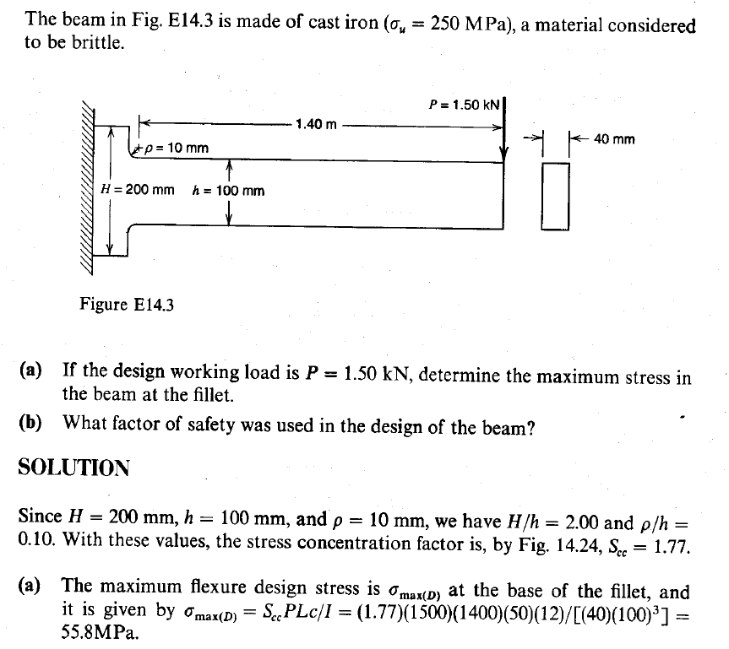
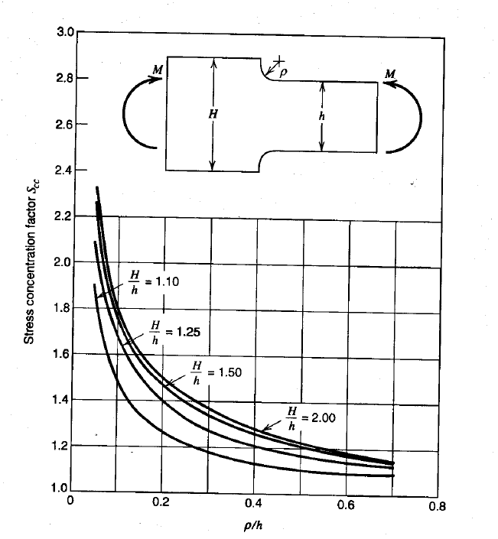
Demo of a Commercial FEA Package
Determine maximum stress for the following problem:
ρ/h = 0.10
Source: Advanced Mechanics of Materials, Boresi et al, 1993.

