Slide 1
MCE 466 – Introduction to Finite Element Methods
Instructor: David G. Taggart
Dept. of Mechanical, Industrial and Systems Engineering
University of Rhode Island
Fall 2021

Slide 2
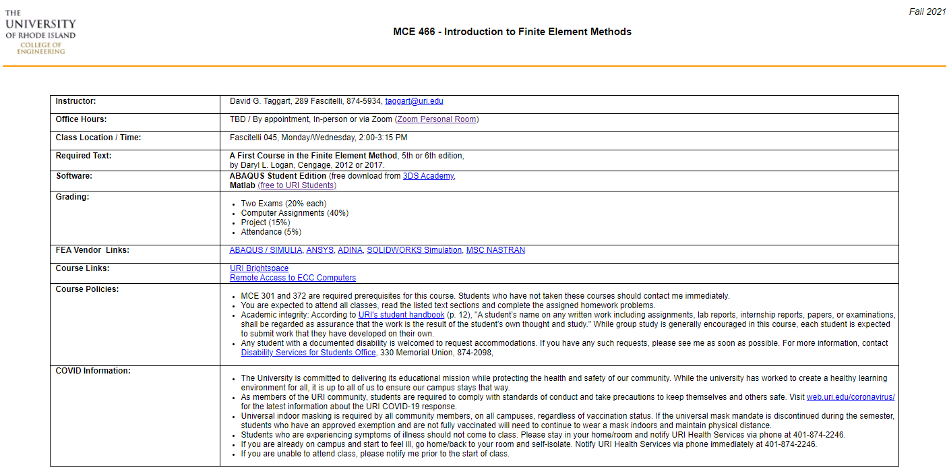
Syllabus
(https://dgtaggart.github.io/mce466/)

Slide 3
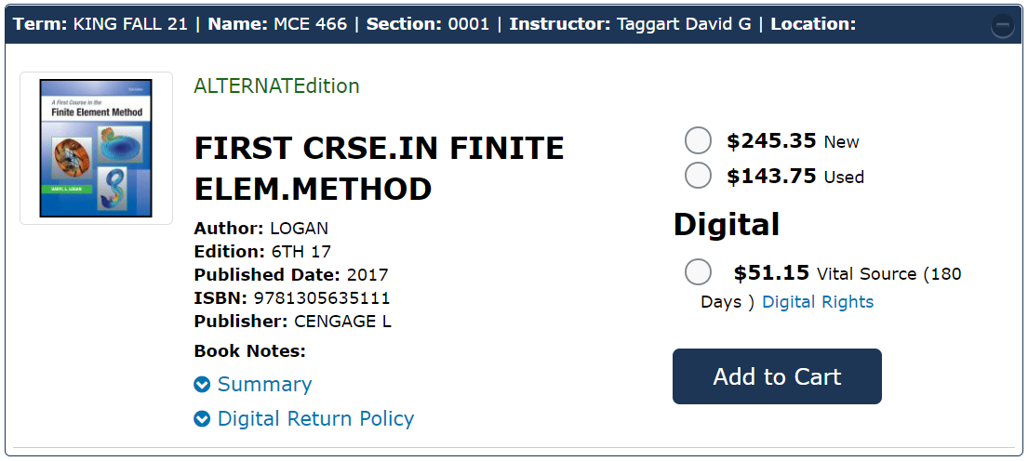
Textbook
A First Course in the Finite Element Method, 5th or 6th edition, by Daryl L. Logan, Cengage, 2012 or 2017
URI Bookstore – 6th edition

Slide 4
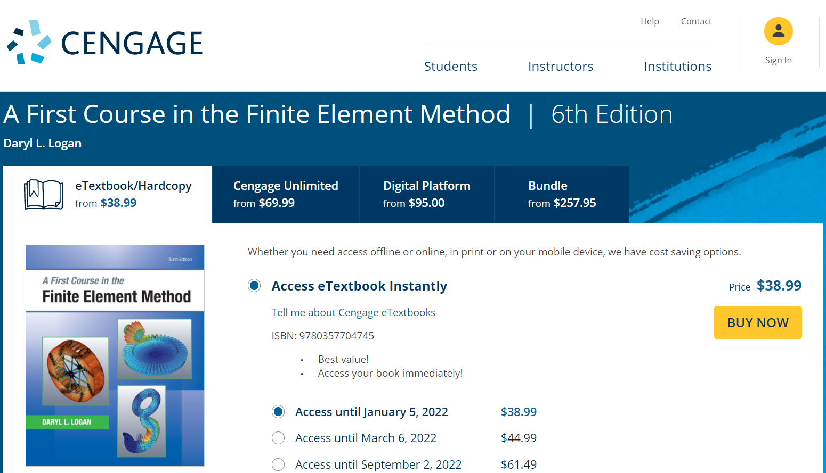
Textbook – Cengage.com

Slide 5
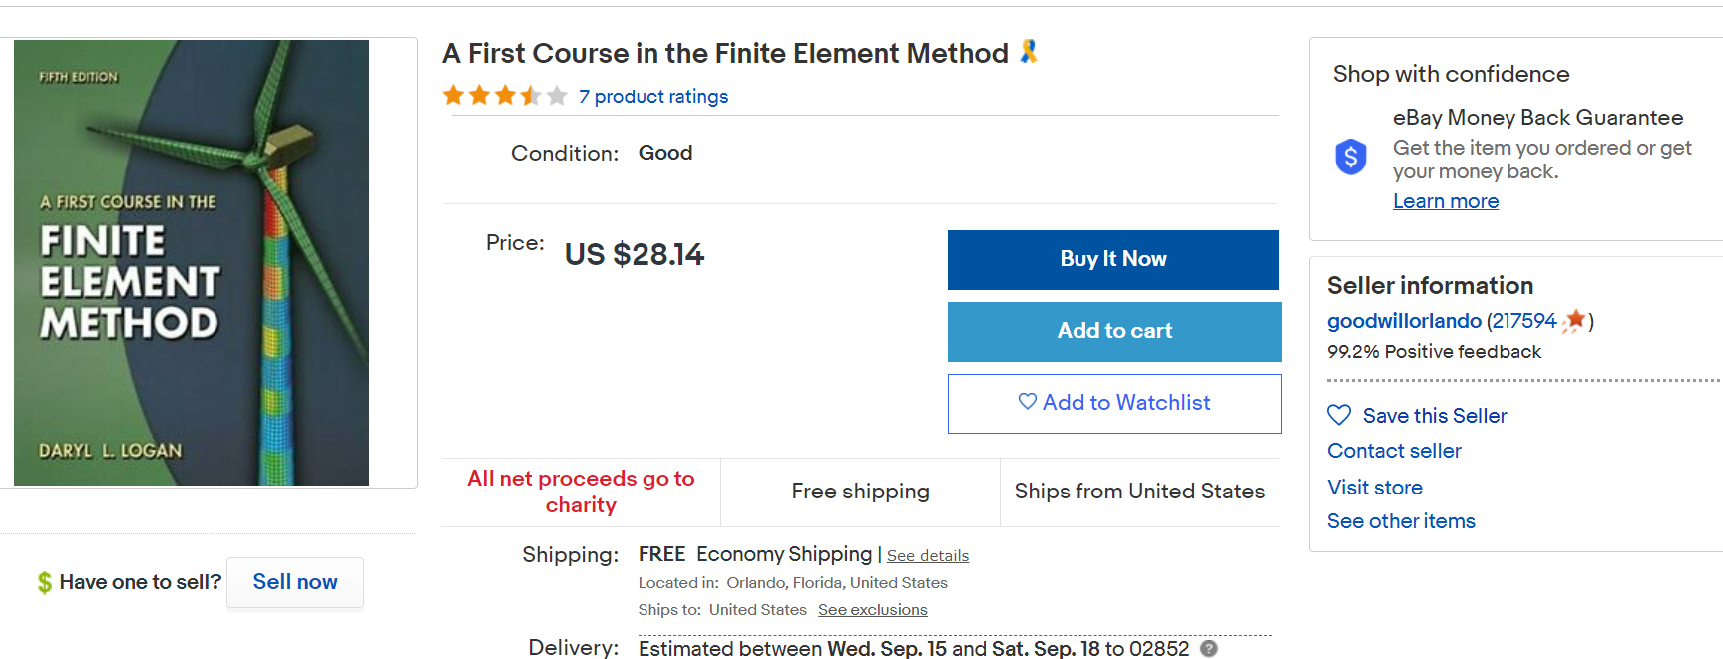
Textbook, 5th edition (ebay)

Slide 6
Software
Abaqus Student Edition
Free download for students in FEA course
Create account and download from:
http://academy.3ds.com/software/abaqus-student-edition/
Matlab (free to current URI students)
Download from:
https://web.uri.edu/research-computing/matlab/

Slide 7
Grading
Two Exams (20% each)
Computer Assignments (40%)
Project (15%)
Attendance (5%)

