Slide 1

Chapter 2 Deformation: Displacements & Strain
Elasticity Theory, Applications and Numerics M.H. Sadd , University of Rhode Island

Slide 2
Deformation Example
Elasticity Theory, Applications and Numerics M.H. Sadd , University of Rhode Island

Slide 3
Small Deformation Theory
Elasticity Theory, Applications and Numerics M.H. Sadd , University of Rhode Island

Slide 4
Two Dimensional Geometric Deformation
Strain-Displacement Relations
Strain Tensor
Elasticity Theory, Applications and Numerics M.H. Sadd , University of Rhode Island

Slide 5
Example 2-1: Strain and Rotation Examples
Elasticity Theory, Applications and Numerics M.H. Sadd , University of Rhode Island

Slide 6
Strain Transformation
Elasticity Theory, Applications and Numerics M.H. Sadd , University of Rhode Island

Slide 7
Two-Dimensional Strain Transformation
Elasticity Theory, Applications and Numerics M.H. Sadd , University of Rhode Island

Slide 8
Principal Strains & Directions
y
2
1
x
z
3
(General Coordinate System)
(Principal Coordinate System) No Shear Strains
Elasticity Theory, Applications and Numerics M.H. Sadd , University of Rhode Island

Slide 9
Spherical and Deviatoric Strains
. . . Spherical Strain Tensor
. . . Deviatoric Strain Tensor
Elasticity Theory, Applications and Numerics M.H. Sadd , University of Rhode Island

Slide 10

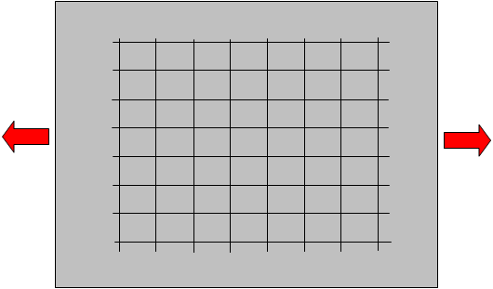
Compatibility Concept Normally we want continuous single-valued displacements; i.e. a mesh that fits perfectly together after deformation
Undeformed State
Deformed State
Elasticity Theory, Applications and Numerics M.H. Sadd , University of Rhode Island

Slide 11
Mathematical Concepts Related to Deformation Compatibility
Strain-Displacement Relations
Given the Three Displacements:
We have six equations to easily determine the six strains
Given the Six Strains:
We have six equations to determine three displacement components. This is an over-determined system and in general will not yield continuous single-valued displacements unless the strain components satisfy some additional relations
Elasticity Theory, Applications and Numerics M.H. Sadd , University of Rhode Island

Slide 12

Physical Interpretation of Strain Compatibility
Elasticity Theory, Applications and Numerics M.H. Sadd , University of Rhode Island

Slide 13
Compatibility Equations Saint Venant Equations in Terms of Strain Guarantee Continuous Single-Valued Displacements in Simply-Connected Regions
Elasticity Theory, Applications and Numerics M.H. Sadd , University of Rhode Island

Slide 14
Examples of Domain Connectivity
Elasticity Theory, Applications and Numerics M.H. Sadd , University of Rhode Island

Slide 15
Curvilinear Strain-Displacement Relations Cylindrical Coordinates
Elasticity Theory, Applications and Numerics M.H. Sadd , University of Rhode Island

