Slide 1

Chapter 4 Material Behavior – Linear Elastic Solids
Linear Elastic Constitutive Solid Model Develop Force-Deformation Constitutive Equation in the Form of Stress-Strain Relations Under the Assumptions:
Solid Recovers Original Configuration When Loads Are Removed
Linear Relation Between Stress and Strain
Neglect Rate and History Dependent Behavior
Include Only Mechanical Loadings
Thermal, Electrical, Pore-Pressure, and Other Loadings Can Also Be Included As Special Cases
Elasticity Theory, Applications and Numerics M.H. Sadd , University of Rhode Island

Slide 2
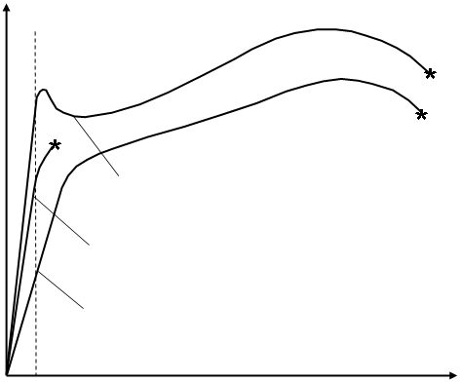

Typical One-Dimensional Stress-Strain Behavior
σ
Steel
Tensile Sample
Cast Iron
Aluminum
ε
Applicable Region for Linear Elastic Behavior
σ = E ε
Elasticity Theory, Applications and Numerics M.H. Sadd , University of Rhode Island

Slide 3
Linear Elastic Material Model Generalized Hooke’s Law
with
or
36 Independent Elastic Constants
Elasticity Theory, Applications and Numerics M.H. Sadd , University of Rhode Island

Slide 4
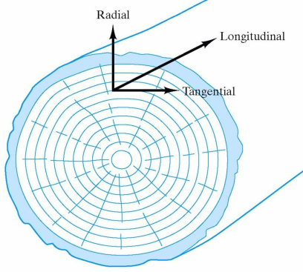
Anisotropy and Nonhomogeneity
Anisotropy - Differences in material properties under different directions. Materials like wood, crystalline minerals, fiber-reinforced composites have such behavior.
Typical Wood Structure
(Body-Centered Crystal)
(Hexagonal Crystal)
(Fiber Reinforced Composite)
Note Particular Material Symmetries Indicated by the Arrows
Nonhomogeneity - Spatial differences in material properties. Soil materials in the earth vary with depth, and new functionally graded materials (FGM’s) are now being developed with deliberate spatial variation in elastic properties to produce desirable behaviors.
Gradation Direction
Elasticity Theory, Applications and Numerics M.H. Sadd , University of Rhode Island

Slide 5
Isotropic Materials Although many materials exhibit non-homogeneous and anisotropic behavior, we will primarily restrict our study to isotropic solids. For this case, material response is independent of coordinate rotation
Generalized Hooke’s Law
λ - Lamé’s constant
μ - shear modulus or modulus of rigidity
Elasticity Theory, Applications and Numerics M.H. Sadd , University of Rhode Island

Slide 6
Isotropic Materials Inverted Form - Strain in Terms of Stress
Elasticity Theory, Applications and Numerics M.H. Sadd , University of Rhode Island

Slide 7
Physical Meaning of Elastic Moduli
Simple Tension
Pure Shear
Hydrostatic
Compression
p
σ
τ
τ
τ
p
τ
p
σ
Elasticity Theory, Applications and Numerics M.H. Sadd , University of Rhode Island

Slide 8
Relations Among Elastic Constants
Elasticity Theory, Applications and Numerics M.H. Sadd , University of Rhode Island

Slide 9
Typical Values of Elastic Moduli for Common Engineering Materials
 | E (GPa) | ν | μ(GPa) | λ(GPa) | k(GPa) | α(10⁻⁶/ºC)
Aluminum | 68.9 | 0.34 | 25.7 | 54.6 | 71.8 | 25.5
Concrete | 27.6 | 0.20 | 11.5 | 7.7 | 15.3 | 11
Cooper | 89.6 | 0.34 | 33.4 | 71 | 93.3 | 18
Glass | 68.9 | 0.25 | 27.6 | 27.6 | 45.9 | 8.8
Nylon | 28.3 | 0.40 | 10.1 | 4.04 | 47.2 | 102
Rubber | 0.0019 | 0.499 | 0.654x10⁻³ | 0.326 | 0.326 | 200
Steel | 207 | 0.29 | 80.2 | 111 | 164 | 13.5
Elasticity Theory, Applications and Numerics M.H. Sadd , University of Rhode Island

Slide 10
Hooke’s Law in Cylindrical Coordinates
x₃
z
σ_{z}
τ_{θz}
τ_{rθ}
τ_{rz}
σ_{θ}
σ_{r}
x₂
r
dθ
x₁
θ
dr
Elasticity Theory, Applications and Numerics M.H. Sadd , University of Rhode Island

Slide 11
Hooke’s Law in Spherical Coordinates
x₃
τ_{Rθ}
σ_{R}
τ_{Rφ}
σ_{θ}
φ
R
τ_{φθ}
σ_{φ}
x₂
θ
x₁
Elasticity Theory, Applications and Numerics M.H. Sadd , University of Rhode Island

