Slide 1

Chapter 9 Extension, Torsion and Flexure of Elastic Cylinders
Prismatic Bar Subjected to End Loadings
Semi-Inverse Method
Elasticity Theory, Applications and Numerics M.H. Sadd , University of Rhode Island

Slide 2
Extension of Cylinders
Assumptions
Load P_{z} is applied at centroid of cross-section so no bending effects
Using Saint-Venant Principle, exact end tractions are replaced by statically equivalent uniform loading
Thus assume stress σ_{z} is uniform over any cross-section throughout the solid
Using stress results into Hooke’s law and combining with the strain-displacement relations gives
Integrating and dropping rigid-body motion terms such that displacements vanish at origin
Elasticity Theory, Applications and Numerics M.H. Sadd , University of Rhode Island

Slide 3
Torsion of Cylinders
Guided by Observations from Mechanics of Materials
projection of each section on x,y-plane rotates as rigid-body about central axis
amount of projected section rotation is linear function of axial coordinate
plane cross-sections will not remain plane after deformation thus leading to a warping displacement
Elasticity Theory, Applications and Numerics M.H. Sadd , University of Rhode Island

Slide 4
Torsional Deformations
y
P'
P
r
S
β
θ
O
x
α = angle of twist per unit length
R
w = warping displacement
Now must show assumed displacement form
will satisfy all elasticity field equations
Elasticity Theory, Applications and Numerics M.H. Sadd , University of Rhode Island

Slide 5
Stress Function Formulation
Equilibrium Equations
Compatibility Relation
Introduce Prandtl Stress Function φ = φ(x,y) :
Equilibrium will be identically satisfied and compatibility relation gives
a Poisson equation that is amenable to several analytical solution techniques
Elasticity Theory, Applications and Numerics M.H. Sadd , University of Rhode Island

Slide 6
Boundary Conditions Stress Function Formulation
On Lateral Side: S







n
On End: R (z = constant)
Elasticity Theory, Applications and Numerics M.H. Sadd , University of Rhode Island

Slide 7
Displacement Formulation
Displacement component satisfies Laplace’s equation
On Lateral Side: S
On End: R
Elasticity Theory, Applications and Numerics M.H. Sadd , University of Rhode Island

Slide 8
Formulation Comparison
Stress Function Formulation
Displacement Formulation
Relatively Simple Governing Equation
Very Simple Boundary Condition
Very Simple Governing Equation
Complicated Boundary Condition
Elasticity Theory, Applications and Numerics M.H. Sadd , University of Rhode Island

Slide 9
Multiply Connected Cross-Sections
Boundary conditions of zero tractions on all lateral surfaces apply to external boundary S_{o} and all internal boundaries S₁, . . . Stress function will be a constant and displacement be specified as per (9.3.20) or (9.3.21) on each boundary S_{i}, i = 0, 1, . . .
where φ_{i} are constants. Value of φ_{i} may be arbitrarily chosen only on one boundary, commonly taken as zero on S_{o} .
Constant stress function values on each interior boundary are found by requiring displacements w to be single-valued, expressed by
where A₁ is area enclosed by S₁
Value of φ₁ on inner boundary S₁ must therefore be chosen so that relation is satisfied. If cross-section has more than one hole, relation must be satisfied for each hole.
Boundary conditions on cylinder ends will be satisfied, and resultant torque condition will give
Elasticity Theory, Applications and Numerics M.H. Sadd , University of Rhode Island

Slide 10
Membrane Analogy
Stress function equations are identical to those governing static deflection of an elastic membrane under uniform pressure. This creates an analogy between the two problems, and enables particular features from membrane problem to be used to aid solution of torsion problem. Generally used to providing insight into qualitative features and to aid in developing approximate solutions.
Membrane Equations
Torsion Equations
Equations are same with: φ = z , p/N = 2μα , T = 2V
Elasticity Theory, Applications and Numerics M.H. Sadd , University of Rhode Island

Slide 11
Torsion Solutions Derived from Boundary Equation
If boundary is expressed by relation f(x,y) = 0, this suggests possible simple solution scheme of expressing stress function as φ = K f(x,y) where K is arbitrary constant. Form satisfies boundary condition on S, and for some simple geometric shapes it will also satisfy the governing equation with appropriate choice of K. Unfortunately this is not a general solution method and works only for special cross-sections of simple geometry.
Elasticity Theory, Applications and Numerics M.H. Sadd , University of Rhode Island

Slide 12
Example 9.1 Elliptical Section
y
b
a
x
Look for Stress Function Solution
φ satisfies boundary condition and will satisfy governing governing if
Since governing equation and boundary condition are satisfied, we have found solution
Elasticity Theory, Applications and Numerics M.H. Sadd , University of Rhode Island

Slide 13
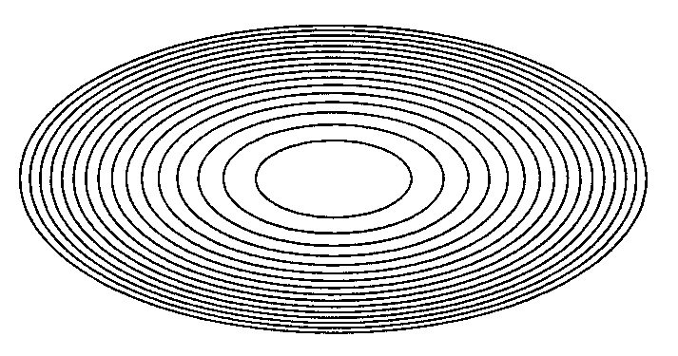
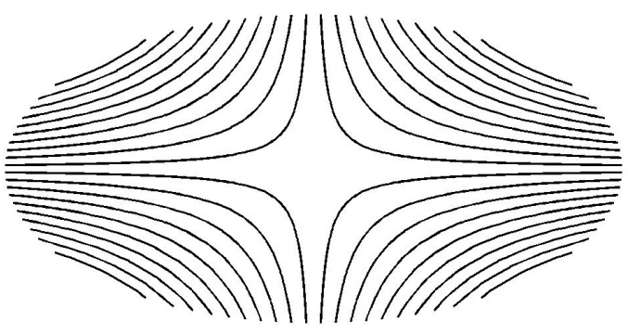
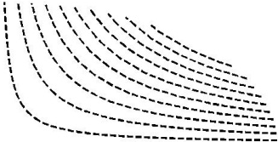

Elliptical Section Results
(Stress Function Contours)
(Displacement Contours)
Stress Field
Displacement Field
Loading Carrying Capacity
Angle of Twist
Elasticity Theory, Applications and Numerics M.H. Sadd , University of Rhode Island

Slide 14
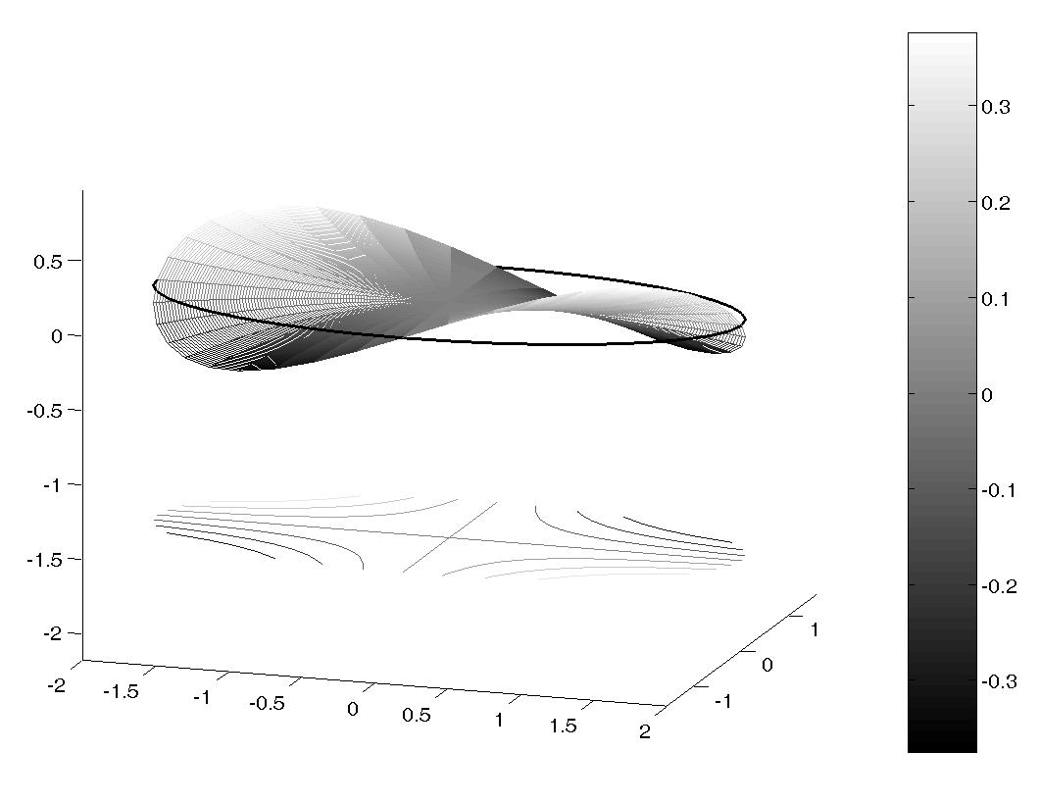
Elliptical Section Results 3-D Warping Displacement Contours
T
Elasticity Theory, Applications and Numerics M.H. Sadd , University of Rhode Island

Slide 15
Example 9.2 Equilateral Triangular Section
For stress function try product form of each boundary line equation
φ satisfies boundary condition and will satisfy governing governing if
Since governing equation and boundary condition are satisfied, we have found solution
Elasticity Theory, Applications and Numerics M.H. Sadd , University of Rhode Island

Slide 16
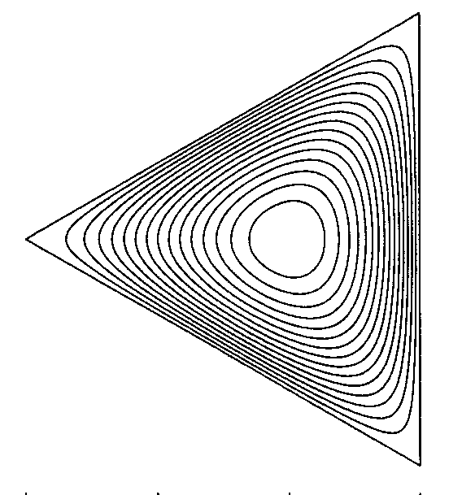
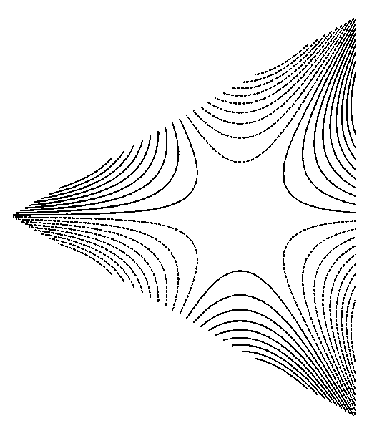
Equilateral Triangular Section Results
(Stress Function Contours)
(Displacement Contours)
Stress Field
Displacement Field
Loading Carrying Capacity
Angle of Twist
Elasticity Theory, Applications and Numerics M.H. Sadd , University of Rhode Island

Slide 17
Additional Examples That Allow Simple Solution Using Boundary Equation Scheme
y
y
r = 2acosθ
.
a
r
a
r = b
θ
x
x
Section with Higher Order
Polynomial Boundary (Example 9-3)
Circular Shaft with Circular
Keyway (Exercise 9-22/23)
Elasticity Theory, Applications and Numerics M.H. Sadd , University of Rhode Island

Slide 18
Examples That Do Not Allow Simple Solution Using Boundary Equation Scheme
y
b
a
x
General Triangular Section
Rectangular Section
Elasticity Theory, Applications and Numerics M.H. Sadd , University of Rhode Island

Slide 19
Example 9.4 Rectangular Section Fourier Method Solution
y
Previous boundary equation scheme will not create a stress function that satisfies the governing equation. Thus we must use a more fundamental solution technique - Fourier method. Thus look for stress function solution of the standard form
b
a
x
homogeneous solution must then satisfy
Separation of Variables Method
Elasticity Theory, Applications and Numerics M.H. Sadd , University of Rhode Island

Slide 20
Rectangular Section Results
Stress Field
Loading Carrying Capacity/Angle of Twist
Displacement Field
Elasticity Theory, Applications and Numerics M.H. Sadd , University of Rhode Island

Slide 21
Rectangular Section Results
Elasticity Theory, Applications and Numerics M.H. Sadd , University of Rhode Island

Slide 22
Torsion of Thin Rectangular Sections (a<<b)
y
Investigate results for special case of a very thin rectangle with a << b. Under conditions of b/a >> 1
b
a
x
Composite Sections
Torsion of sections composed of thin rectangles. Neglecting local regions where rectangles are joined, we can use thin rectangular solution over each section. Stress function contours shown justify these assumptions. Thus load carrying torque for such composite section will be given by
Elasticity Theory, Applications and Numerics M.H. Sadd , University of Rhode Island

Slide 23
Example 9.5 Hollow Elliptical Section
For this case lines of constant shear stress coincide with both inner and outer boundaries, and so no stress will act on these lateral surfaces. Therefore, hollow section solution is found by simply removing inner core from solid solution. This gives same stress function and stress distribution in remaining material.
Constant value of stress function on inner boundary is
Load carrying capacity is determined by subtracting load carried by the removed inner cylinder from the torque relation for solid section
Maximum stress still occurs at x = 0 and y = ±b
Elasticity Theory, Applications and Numerics M.H. Sadd , University of Rhode Island

Slide 24
Hollow Thin-Walled Tube Sections
C
Membrane
Tube Centerline
a
a
φ_{o}
A
B
A
B
(Section aa)
t
With t<<1 implies little variation in membrane slope, and BC can be approximated by a straight line. Since membrane slope equals resultant shear stress
Load carrying relation:
where A = section area, A_{i} = area enclosed by inner boundary, A_{c} = area enclosed by centerline
Combining relations
Angle of twist:
where S_{c} = length of tube centerline
Elasticity Theory, Applications and Numerics M.H. Sadd , University of Rhode Island

Slide 25
Cut Thin-Walled Tube Sections
Cut
Cut creates an open tube and produces significant changes to stress function, stress field and load carrying capacity. Open tube solution can be approximately determined using results from thin rectangular solution. Stresses for open and closed tubes can be compared and for identical applied torques, the following relation can be established (see Exercise 9-24)
Elasticity Theory, Applications and Numerics M.H. Sadd , University of Rhode Island

Slide 26
Torsion of Circular Shafts of Variable Diameter
x
.
θ
r
Displacement Assumption
u_{r} = u_{z} = 0
u_{θ} = u_{θ} (r,z)
z
y
Equilibrium Equations
Stress Function Approach
Boundary Condition
Load Carrying Torque
Elasticity Theory, Applications and Numerics M.H. Sadd , University of Rhode Island

Slide 27
Conical Shaft Example 9-7
r
z
2ϕ
Stress Function Solution
Stresses
Displacement
ωr is rigid-body rotation about z-axis and ω can be determined by specifying shaft rotation at specific z-location
Elasticity Theory, Applications and Numerics M.H. Sadd , University of Rhode Island

Slide 28
Conical Shaft Example 9-7 ϕ = 30º Comparison with Mechanics of Materials
Elasticity Theory, Applications and Numerics M.H. Sadd , University of Rhode Island

Slide 29
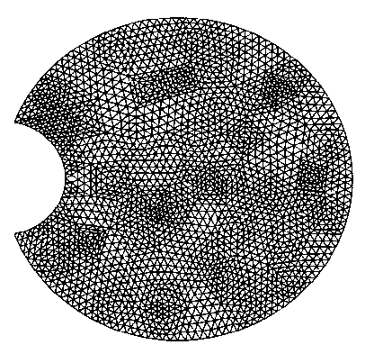
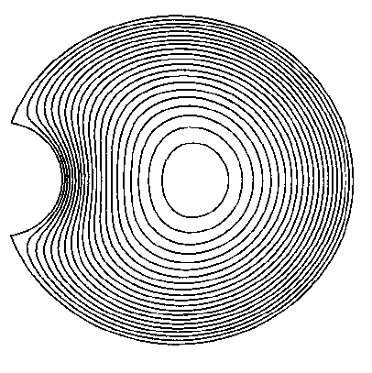
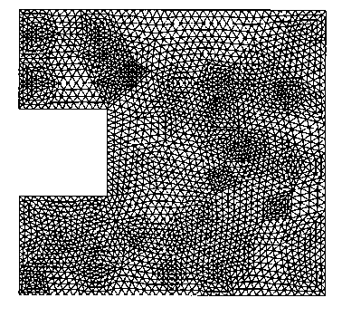
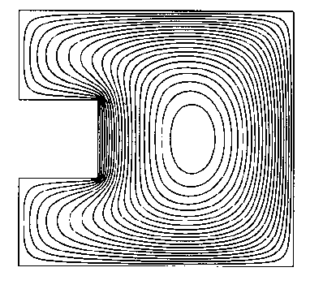
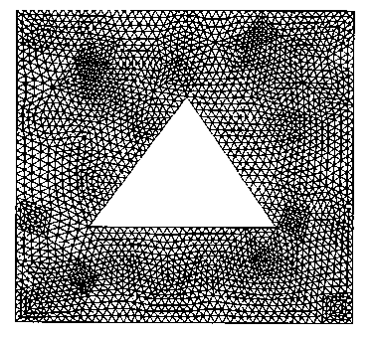
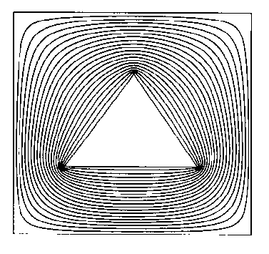
Numerical FEA Torsion Solutions
•
A
(4224 Elements, 2193 Nodes)
(Stress Function Contours)
(4928 Elements, 2561 Nodes)
(Stress Function Contours)
(4624 Elements, 2430 Nodes)
(Stress Function Contours)
Elasticity Theory, Applications and Numerics M.H. Sadd , University of Rhode Island

Slide 30
Flexure of Cylinders
y
Consider flexure of cantilever beam of arbitrary section with fixed end at z = 0 and transverse end loadings P_{x} and P_{y} at
z = ℓ. Problem is solved in Saint-Venant sense, so only resultant end loadings P_{x} and P_{y} will be used to formulate boundary conditions at z = ℓ.
S
x
P_{y}
.
ℓ
R
(x_{o},y_{o})
P_{x}
From general formulation , and motivated from strength of materials choose , where B and C are constants. Stresses τ_{xz} and τ_{yz} will be determined to satisfy equilibrium and compatibility relations and all boundary conditions.
z
Remaining equilibrium equation will be identically
satisfied if we introduce stress function F(x,y) such that
Elasticity Theory, Applications and Numerics M.H. Sadd , University of Rhode Island

Slide 31
Flexure Formulation
Remaining Beltrami-Michell Compatibility Relations
Zero Loading Boundary Condition on Lateral Surface S
Separate Stress Function F into Torsional Part φ and Flexural Part ψ
Elasticity Theory, Applications and Numerics M.H. Sadd , University of Rhode Island

Slide 32
Flexure Formulation
General solution to
where ∇²f = 0
Boundary Conditions on end z = ℓ
where Ι_{x}, Ι_{y} and Ι _{xy} are the area moments of inertia of section R
where J is the torsional rigidity – final relation determines angle of twist α
Elasticity Theory, Applications and Numerics M.H. Sadd , University of Rhode Island

Slide 33
Flexure Example - Circular Section with No Twist
a
z
P
x
ℓ
y
Polar Coordinate Formulation
Solution:
Stress Solution:
Strength of Materials:
Elasticity Theory, Applications and Numerics M.H. Sadd , University of Rhode Island

