Slide 1
Visualize project
IS219-NJIT Spring-2015
By: David Guardia
Prof: Keith Williams

Slide 2
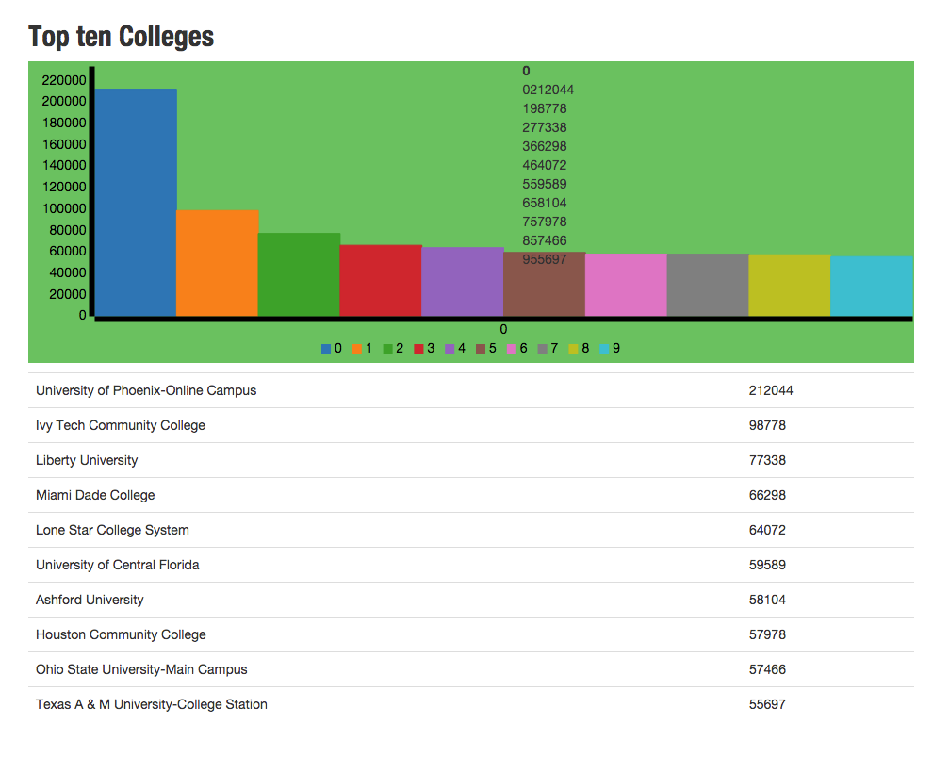
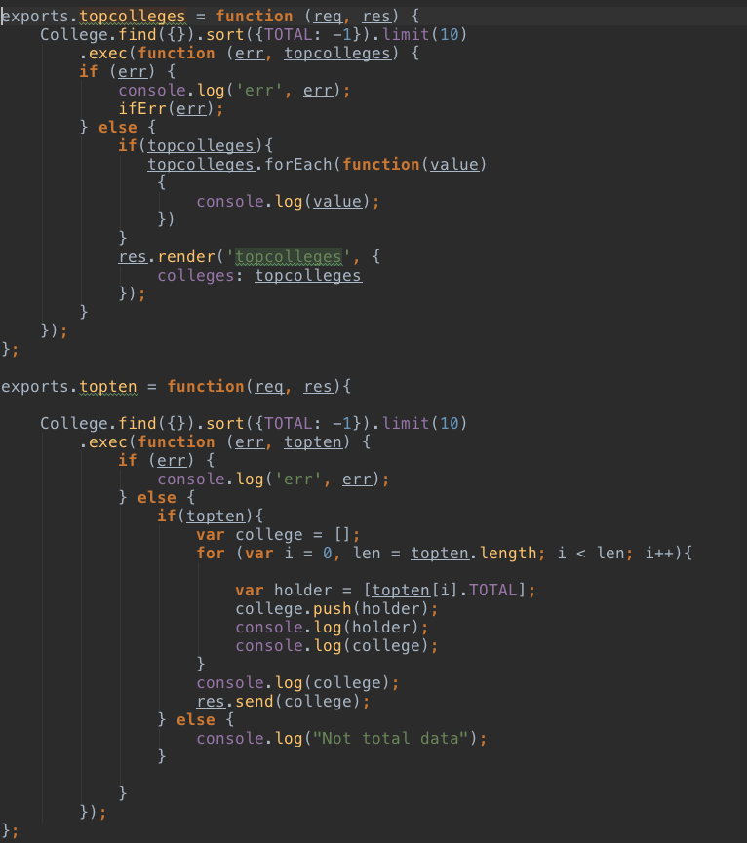
A bar graph showing the top 10 colleges by enrollment
Result
Code

Slide 3
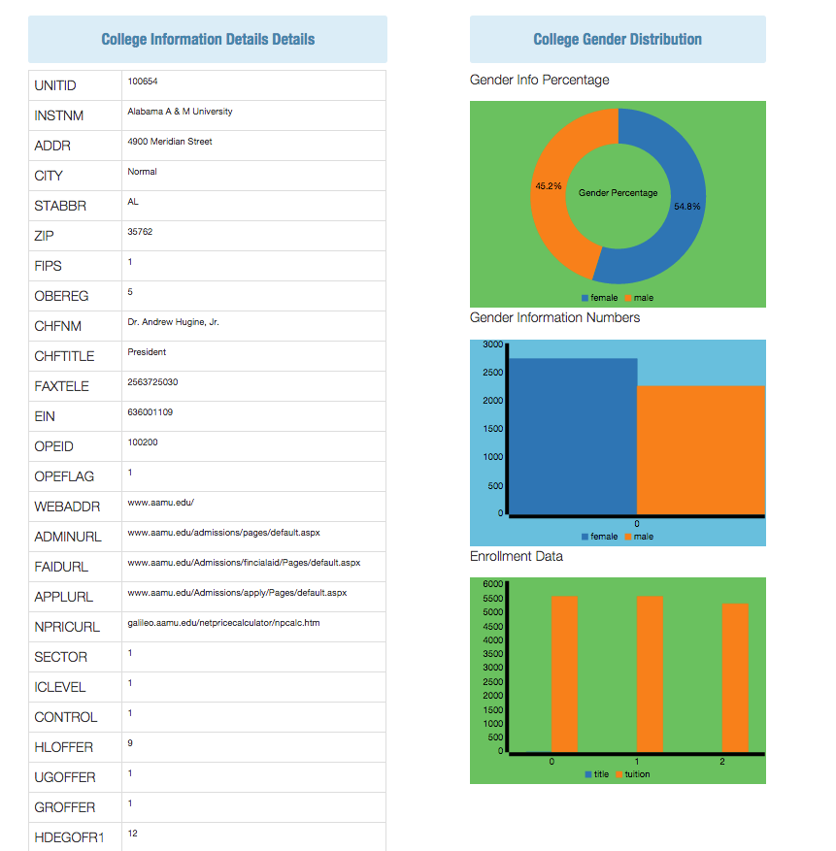
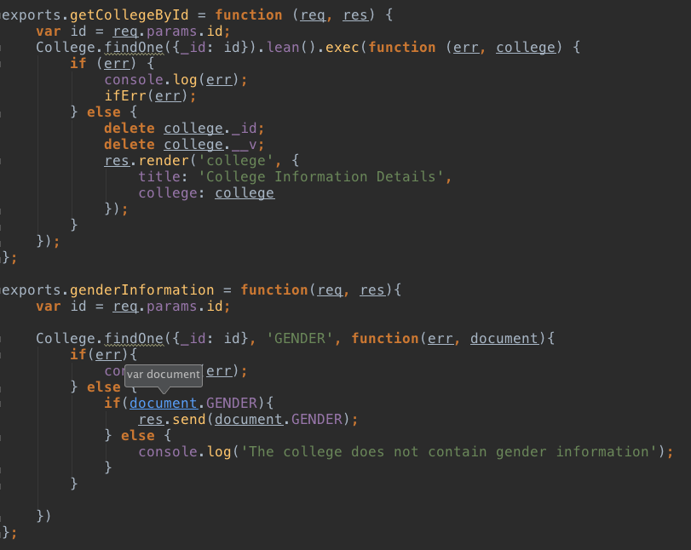
Gender distribution of a college
Result
Code

Slide 4
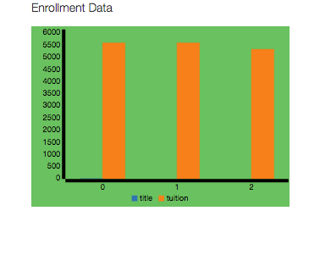
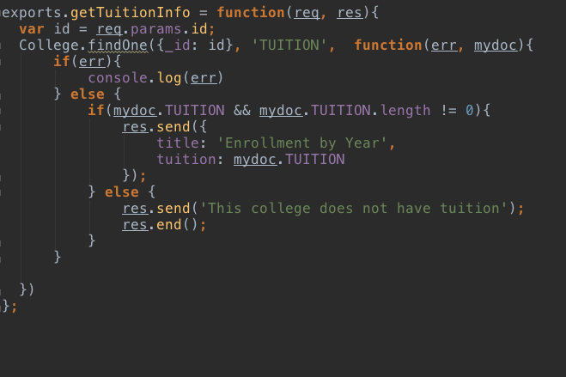
Gender distribution of a college
Result
Code

Slide 5
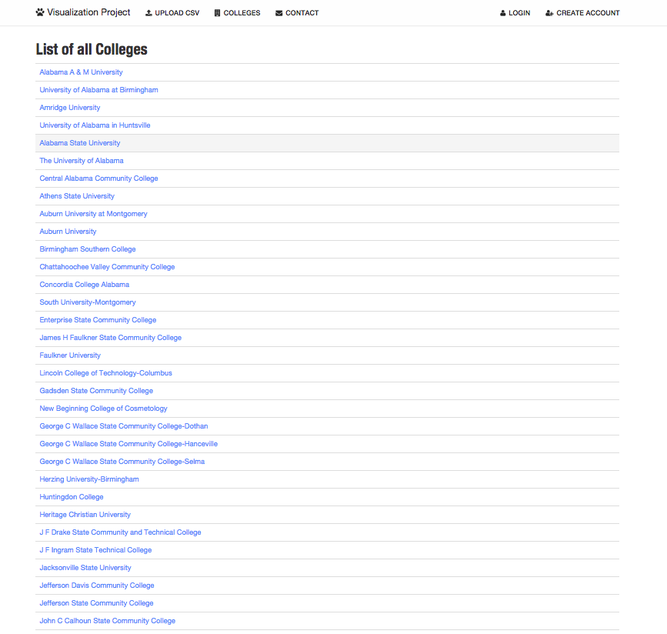
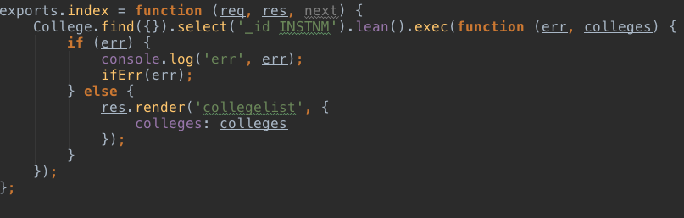
List of Colleges
Result
Code

Slide 6
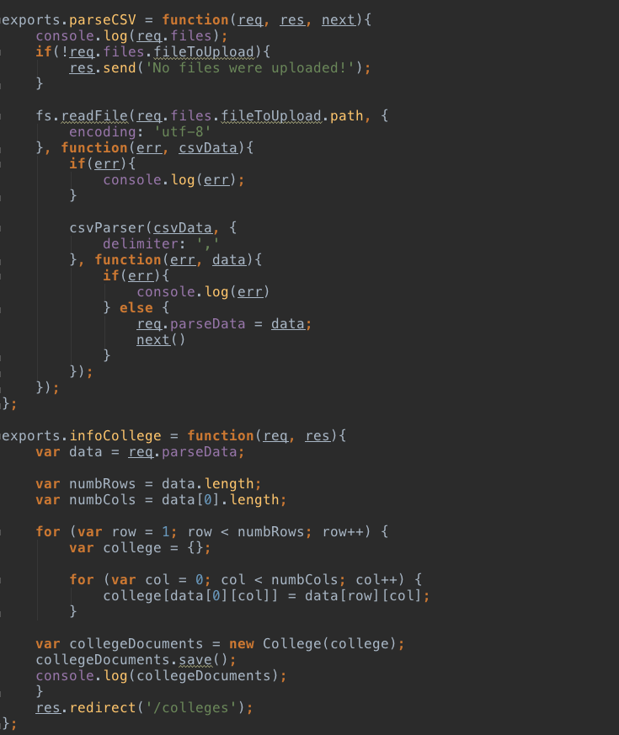
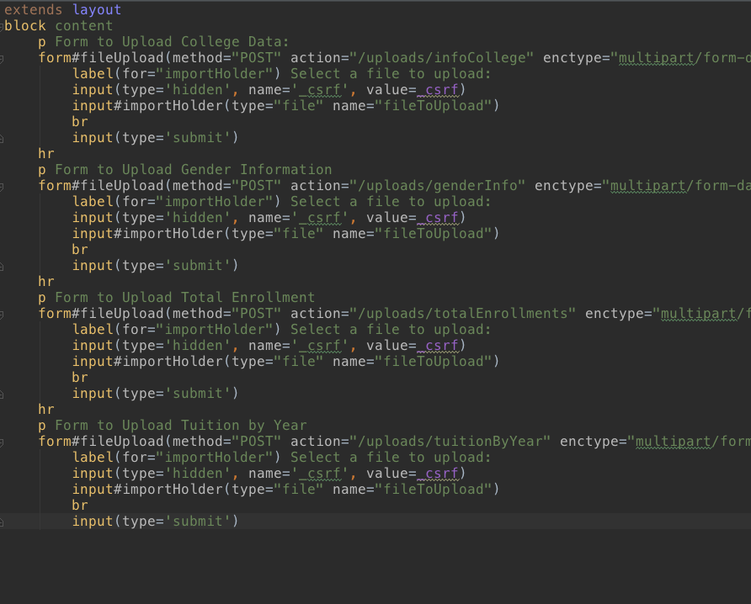
List of Colleges
Upload.jade
Code

Slide 7
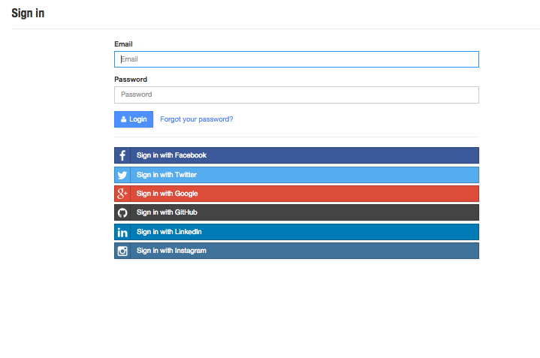
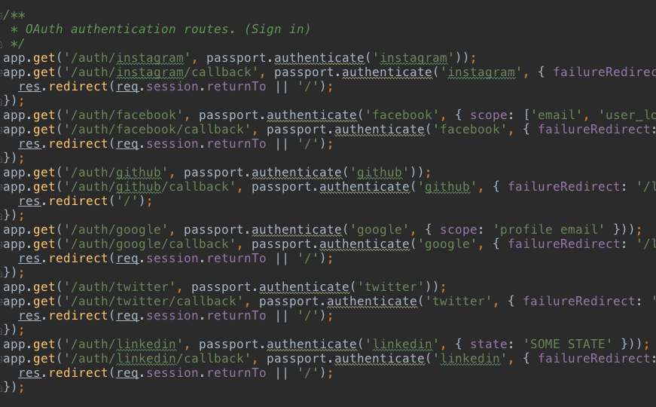
Login
Result
Code

Slide 8
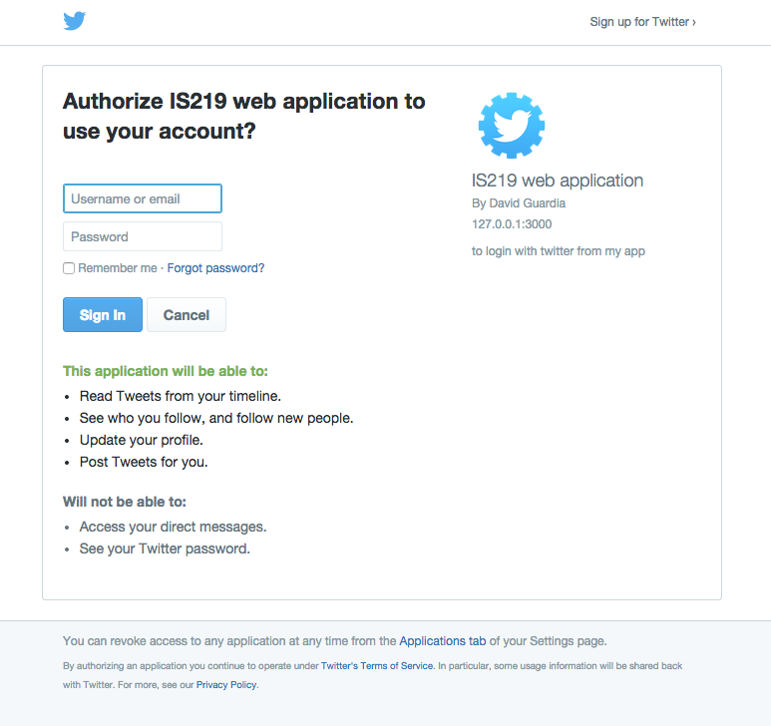
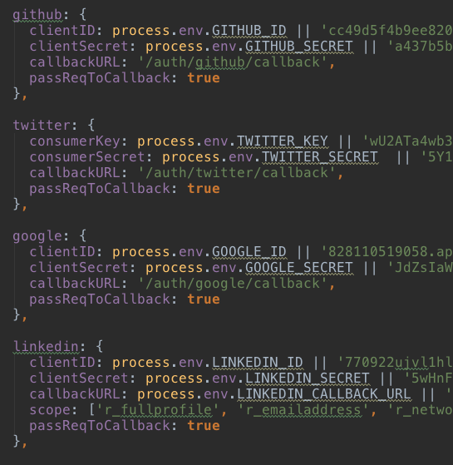
Login with Twitter
Result
Code

Slide 9
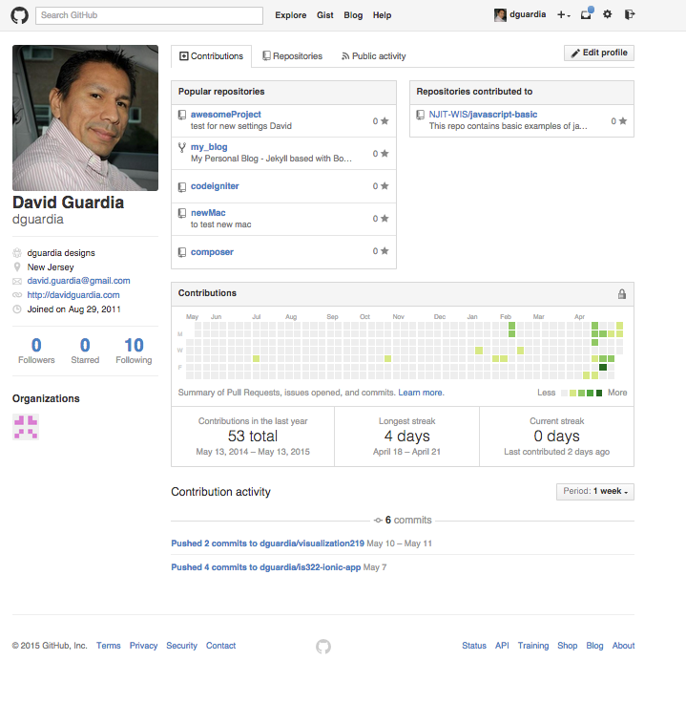
Github
Homepage

Slide 10
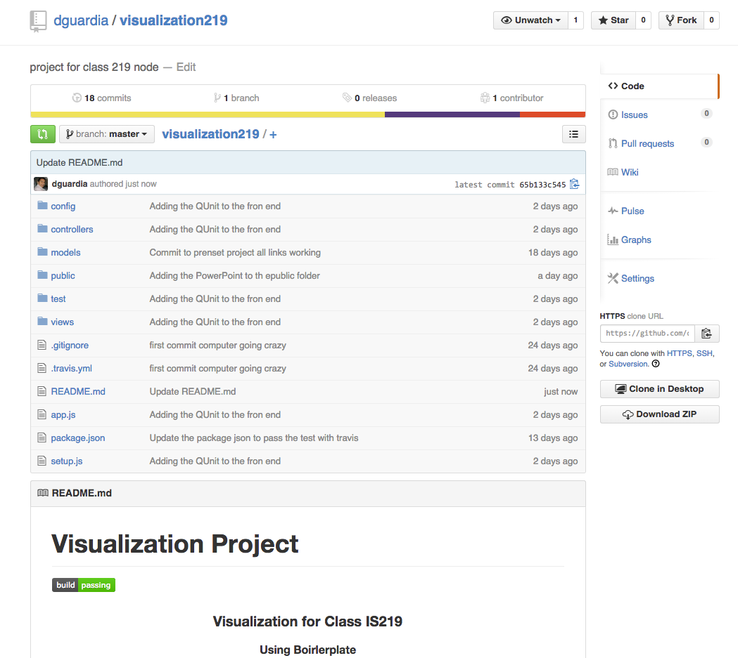
Github
Project Homepage

Slide 11
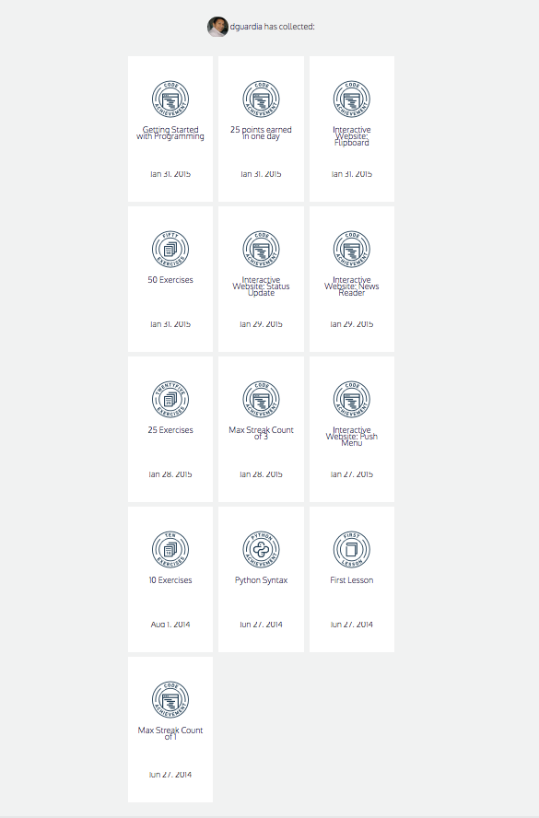
Code Academy
Badges

Slide 12
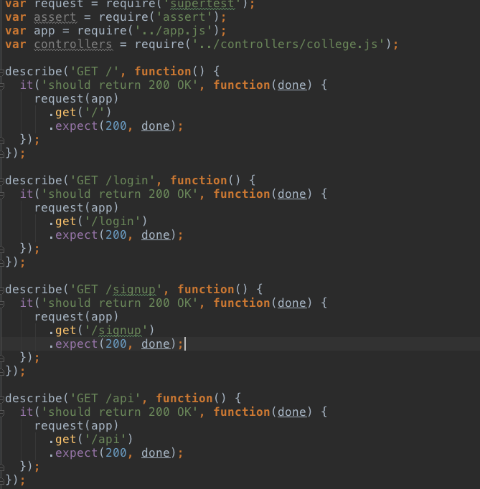
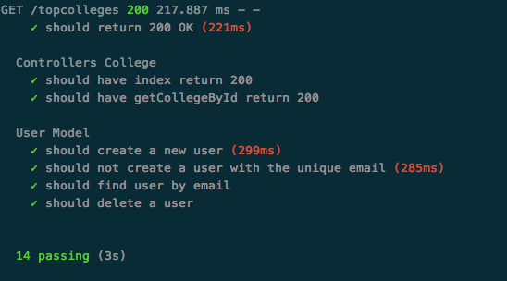
Unit test code and results
Mocha Test
Results

Slide 13
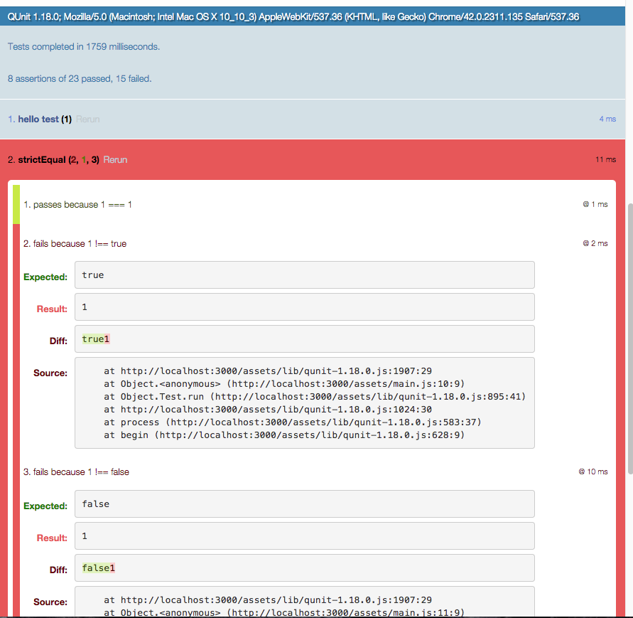
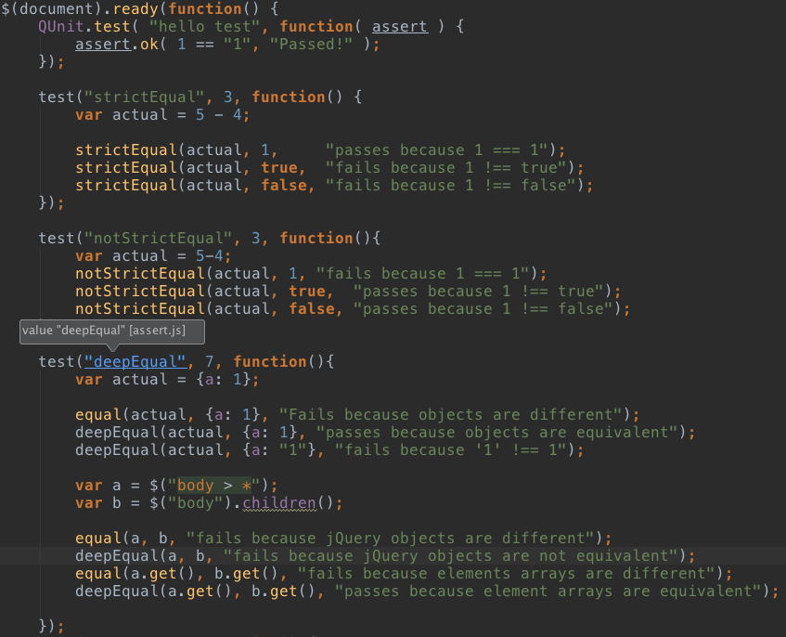
QUnit test code and results
Mocha Test
Results

Slide 14
Top 3 things I learned in the course
Learn NodeJS
The use of MVC for NodeJS
How to use the template engine Jade
Learn How to develop an application using Express
Deploying a server
Learn how to use and test Mocha & QUnit

