Slide 1

DIGITAL MARKETING PLAN

Slide 2
The Brief
Development of a marketing plan that seeks to create awareness for Curators University and establish its relevance among key targets

Slide 3
Why Digital?
For the scale of what needs to be achieved, it is important that we become nimble and highly targeted in our approach
A chunk of the key targets that we hope to attract are social entrepreneurs, innovators, etc. have adopted digital as a key platform for interaction, and thus the choice of a digital focused marketing plan.

Slide 4
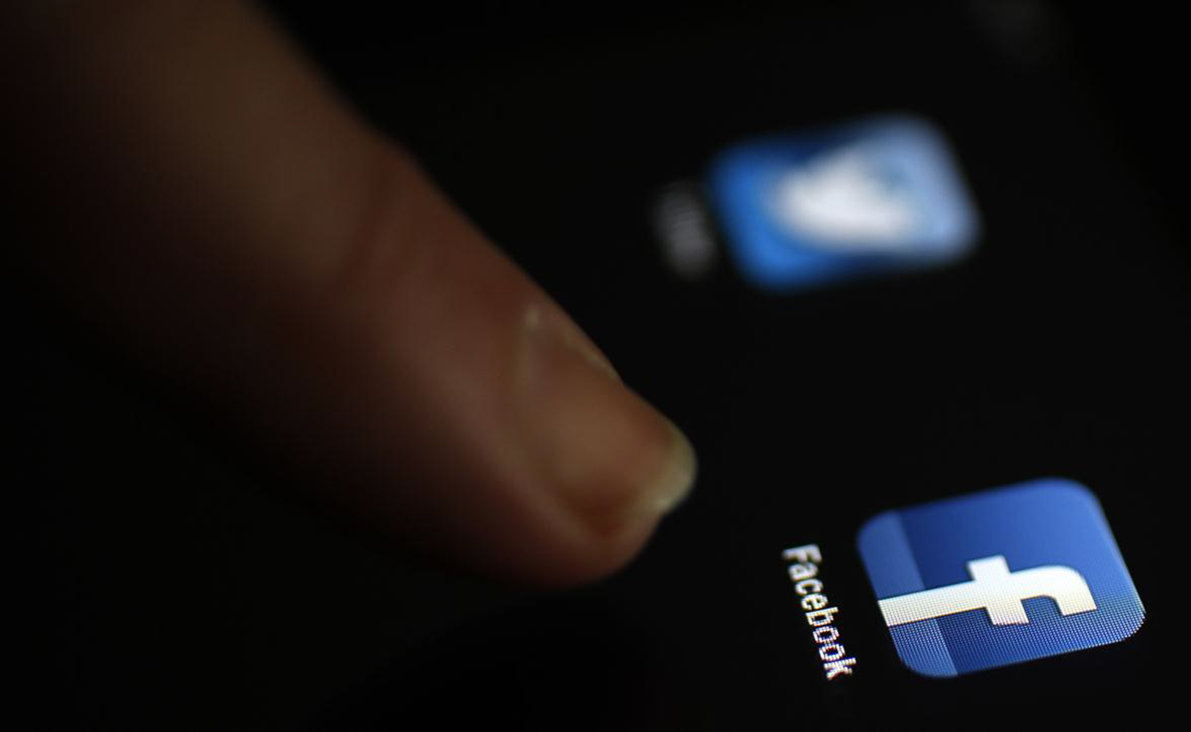
Perception of your needs
Great companies that build an enduring brand have an emotional relationship with customers that has no barrier. And that emotional relationship is on the most important characteristic, which is trust.
- Howard Schultz, Chairman & CEO of Starbucks

Slide 5
Social Media & IM Platforms Resonate well with our target audience
Avg. number of platforms used daily
Top social networking and
instant messaging platforms
Favourite platform (by age)
%
16-24 years
%
2.2
25-34 years
2.1
35-44 years
1.8
45-54 years*
Base size too small for analysis
55-65 years*
Base size too small for analysis
Favourite
Weekly users
Social networking platform
Instant messaging platform
Source: TNS Connected Life 2014 Report (Nigeria)

Slide 6
Our Approach
01
Awareness
Sponsored ads on the social media platforms to help reach a wider target audience
02
Engagement
Build strong connection via community management on top social media platforms (facebook, Twitter,) & instant messaging apps hinged on their touch-points

Slide 7


ENGAGEMENT Platforms: Objective
* Objective of each platforms
Facebook
Create top of mind awareness and generate talk ability with engaging and sharable content
the key social voice of the brand online (the heart of all social media activity)
Showcasing bite sized content related to brand events or inspired by brand values
Inviting user conversation around product, brand and brand inspired
A minimum of 2 updates/day(Monday- Friday)
Grow and sustain online community
Drive interaction in a way that ensures knowledge of the brand
Twitter
Ensure all updates are in line with brand ACTIVITIES OFFLINE
Serve as a supporting Platforms for Facebook
Could act as a service and information dissemination portal
A minimum of 5 updates/daily (Monday to Friday)
Join relevant conversations and interest points of our TG on this platform
Content Type
The Curators University brand will be brought to life on social media with the tone and speak used in deploying conversations on these platforms.
With the use of emoticons and exclamation mark were necessary, the brand will be more personalized than functional.
Automated responses will be at a minimal and response time will be quick!
Visuals (all posts will have supporting images)
Short Videos/animations

Slide 8
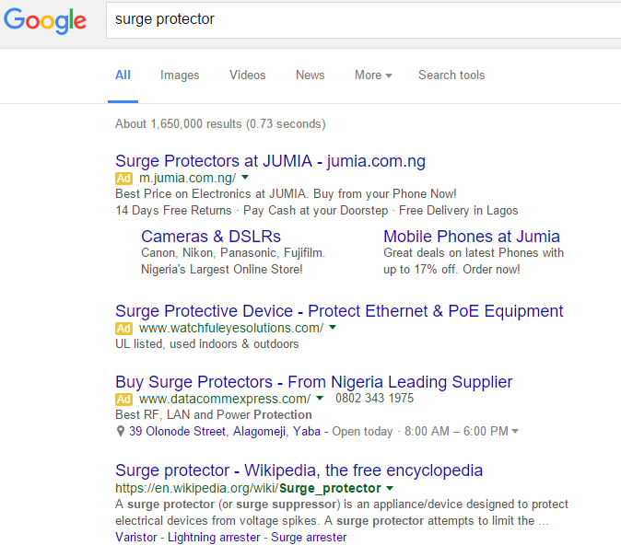

Digital Marketing Highlights
SEO/SEM
With relevant use of keywords across search engines, Curators University will be represented.
We will also explore the use of SEM where the brand website will be promoted through paid advertising to increase visibility.
Combination of SEM and SEO will help achieve a higher ranking in search engine results
ONLINE ADS
Strategic advert placements in a way that gives great value to the brand
Ensure each advert has a message or aids knowledge of brand in a direct or indirect manner
Derive cutting edge adverts materials to attract customers to the page.
Suggested online advertising avenues; Facebook, Twitter, LinkedIn, Google Ads that are both Mobile and PC enabled to ensure maximum=m reach

Slide 9


AWARENESS Social Media Ads
Increasing brand visibility is the basic goal of all advertising. That has always been the case, whether that advertising was done through television commercials, print ads or radio ads.
We will be deploying both facebook and twitter ads that would aid awareness and increase fan/follower-base quickly.
For facebook we will be doing both Page and Post boost while for twitter we will explore the Promoted Ads services.

Slide 10
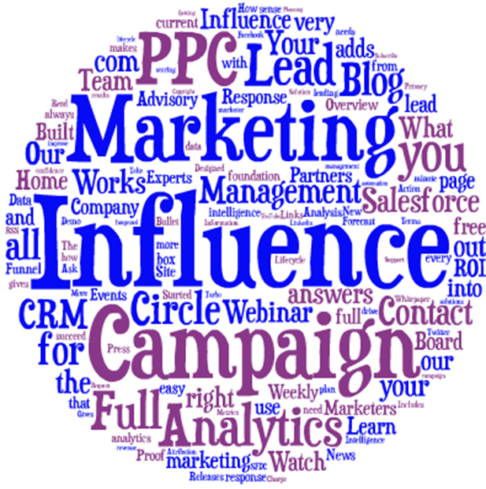

Influencer Marketing Highlights
INFLUENCE MARKETING
This is basically using individuals whose personalities/office/social status influence decisions of the target audience. This influencers usually have a high number of followers and conversation starters.
All tweets will be aimed informing users about the brand, its product and its functionality. Users will either be directed to the social media platforms or the website.
Example of influencers are
@omojuwa
@henryOkelue and more
Want your brand activity to trend? They make it happen
BLOG REVIEWS
Strategic partnership with tech blogs to give reviews and service suggestion
Key partnerships with sites such as Jobberman, PushCV would be ey as they have all recently incorporated learning platforms onto their sites

Slide 11
Next Steps
Approval of
Manage social media accounts
Tone/speak of brand online
Conversation plan
Page boost to increase awareness participation and fan base .
Create and sustain engagement on platforms with approved conversation and supporting images.
Ad Deployment on selected platforms
Ad placement on agreed platform (mobile and PC)
Create awareness with use of influencers and ad placement

Slide 12
THANK YOU

