Slide 1


APK 6725 AI for Sports and Movement Sciences
Time: Online Class
Location: Online Class

Slide 2
APK 6725 – Instructor
Diego L. Guarín, Ph.D.
Email: d.guarinlopez@ufl.edu
Office: FLG 139
Office Hours: Monday 2:00 – 5:00 PM
If this time doesn’t work for you, please send me an email to find a suitable time.

Slide 3
APK 6725 – Instructor
Diego L. Guarín, Ph.D.
2014-2017 | Ph.D. in Biomedical Engineering | McGill University
2017-2019 | Postdoc – Electrophysiology | Harvard Medical School
2019-2020 | Postdoc – AI + neurological disorders | University of Toronto
2020-2022 | Assistant Professor, BME | Florida Institute of Technology
2022- | Assistant Professor, APK | University of Florida

Slide 4
APK 6725 – Instructor
Diego L. Guarín, Ph.D.
- Published 60+ research articles in journals as NPJ Parkinson’s Disease, Parkinsonism & Related Disorders, IEEE Transactions on Neural Systems and Rehabilitation Eng, IEEE Journal of Biomedical Health Informatics.
Received over 1100+ citations so far
Main areas of research include Motor Control, Neuromuscular Disorders, Movement Quantification via Digital Technologies, Home-Based monitoring, and Application of Machine Learning to Health.

Slide 5
APK 6725 – Why?
Technology has been pivotal for analysis of movement.
The Horse in Motion, 1878

Slide 6
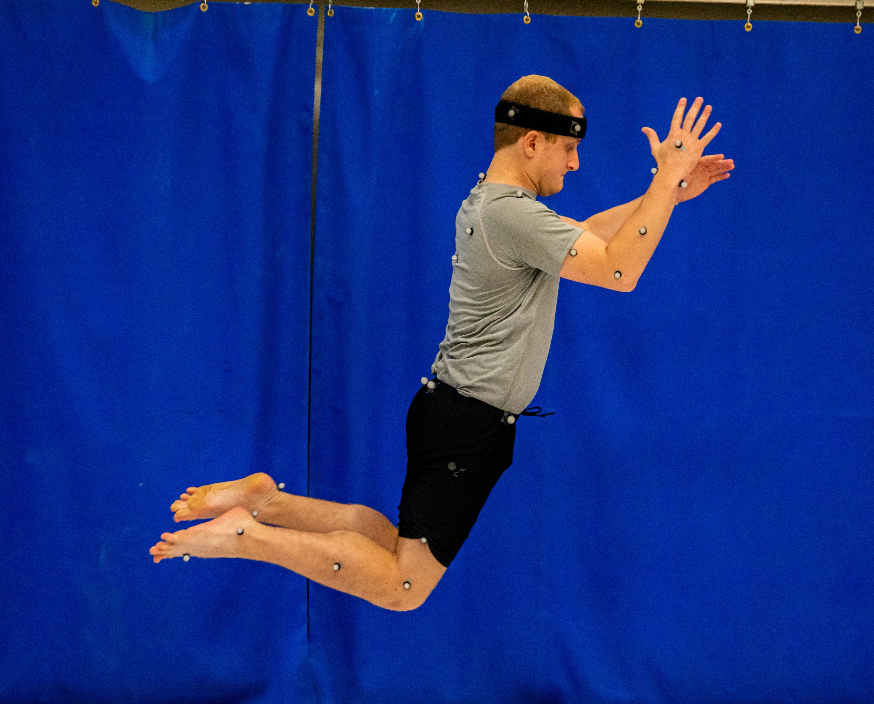
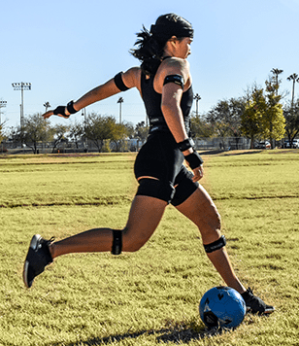
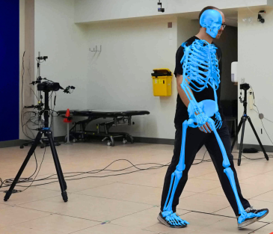
APK 6725 – Why?
Modern technologies allow us to capture movement with high accuracy and flexibility.
Motion Capture
Wearable Sensors
Markerless Motion Capture

Slide 7
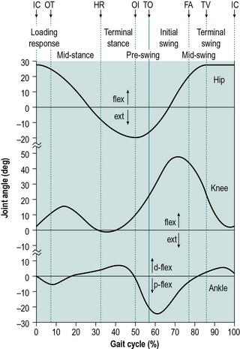
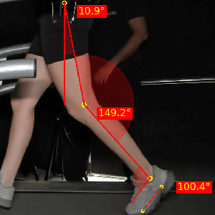
APK 6725 – Why?
Movement data analysis has many applications, including:
Performance assessment and enhancement
Injury risk assessment and prevention
Disease diagnosis
Rehabilitation optimization and evaluation
Rehabilitation feedback

Slide 8
APK 6725 – Learning Objectives
In this class, you will
Learn basic tools for movement analysis
Python programming
Data handling (NumPy and Pandas)
Data Visualization (Matplotlib/Seaborn)
Machine learning and Deep learning
Learn to capture and analyze movement data
Learn to analyze and interpret movement data in healthy and disease populations

Slide 9
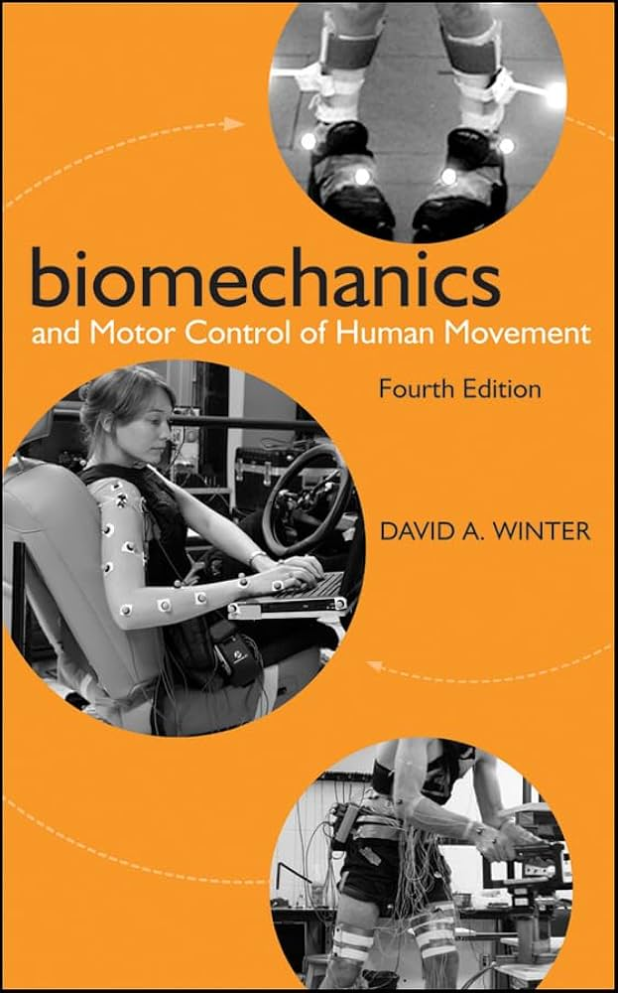
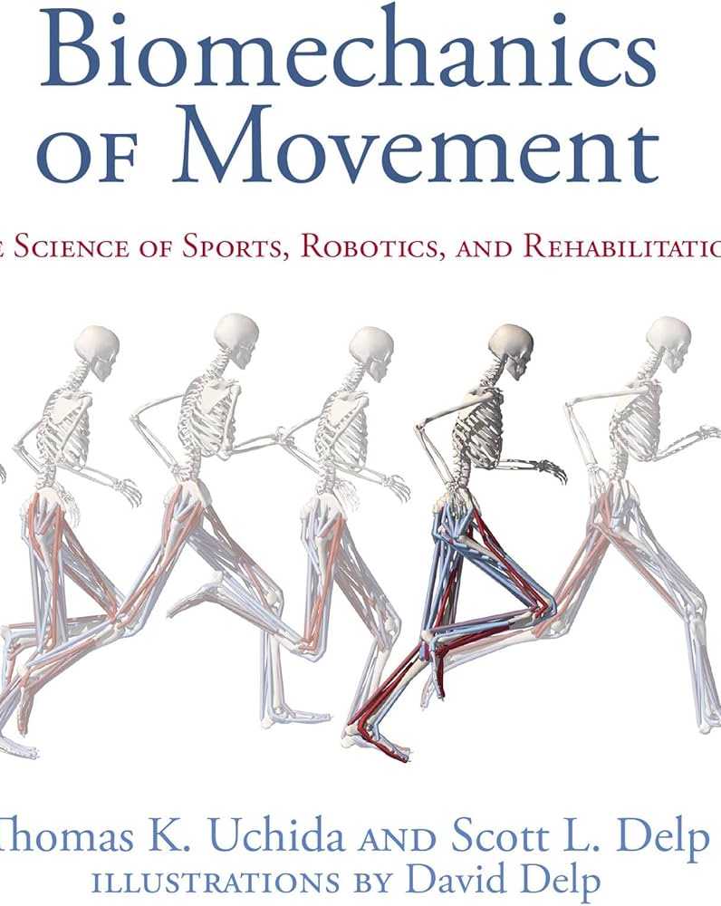



APK 6725 – Books
This class doesn’t have required books. All the material discussed in class can be found online for free.
Some books I used when creating this class include:

Slide 10
APK 6725 - Grading
Evaluation Components (number of each) | Points Per Component | % of Total Grade
Assignments (x 10) | 5 pts each = 50 pts | 50/100 = 50%
Group Presentation (x1) | 20 pts each = 20 pts | 20/100 = 20%
Final Project Report (x1) | 30 pts each = 30 pts | 30/100 = 30%

Slide 11
APK 6725 - Grading
Assignments
There will be 10 assignments distributed throughout the term.
Working with your peers is highly encouraged. That said, each class member must submit an individual assignment via canvas.
If you worked with someone, please let me know in the assignment.

Slide 12
APK 6725 - Grading
Project
Students must work in a group (of two to four people) to design and develop a project reflecting the knowledge/methodologies learned in class.
In this project, students must select a dataset (or record your own data) and apply appropriate data analysis techniques to make sense of the data an extract useful information.

Slide 13
APK 6725 - Grading
Project
A dataset will be provided for the project with specific objectives (more to come).
You can either complete the suggested project or select your own project. That said, review the suggested project to understand the expectations and required effort.

Slide 14
APK 6725 - Grading
Project
Potential ideas for projects include:
Replicate results from a published paper (highly encouraged).
Classify healthy vs. patients from wearable data acquired during gait.
Predict risk of falls in elderly subjects based on wearable data.
Activity classification based on wearable data.
Compare joint angles of young vs. older adults during gait from videos.

Slide 15
APK 6725 - Grading
Project
Students must prepare a written report, including the methods and results obtained in the project. The report should include a brief description of the problem being analyzed, the data, and present a summary of the results, and final discussion.
Format:
Font : Arial 11 pts
Max length : 10 pages
Reference style: APA

Slide 16
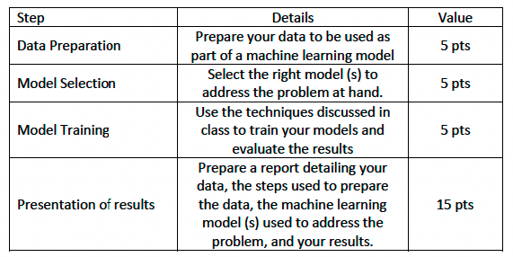
APK 6725 - Grading
Project
I will use the following rubric to evaluate your project.

Slide 17
APK 6725 - Grading
Presentation
Students must prepare a 10 minutes presentation describing the project and results. The presentation must include:
Background
Methods
Results
Discussion

Slide 18
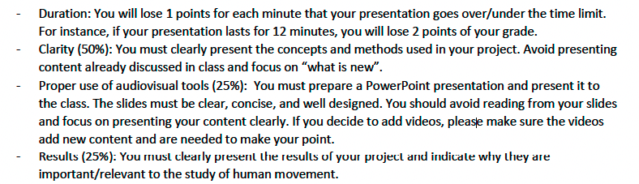
APK 6725 - Grading
Presentation
I will use the following rubric to evaluate your presentation:

Slide 19
APK 6725 - Grading
Notes
The project + presentation represent 50% of your grade. You should spend 3 to 5 hours per week working on the project.
Start working on your project now. Don’t leave it for the last few weeks of class.
Groups must be created the first week of class and students should start working together immediately to identify any potential issues/incompatibilities.
Larger groups are expected to work in more complex projects.

Slide 20
APK 4720 / APK 6725
Use of generative AI.
Use of AI and large language models is encouraged in this class, most people are using these tools, and not learning to use them will put you at a disadvantage.
Good uses of AI include:
Explain code functionality in plain English.
Identify and correct bugs in your code.
Generate documentation

Slide 21
APK 6725
Use of generative AI.
Bad uses of AI include:
Ask it to do your assignment.
Give it some data and ask the algorithm to analyze it.
Use it to write your report or make your presentation.
AI can solve your assignments, but YOU won’t learn anything.

