Slide 1


APK 6725 AI for Sports and Movement Sciences
Getting Started with Google Colab

Slide 2
Where you will work this term
Google Colab
This course runs in Google Colab, a free service that runs Python notebooks in your web browser.
There is nothing to install. It works on any computer, including Chromebooks and tablets.
Colab is our main environment. For the deep-learning and computer-vision weeks, UF HiPerGator is a second option.
2

Slide 3
What you need
Accessing Google Colab
All you need to access Google Colab is a Google Account.
As a UF student you already have one: your UF account includes Google Drive.
You can sign in with your UF Google account or a personal Google account. Either one works.
Open Colab at: https://colab.research.google.com
3

Slide 4
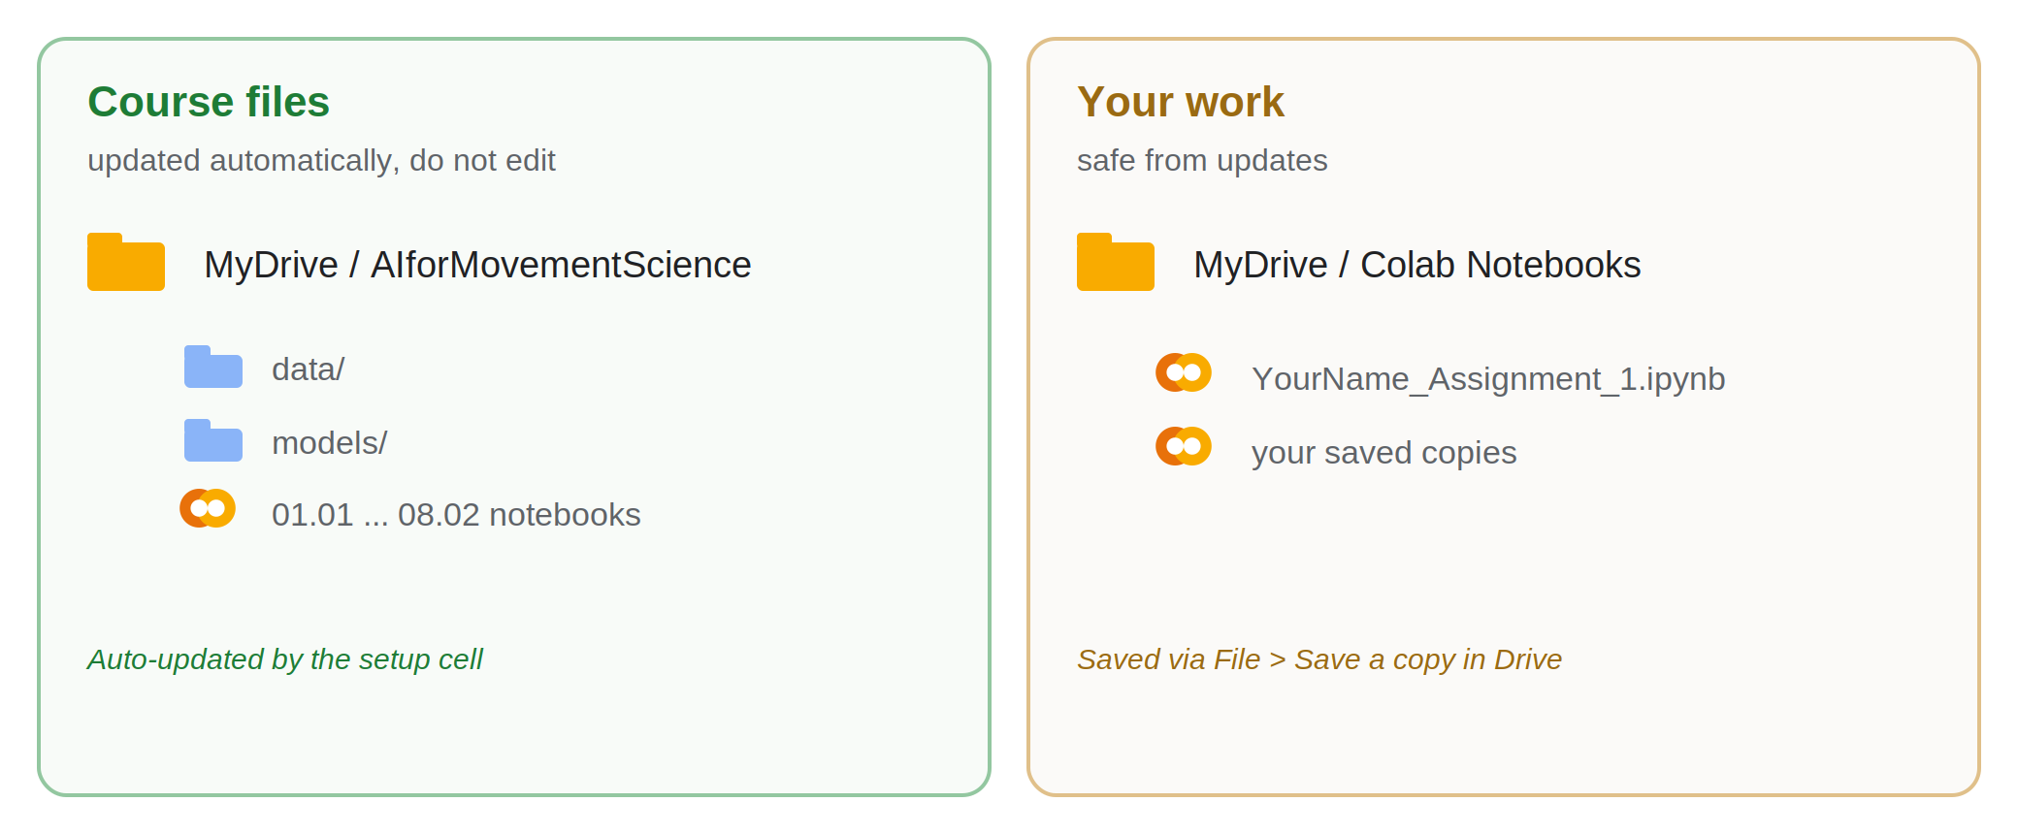
How this course is set up in Colab
The course files live in one folder in your Google Drive. You download it once, and a setup cell keeps it up to date.
You always work on your own copy of a notebook, so your answers are never overwritten by an update.
4

Slide 5
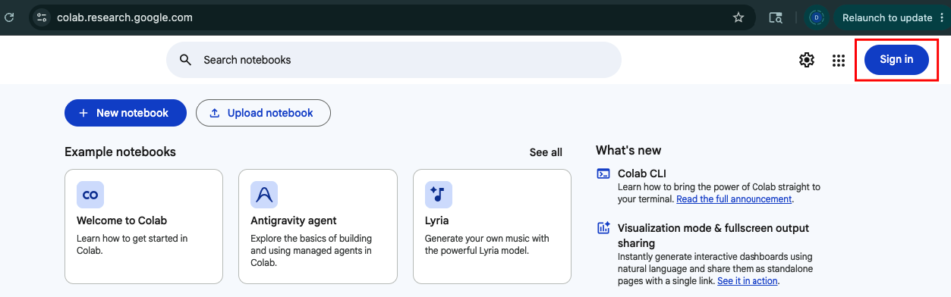
Step 1: Open Colab and sign in
Go to https://colab.research.google.com
Click Sign in (top-right) and choose your Google account.
5

Slide 6
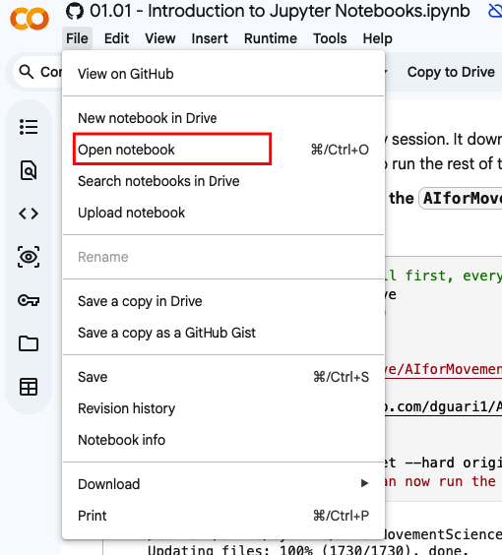
Step 2: Open a new Notebook
After signing, click on
Once you access Colab, click : File -> Open notebook -> GitHub
This action will open a search bar.
6

Slide 7
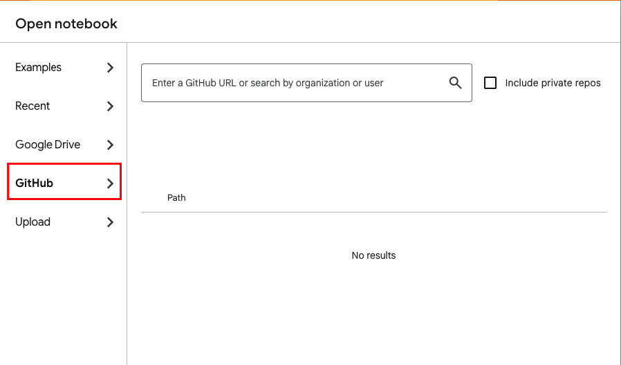
Step 3: Open a new Notebook from the Repository
In the search bar, type “dguari1/AIforMovementScience” and press Enter.
6

Slide 8
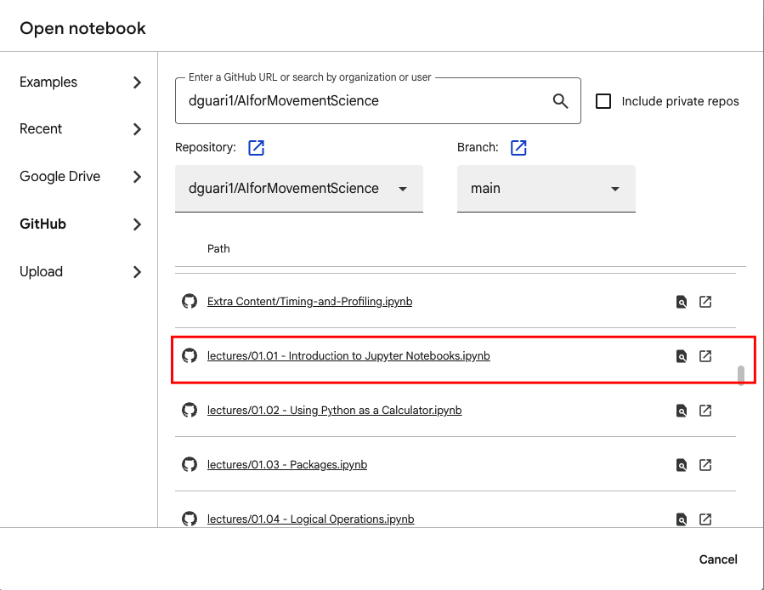
Step 4: Open the course notebook from GitHub
Localize and click on the first Notebook of the series, called
01.01 – Introduction to Jupyter Notebooks.ipynb
6

Slide 9

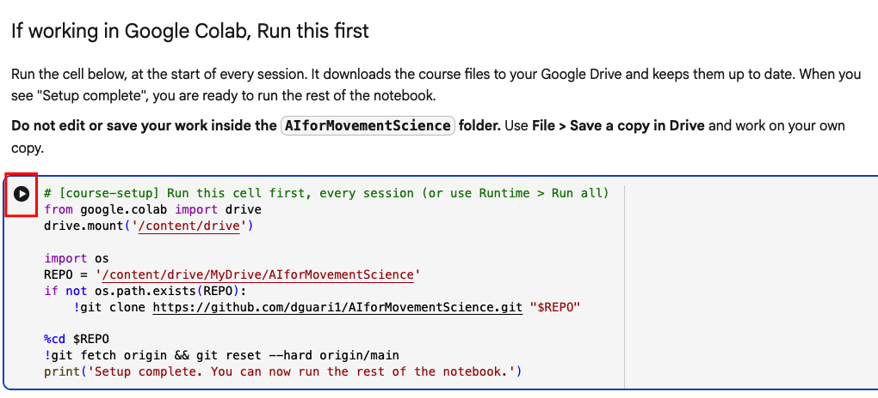
Step 5: Run the setup cell (first cell of every notebook)
The first cell of each Notebooks downloads the course material to your Google Drive and updates them to the latest version.
Run it at the start of every session by clicking on the button. The first time it downloads everything; after that it checks for updates.
7

Slide 10
Step 5: Run the setup cell (first cell of every notebook)
The first cell of each Notebooks downloads the course material to your Google Drive and updates them to the latest version.
Run it at the start of every session by clicking on the button. The first time it downloads everything; after that it checks for updates.
If this is your first time doing it, this process will take a few minutes. Also, stay near your computer as Google Colab will ask for permission to write/read your Google Drive.
7

Slide 11
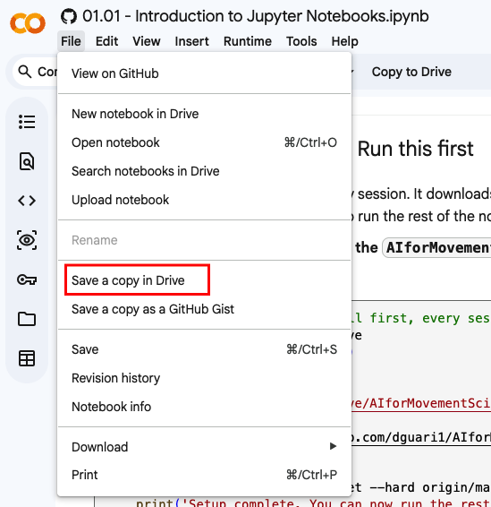
Step 6: Save your own copy and work on it
Click
File -> Save a copy in Drive.
A copy of the notebook is saved to
Google Drive -> "Colab Notebooks".
Do all of your work in that copy.
Important: never edit or save your work inside the AIforMovementScience folder. The setup cell (step 5) replaces that folder with the latest version each session, so anything saved there would be lost.
Always work on your saved copy.
8

Slide 12
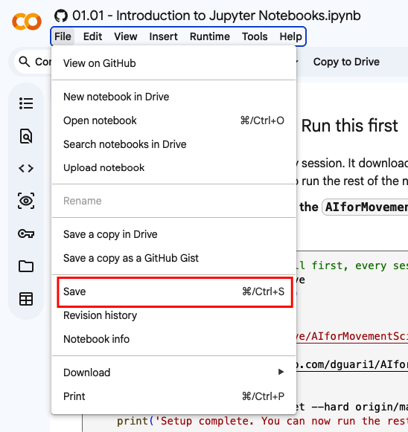
How Colab sessions work
Colab gives you a temporary computer for each session. After a few minutes of inactivity, the session is timed-out and removed from the computer.
Once the session is timed-out, you need to re-start the session and re-run all the Notebooks cells.
Colab will save your work automatically, you can also save it yourself
File -> Save
9

Slide 13
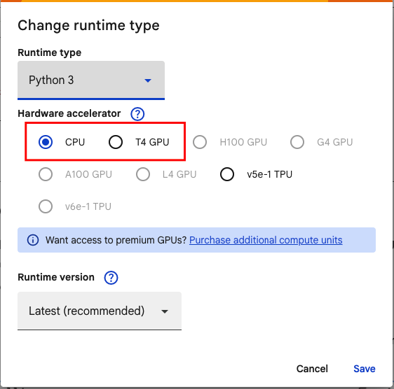
Turn on a GPU
The neural-network, deep-learning, and computer-vision weeks run much faster with a GPU.
Colab allows you to access a GPU for free
Runtime -> Change runtime type -> T4GPU -> Save.
Free GPU time is limited. If none is available, you can always use HiPerGator.
10

Slide 14
Install extra packages (when a notebook asks)
Colab already includes NumPy, pandas, Matplotlib, scikit-learn, and PyTorch.
Some later notebooks need extra libraries. Install it at the top of the session, for example:
!pip install ultralytics
You need to re-run these installs each session, just like the setup cell, as they are not stored.
11

Slide 15
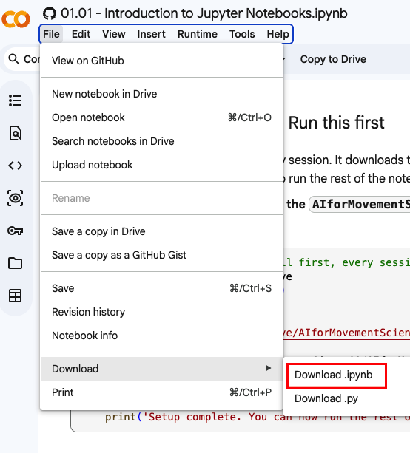
Submitting your assignments
Work in your copy of the notebook.
Download the notebook so it can be shared
File -> Download -> Download .ipynb.
Change the file name to: YourName_Assignment_#.ipynb
and submitted it via Canvas
12

Slide 16
Returning to work
After the initial set-up, the full repository now lives in your Google Drive. To access the other lectures, you can find them in
Drive -> MyDrive -> AIforMovementScience -> lectures
You can also access the assignments at
Drive -> MyDrive -> AIforMovementScience -> Assignments
1
2
Remember to save a copy of the file before making any changes.
13

Slide 17
Troubleshooting
"FileNotFoundError" or "No such file: data/..."? You skipped the set-up cell. Run it and try again.
"ModuleNotFoundError"? Re-run the pip install for that library.
No GPU available? Use CPU for now, try again later, or switch to HiPerGator.
14

Slide 18
Getting help
Post your questions on Canvas.
Bring questions to office hours (Monday 3 - 5 pm).
Course repository: github.com/dguari1/AIforMovementScience
15

