Slide 1

Factors influencing Suicides
Team 4
Dominik, Maeva, Julianna

Slide 3




Source of the data
Original data set from Kaggle
REST Alpha2 country codes
Additional data from the World Bank API
Smoking habbits
Alcohol consumption
Unemployment rate
Population

Slide 4

Data infrastructure
Load the original dataset into MySQL from a csv
Share a file this way may cause complications
Hosted our MySQL database on a AWS instance
Use this connection, reproductivity was ensured
Add the country codes through REST “name” functionality
The World Development Indicators (WDIs) were loaded directly into KNIME using the API extraction
Using an .xlsx file with the API codes hosted on OneDrive for reproductivity

Slide 5
Etl data pipeline
Filter country code maping column
Join the table with the country code
Variables in KNIME
World bank API implementation until the join after the loop ending including data wrangling problems and decisions

Slide 6

Data visualization - cleaning
Filtere out all missing values
Using a histogram we mainly have observations for 2010
Switch to a cross-sectional analysis from a time series
Filter out any observations not belonging to that year

Slide 7
Data Visualization – general facts

Slide 8
Data visualization – total population
Two variables that encompased the whole population
GPD per Capita
Population
Population graph straight forward
No clear correlation but some connection
Decided to do a log-log transformation for GDP per Capita
Absolutely no correlation between GDP per Capita and number of suicides

Slide 9


Data visualization – by Gender
Some of the variables had a division by gender
Smoking has no correlation to number of suicides
Average smokers larger tandancy to commit suicide
There is a small amount of correlation between unemployment and number of suicides but almost neglegable
For alcohol we decided to do a log-log analysis
Definite correlation between alcohol consumption and suicide rate

Slide 10

GRAPH : Suicide BY AGE RANGE

Slide 11

GRAPH : Suicide BY country

Slide 12
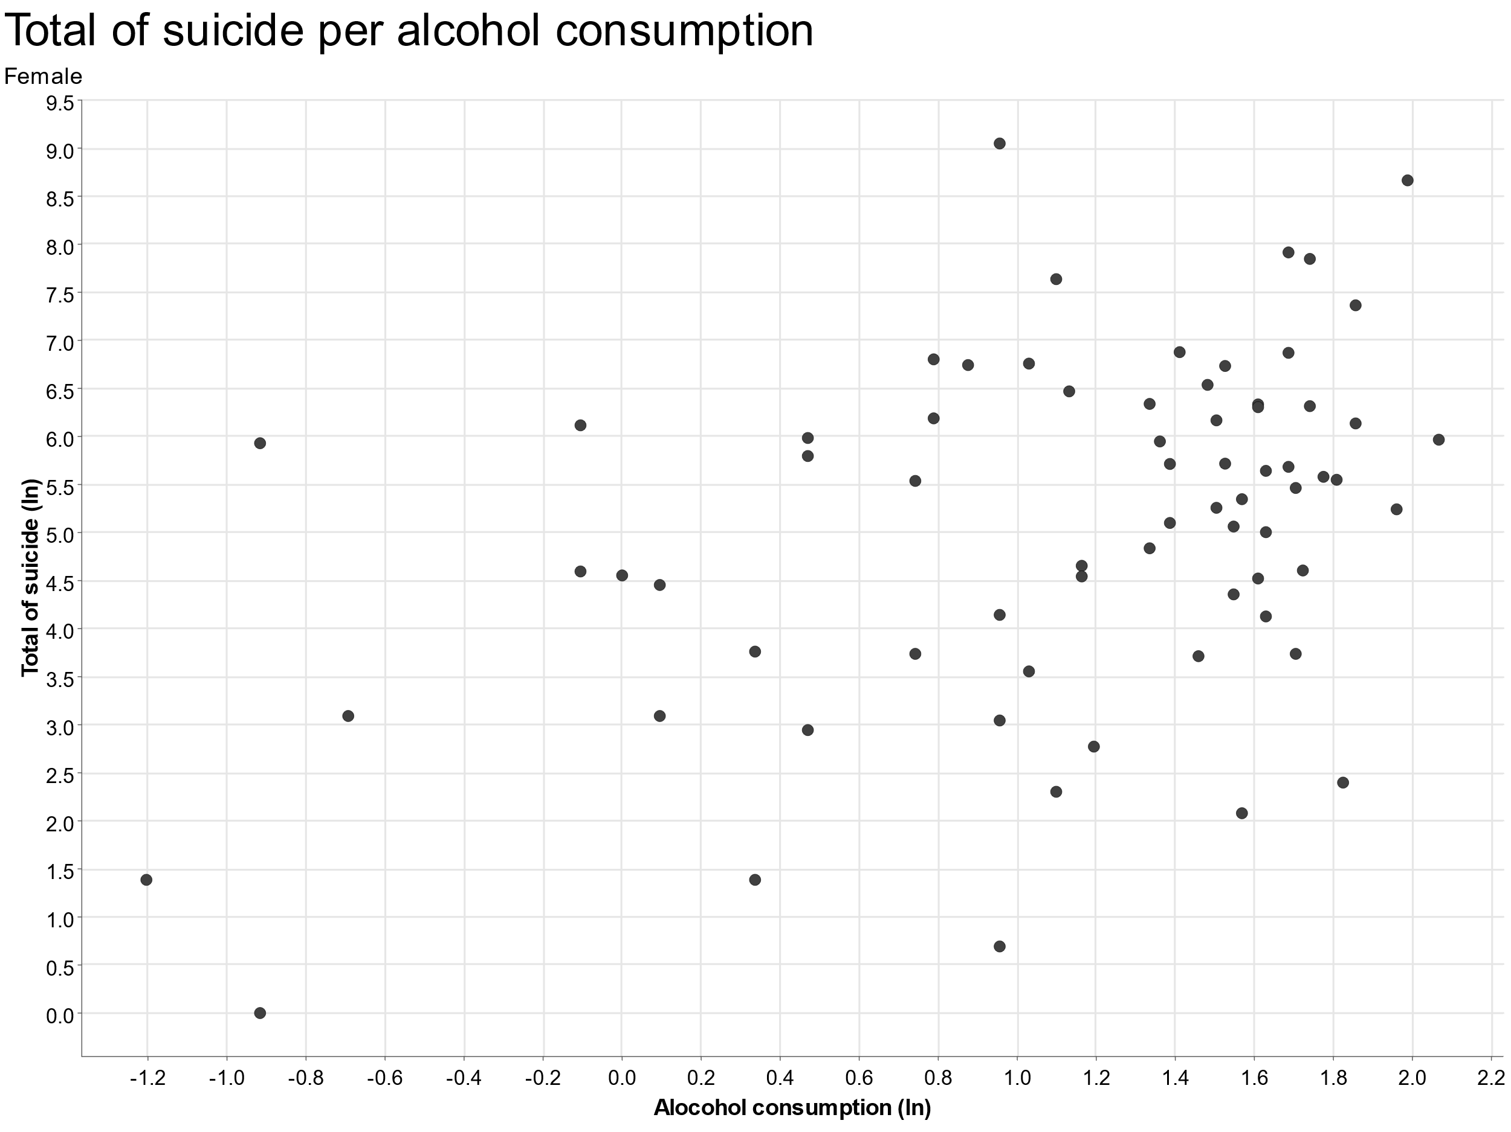
GRAPH : Suicide BY ALCOHOL CONSUMPTION

