Slide 1

Factors influencing Suicides
Team 4
Julianna : Visualization + cleaning + documentation + presentation Maeva : SQl + help with visualization + Documentation + presentation Dominik : Data infrastructure + API + ETL + documentation

Slide 2




Source of the data
Original data set from Kaggle
REST Alpha2 country codes
Additional data from the World Bank API
Smoking habbits
Alcohol consumption
Unemployment rate
Population

Slide 3
Questions
Which countries tend to have higher suicide rate?
What age group tend to have higher suicide rates?
How can it be related to socioeconomic indicators like, Unemployment Rate, GDPPC, alcohol consumption and cigarette consumption?

Slide 4

Data infrastructure
Load the original dataset into a local MySQL DB using the .csv from Kaggle
Realise storing the data this way may cause complications
Turn to hosting - new MySQL database instance on AWS (this ensured reproducibility)
Create dump and importing data & structure in MySQL Workbench
Create grader user with read only rights (only selects allowed)
Use the REST Countries to find the Alpha2 country codes of countries
Use World Bank’s API to enrich our data
Use an .xlsx file that contained the WDI codes (hosted on GitHub for reproducibility and dynamism)

Slide 5
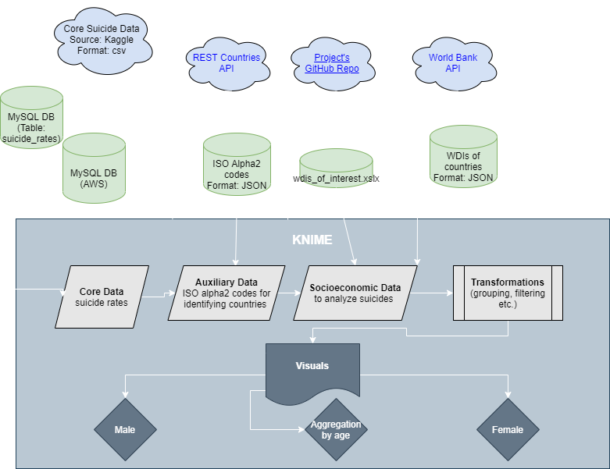
Etl data pipeline
Connect to MySQL DB hosted on AWS
Use the “name” functionality of the REST Countries API to get country codes
Mapp codes to countries with a join
The World Development Indicators (WDIs) were retrieved by using World Bank’s API.
Use loop construction, conditional branching and list to table transformation)
Extract last and earliest years in core data to variables to plug into the URL (to improve efficiency)
Notes:
Our data flow is efficient because it gets all data with only 1 API request / WDI

Slide 6


Data visualization - cleaning
Filter out all missing values
Using a histogram we mainly have observations for 2010
Switch to a cross-sectional analysis from a time series
Filter out any observations not belonging to that year
All the analysis and visualization concern only 2010

Slide 7

GRAPH : Suicide BY AGE RANGE
Person between 35 and 54 years age range are more likely to commit suicide
The Scale of the age range varies

Slide 8

GRAPH : Suicide BY country
TOP 10 of countries that commit the most suicides by 100k habitants in 2010
Suriname
Lithuania
Belarus
Kazakhstan
Hungary

Slide 9
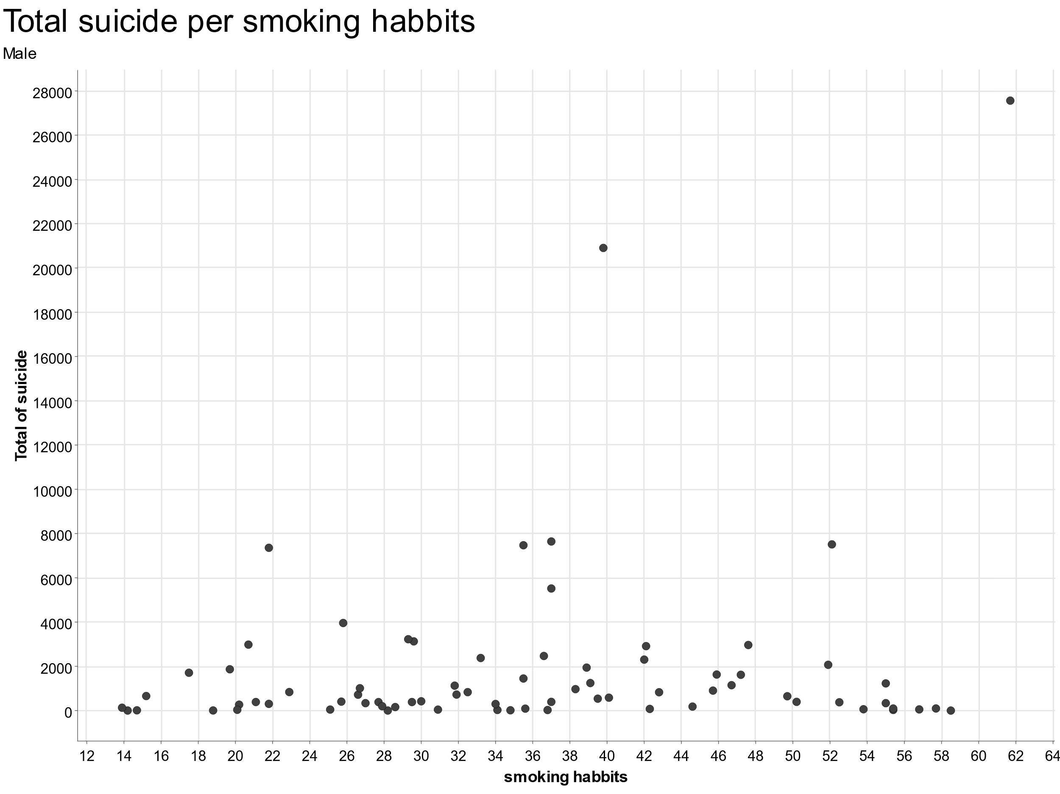
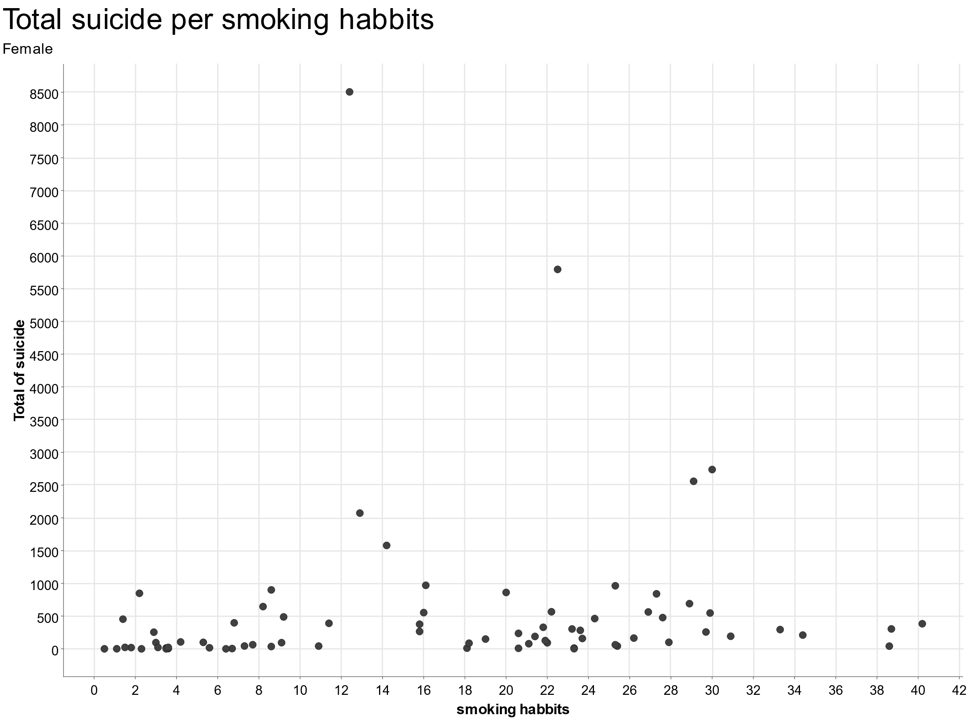


GRAPH : Suicide BY Smoking
Notes:
Some of the variables had a division by gender
Smoking has no correlation to number of suicides
Average smokers larger tandancy to commit suicide

Slide 10
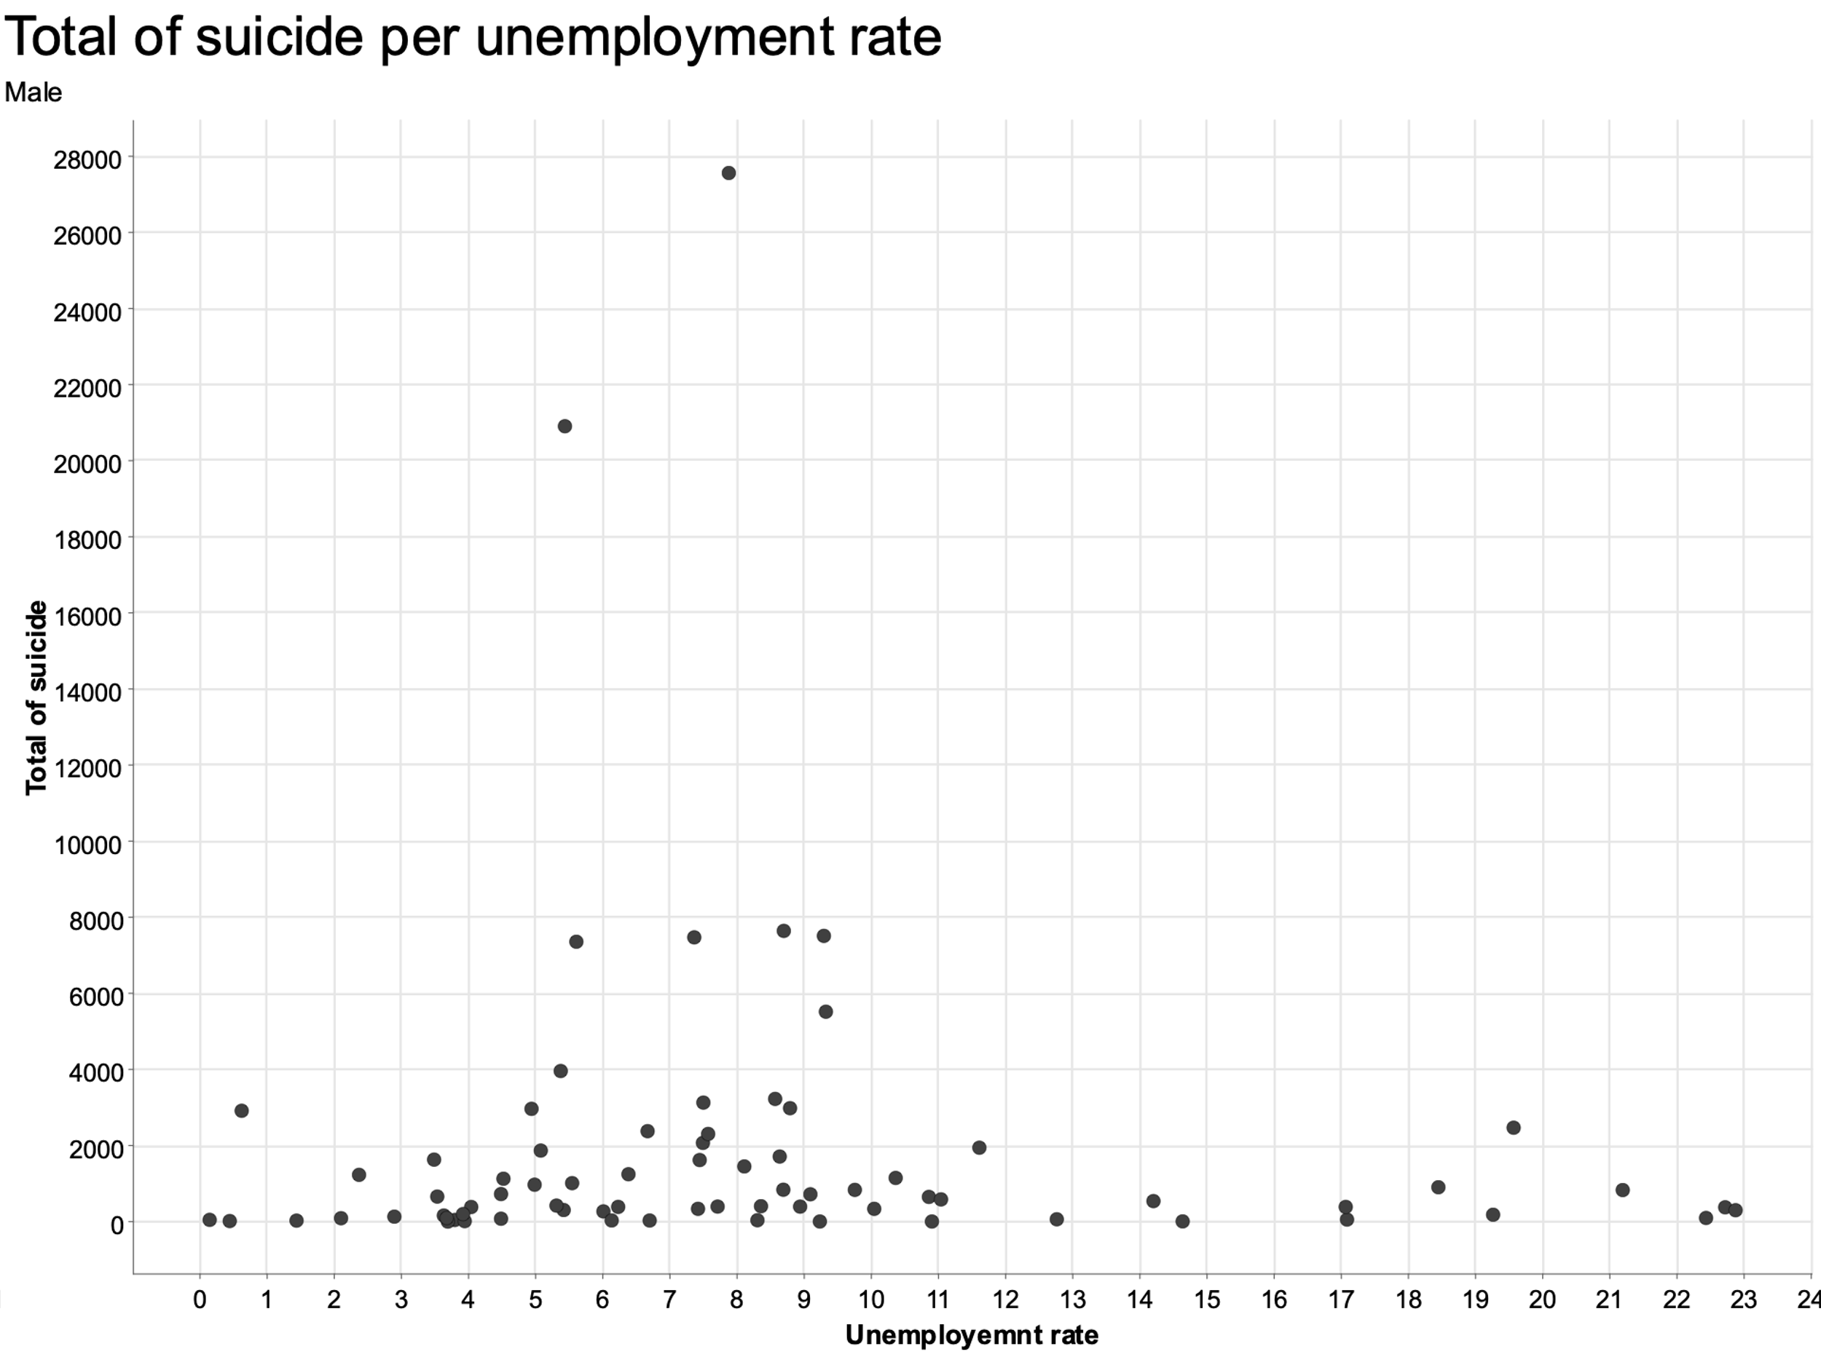
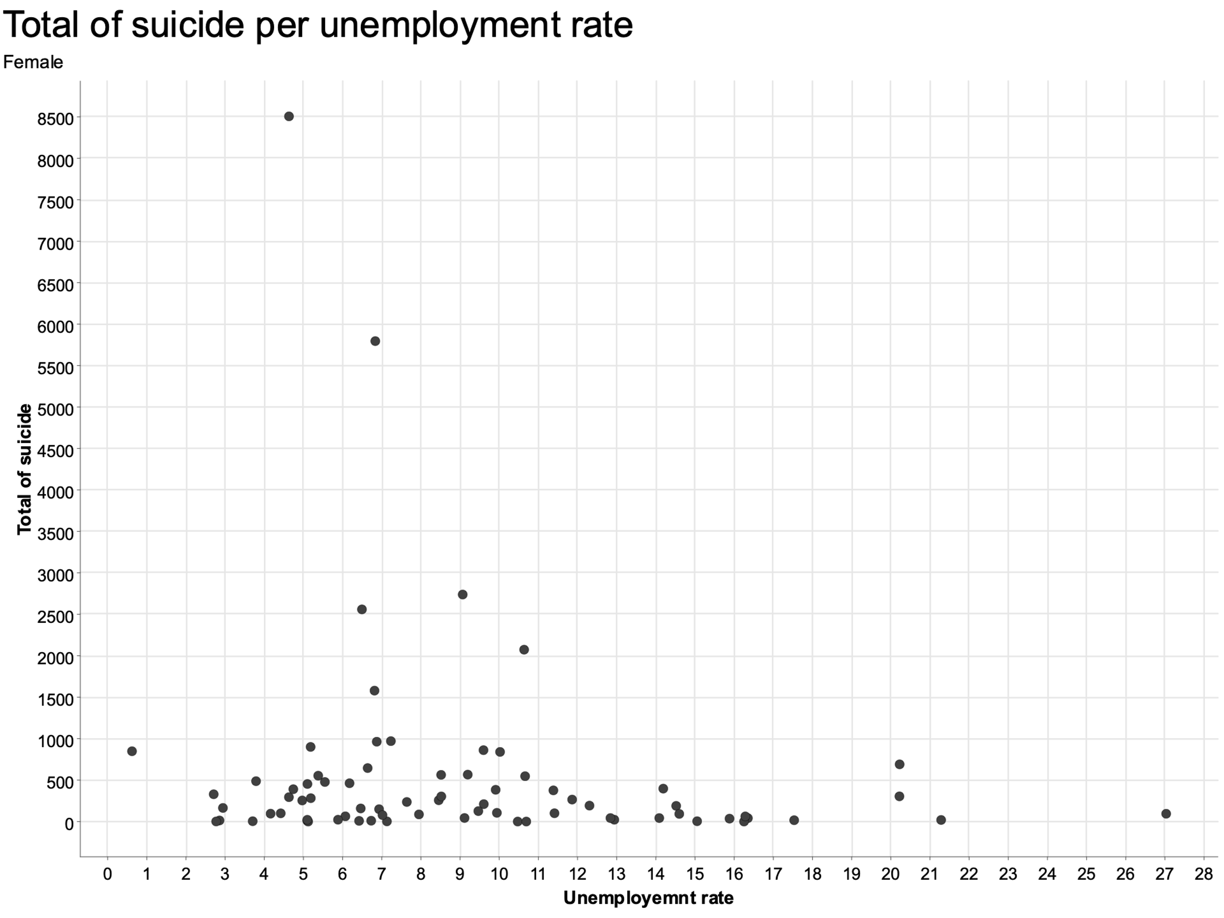
GRAPH : Suicide BY Unemployment
Notes:
There is a small amount of correlation between unemployment and number of suicides but almost neglegable

Slide 11
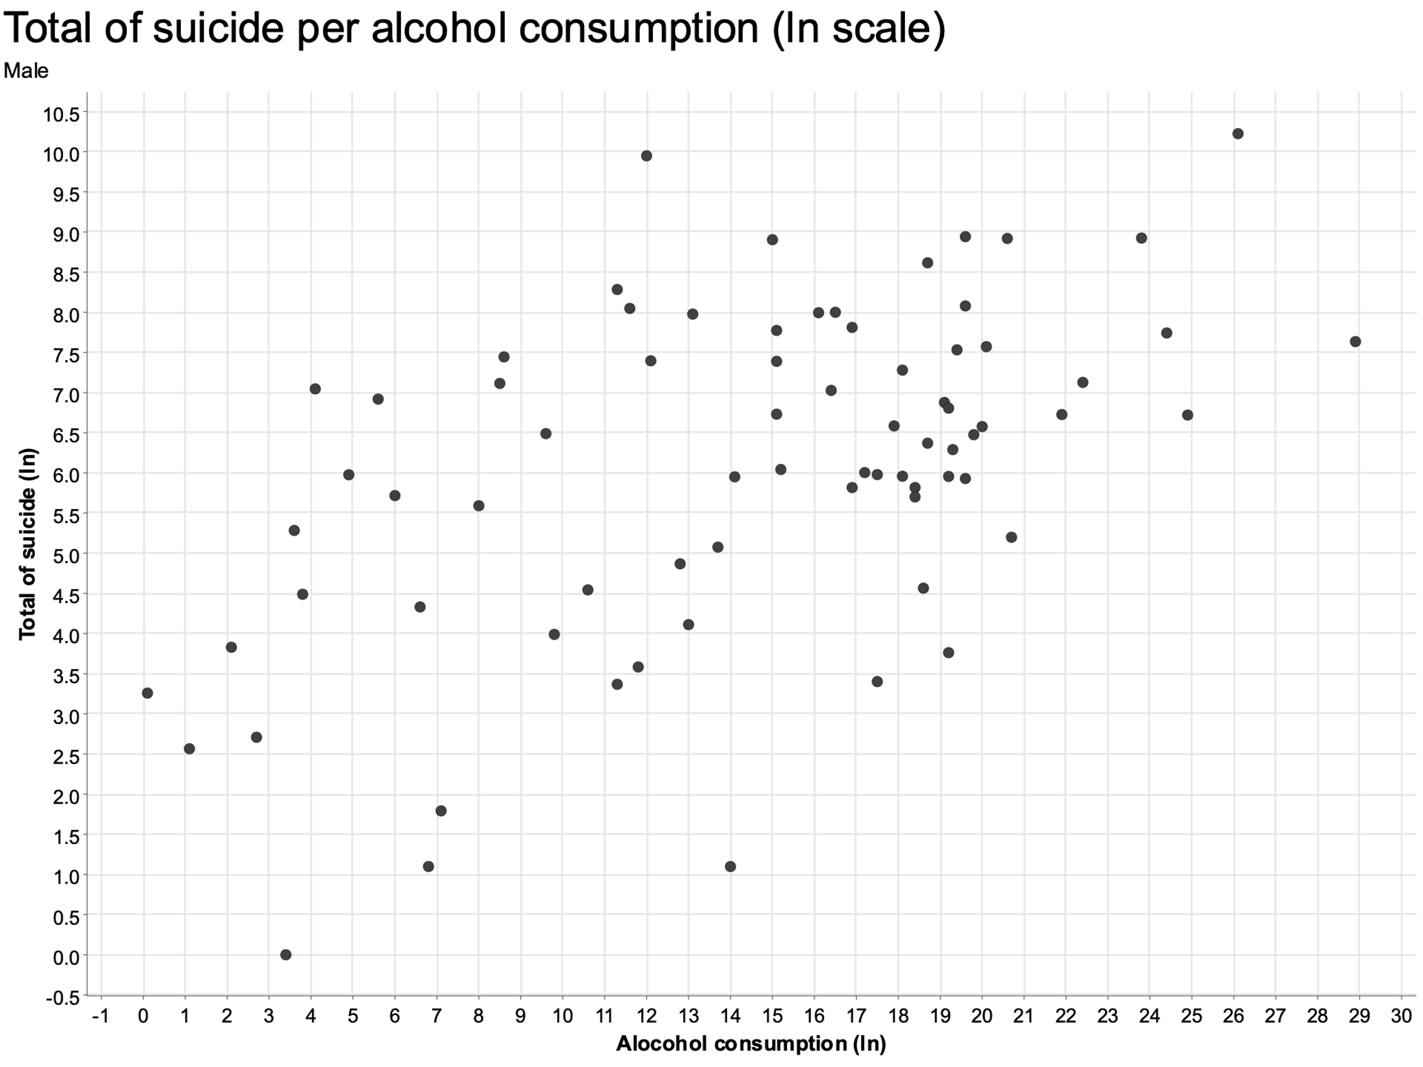
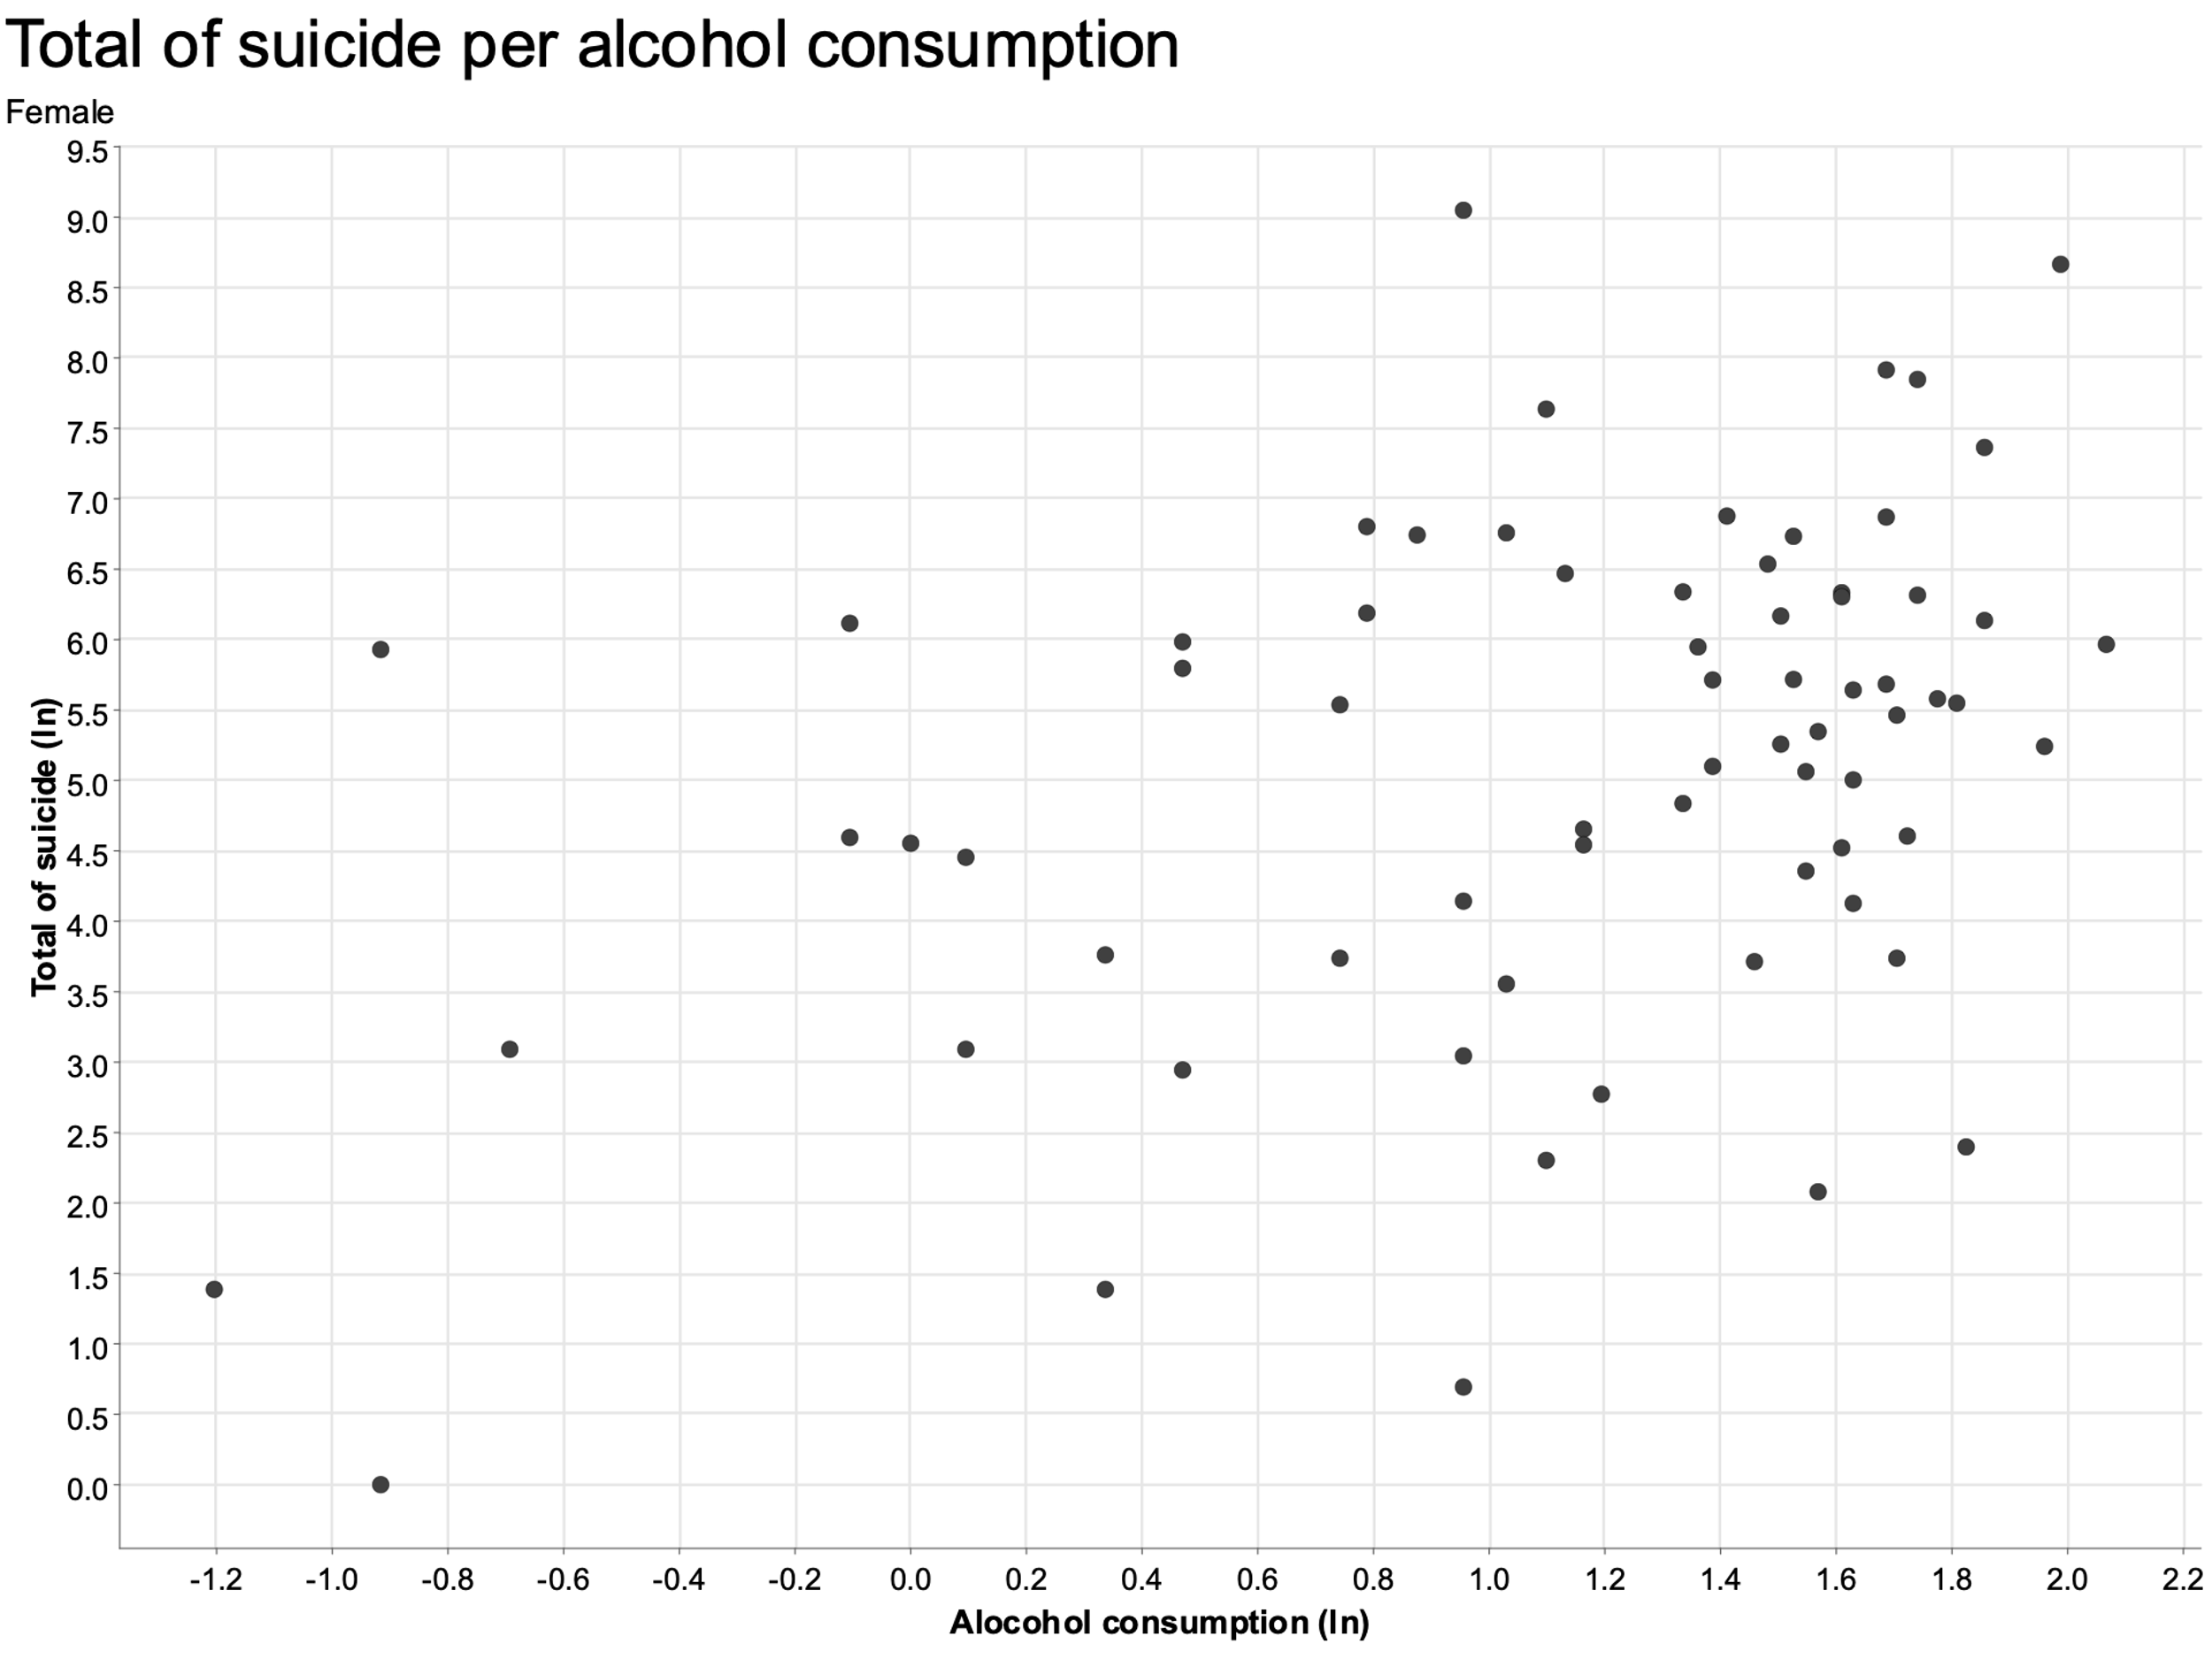
GRAPH : Suicide BY ALCOHOL CONSUMPTION
Notes:
For alcohol we decided to do a log-log analysis
Definite correlation between alcohol consumption and suicide rate

Slide 12
Data visualization – total population
Two variables that encompased the whole population
GPD per Capita
Population
Population graph straight forward
No clear correlation but some connection

Slide 13
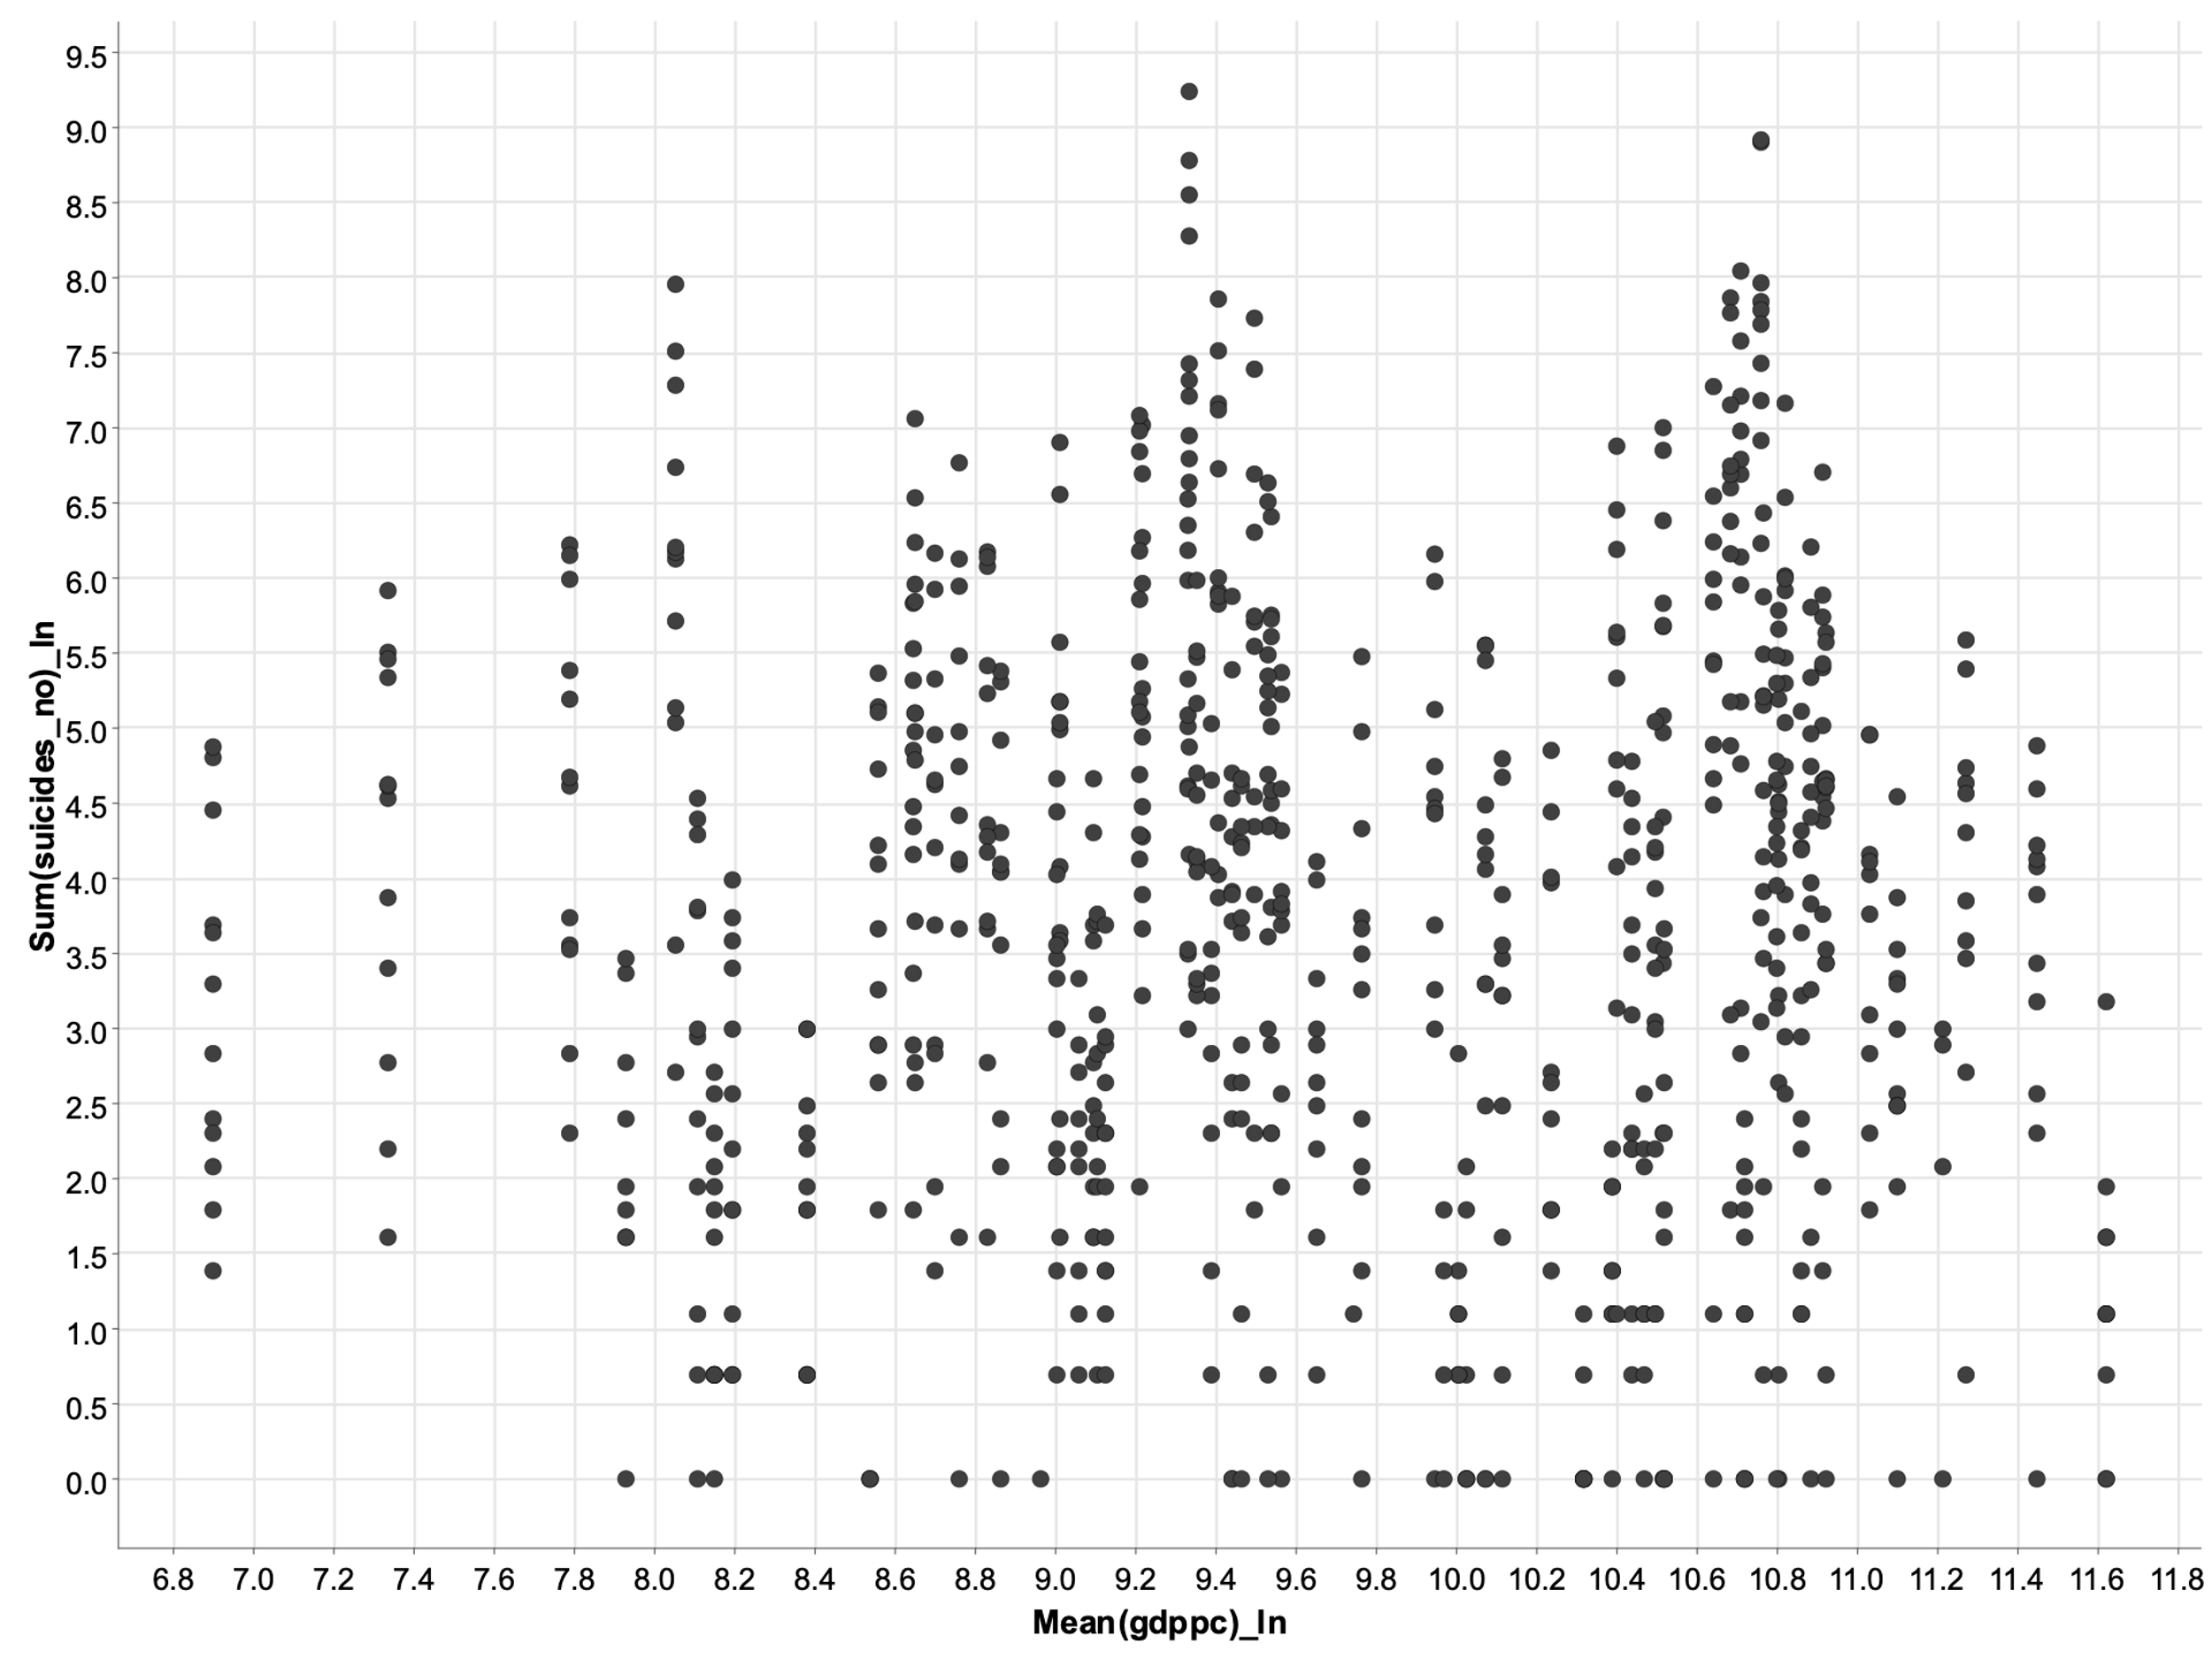
GRAph: Suicides PEr gdp per capita
Notes:
Decided to do a log-log transformation for GDP per Capita
Absolutely no correlation between GDP per Capita and number of suicides

Slide 14

Thank you for your attention

