Slide 1

Securing Workloads

Slide 2
Securing Workloads

Slide 3
Example Microservices application
Product page
Catalog
Reviews
Rating

Slide 4
Labels of work loads
app: product page
app: details
app: reviews
app: rating

Slide 5
Network Policy
Control traffic from/to Pods
Pod

Slide 6
Network Policy
Network policy are implemented by network plugin
By default pods are not isolated
Pods become isolated by having a network policy
that selects them.
Default is deny all

Slide 7
Labels
Pods can have labels
Labels associate identifying metadata with Pods
app: product
tier: api
app: products
tier: db
app: reviews
tier: api
role: search
app: reviews
tier: db
data: user

Slide 8
Label Selector
Label selector can select set of Pods
matchLabels:
app: products
app: product
tier: api
app: products
tier: db
app: reviews
tier: api
role: search
app: reviews
tier: db
data: user

Slide 9
Label Selector
Label selector can select set of Pods
matchLabels:
tier: db
app: product
tier: api
app: products
tier: db
app: reviews
tier: api
role: search
app: reviews
tier: db
data: user

Slide 10
Empty Label Selector
Selects all Pods in namespace
app: product
tier: api
app: products
tier: db
matchLabels: {}
app: reviews
tier: api
role: search
app: reviews
tier: db
data: user

Slide 11
Writing a Network Policy
Select Pods for which Network Policy need to be applied
using podSelector (which uses label selector)
Specify the direction in which traffic need to be controlled.
Ingress
Egress
Pod
Pod
Specify rules to allow traffic, default is deny all.
Ingress - Who can connect to this Pod ?
Egress - Whom this Pod can connect to ?

Slide 12
apiVersion: networking.k8s.io/v1
kind:NetworkPolicy
metadata:
....
spec:
podSelector:
matchLabels:
role: db
ingress:
....
egress:
.....

Slide 13
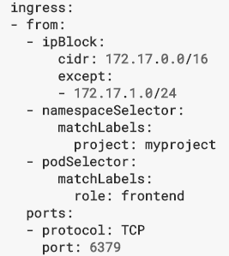
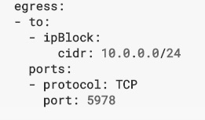

Slide 14
Selectors that form the rules in ingress or egress section
podSelector
Selects particular Pods in same namespace
namespaceSelector
Particular namespace from which Pods are selected.
Namespace is identified by Label

Slide 15
namespaceSelector & podSelector
specific Pods in specific Namespace
ipBlock
IP CIDR range
Pods are ephemeral ip address changes on rescheduling
Use for external IP address

Slide 16
Multiple selectors are ORed,
If one of the selector allows the connection,
traffic is allowed

Slide 17
Restricting to specific port
By default all ports are open
We can restrict to open only specific ports
Use container port

Slide 18
Egress rules
Connection from Pods to other Pods Or external endpoint
Egress policies actually block DNS resolution
Need to add rules to allow DNS traffic to coreDNS server.

Slide 19
Network Plugin
Network policies needs to be supported by network plugin.
Need to install network plugin like calico, weavenet or romana
Else network policies will not work.

Slide 20
Return traffic
Network policies are defined on connections
On incoming connections, return traffic is allowed.

