Slide 1

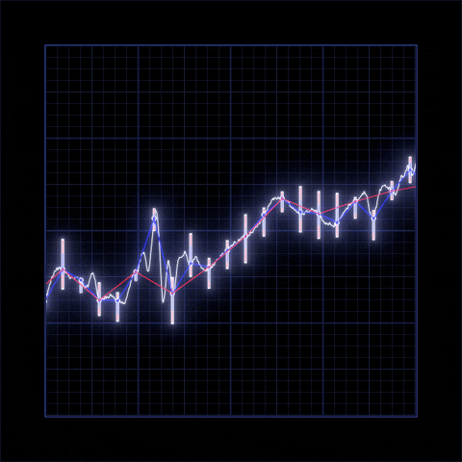
The
S&P 500
Team Pentagon
Notes:
WE are team Pentagon, and we created a tool to help novice investors navigate the S&P 500.

Slide 2
What is that?
Standard & Poor's 500 Index
A market-capitalization-weighted index of the 500 largest U.S. publicly traded companies.
One of the most widely quoted stock market indexes
Notes:
It is also known as the Standard & Poor's 500 Index. It is a market-capitalization-weighted index of the 500 largest publicly traded companies in the U.S.
Because of that (it represents the largest publicly traded companies in the U.S.) it is one of the most widely quoted stock market indexes.

Slide 3
Divided into 11 sectors
Grouped by industry or related industries.
Notes:
These 500 stocks in the index are divided into 11 sectors, each of them consisting of companies in the same or related industries.

Slide 4
We will provide you with the top 3 stocks of each sector with the Best Value, Fastest Growth and Most Momentum.
The S&P only provides the top 10 companies on their website.
Notes:
The S&P does not currently provide the total list of all 500 companies on its website, outside of the top 10 at no additional cost.
So we thought we will provide you with the top 3 stocks of each sector with the Best Value, Fastest Growth and Most Momentum.
Best Value Stocks:
These are the stocks with the lowest 12-month trailing price-to-earnings (P/E) ratio.
Fastest Growing Stocks:
These are the stocks with the highest year-over-year (YOY) earning per share growth.
Stocks with the Most Momentum:
These are the stocks that had the highest total return over the last 12 months.
there is historic data and a report generated as a point of reference. and just show it
yup and the information is all coming from the same scrape and mongodb db

Slide 5
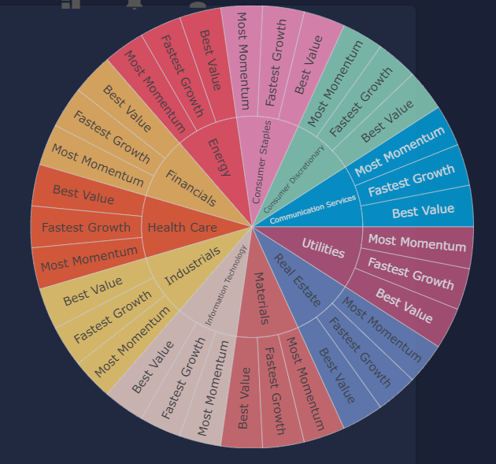

Slide 6
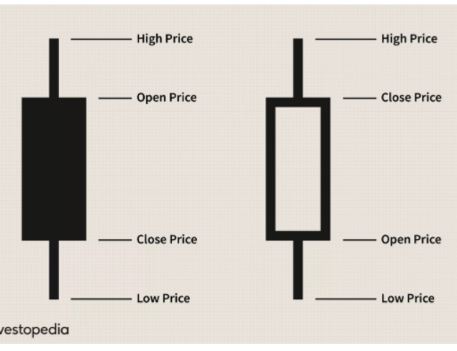
Candlestick Chart
Used by traders to determine possible price movement based on past patterns.
They show four price points (open, close, high, and low) throughout the period the trader specifies.
Notes:
Another tool we thought we could provide you with would be a candle stick chart. This is used by traders to determine possible price movement based on past patterns.
Each daily candlestick shows the market's open, high, low, and close price each day, and you can see all four point for a specific period.
Show Candlestick graph here
The candlestick has a wide part, which is called the "real body.“
The real body represents the price range between the open and close of that day's trading. When the real body is filled with light gray, it means the close price was lower than the open price. Where the real body is teal, it means the close price was higher than the open price.
At the bottom we have the turnover ratio of a stock. This is a measure of sellers versus buyers. It is calculated by dividing the daily volume of a stock by the number of shares available for sale by the general trading public.
The volatility refers to the amount of uncertainty or risk related to the size of changes in a security's value. We calculated the Volatility by obtaining the square root of the variance. The standard deviation is the square root of the variance.

Slide 7
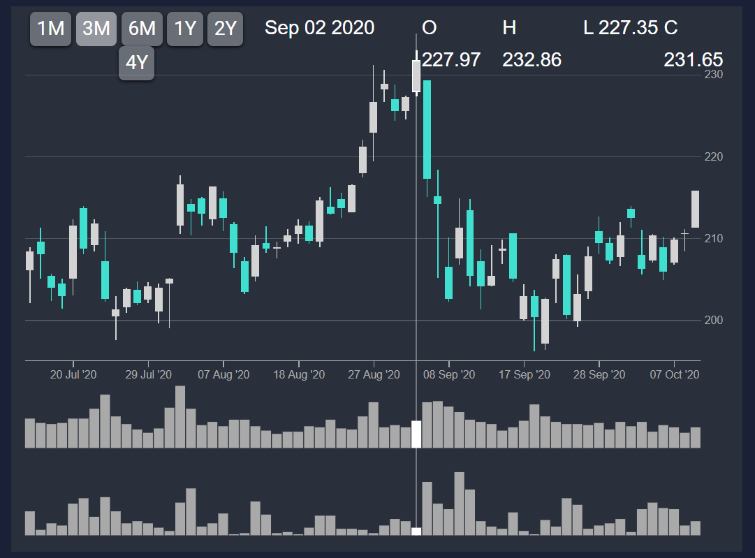

Slide 8
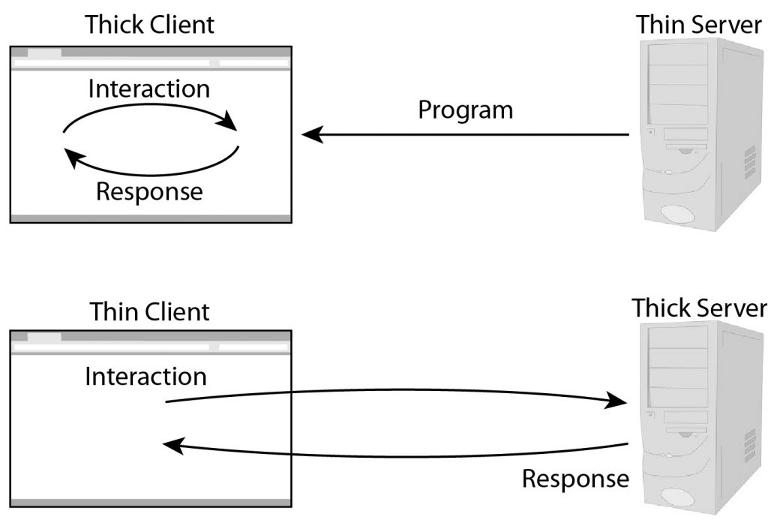
Let’s get technical
Thin client: HTML website page.
Interaction in the thin client: The user enters the stocks and date ranges that they would like to see
Thick server: Python code that pulls-in the information from the HTML website. Turns the input into the variables and sends the info thru the ETL process to pull the requested data.
Response from thick server: The requested stock information in graph form presented to the user.

Slide 9
Sources
https://www.investopedia.com/
yfinance
www.wsj.com

