Slide 1
cookie cutter data science
a clean, repeatable project template
that everyone will thank you for

Slide 2
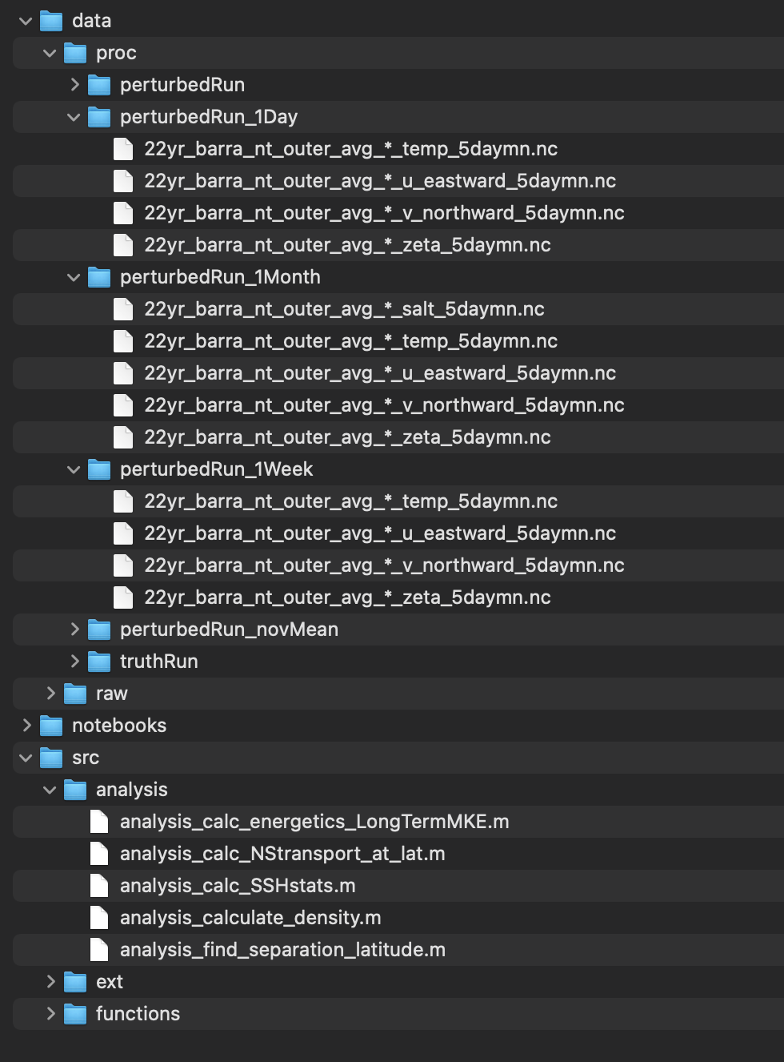
what am i talking about…
a folder structure(+) template for science projects

Slide 3
principles:
clean code structure can help you
other people will thank you
you will thank you

Slide 4
clean code structure
Projects often have same series of steps
Choose a folder structure, file structure, categorization to help
Use this folder structure with each project but let it grow.
Don’t re-invent the wheel

Slide 5
others will thank you
Sharing with team-mates
e.g.
calc_transport.m
calc_transport_v2.m
calc_transport_v3.m
calc_transport_final.m
calc_transport_final_final.m
calc_transport_final_2017.m
calc_transport_final_2017v2.m
calc_transport_final_FINAL.m
2. Sharing with the public

Slide 6
you will thank you
”I got an email from an international collaborator, asking for a script I used to generate some data. Where is that script now?”

Slide 7
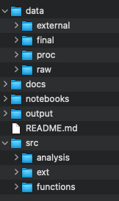

my cookie cutter folder structure
README.md

Slide 8

my cookie cutter folder structure
data folder

Slide 9

my cookie cutter folder structure
docs

Slide 10

my cookie cutter folder structure
output

Slide 11

my cookie cutter folder structure
src

Slide 12

my cookie cutter folder structure
notebooks

Slide 13
file convention
e.g. naming notebook files:
1.0_dave_calculateTransport.py
NameOfNotebook_v1.m
Increment the version number – but if you start to change script to look at different topic, make new notebook.
New notebook for making final figures.

Slide 14
tips
make a git repo. check out for every new project. Easy template for each new project.
If it makes sense – commit each project to a new repo so you will have version control.
maintain git repo – if you find a bug in an analysis, correct and push back to repo.
(python) can use a __init__.py file in the src/ folder to make it a module (matlab) can use addpath(genpath(../.)) etc
https://drivendata.github.io/cookiecutter-data-science/

