Slide 1


Spring Integration - basics
Martin Toshev, Diyan Yordanov
Cisco Systems

Slide 2

Agenda
Overview of Software Integration
What are the Enterprise Integration Patterns ?
What is Spring Integration ?
Enterprise Integration Patterns implementation in Spring Integration
Notes:
Martin

Slide 3
Overview of Software Integration
Enterprise companies have many software applications developed in different languages and run on different platforms. These applications need to communicate. Even the big ERP systems can not live alone and should be integrated with other systems.
Application integration needs to provide efficient, reliable and secure data exchange between multiple enterprise applications in order to support common business processes and data sharing.
EAI Suite – suites that encompass messaging, business process automation, workflow, portals, and other functions. Key players in this marketplace are IBM WebSphere MQ, Microsoft BizTalk,TIBCO, WebMethods, SeeBeyond, Vitria, CrossWorlds, and others. Many of these products include JMS as one of the many client API’s they support.
Notes:
Dido

Slide 4
What are Enterprise Integration Patterns ?
A collection of design patterns for use in enterprise application integration and message-oriented middleware
Understanding the patterns allows you to:
  build effective messaging systems
  develop applications that provide the ability to integrate with another systems in a cleaner manner using messaging
  gain insight on how to integrate completely different applications using messaging
Several frameworks already implement these patterns (Spring Integration, Apache Camel, Guarana DSL etc.)
Notes:
Martin

Slide 5

There are seven categories of enterprise integration patterns (organized in a catalogue):
    Messaging Systems
    Messaging Channels
    Message Construction
    Message Routing
    Message Transformation
    Messaging Endpoints
    System Management
Notes:
Martin

Slide 6

An open-source framework for Enterprise Application Integration
Builds on top of the Spring framework
Supports message-driven architectures where IoC (inversion of control) applies to runtime concerns (the messaging and integration concerns are handled by the framework, so business components are further isolated from the infrastructure and developers are relieved of complex integration responsibilities)
Notes:
Martin

Slide 7

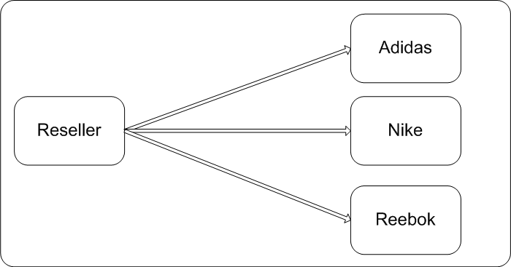
  4 different applications should be integrated:
  - 3 clothing manufactures – Adidas, Reebok and Nike
  - 1 reseller that buys from them
Notes:
Dido

Slide 8

  direct communication using application-layer sockets
  enforces high coupling between applications
Notes:
Dido
Problems:
Platform Technology – internal representations of numbers and objects
Location – hard-coded machine addresses
Time – all components have to be available at the same time
Data Format – the list of parameters and their types must match

Slide 9

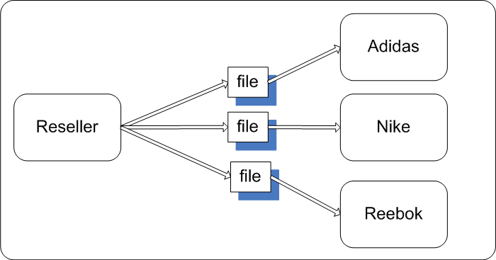
  communication using shared files
  can lack timeliness
  may not enforce data format sufficiently
Notes:
Dido
Updates tend to occur infrequently – operating with files is slow.
Data inconstancy

Slide 10

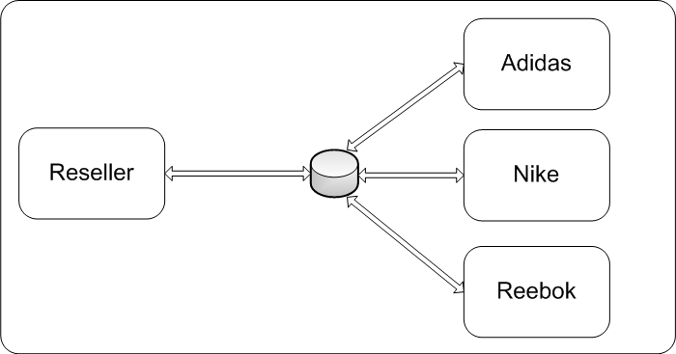
  communication using a shared database
  can lack timeliness
  the database can turn into a performance bottleneck
Notes:
Dido
DB server can become a bottleneck.
A large and complex DB shcema
Deadlocks as each application locks others out of the data
Collect a large amounts of incompatible data
Third-party applications work with their own DBs

Slide 11

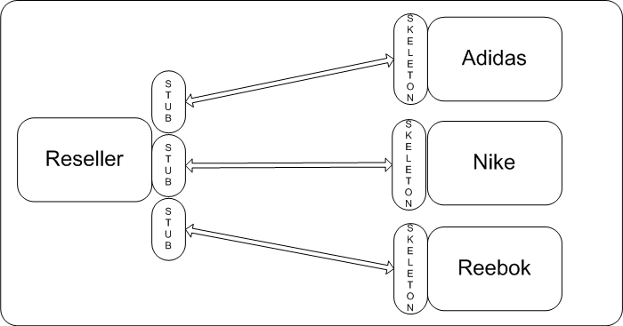
  communication using RPC
  although reduced - coupling is still an issue
Notes:
Dido
Still coupled systems.
Both apps should be up and running
Synchronous invocation over the network
Communication between many applications could become a mess.

Slide 12


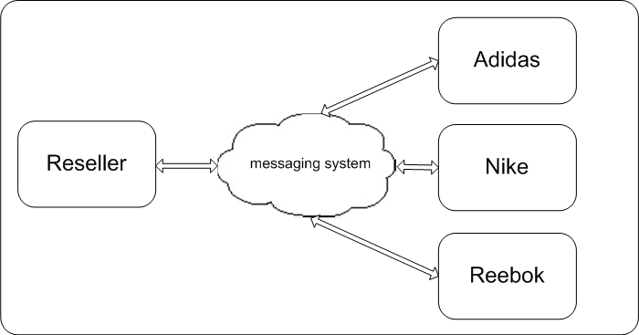
  messaging – delegates communication details to the messaging system
Notes:
Dido
Asynchronous messaging is fundamentally a pragmatic reaction to the problems of distributed systems.
Sending a message does not require both systems to be up and ready at the same time.
Louse coupling
Consistency
Async programming needs some learning curve

Slide 13
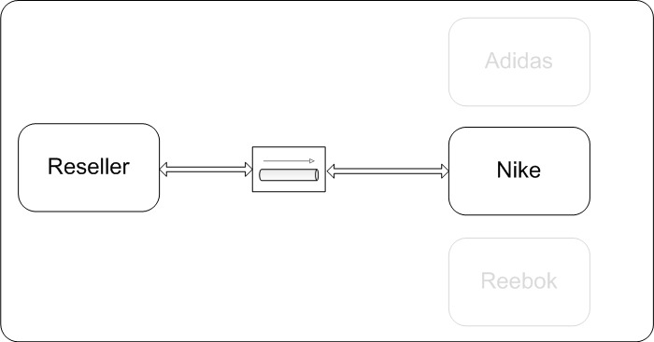
EIP in Spring Integration
Use case: reseller wants to buy from Nike (they are aware of the messaging system)
Notes:
Dido

Slide 14

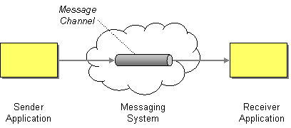
EIP in Spring Integration
Messaging Systems
  Message
  Message Channel
Notes:
Message - An atomic packet of data that can be transmitted
Header – Information used by the messaging system that describes the data being transmitted, its origin, its destination, and so on.
Message body – The data being transmitted; generally ignored by the messaging system and simply transmitted as-is.
Channel - messaging applications transmit data through virtual pipes that connects a sender to a receiver. One application sends data to the channel and the other reads it from the channel.

Slide 15
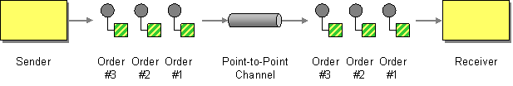
EIP in Spring Integration
Messaging Channels
  Point-to-Point Channel
Notes:
PtoP ensures that only one receiver will
receive a particular message

Slide 16
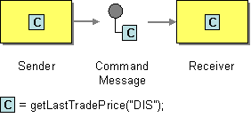
EIP in Spring Integration
Message Construction
  Command Message
Notes:
Command message to invoke a procedure in another application – same as the command OOD pattern.

Slide 17
EIP in Spring Integration
DEMO – Simple Channel

Slide 18
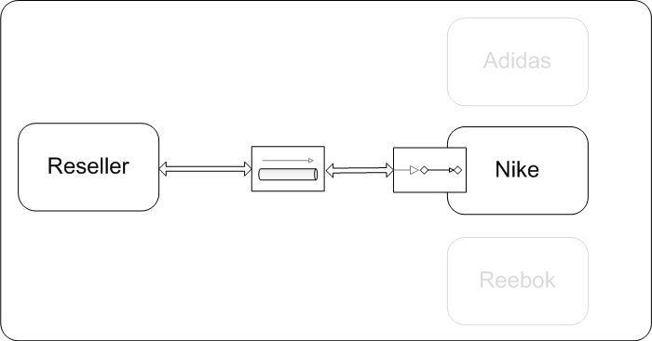
EIP in Spring Integration
Use case: reseller wants to buy from Nike (reseller is aware of the messaging system and Nike is not)
Notes:
Dido

Slide 19
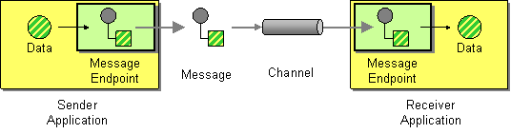
EIP in Spring Integration
Messaging Systems
  Message Endpoint
Notes:
Dido
This is how an application connects to a messaging system so that it can send and receive messages.
With the previous example we made 2 endpoints by using the messaging API.
Using some frameworks and tools like Spring, most of the endpoint code is already done so we can use already implemented endpoints.

Slide 20
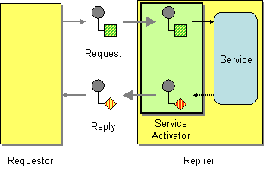
EIP in Spring Integration
Messaging Endpoints
  Service Activator
Notes:
Dido
Service Activator that connects the messages on the channel to the service being accessed. It allows the service to be used with or without messaging.
In Spring
The Service Activator is the endpoint type for connecting any Spring-managed Object to an input channel. I the object method returns a

Slide 21
EIP in Spring Integration
DEMO – Service Activator
Notes:
Dido

Slide 22
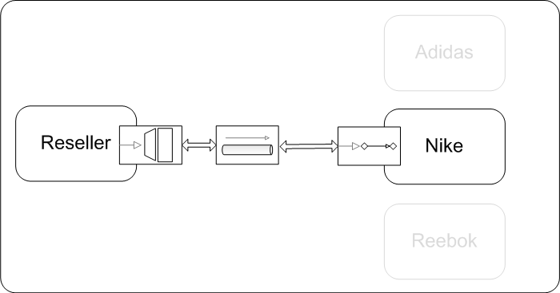
EIP in Spring Integration
Use case: reseller wants to buy from Nike (both Nike and the reseller and not aware of the messaging system)
Notes:
Messaging Gateway, a class than wraps messaging-specific method calls and exposes
domain-specific methods to the application

Slide 23
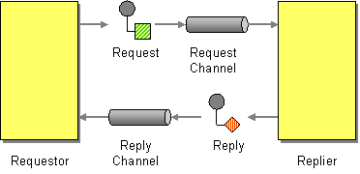
EIP in Spring Integration
Message Construction
  Request-Reply
Notes:
Dido

Slide 24
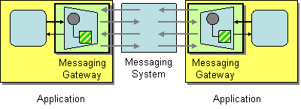
EIP in Spring Integration
Messaging Endpoints
  Messaging Gateway
Notes:
Dido

Slide 25
EIP in Spring Integration
DEMO – Messaging Gateway
Notes:
Dido

Slide 26
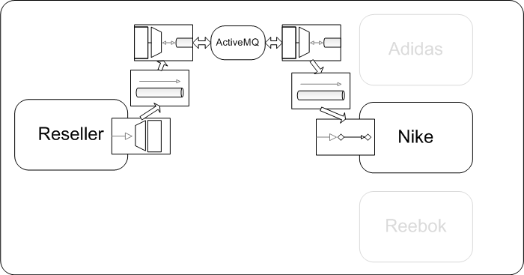
EIP in Spring Integration
Use case: reseller wants to buy from Nike using JMS (both reseller and Nike are not aware of the messaging system)
Notes:
Dido

Slide 27
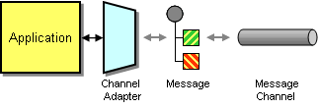
EIP in Spring Integration
Messaging Channel
  Channel Adapter
Notes:
Dido
Use a Channel Adapter that can access the application's API and publish messages on a channel based on this data, and that likewise can receive messages and invoke functionality inside the application.

Slide 28
EIP in Spring Integration
DEMO – Channel Adapter
Notes:
Dido

Slide 29
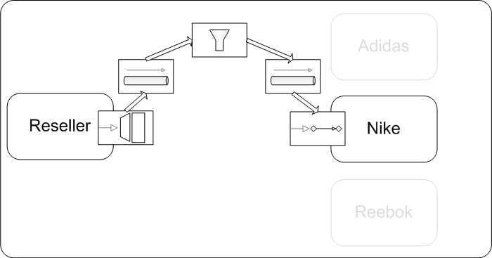
EIP in Spring Integration
Use case: reseller wants to buy from Nike and Nike requires authentication from the reseller
Notes:
Dido

Slide 30

EIP in Spring Integration
Messaging Systems
  Pipes and Filters
Notes:
Dido

Slide 31
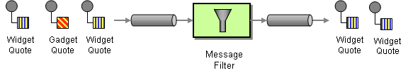
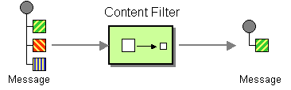
EIP in Spring Integration
Messaging Routing
  Filter
  Content Filter
Notes:
Dido

Slide 32
EIP in Spring Integration
DEMO – Pipes and Filters

Slide 33
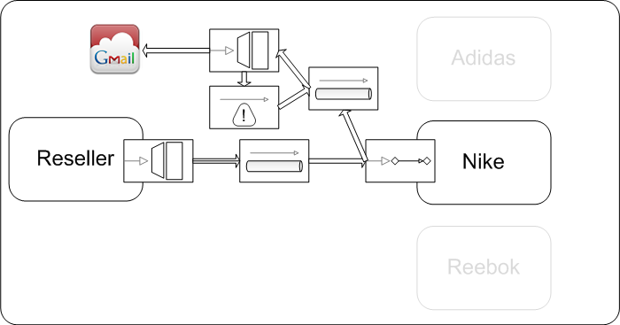
EIP in Spring Integration
Use case: reseller wants to buy from Nike and Nike wants to send a notification on order receipt
Notes:
Dido

Slide 34
EIP in Spring Integration
Demo – Email Notification With Retry

Slide 35
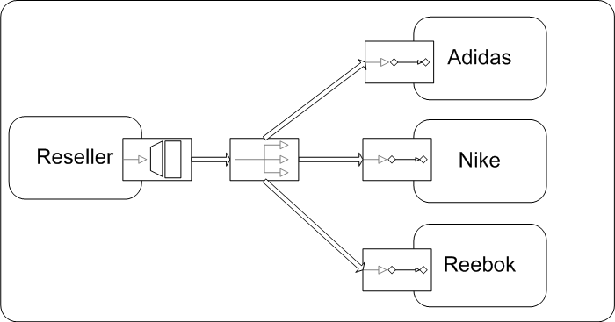
EIP in Spring Integration
Use case: reseller wants to buy from multiple manufacturers – Nike, Adidas and Reebok (using publish-subscribe channel)
Notes:
Dido

Slide 36
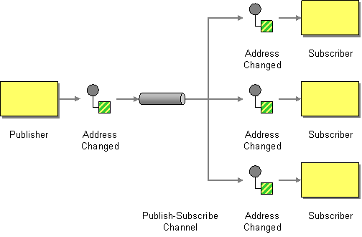
EIP in Spring Integration
Messaging Channel
  Publish-Subscribe Channel
Notes:
Dido

Slide 37
EIP in Spring Integration
DEMO – Publish-Subscribe

Slide 38
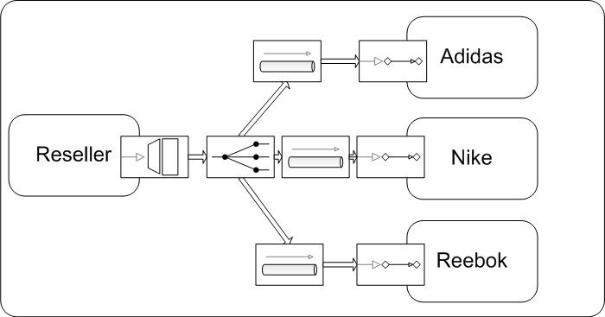
EIP in Spring Integration
Use case: reseller wants to buy from multiple manufacturers – Nike, Adidas and Reebok (using recipient list)
Notes:
Martin

Slide 39

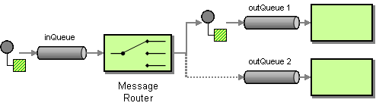
Messaging Systems
  Message Router
Notes:
Martin

Slide 40
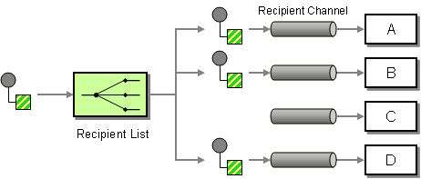
Message Routing
  Recipient List

Slide 41
EIP in Spring Integration
DEMO – Recipient List

Slide 42
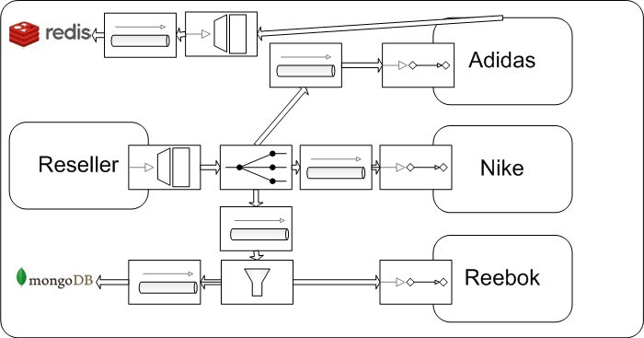
EIP in Spring Integration
Use case: reseller wants to buy from multiple manufacturers – Nike, Adidas and Reebok (Nike and Adidas require authentication with monitoring)
Notes:
Martin

Slide 43
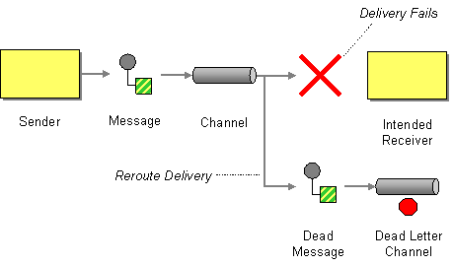
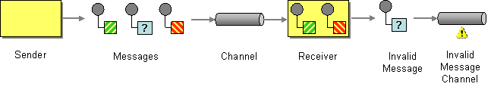
EIP in Spring Integration
Messaging Channels
  Dead Letter Channel
  Invalid Message Channel

Slide 44
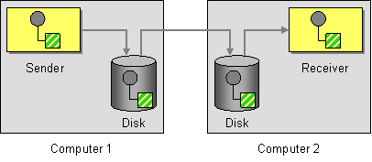
EIP in Spring Integration
Messaging Channels
  Guaranteed Delivery

Slide 45
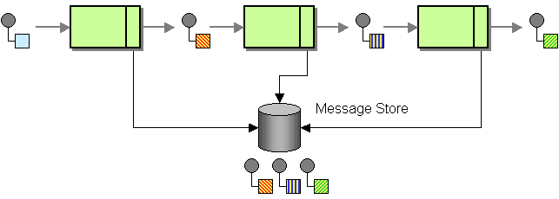
EIP in Spring Integration
System management
  Message Store

Slide 46
EIP in Spring Integration
DEMO – Invalid/Dead Letter Channel

Slide 47
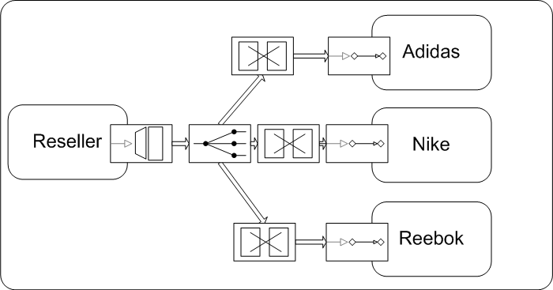
EIP in Spring Integration
Use case: reseller wants to buy from multiple manufacturers – Nike, Adidas and Reebok (they accept different types of messages)
Notes:
Martin

Slide 48
EIP in Spring Integration
DEMO – Transformer

Slide 49

EIP in Spring Integration
Use case: reseller wants to buy from multiple manufacturers – Nike, Adidas and Reebok (the reseller wants to explicitly specify the manufacturer)
Notes:
Martin

Slide 50
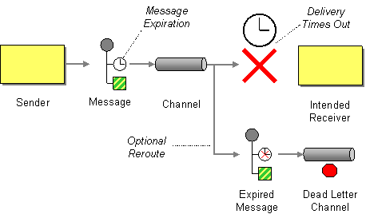
Message Routing
  Content-based Router

Slide 51
EIP in Spring Integration
DEMO – Content-based Router

Slide 52
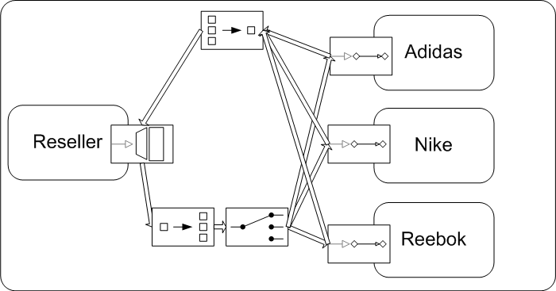
EIP in Spring Integration
Use case: reseller wants to buy from multiple manufacturers – Nike, Adidas and Reebok (reseller wants to send a batch request and receive a response)
Notes:
Martin

Slide 53
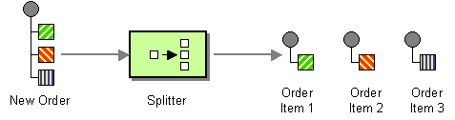
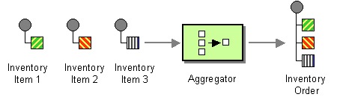
Message Routing
  Splitter
  Aggregator

Slide 54
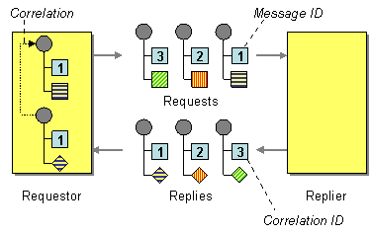
EIP in Spring Integration
Message Construction
  Correlation Identifier

Slide 55
EIP in Spring Integration
DEMO – Splitter/Aggregator

Slide 56
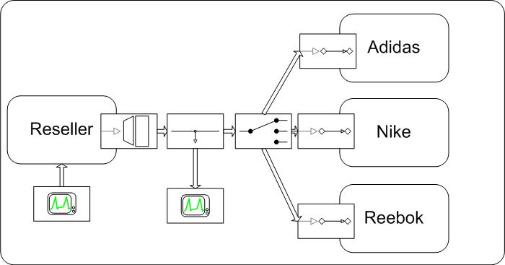
EIP in Spring Integration
Use case: reseller wants to buy from multiple manufacturers – Nike, Adidas and Reebok (ordering should be monitored and managed externally)
Notes:
Martin

Slide 57
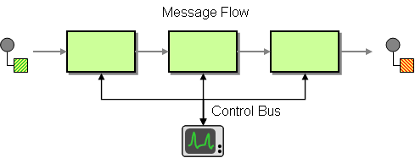
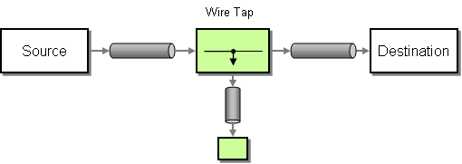
EIP in Spring Integration
Message Routing
  Wire Tap
  Control Bus

Slide 58
EIP in Spring Integration
DEMO – Management/Monitoring

Slide 59
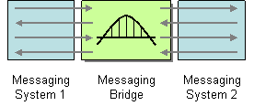
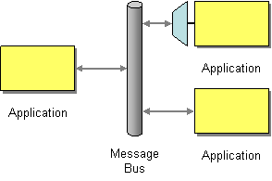
EIP in Spring Integration
Messaging Channels
  Messaging Bridge
  Message Bus

Slide 60
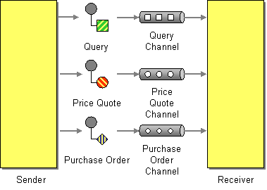
EIP in Spring Integration
Messaging Channels
  Datatype Channel

Slide 61

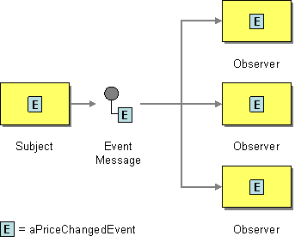
EIP in Spring Integration
Message Construction
  Document Message
  Event Message

Slide 62
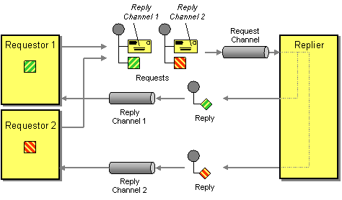
EIP in Spring Integration
Message Construction
  Return Address

Slide 63
EIP in Spring Integration
Message Construction
  Message Expiration
  Format Indicator – enables the sender to tell the
  receiver the format of the message

Slide 64
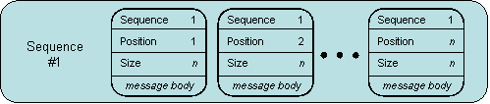
EIP in Spring Integration
Message Construction
  Message Sequence

Slide 65
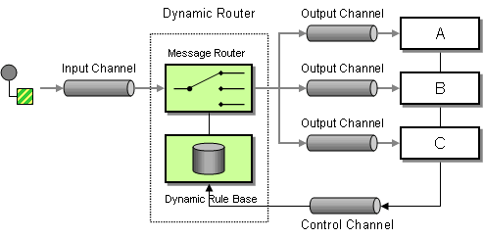
EIP in Spring Integration
Message Routing
  Dynamic Router

Slide 66
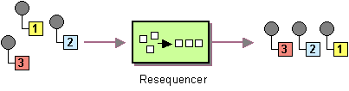
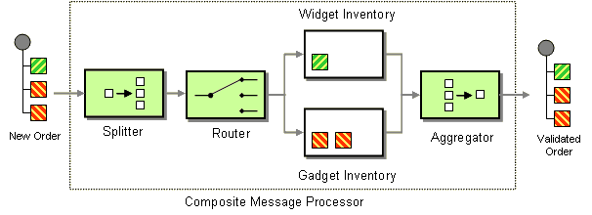
EIP in Spring Integration
Message Routing
  Resequencer
  Composed Message Processor

Slide 67
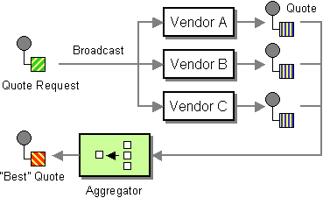

EIP in Spring Integration
Message Routing
  Scather-Gather
  Routing Slip

Slide 68


EIP in Spring Integration
Message Routing
  Process Manager
  Message Broker

Slide 69


EIP in Spring Integration
Message Transformation
  Envelope Wrapper
  Content Enricher

Slide 70

EIP in Spring Integration
Message Transformation
  Claim Check

Slide 71


EIP in Spring Integration
Message Transformation
  Normalizer
  Canonical Data Model

Slide 72


EIP in Spring Integration
Messaging Endpoints
  Messaging Mapper
  Transactional Client

Slide 73


EIP in Spring Integration
Messaging Endpoints
  Polling Consumer
  Event-Driven Consumer

Slide 74


EIP in Spring Integration
Messaging Endpoints
  Competing Consumers
  Message Dispatcher

Slide 75


EIP in Spring Integration
Messaging Endpoints
  Selective Consumer
  Durable Subscriber

Slide 76
EIP in Spring Integration
Messaging Endpoints
  Idempotent Receiver – an endpoint that is able to receive and distinguish between duplicate messages

Slide 77

EIP in Spring Integration
System Management
  Detour

Slide 78

EIP in Spring Integration
System Management
  Message History

Slide 79

EIP in Spring Integration
System Management
  Smart Proxy

Slide 80


EIP in Spring Integration
System Management
  Test Message
  Channel Purger

Slide 81
Summary
Design carefully your integration solutions – think of maintainability, performance, scalability and other critical factors that are of higher priority
Hopefully – you have a better insight on how to integrate different applications/components (and in particular - using Spring Framework)
You can find this presentation and the associated source code in GitHub (https://github.com/dgyordanov/springintegration)

Slide 82

Q&A
Thank you !

Slide 83




References

Slide 84
References
Enterprise Integration Patterns – Designing, Building and Deploying Messaging Solutions, Gregor Hohpe, Bobby Woolf
http://www.eaipatterns.com/
Spring integration (springsource.com)
http://www.springsource.org/spring-integration
Implementing enterprise integration patterns (springsource.com)
http://blog.springsource.org/2008/05/19/implementing-enterprise-integration-patterns-part-0/
Getting started with Spring Integration v2 and Enterprise Integration Patterns – A Simple Example using File and Mail Adapters
http://java.dzone.com/articles/getting-started-spring-0

Slide 85
References
Getting started with Spring Integration v2 and Enterprise Integration Patterns – A Simple Example using File and Mail Adapters
http://java.dzone.com/articles/getting-started-spring-0
Solving the Enterprise Integration Puzzle with Spring Integration
http://wordpress.transentia.com.au/wordpress/2010/01/25/solving-the-enterprise-integration-puzzle-with-spring-integration/
Spring Integration – Enterprise Integration Patterns (Vikas Kumar’s blog)
http://vikaskumar9.blogspot.com/2011/01/spring-integration-enterprise.html
Enterprise Application Integration (wikipedia category of articles)
http://en.wikipedia.org/wiki/Category:Enterprise_application_integration
Understanding Enterprise Integration Patterns
http://architects.dzone.com/articles/enterprise-integration

Slide 86
References
Spring Integration in 10 minutes
http://blog.springsource.org/2009/02/13/982/
Spring Integration Samples
http://blog.springsource.org/2007/12/21/spring-integration-samples/
Spring Integration 1.0.3 Sample – Just Add Maven
http://blog.springsource.org/2009/07/21/spring-integration-103-samples-just-add-maven/
Spring Integration: A new addition to the Spring portfolio
http://blog.springsource.org/2009/07/21/spring-integration-103-samples-just-add-maven/

