Slide 1
Automated geographical alignment procedure through dense point clouds simplification
Digital Humanities Laboratory
Master project midterm presentation
Loris Aiulfi
Supervisor: Nils Hamel, Frédéric Kaplan
Notes:
Greetings.
Master project on point cloud alignment through their simplification
1. Present problematic and goal
2. Short state of the art review
3. Simplification process based on a semester project I did previously. And the current enhancements and modifications
4. Future work

Slide 2
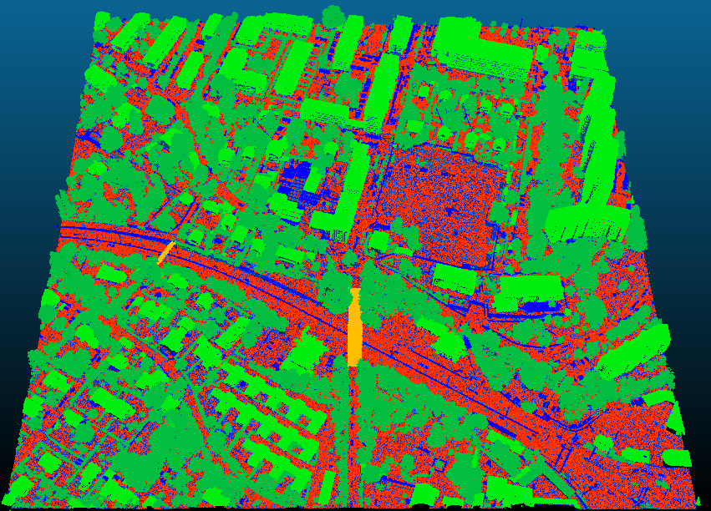
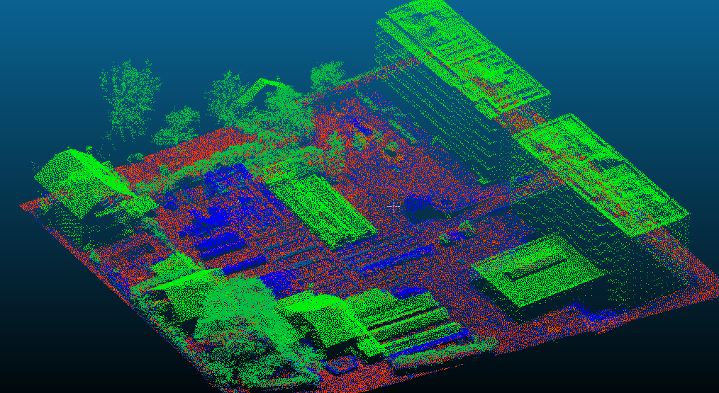
Point Cloud Alignment
Notes:
PC alignment meaning: Fitting a source PC into a target Object (PC or another type. In our case a simple blockout of the city)
Topic of interest during last few years, due to the increase of PC usage in a lot of fields.
PC are of various types: LIDAR data as these images or photogrammetry.
Often in a local coordinate system → not aligned in the real world.
Often divided in multiple parts, only partially overlapping.
Already a lot of algorithms try to solve this problem → Usually work with simple PCs of interiors, like a kitchen, of domestic objects, but as the number of points and the complexity of the cloud increases, results start to get worse and worse, and I will show some examples later.

Slide 3
State of the art
Local: ICP, NDT
  Assumes good starting position
Global: FPCS, KFPCS, RANSAC, Branch And Bounds
  Makes no assumption on starting positions
A local algorithm is used to refine the initial alignment of a global one.
Notes:
All of them: optimize a cost function of some sort.
Local: assume an initial position of source close to global minimum, otherwise tends to get stuck in a local minimums.
Global: makes no assumptions on initial position, but are usually less precise. → local algo used after a global one.
With increase of points → cost function becomes pathologic as it increases the number of local minimums

Slide 4
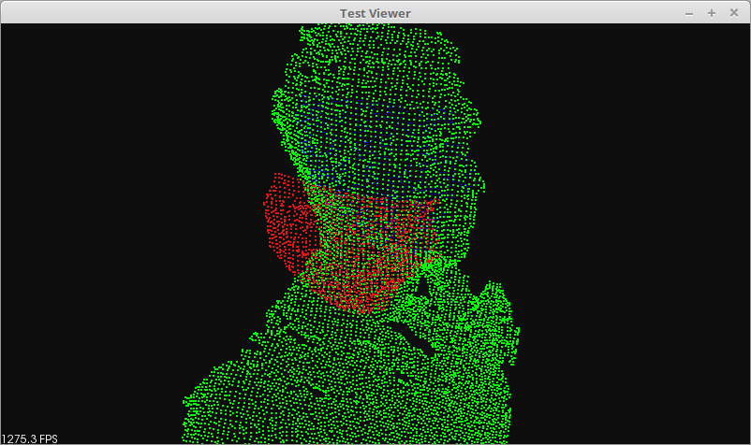
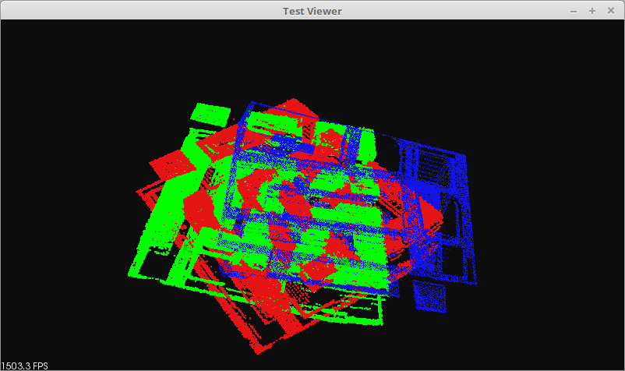
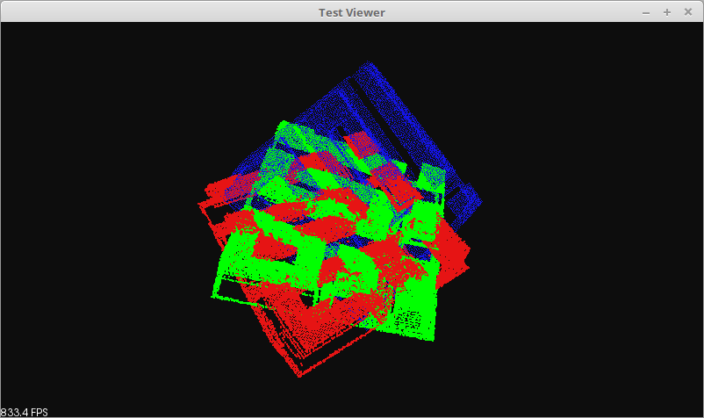
Keypoint 4 Points Congruence Set (KFPCS)
Notes:
Some tests made of global algorithms.
1. An example of working alignment. Provided on a tutorial on PCL.
Green is target, red is source, blue is the source with the transformation found by the algorithm.
2. The same with one of our PC. The source is unaligned from the target by a rotation of 45 degrees.

Slide 5
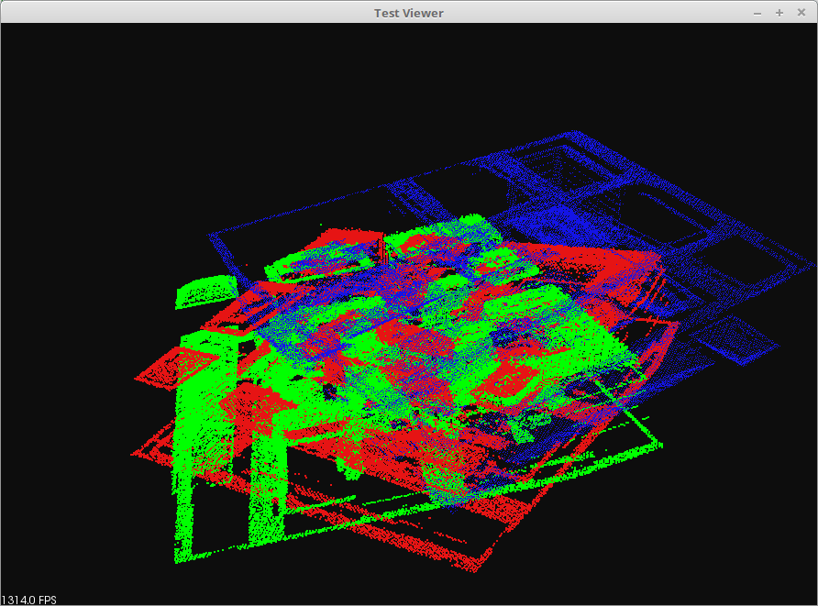
Sample Consensus Initial Alignment (Sac-ia)
Notes:
Here another example of (Random sample consensus).
Same colors.
The algo found a minima by flipping the source PC. And aligning on the roofs, that is the part with the higher point density.
As said before: lots of points and complex features of such PCs tends to render usual cost functions on points/local features useless for alignment.
→ Work on a simplification

Slide 6
Point Cloud Simplification
Plane segmentation
  Choose a starting point randomly
  Expand area by finding neighboring points
  Compute the plane formed by the set of points
  Iteratively growth the region by adding new neighbors that belong to the plane
  Repeat until all planes are found
Notes:
Semester project about 2 years ago about Plane segmentation
Short summary of the algo: Region growing
1. Start on a random point
2. Expand area around the point by finding its neighbors
3. Try to fit a plane on the set of points
4. If we are of a plane → expand the region by iteratively adding neighboring points to the plane until no more points are found.
5. Repeat until all planes are found.

Slide 7
Point Cloud Simplification
Plane segmentation updates
  Added PCL support to use its features
    KdTree, PFHSignature, PCLViewer
    Significant speed up neighborhood searches
  Normals and curvature computation as a preprocessing step
  Multi-threading using OpenMP
  Simplification of starting point choice:
    lowest curvature → it always start on a flat area
Notes:
First step of the project: Optimize and increase robustness of the plane segmentation.
1. Reimplemented the algo to include PCL support. Point Cloud Library: main open source library to process point clouds. Contains a lot of useful features:
a. KdTrees → fast neighborhood search
b. PFHSignature → Useful to analyze a set of points and find if they represent a plane
c. PCLViewer → allows to easily display PCs with their features and contains a lot of built-in functions
2. Moved normal and curvature computation in a preprocessing step.
3. Added multi-threading for preprocessing step, and in a lot of steps in the region growing.
4. Simplified starting point choice

Slide 8
Point Cloud Simplification
Notes:
Example on a small PC

Slide 9
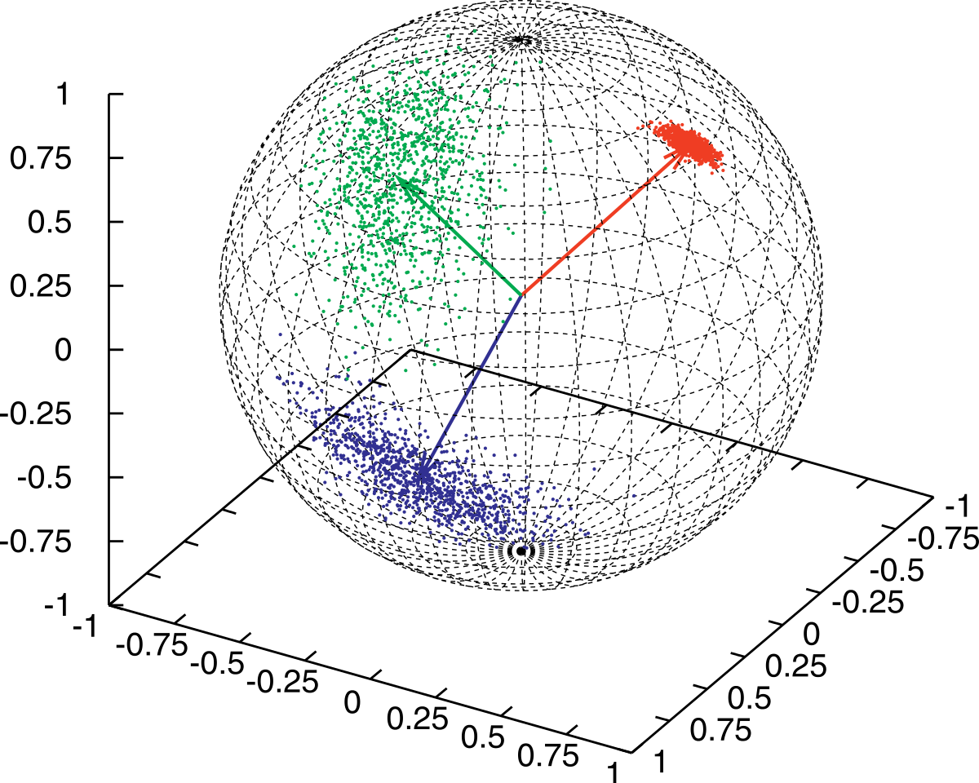
Future Work
Based on the planes found beforehand
Rotation
  Normal signature of the planes normal vectors
Translation
  Signature of planes center
Results evaluation
  Aligned LIDAR and photogrammetry
  clouds of Geneva.
Normals distribution example
Notes:
1. Last step of the plane segmentation. Merge segmented planes that are on the same surface.
2. Main Part of the project → Based on the simplification in planes, design and implement the alignment algorithm.
Use of planes will reduce drastically the number of variables and parameters used to optimize the cost functions.
Rotation: Normal vectors signature of both source and target objects. Find a rotation that fits the source into the target.
Translation: Same principle using plane centers and boundaries.
3. Results evaluation: Based on already aligned data on known areas that will unaligned on purpose. It will thus be possible to compute an error value and confront it with other algorithms.

Slide 10
Bibliography
CloudCompare:
PCL:
OpenMP:
ICP:
NDT:
FPCS, KFPCS:
RANSAC, Sac-ia:
BnB:

