Slide 1
Automated geographical alignment procedure through dense point clouds simplification
Digital Humanities Laboratory
Master project final defense
Loris Aiulfi
Responsible: Prof. Frederic Kaplan EPFL/DHL
Supervisor: Nils Hamel EPFL/DHL
Notes:
PC simple and flexible data type used in a lot of fields since a few years. Obtained via various devices and processes.
Set of 3D points expressed in a local coordinate system when obtained → not aligned in the real world. → needed for most applications involving geographical data
Already a lot of algorithms try to solve this problem. Principle is to fit a source PC into a target PC, for which its real world alignment is already known.
In this project, the PC that must be aligned are representing cities and here are some examples.

Slide 2
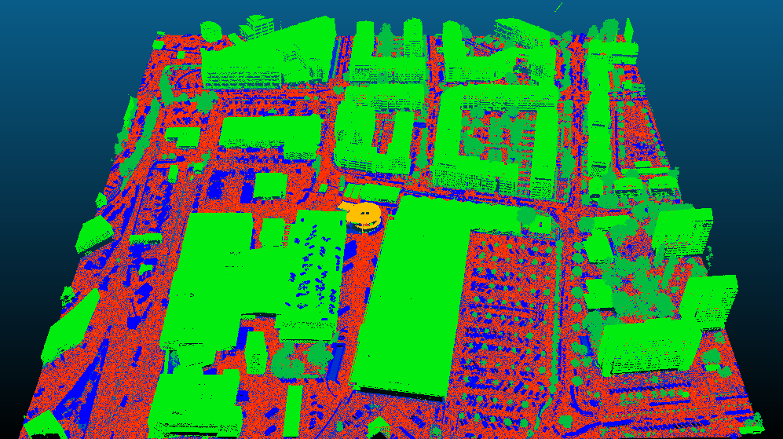
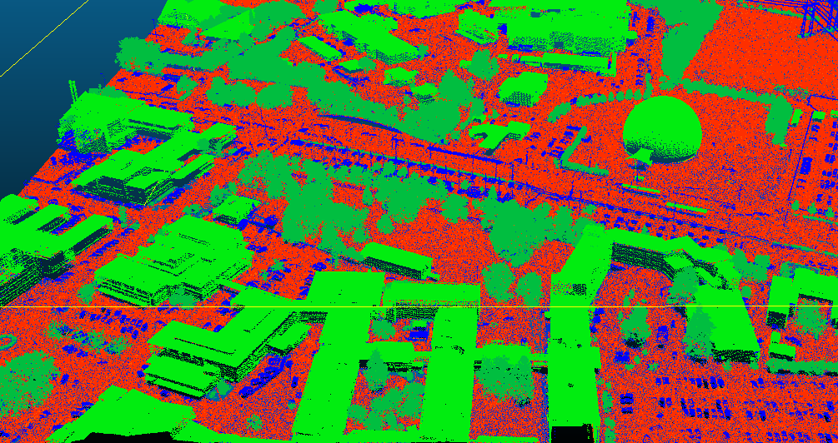
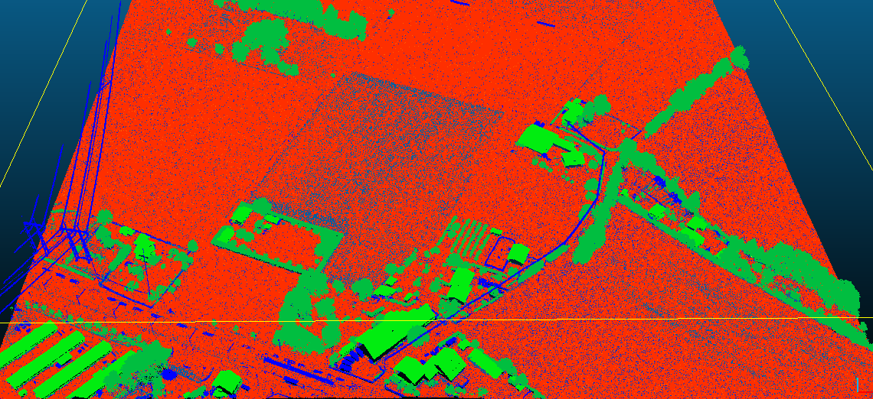
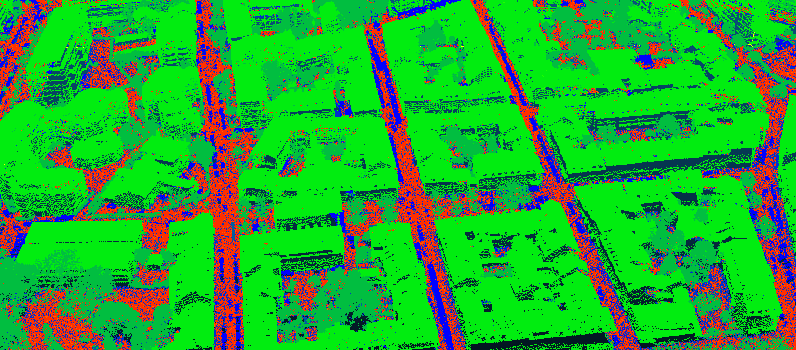
Point Cloud Examples
Notes:
PC of Geneva city obtained by aerial Lidar scans provided by the Geneva Cadaster.
Represent various densities of buildings and can contain billions of points to cover the entire city.
As you can see these are quite complex clouds, with a lot of details.
→ As a consequence of this complexity, usual algorithm struggle to align even small areas of these type of clouds because of the number of points and features they must process.
→ objective of this project → design an algorithm that is able to process such clouds.

Slide 3
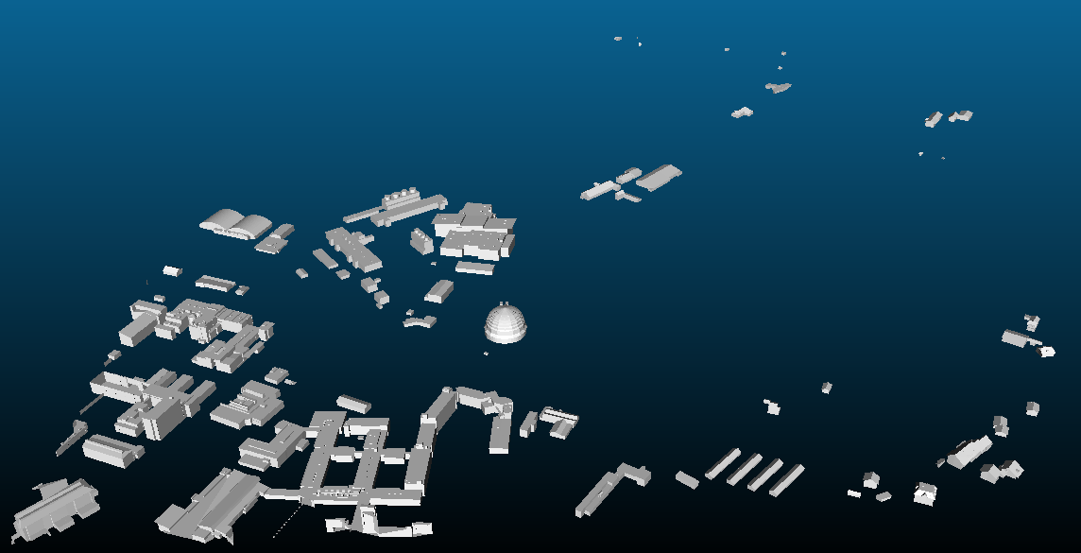
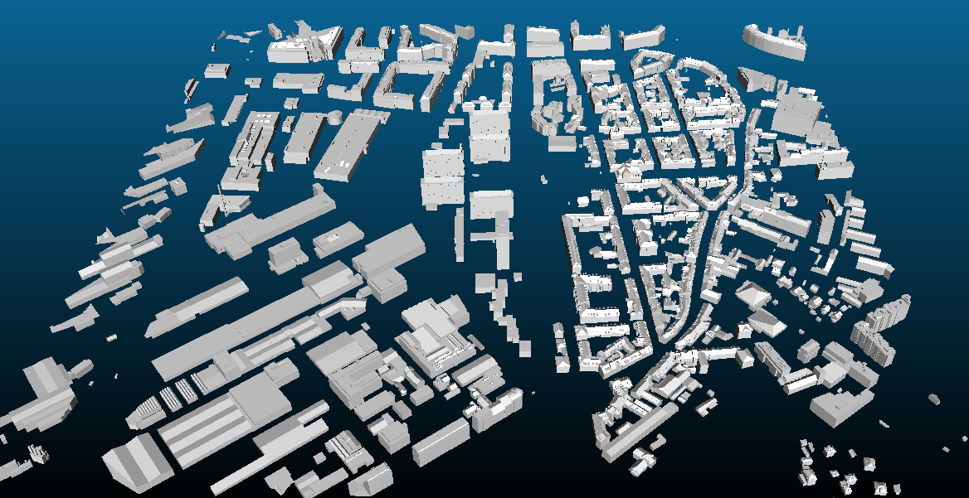
Mesh Examples
Notes:
Geneva is also available in a 3D mesh format, representing the buildings with simplified shapes.
This opens the possibility to align clouds not only on other point clouds, but also on these type of target.
Also an objective of this project.
Literature on this particular topic is nonexistent or rare, and I did not find any publication that spoke about this.

Slide 4
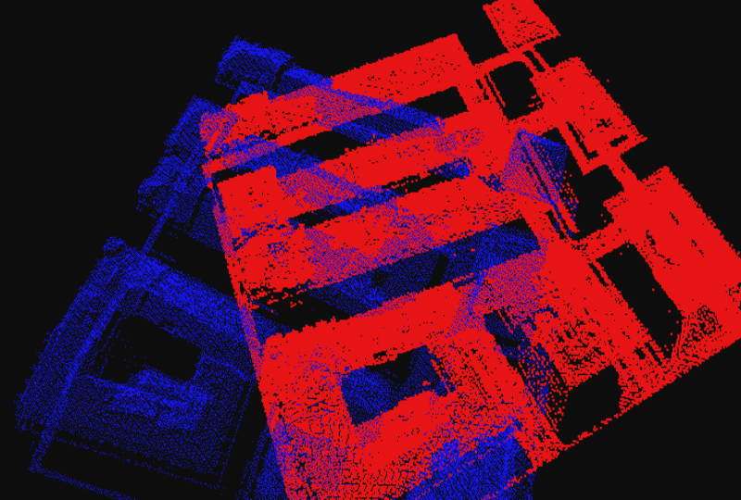
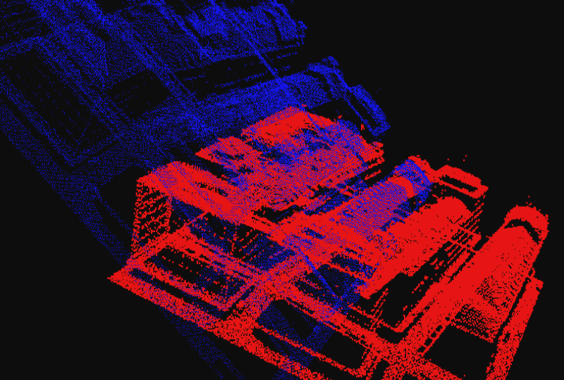
State of the art evaluation
Sac-ia: No initial transformation
KFPCS: No initial transformation
Notes:
Evaluate ability of 3 state of the art algorithm to align such clouds.
In order to evaluate current algos:
Take small areas of the PC.
Tested with various angles. Three state of the art algorithms.
→ Here are 2 examples of results. Of simplest test → the sources have not been rotated.
In red is the source cloud, target would be in green but is completely overlapped by the source.
→ The real transformation is the identity matrix.
Cause is high complexity of the clouds → usual features on the points not sufficient.

Slide 5

Methodology
Overview of the algorithm:
  Plane Simplification:
    Point Clouds: Preprocessing → Plane segmentation → Plane merging.
    Mesh: Simple plane merging.
  Alignment:
    Selection of equivalent planes by APFH comparison to build matrix M:
      Pass through source planes list by decreasing surface order.
      For each source: Select target plane having a similar surface and with minimal APFH difference.
    Least-squares optimization on the cost function:
      Building matrix H from cost function.
      Singular value decomposition on H. Resulting in 3 matrices U, S, V
      The rotation is given by R = VU^{T}
Notes:
Base idea is to perform the alignment process on a simplified version of the PC.
Due to the type of clouds that forms the dataset → Usage of a Plane segmentation algorithm to obtain the list of planes.
This allows to convert both the clouds and the meshes in this common referential of list of planes.
Plane merging: Merge together neighboring planes that belong to the same surface.
Build cost function where only the selected plane association are taken into account.

Slide 6
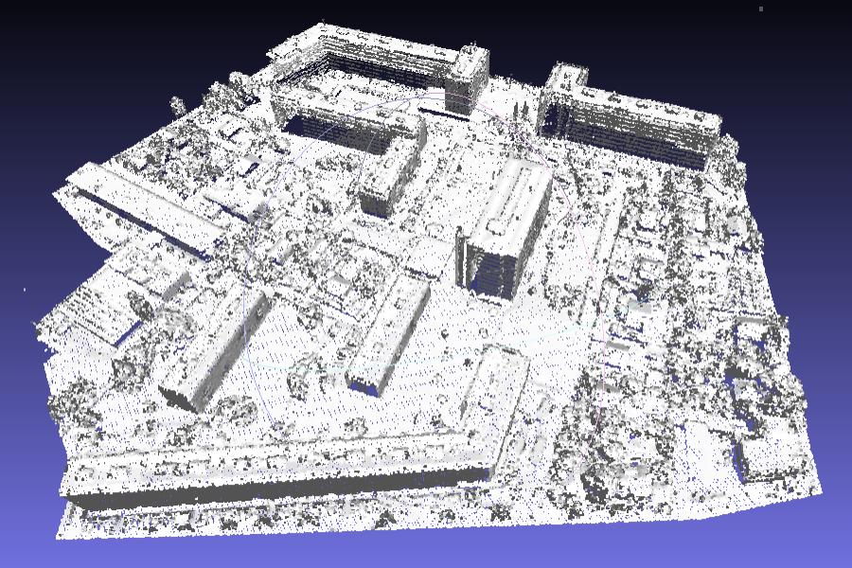
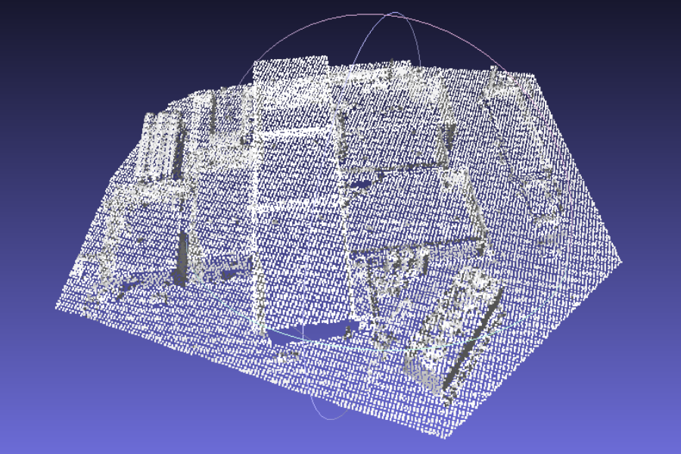
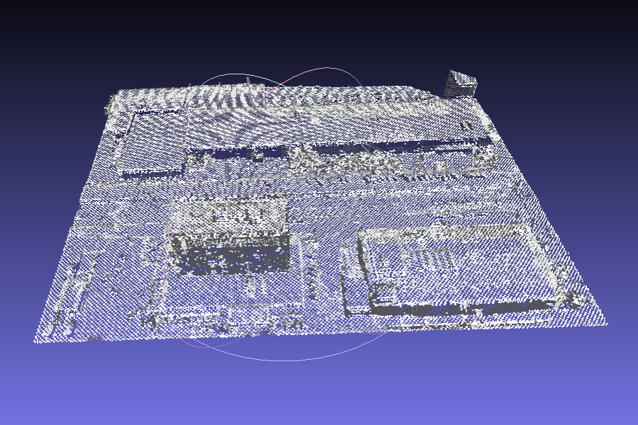
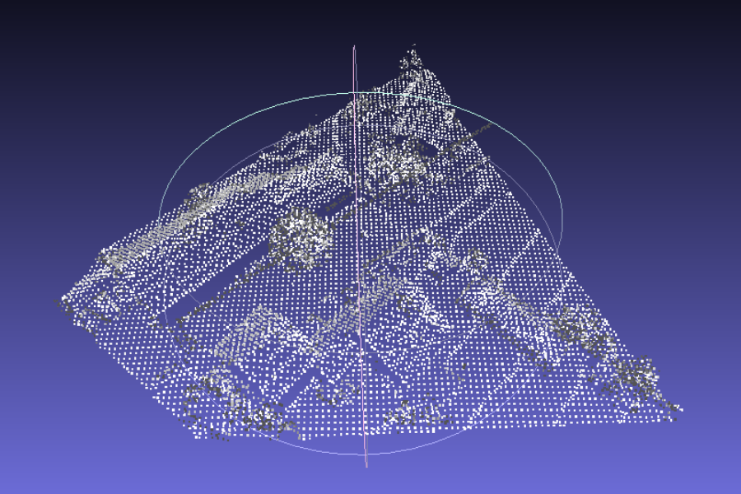
Dataset Overview
Notes:
Extracted smaller areas of the large clouds
To build the testing set, random rotations and translations were applied to create the source, original clouds are the targets.
Then preprocessed them.

Slide 7
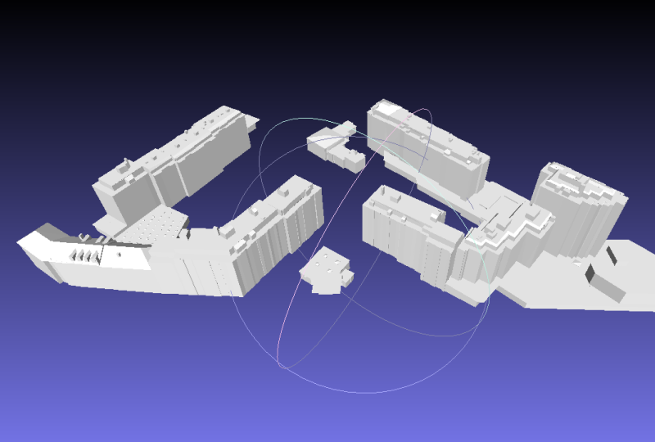
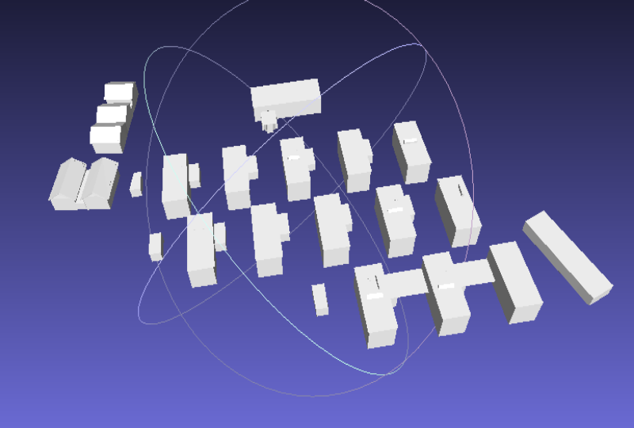
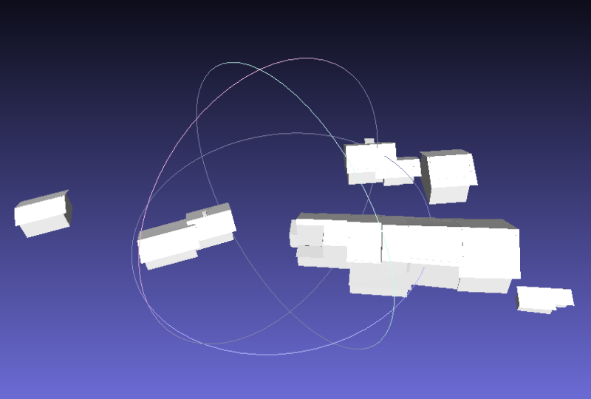
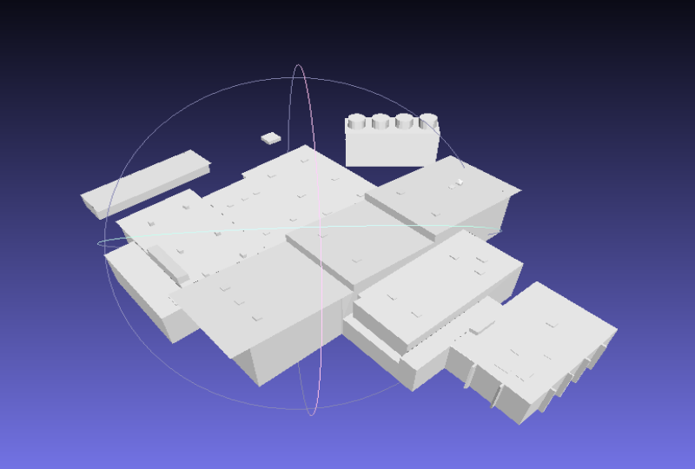
Dataset Overview
Notes:
For meshes, same thing, but no preprocessing is needed.
Then these alignments have been run:
40 Mesh-mesh
80 Cloud-Cloud
52 Cloud-Mesh
Here is an example of such run.

Slide 8
Alignment Example
Notes:
About 40’000 points for each cloud

Slide 9
Results – Evaluation Process
Statistics:
  Rotation error:
    Euler angles are computed on M:
    The error value is given by:
  Translation error: Distance between the centroid of matched plane’s centers of the source and target planes.
Notes:
Rotation error:
→ R*R’ is identity if the found rotation is optimal. → then the Euler angles are all equal to 0.
Translation error:
Compute centroid of planes centers from the list of selected planes in the source, and the centroid of planes centers from selected planes in target.
→ Take the norm of this vector.
→ Equal to 0 if the source has been perfectly aligned, thus positioned.

Slide 10
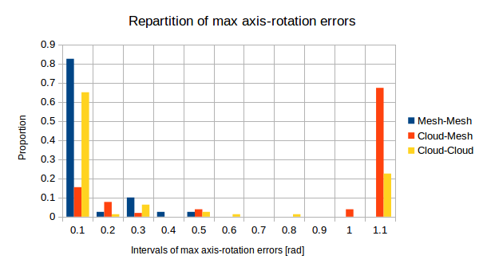
Results – Rotation Error
Notes:
0.1rad = 5.7°
Mesh:
Average: 2.66°
Median: 0.024°
Cloud:
Median: 1.6°
More High angles → flipped clouds
Cloud-Mesh:
Higher errors, lots of flipped source.
Satisfying for mesh-mesh and cloud-cloud.

Slide 11
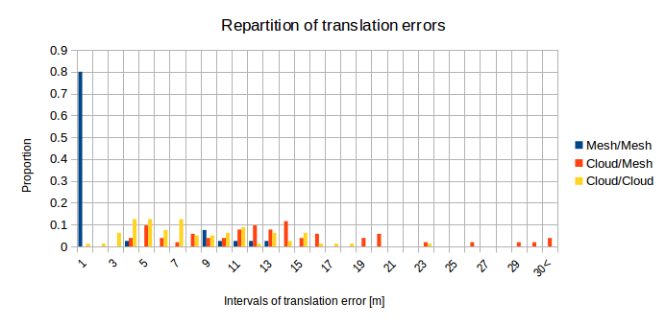
Results – Translation Error
Notes:
Mesh – Mesh: goods results with less than 1 meter translation error
However:
Cloud – Cloud: errors are higher and uniformly distributed in between 2 to 20 meters.
→ Curious for cloud – cloud, because the visual results does not seem to have such bad errors.
→ Hint that it can com from mistakes when selecting matching planes.

Slide 12
Results – Plane matching evaluation
Principle:
  Evaluation of the matching quality after alignment.
  Each plane’s centroid is displayed as a point (red=source, green=target).
  The centroids that have been matched together are linked by a white line.
  Ideally: every source point is linked to the nearest target point and these overlap.
Notes:
In order to understand the strange translation errors: added another statistics
The distance between two corresponding centroids has been recorded for all matched planes.
Each result is displayed with the reference to its left

Slide 13
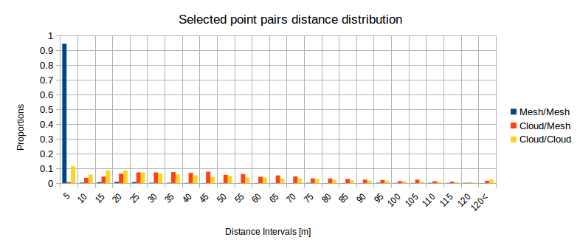
Results – Plane matching evaluation
Notes:
Confirms results of translation errors.
Mesh-Mesh are very satisfying.
→ There is a problem when matching planes together because even with a lot of successful cloud-cloud alignments their distance between source and target centers of each corresponding plane is more or less uniformly distributed in the interval.
→ Visual results

Slide 14
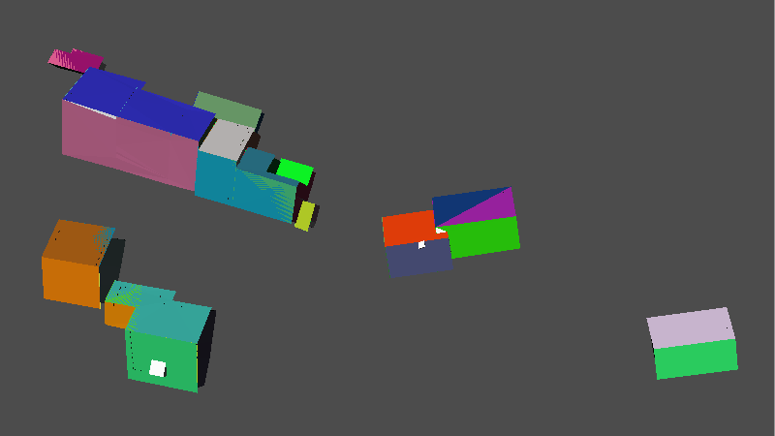
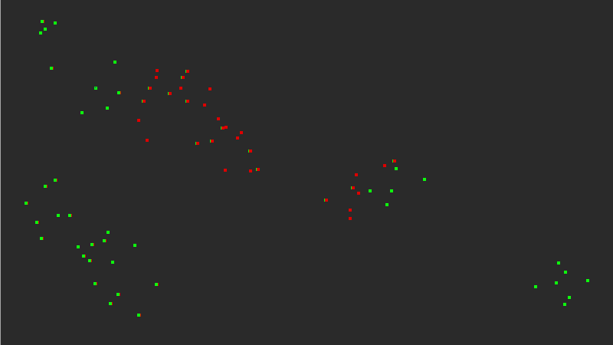
Results – Plane matching evaluation
Mesh → Mesh: Ideal case
Notes:
Mesh on Mesh:
Ideal case → Distance between each selected point is near 0
Only point correspondence in overlap area.

Slide 15
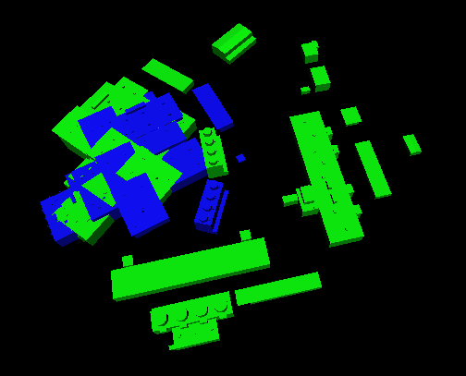
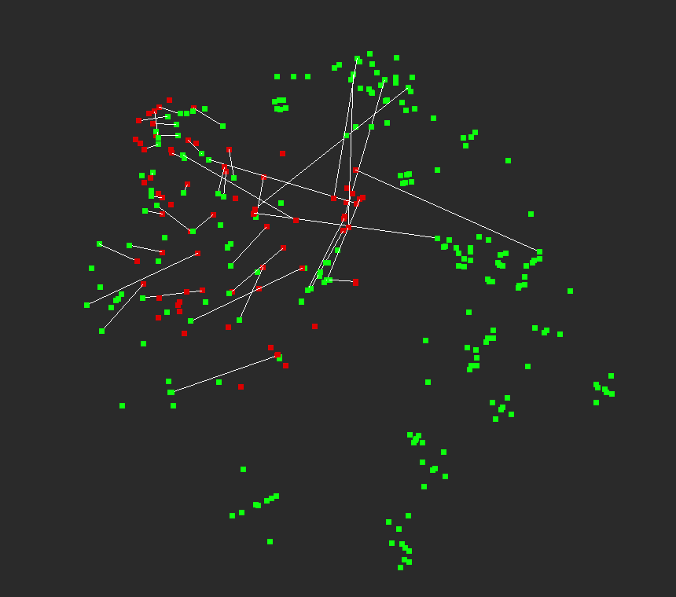
Results – Plane matching evaluation
Mesh → Mesh: With rotation error
Notes:
Only wrong rotation. → Wrong correspondences due to choice imprecisions. Some are with neighboring planes, other more far away.
For example a neighboring roof → several meters of error.

Slide 16
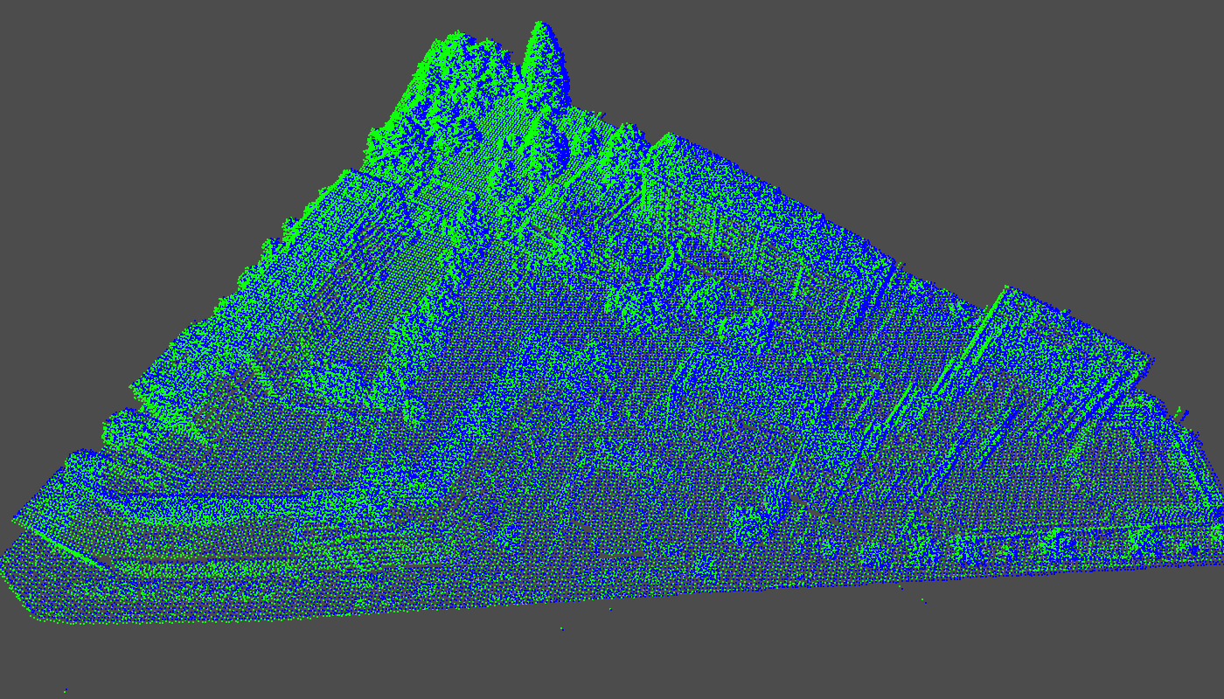
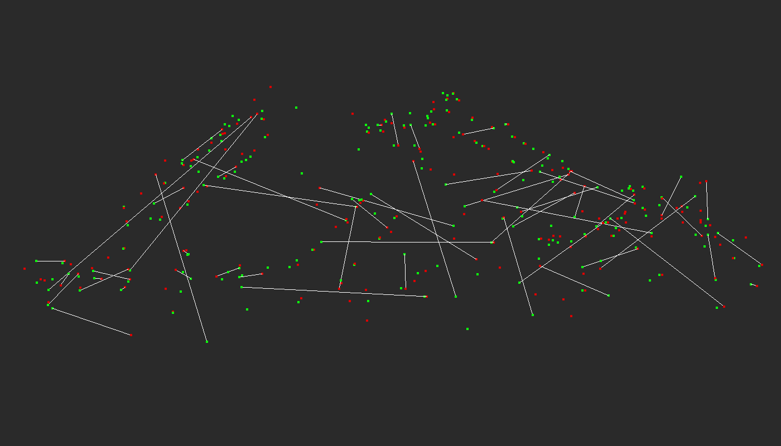
Results – Plane matching evaluation
Cloud → Cloud
Notes:
Good alignment.
Like with previous example.
Some source plane matched with a target plane that is near the optimal one. For example a neighboring roof or wall.
Long correspondences which are incorrect.
→ Alignment however is good because these compensate each other + last ICP step is done on the complete lists of centers.
→ Zoom a bit

Slide 17
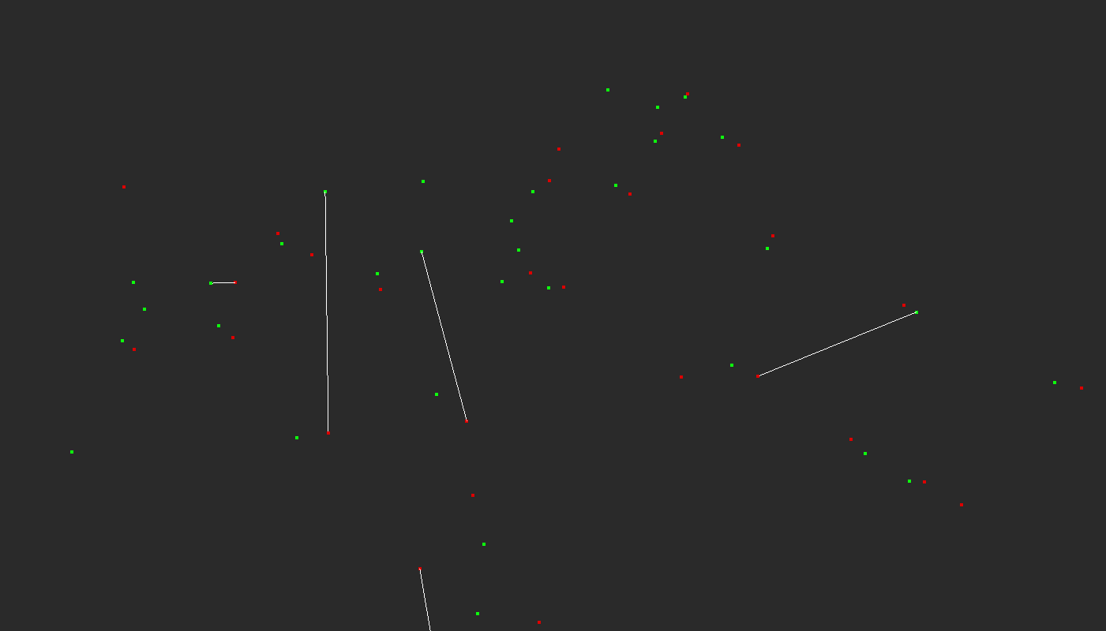
Results – Plane matching evaluation
Cloud → Cloud: Closer Look
Notes:
Precision issue: Some source points are linked to a neighbor of the optimal target point. → Easily 10+ meters of error, for planes of buildings
Plane segmentation however seems good: most of the source points have a target point nearby.

Slide 18
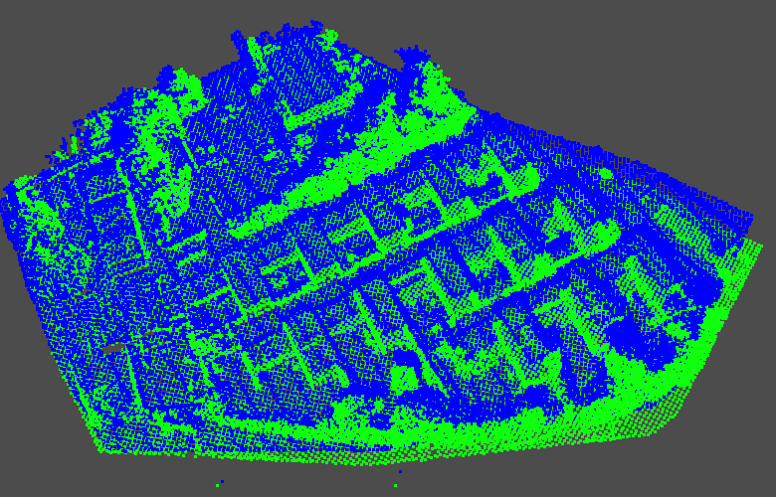
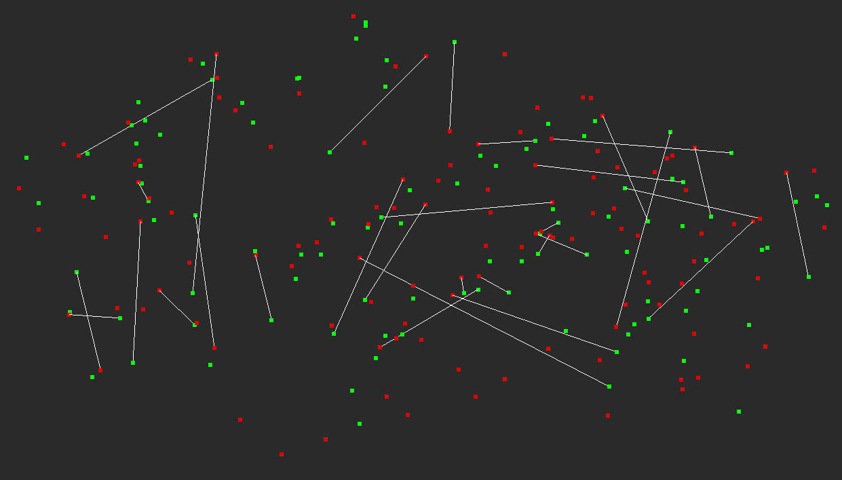
Results – Plane matching evaluation
Cloud → Cloud: Rotation error
Notes:
Small rotation error.
Pattern of points correspond well → Plane segmentation works well.
Like before → plane matching not so much.

Slide 19
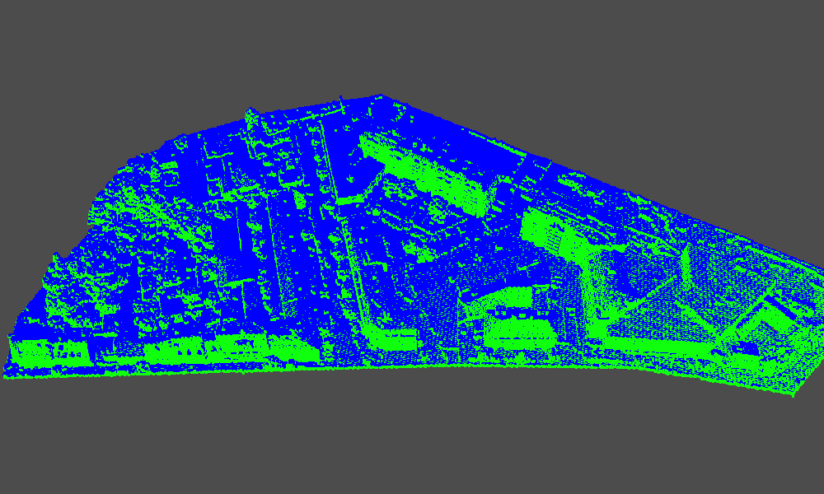
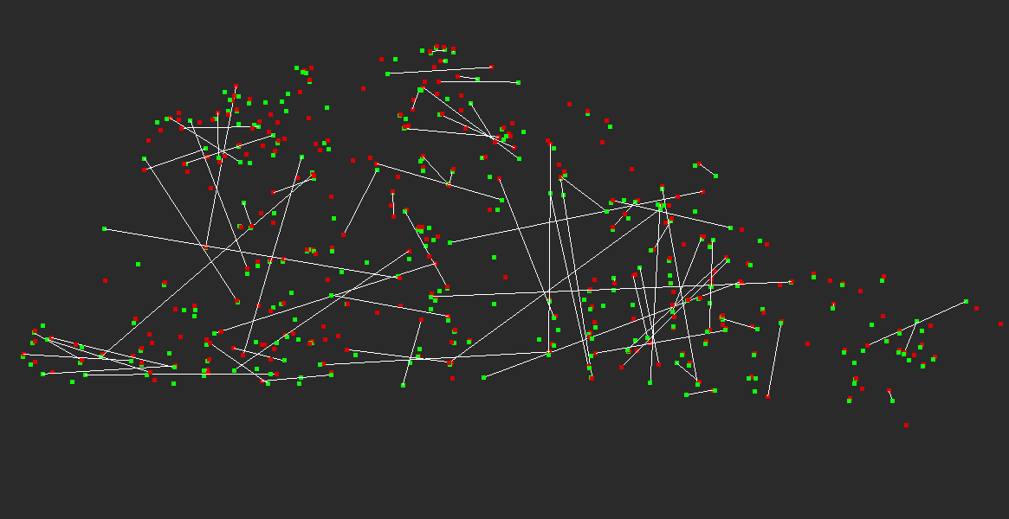
Results – Plane matching evaluation
Cloud → Cloud: Translation error
Notes:
Small translation error of 1- 2 meters.
Same here: planes distribution are similar in both the the source and target.
But plane matching is not good.

Slide 20
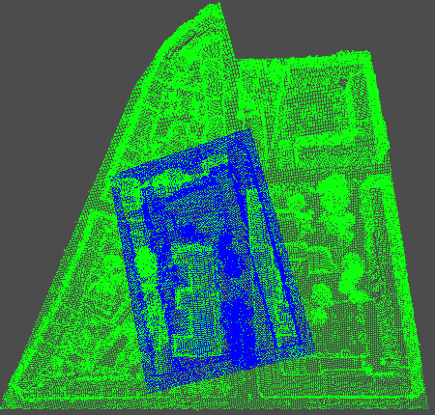
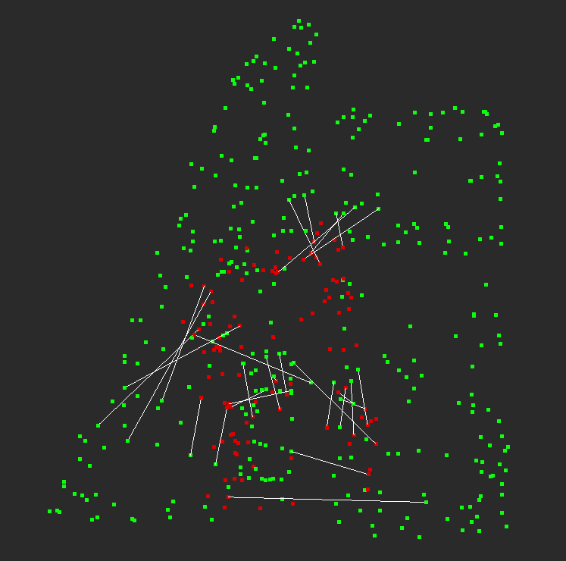
Results – Plane matching evaluation
Cloud → Cloud: Source has been flipped.
Notes:
Source is flipped by 180° + Translation error
This happens mainly when the target is larger than the source. It is a typical case of getting stuck in a local minimum.
Usually the source is still more or less at the correct location, but flipped, in this example it is not the case.
Pattern of buildings that are similar: long, with the same roof type → APFH is not descriptive enough → wrong pairs.

Slide 21
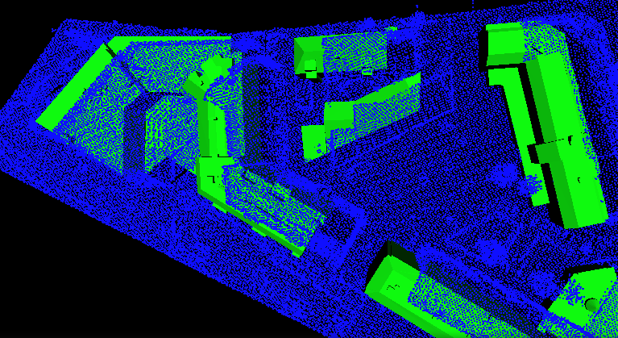
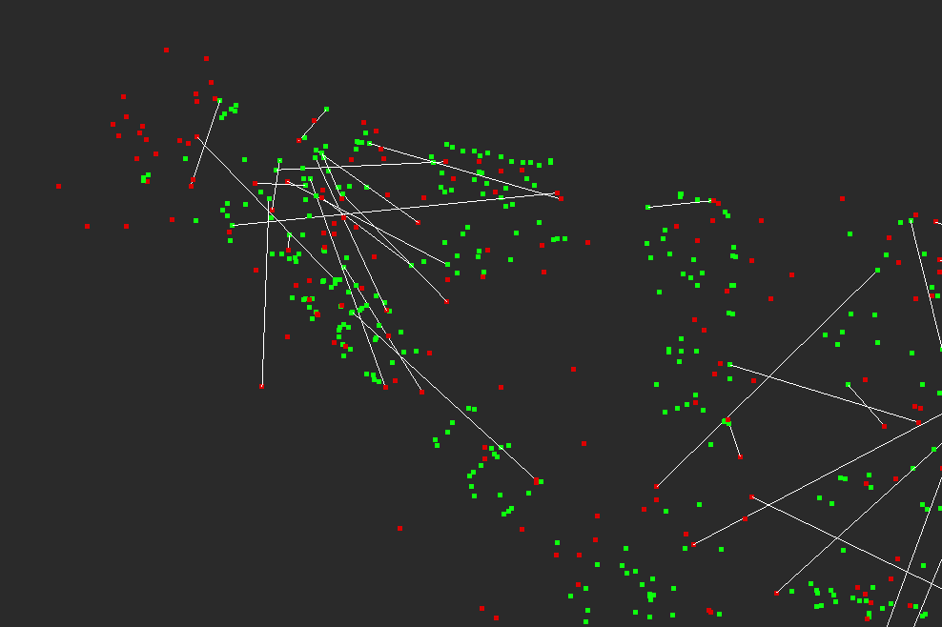
Results – Plane matching evaluation
Cloud → Mesh: Translation error
Notes:
Now the same with cloud – mesh alignments.
Translation Errors: Same problem than previous examples.
Additional Cause: Mesh and Clouds are different → Ground → planes not present in mesh.
Some small houses in cloud that are also not in mesh, but in the cloud it as been segmented in planes.

Slide 22
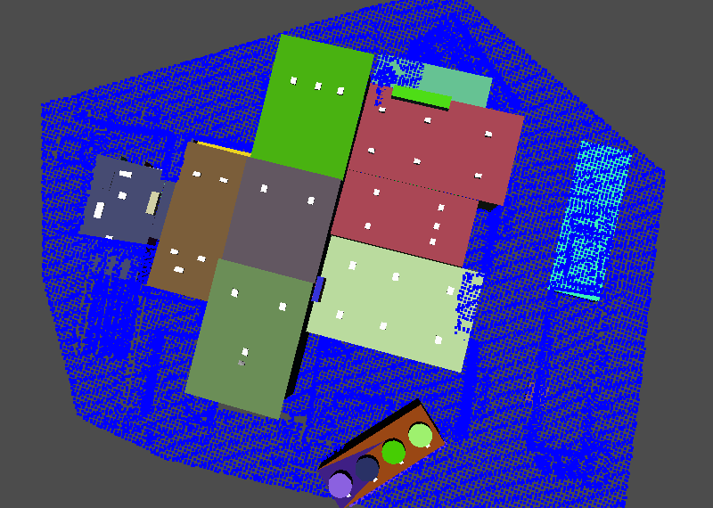
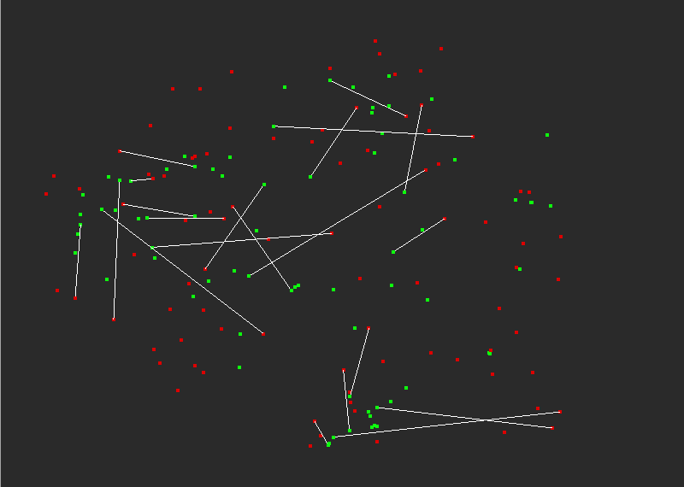
Results – Plane matching evaluation
Cloud → Mesh: Source was flipped
Notes:
Last example with a flipped cloud source on mesh.
→ Happens often with this type of alignment.

Slide 23
Main Issues
Plane segmentation:
  Precision of the segmentation: missing or incomplete plans.
  Cloud → Mesh: Very different objects (ground planes, level of details).
  → APFHs can change.
Plane matching selection:
  Imprecisions: neighboring planes of optimal one can be selected.
  When the target is larger, points that are not in the overlap can be matched.
→ The current features aren’t discriminant enough when the lists of planes change.
→ The selection process is not well adapted
Notes:
Segmentation:
Feature histograms that are computed do change between a source and target that represent the same area. → we have seen that with perfect mesh-mesh, it works.
→ These difference between feature histograms cause matching imprecisions and errors.
→ Thus, the current feature histograms aren’t enough discriminant to find good plane associations in a robust way.
Nonetheless, the results for Cloud on Cloud alignments are still good → The errors of pair selection does seem to compensate themselves, so that the alignment is near it’s optimal solution and the ICP phase is sufficient to correct the imprecisions.

Slide 24
Conclusion
Enhancements:
  Increase the APFH descriptiveness
  Perform alignment on several versions of the segmented planes.
  Cloud → Mesh: Exclude planes on the ground → Need a way to detect them.
  Change pair selection process: Ransac
Notes:
Adding new features to histogram.
Plane merging and segmentation parameters can be tweaked to output variable level of detail → merge more or less. For example change the upper bound on normal vectors angle, or criterion on overlap distances.
Planes on the ground have often complicated shapes, non, convex, and so on. Could detect these shapes and exclude them.
Pair selection process must be resistant to partial overlap, incomplete sets, noise.
→ Can correspond to a Ransac based algorithm. → on the list of planes, thus much faster.
Finally, it needs more work into this simplification idea, but we have seen that the principle can work if the simplification produce similar results for all type of object.

Slide 25


Alignment algorithm
  Comparing APFHs:
  Modified least squares optimization function:
  Resulting SVD problem to find th optimal rotation:
  The translation is then computed:

