Slide 1
Tool intro: Recogito / Pelagios
Robert Casties
MPI for History of Science, Germany

Slide 2
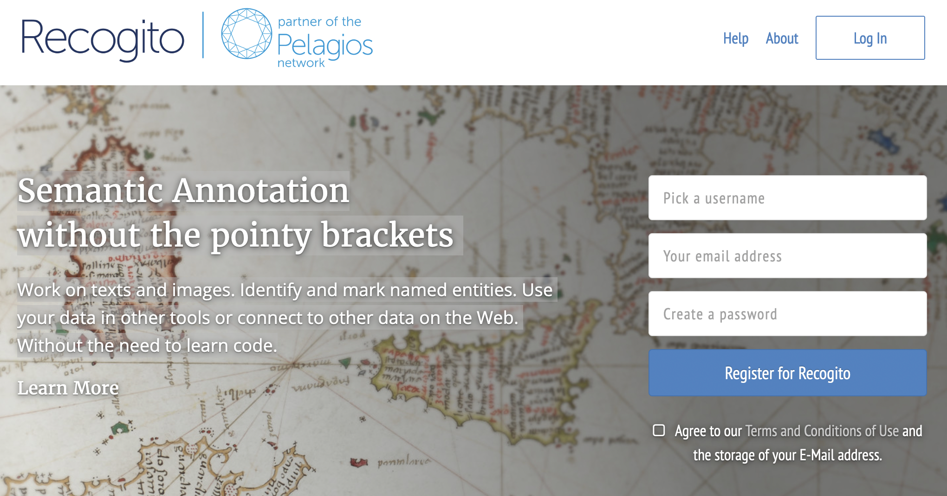

Slide 3
Recogito
https://recogito.pelagios.org/
Free webservice to annotate documents
Works with text (plain, TEI) and image (file, IIIF) documents
Annotate places, persons and events in the document
Annotate relations between entities
Places can be linked to gazetteers (Pleiades, Geonames, …)
Simple custom vocabularies (term, URI)

Slide 4
Recogito
Private or public use or collaborative editing in groups
Export in different formats (CSV, JSON, TEI, not all formats support all annotations!)

Slide 5
Pelagios
https://pelagios.org/
The Pelagios Network is a long-running initiative that links information online through common references to places.
Started with Recogito, the Pleiades gazetteer and the Peripleo visualization https://peripleo.pelagios.org/
Now a Network of practicioners on the areas Annotation, Collaboration, Gazetteers, Pedagogy, Registry, Visualisation

