Slide 1
Processing Recogito annotations
Robert Casties
MPI for History of Science, Germany

Slide 2
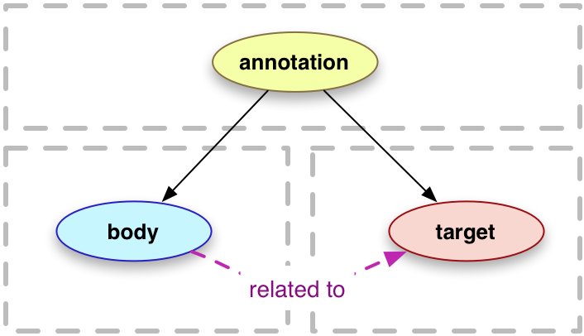
Recogito annotations
Use W3C Web Annotation ontology https://www.w3.org/TR/annotation-model
Place annotations use GeoJSON https://geojson.org/

Slide 3

CIDOC-CRM
“The CIDOC Conceptual Reference Model (CRM) is a theoretical and practical tool for information integration in the field of cultural heritage.”
https://cidoc-crm.org/
Nice overview of current 7.1.1 version: https://cidoc-crm.org/html/cidoc_crm_v7.1.1.html

Slide 4
Recogito annotations
Annotations can be fully exported as JSON-LD https://json-ld.org/
Annotated relations need to be exported separately as CSV
Relation endpoints are annotated entities in the text (“Adam” at position 10133 –is_father_of-> “Seth” at position 14555)
To generalize relations we need to create URIs for generic entities (“the person Adam” of type crm:E21_Person)
Then we can create relations between the person entities (“the person Adam” –crm:P152_has_parent→ “the person Seth”)

Slide 5
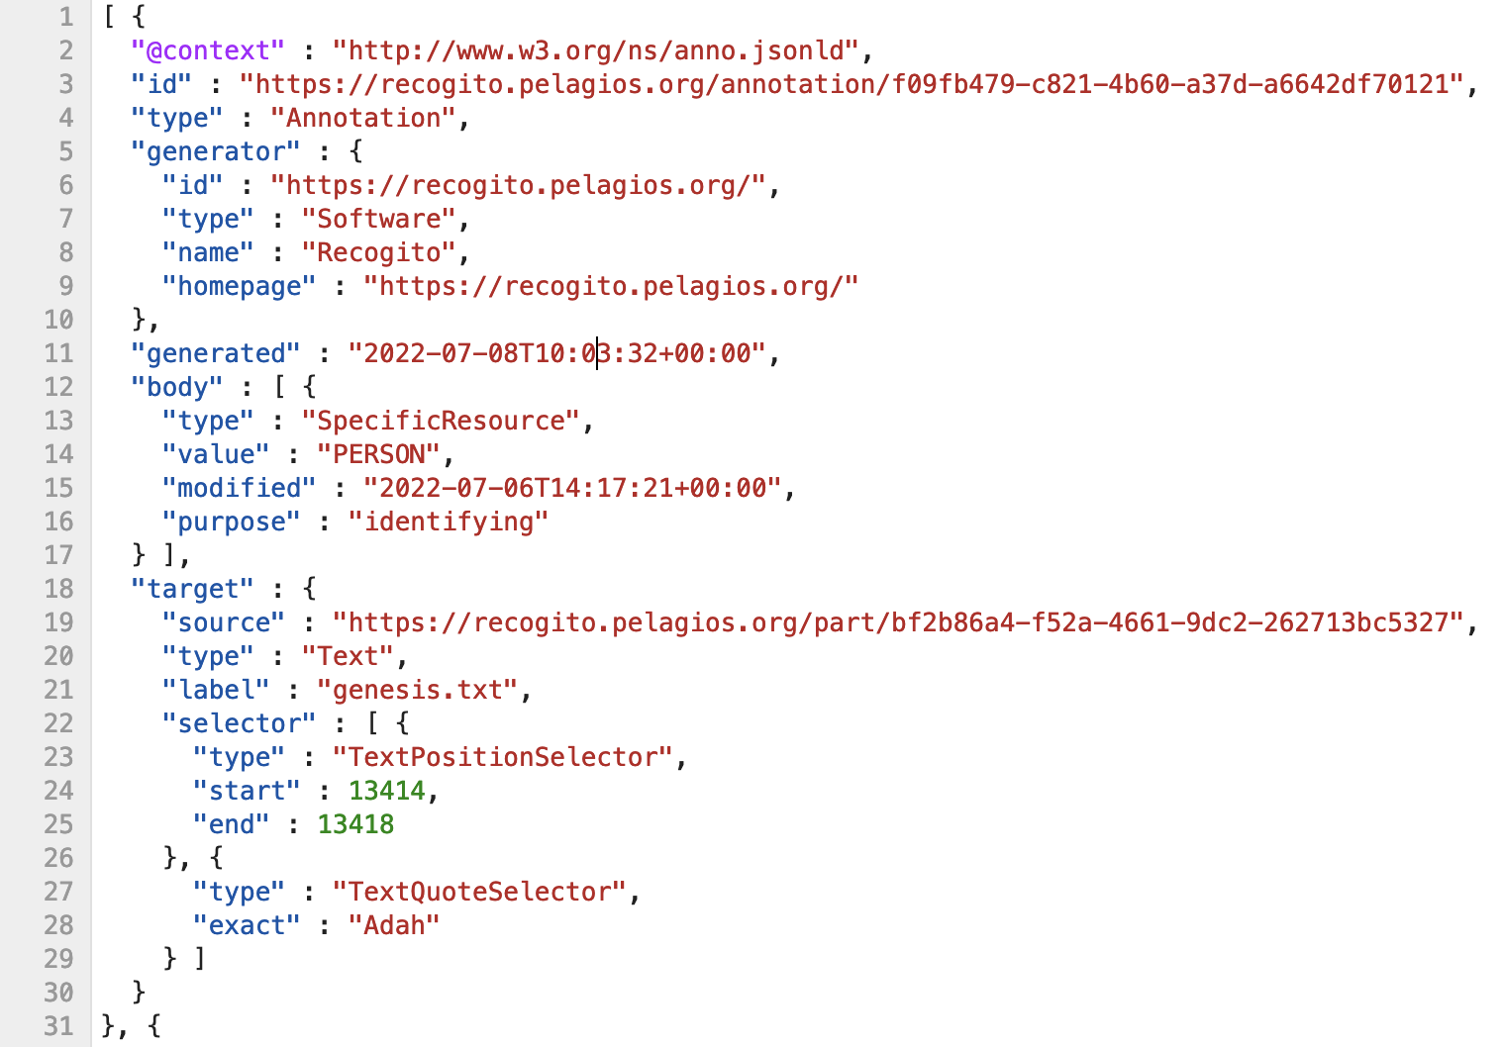

Slide 6
