Slide 1
Tool intro: Blazegraph
Robert Casties
MPI for History of Science, Germany

Slide 2
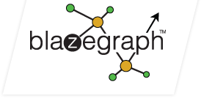
Blazegraph
https://github.com/blazegraph/database
(old: https://blazegraph.com/)
Triplestore: stores RDF triples and allows SPARQL queries
Import and export of different RDF formats
Simple web frontend

Slide 3
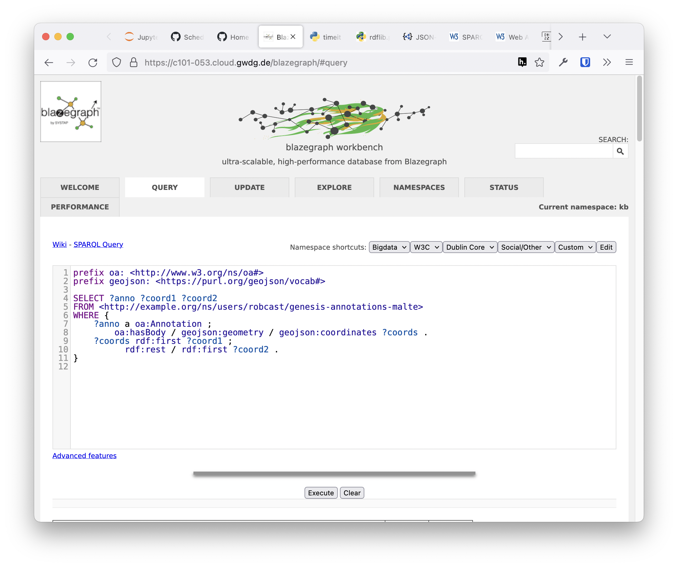

Slide 4
Blazegraph
Supports SPARQL 1.1, including Update
Works with many libraries, including RDFlib
Proprietary full-text search using Lucene/Solr
Good performance, even for large graphs
Run as Java application or Docker container
Open source, but unmaintained
Many other Triplestores, mostly commercial or not very performant

