Slide 1
Annotating Data in Recogito
Christian Chiarcos
University of Cologne, Germany

Slide 2
Workflow for the tutorial
Goal: Show how RDF technology can be used for combining tools and data
  here: annotate and link named entities
Recogito: Annotate with JSON-LD
  plain text => plain text + RDF data
Protége: Create and browse ontologies
  OWL
BlazeGraph: Query, transform and link annotations and ontologies
  OWL + RDF data
Sample data:
  World English Bible (English)
  if you have your own data, feel free to try that, as well, but this is what we prepared

Slide 3
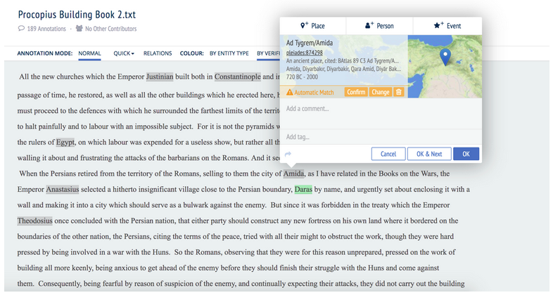
Recogito
Tool for the annotation of (e.g., geographical) entities and their relations
https://classicalstudies.org/scs-blog/kilian-mallon/review-recogito-visualizing-mapping-and-annotating-ancient-texts

Slide 4
Recogito
Intro Example data (5 min)
https://classicalstudies.org/scs-blog/kilian-mallon/review-recogito-visualizing-mapping-and-annotating-ancient-texts

Slide 5
TODO: walk through (20 min)
Tool for the annotation of (e.g., geographical) entities and their relations
Walk through with example data (20min)
- create account
- download data from GitHub
- upload data into Recogito
- hand-annotate a few terms
- run NER
- annotate "father of" relationship
- export JSON-LD

