Slide 1
Tool intro: Protégé
Christian Chiarcos
University of Cologne, Germany

Slide 2
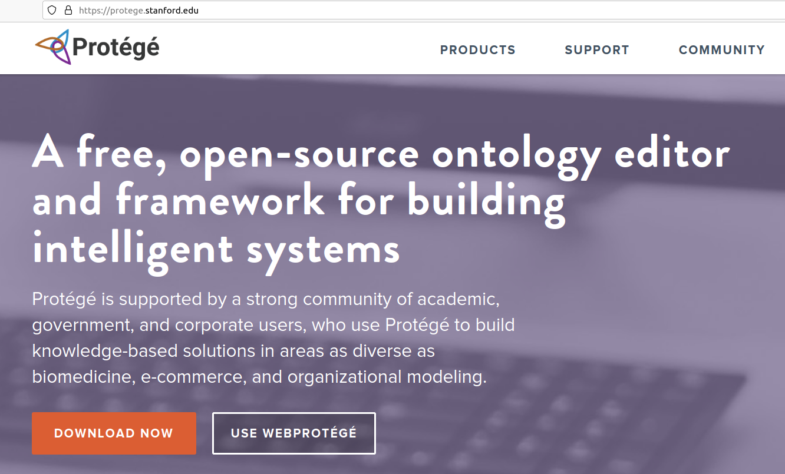
Protégé
Protégé ontology editor
two flavors:
- web version
- desktop version
use for browsing,
querying, editing
or creating ontologies
vast amount of plugins:
- visualizations
- reasoners
- domain adaptations

Slide 3
WebProtégé: https://webprotege.stanford.edu/
Protégé ontology editor
two flavors:
- web version
- desktop version
use for browsing,
querying, editing
or creating ontologies
vast amount of plugins:
- visualizations
- reasoners
- domain adaptations

Slide 4
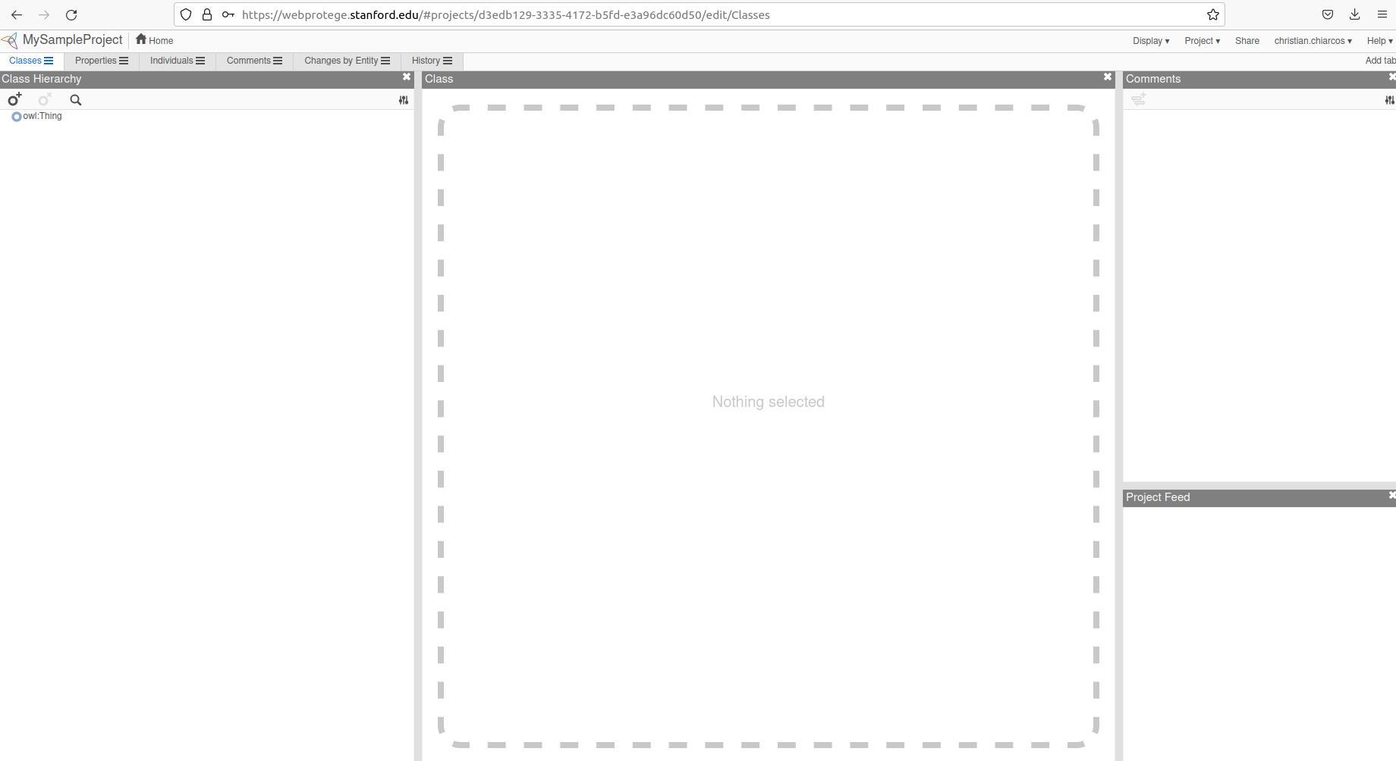
WebProtégé: Tabs / Views
WebProtégé: https://webprotege.stanford.edu/
tabs for:
- classes (concepts)
- properties (relations)
- individuals (instances)
- etc. (can be customized)

Slide 5
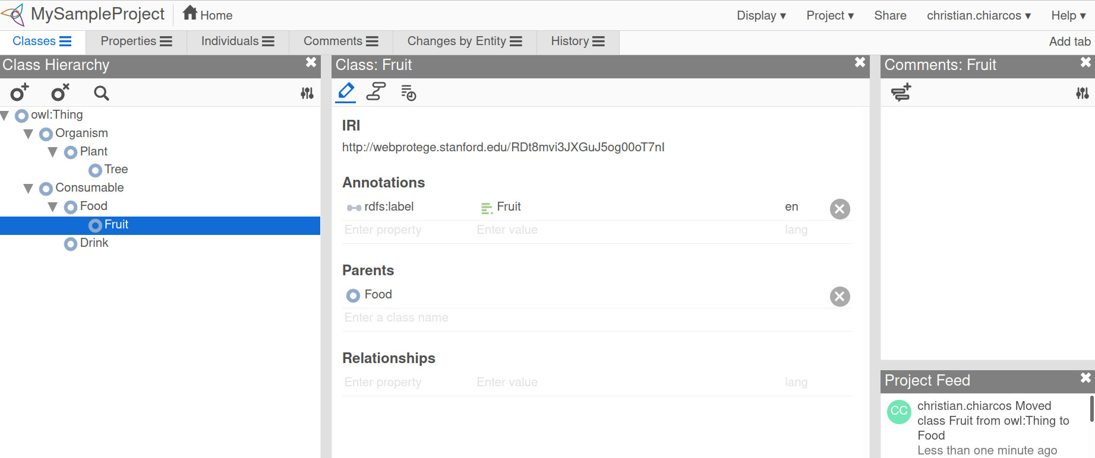
Class View (first/default tab)
Class Definitions
add your own:
- annotations
- parents
- relationships

Slide 6
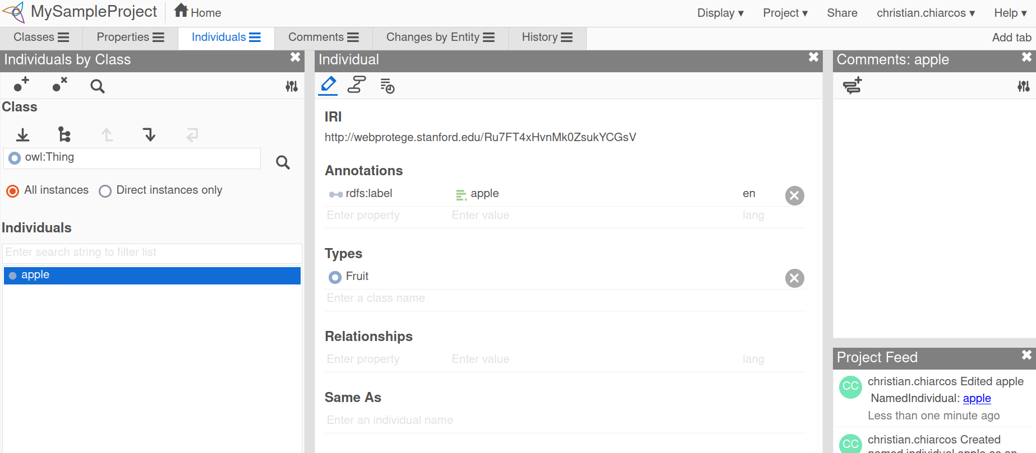
Individuals View: Create an individual
click on the symbol
and make up a name ;)
note that this will be an
instance of owl:Thing
(“anything”)
We should give it a type

Slide 7
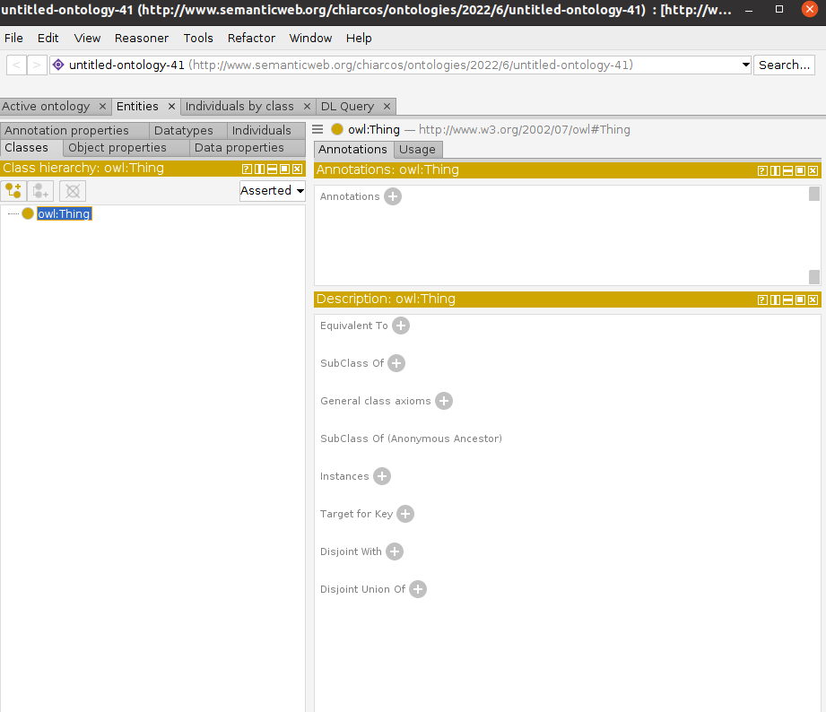
WebProtégé and Desktop Edition
WebProtégé gives you a head start
Desktop edition
similar structure and look
can read and write exactly the same data as WebProtégé
supports many more extensions
(you can actually write your own)
interface a bit more crowded
you can work offline ;)

Slide 8
Properties, Statements, Axioms, Inference
Protégé can be used to
  create/manage taxonomies of concepts
  create instances
But there’s more to it:
  browse/query/explore knowledge graphs
  create properties
    (relations between/features of concepts)
  create axioms
    (formal definitions of concepts and properties)
  perform reasoning
    (drawing inferences from concept definitions)

Slide 9
For your convenience
Complementary slides with a mini-walk through for
creating an ontology with WebProtégé
In the tutorial, we will have a
more thorough walk-through
through Desktop Protégé ;)

Slide 10
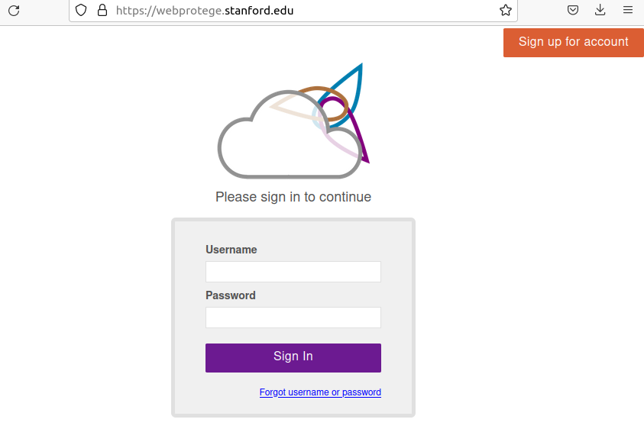
WebProtégé: https://webprotege.stanford.edu/
WebProtégé requires registration
Please do that now, you need your accounts in a few minutes

Slide 11
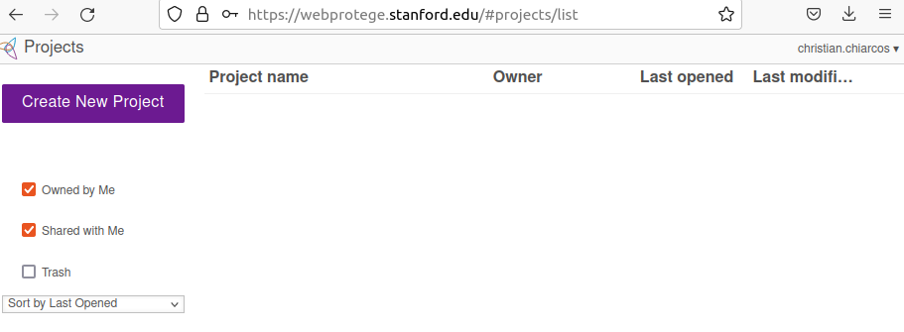
WebProtégé: https://webprotege.stanford.edu/
So, create new project

Slide 12
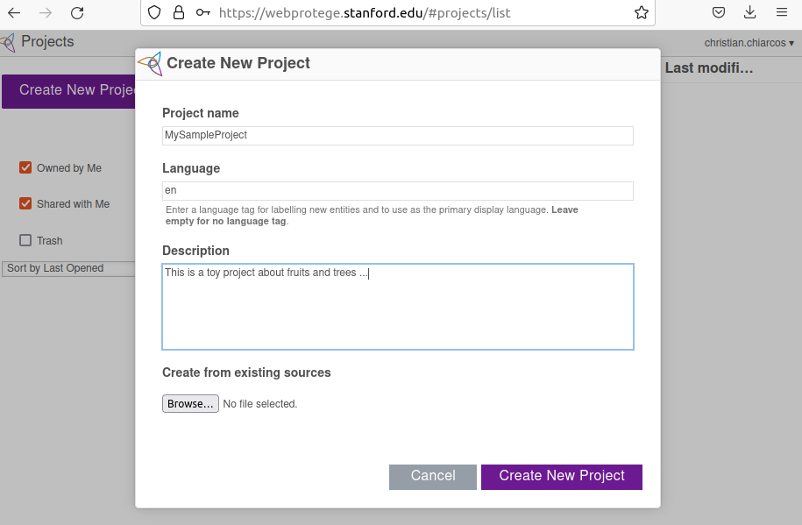
WebProtégé: https://webprotege.stanford.edu/

Slide 13
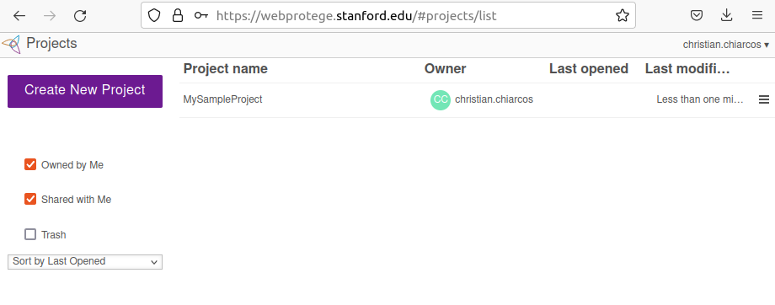
WebProtégé: https://webprotege.stanford.edu/
Now, let’s open “MySampleProject”

Slide 14
WebProtégé: https://webprotege.stanford.edu/
tabs for:
- classes (concepts)
- properties (relations)
- individuals (instances)
- etc. (can be customized)

Slide 15
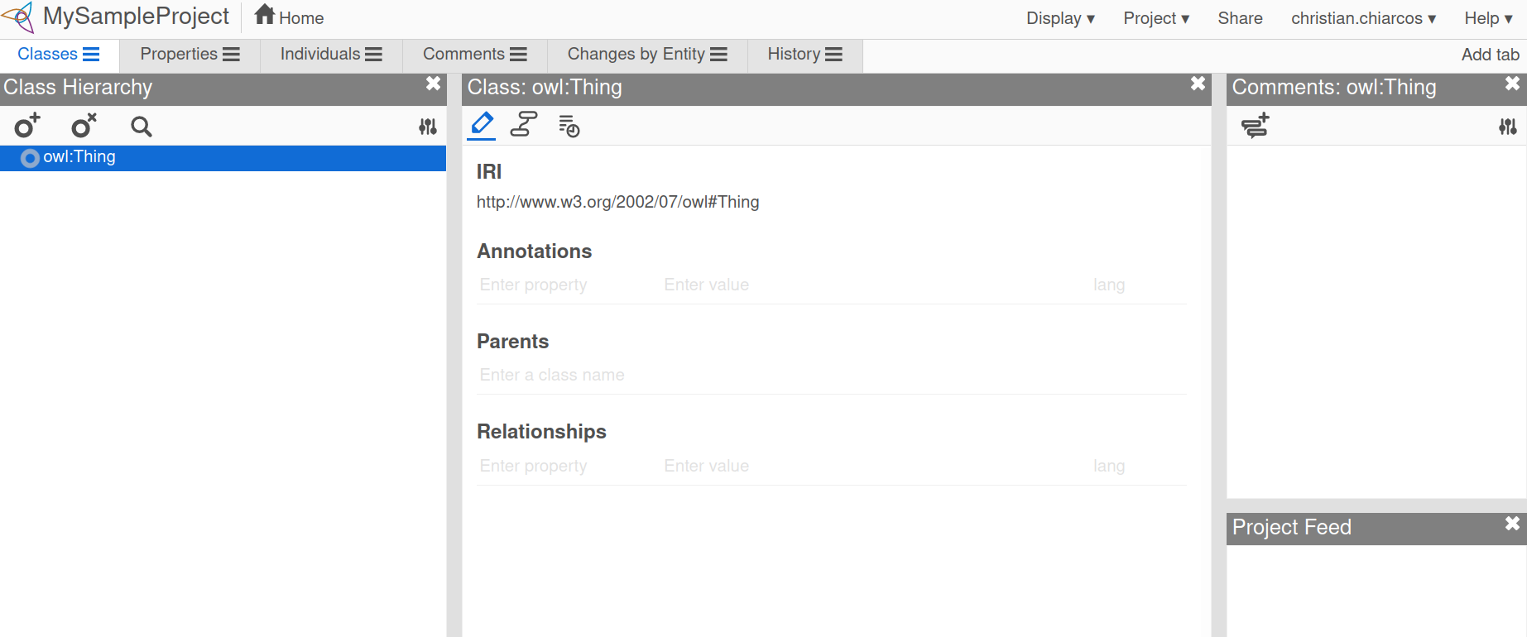
Class view (first/default tab)
Class Hierarchy:
browse,
create (O⁺),
delete (O^{X})
concept hierarchy

Slide 16
Class view (first/default tab)
Class Definitions
add your own:
- annotations
- parents
- relationships

Slide 17
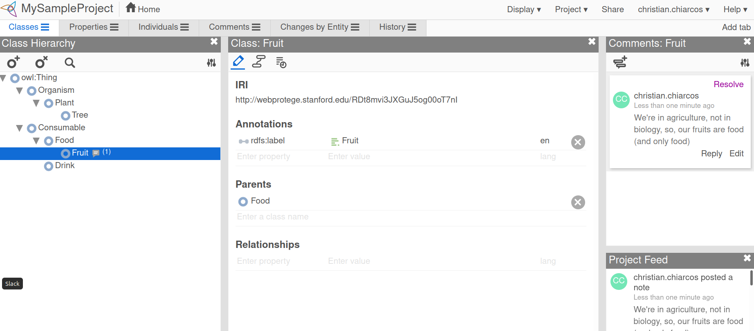
Class view (first/default tab)
Comments:
add your own
Project Feed:
activity log

Slide 18
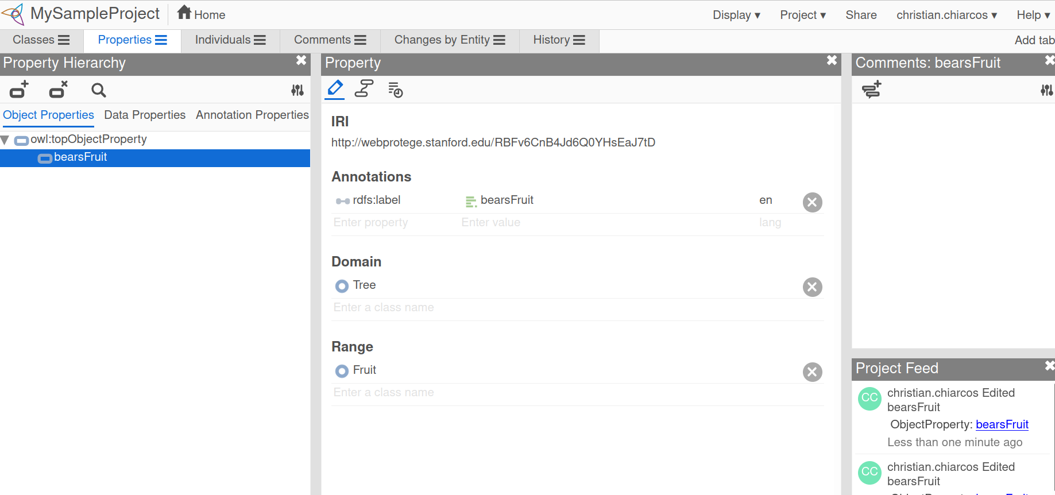
Properties View (analogous structure)
Comments:
add your own
Project Feed:
activity log
Object properties
between individuals
Data properties
attribute-value pairs
Annotation properties
properties of concepts

Slide 19
Individuals Tab: Create an individual
click on the symbol
and make up a name ;)
note that this will be an
instance of owl:Thing
(“anything”)
We should give it a type

Slide 20
Individuals Tab: Give it a type
click on “Types”
and enter one of the
classes/concepts you
just created

Slide 21
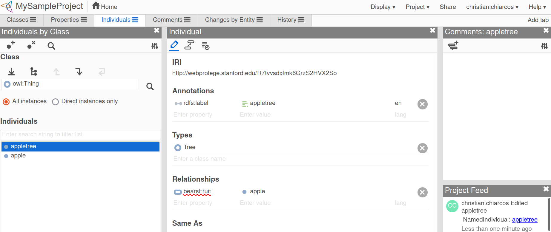
Individuals Tab: Create statements
“Relationships”
just enter the form
with properties and
individuals

Slide 22
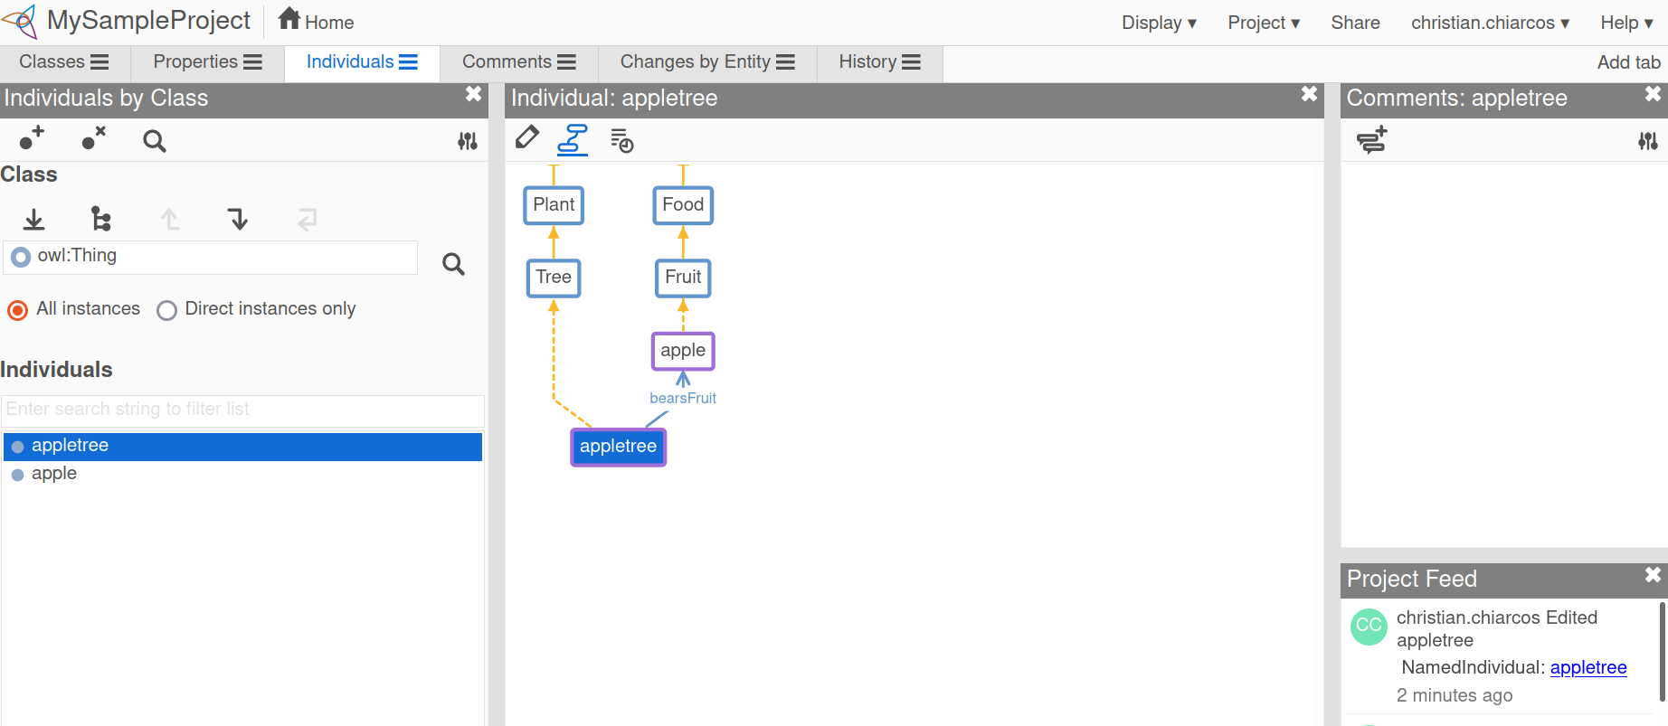
Individuals Tab: View your data
Entity Graph
(second logo)
dashed lines are
inferred triples

Slide 23
Querying: Add tab ...

Slide 24
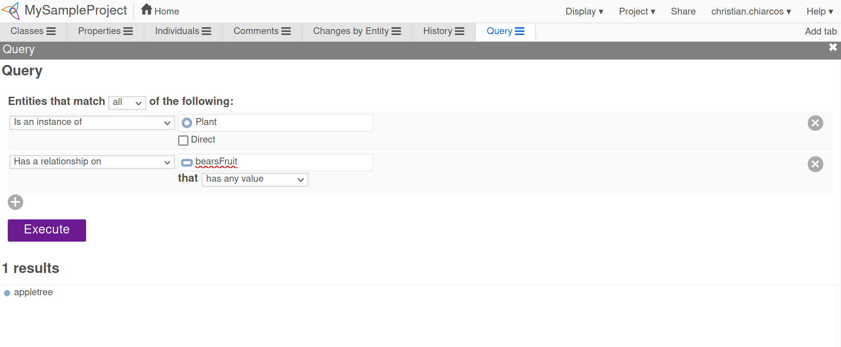
Querying: Query Builder
Implicit statements
We never declared
appletree to be a plant
Still, the query works ...

Slide 25
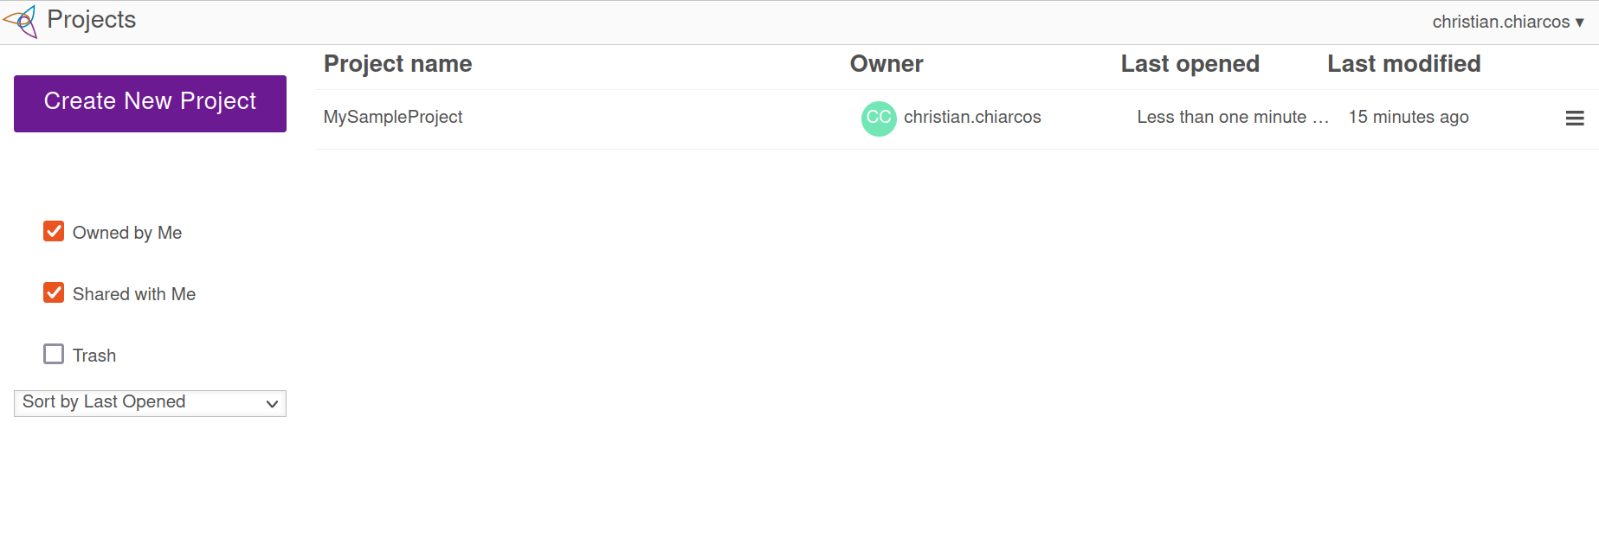
Back to “Home”: Saving it
click on “download”

Slide 26
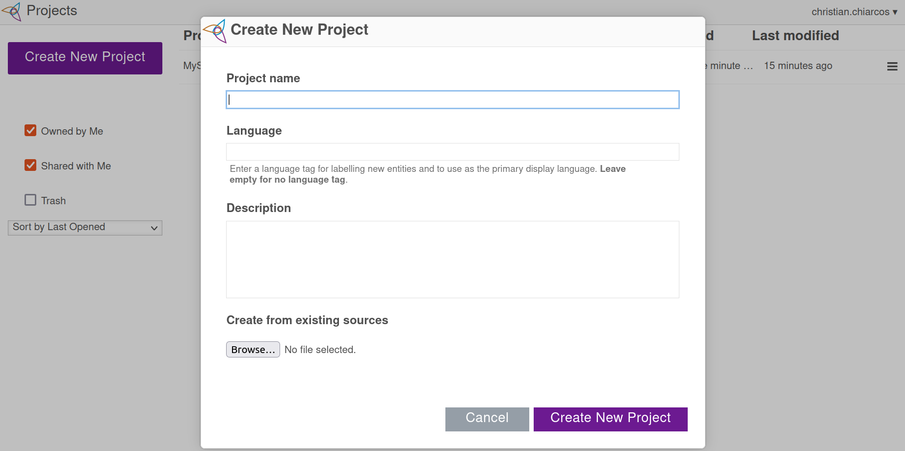
Beyond toy ontologies
When creating a new project, you can also load external ontologies from local files

