Slide 1
Tool intro: Jupyter Notebooks
Robert Casties
MPI for History of Science, Germany

Slide 2
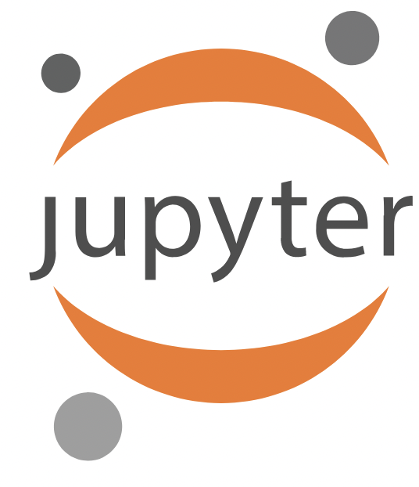
Jupyter(lab)
https://jupyter.org/
Web frontend for interactive programming notebooks
Support for many programming languages, like Python or R
Can be run locally or on a server
  pip install jupyterlab
  jupyter-lab

Slide 3
Jupyter Notebooks
Notebooks run a kernel for a specific language, e.g. Python
Notebooks are made of cells that contain either text (for documentation), lines of the programming language or the output of a programming cell
You can run notebook cells one-by-one or run the whole notebook as one
You can interactively change a cell and re-run it when developing your program
Github can show an uploaded notebook with its output

Slide 4
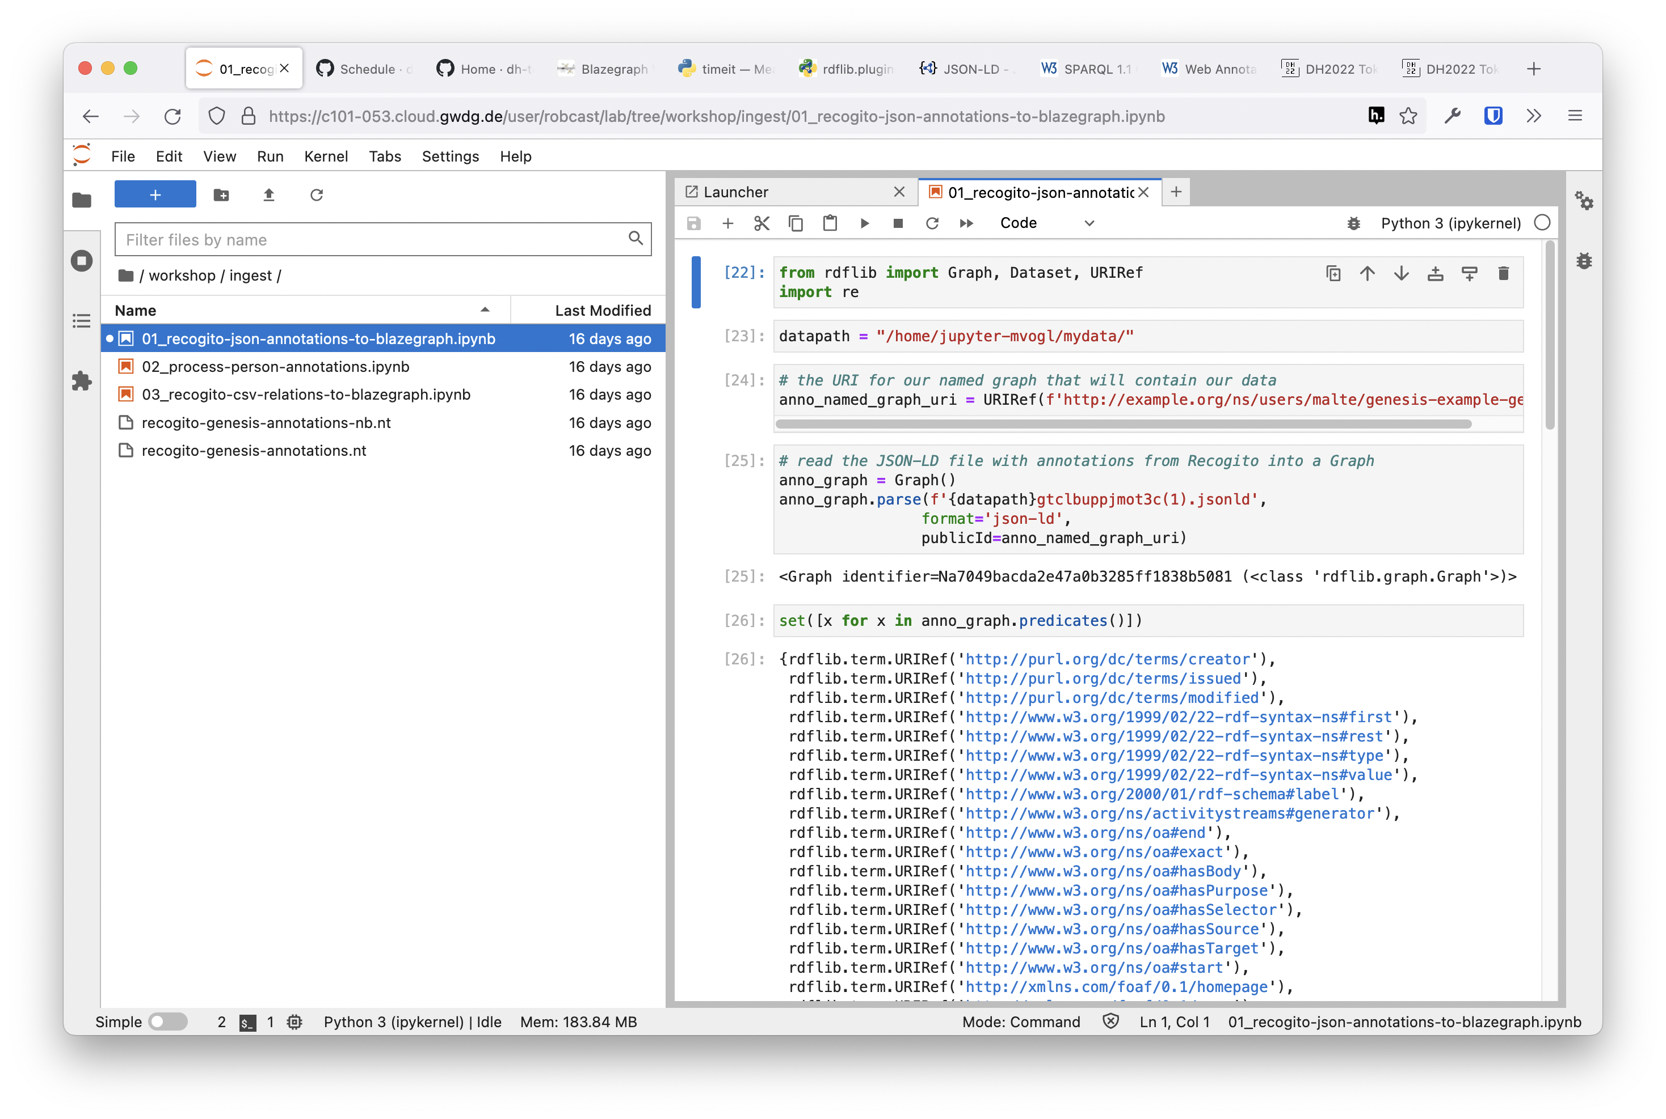

Slide 5
Jupyter Notebooks
Can be used for “literate programming” (Don Knuth)
Can be used for “reproducible science”
Can be converted into “real” Python programs (may need additional work)
Can be developed into books using https://jupyterbook.org

