Slide 1

SMART INDIA HACKATHON 2026
NIRANTAR
Problem Statement ID - SIH26001
Problem Statement Title -
Theme - Disaster Management
PS Category - Software
Team ID - RMKSIH26SW127
Team Name - ICONIX
AI-Based Early Warning and Landslide Risk Monitoring System in NER
- NIRANTAR

Slide 2
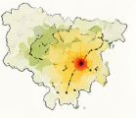


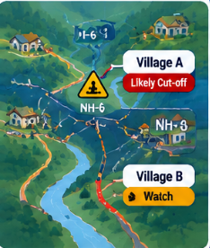
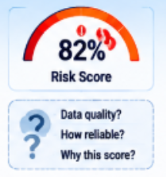
IDEA TITLE
ICONIX
ICONIX
NIRANTAR
Predict the risk. Protect the route. Prioritize the people.
PROBLEM STATEMENT
PROPOSED SOLUTION
To Build an AI-powered early warning system for landslide-prone NER areas using rainfall, soil moisture and terrain data and monitor vulnerable roads, villages and infrastructure, and support timely alerts and evacuation decisions.
Fuse rainfall, soil moisture and terrain with hyperlocal slope thresholds to estimate landslide risk to predict road isolation, route failure and the operational evacuation window and guide decisions with confidence aware risk, action cards and shelter routing.
CORE PROBLEMS
UNIQUENESS / NOVELTY
A road can fail before evacuation is complete.
Regional risk needs slope-level action.
Risk scores need confidence and data-quality context.
Remote areas need warnings that still work offline.
Does not predict road or community isolation.
Predictive road-isolation intelligence.
Dynamic safe-evacuation window
Explainable, confidence-aware AI.
Action cards + hazard aware shelter routing.
AI "Emergency Commander" chatbot.

Slide 3
















TECHNICAL APPROACH
ICONIX
System Architecture
TECH STACK
1 · DATA INGESTION
2 · AI RISK ENGINE
Technology Stack
Rainfall IMD · IMERG
Risk Engine XGBoost
+ rainfall
thresholds
3.HUMAN VALIDATION - DDMA officer
Data Sources
IMD • GPM-IMERG • Sentinel-1 • SMAP • DEM
Satellite Sentinel · SMAP · DEM
InSAR creep layer
Python • XGBoost • InSAR • Risk Thresholds
Citizen photo reports
Impact Runout · Road isolation ·
P1/P2/P3
AI / ML
decide
GEO-SPATIAL
GIS • Runout Modelling • Road Isolation
field reports
6.CITIZEN RESPONSE
4.GOVERNMENT DECISION
BACKEND
FastAPI • PostgreSQL/
PostGIS • REST API
Escalation alert
Green→Yellow→Orange→Red
5 · DISSEMINATION
SACHET / CAP 1.2
Risk map + P1/P2/P3 tiers
What-if simulator
Village action card in local language + voice
React • PWA • Offline Maps
Safe route & shelter
offline maps
Cell broadcast + SMS
FRONTEND
SHAP: why alert fired
Audit trail Created→Approved→Ack
Works offline BLE / Wi-Fi Direct mesh
Multilingual voice
COMMUNICATION
Acknowledge & report back to DDMA
Peers GSI · NESAC · IMD · 112
SMS • Cell Broadcast • Voice • BLE/Wi-Fi
ack / audit

Slide 4
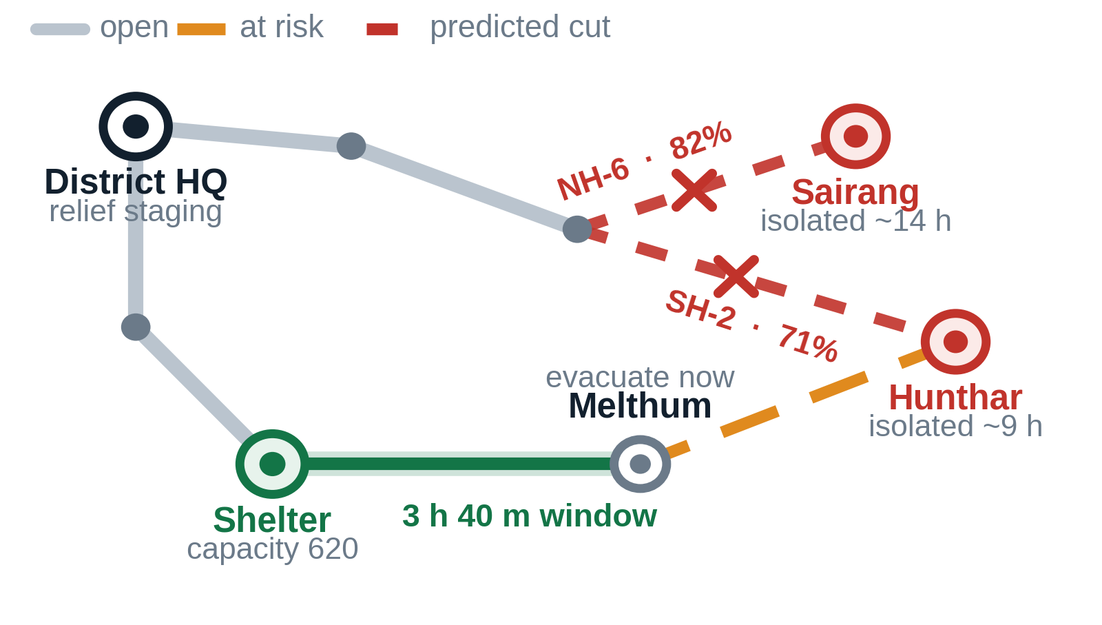




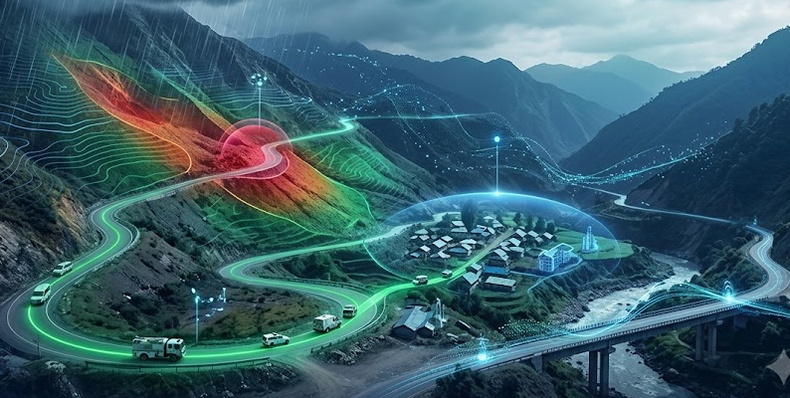


FEASIBILITY AND VIABILITY
ICONIX
LIFE SAFETY
TECHNICAL FEASIBILITY
Proven tech stack (XGBoost, InSAR, DEM)
No custom hardware
Integrates, doesn't rebuild (SACHET).
OPERATIONAL FEASIBILITY
Easy for DDMA/villagers to use
Simple card-based workflow
Clear audit trail stages
Fits existing staff structure
SOCIAL/CULTURAL
NER-specific design
Multilingual voice support
Offline-first for rural areas
Needs community trust
COST STRUCTURE
Data → Free
Infrastructure → Cloud + compute
Development → Manpower only
Integration → Minimal (APIs)
Maintenance → Retrain + upkeep
VALUE PROPOSITION
43.5% of NER landslide-affected
districts represented
Early risk → proactive action
Predict → Prioritise → Act
Business Outcome
↓ Operational disruption
↑ Response efficiency
↑ Infrastructure resilience
KEY BENEFITS
43.5% 64 of 147 affected districts in NER
18.8% India's landslides occurring in NER Himalaya
1,841 NER villages with no mobile coverage
Business Outcome
↓ Operational disruption
↑ Response efficiency
↑ Infrastructure resilience
CHANNELS & DELIVERY
Dashboard - Command & control
Mobile alerts - Field teams
Offline-first - Low-network areas
API integration - Existing systems
POINTS OF SALE
Risk-based deployment
Prioritised inspections
Lower Conceptual Overhead

Slide 5

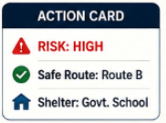
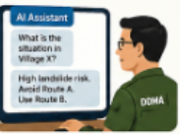

IMPACT AND BENEFITS
ICONIX
LIFE SAFETY
  Early Warning & Risk Reduction
  Offline-first last-mile support
EMERGENCY RESPONSE
  Emergency Priority Score
  Rescue resource prioritisation
  Action-ready recommendations
SMART GOVERNANCE
  Human-in-loop validation
  Auditable alerts & actions
  Continuous feedback loop
CONNECTIVITY
  Predict vulnerable road segments
  Safe Alternate Routing

Slide 6
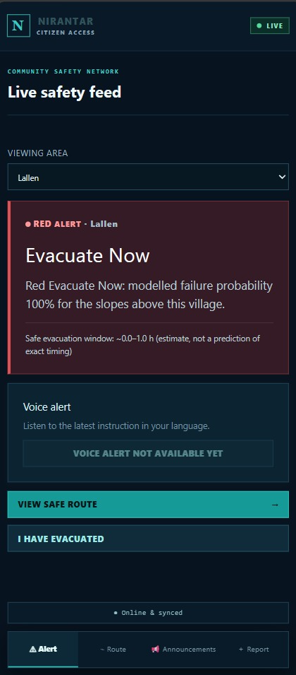
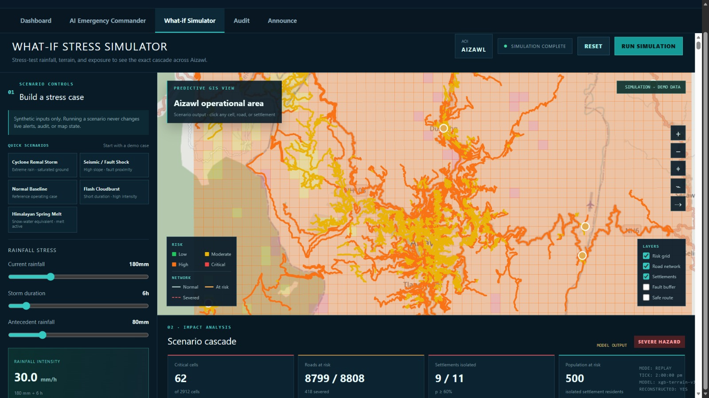
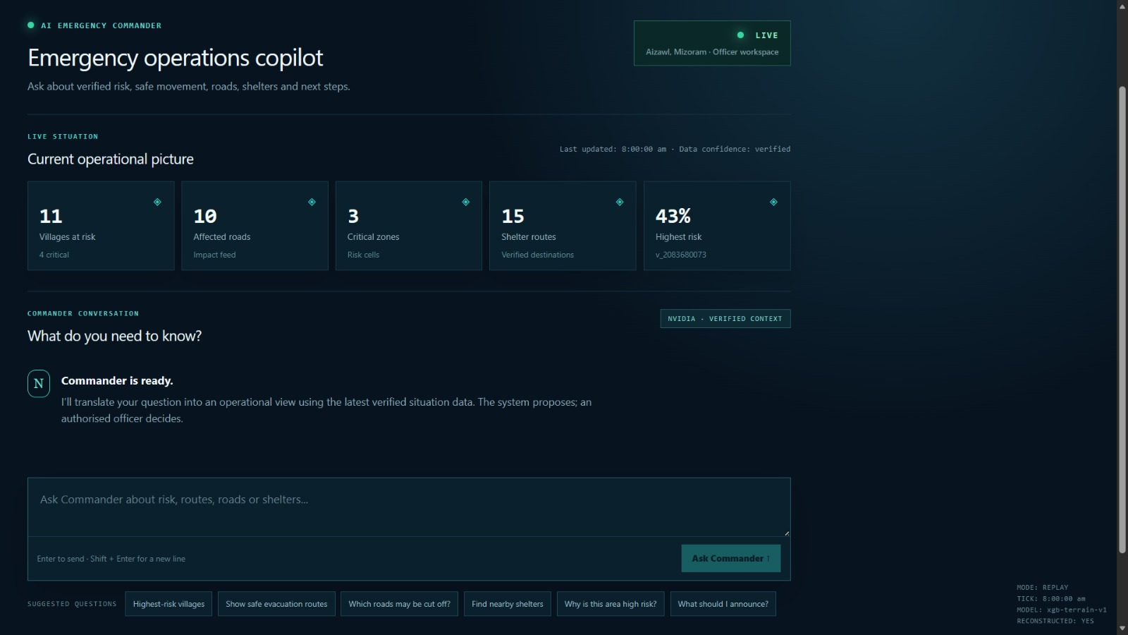
ICONIX
RESEARCH AND REFERENCES
[1]
O. Ghanem, "Predicting Landslide Susceptibility based on Naïve Bayes and Information Value Models in Shibam and AL-Taweelah District, Yemen,"
[2]
. S, M. J, H. G and P. SM, "Evaluating ML Algorithms for Landslide Prediction in Northeast India," 2025 International Conference on Computational Robotics, Testing and Engineering Evaluation (ICCRTEE),
[3]
S. Anand, A. M. A. Sai, A. D. Varma, S. N. Rao, A. Montresor and M. V. Ramesh, "LLM and MCP Enabled AI Agent for Autonomous Multi-Lingual Alerts for Coastal Communities," 2025
[4]
C. Z. John, AI: An AI-Powered Companion for Real-Time Emergency Assistance," 2025 5th International Conference on Evolutionary Computing and Mobile Sustainable Networks (ICECMSN), Coimbatore, India, 2025,
[5]
T . Regula, W. Al-Hoqani, "AI-IoT-Based Federated Edge and Digital Twin Framework for Real-Time Climate-Resilient Hazard Forecasting," 2025
@SIH Idea submission- Template
6
@SIH Idea submission - Template
6

