Slide 1

FINAL SUBMISSION
OncoBrief
Source-verified oncology records, ready for the next consultation
Cancer Care · Consultation Readiness · Care Continuity
TEAM NAME ICONIX
TEAM CODE 6FQ4CN
HEALTH-A-THON 2026 • TITLE
Notes:
OncoBrief helps oncology teams prepare source-verified records before the consultation. Every consequential action stays with a named person. ICONIX, team code 6FQ4CN.

Slide 2

Team Overview & Background
ICONIX
R.M.K. Engineering College
DHAANISH AHAMED B
Team leader and technical lead
Brindha A S
Technology team member
What the team has built
Aishwarya K
Technology team member
A shared evidence workflow spanning record intake, human review, consultation preparation and care coordination.
Bhoomi Goel
Doctor partner
Engineering and clinical workflow review in one team
HEALTH-A-THON 2026 • FINAL SUBMISSION
Notes:
Team names and roles confirmed by the team leader on 26 October 2026. Team output is supported by the current source tree and documented local acceptance. No NCG affiliation, hospital partnership or clinical deployment is claimed.

Slide 3
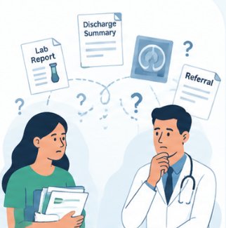
Problem Statement and Supporting Evidence
The records exist. The care team still has to piece them together.
Outside reports can remain outside the EMR
Tata Memorial Hospital’s 2026 patient booklet says outside investigations do not appear in its EMR. Patients must bring previous reports when registering.
That leaves practical work before each visit
Locate missing documents. Check which version is current. Compare conflicting dates. Find who owns the unfinished request.
8 lakh+ annual OPD footfalls at TMH in 2024 show why small preparation delays matter at scale.
Source: Tata Memorial Hospital, Patient Information Booklet 2026, pp. 2, 17 and 40. Hospital context, not an OncoBrief impact result.
HEALTH-A-THON 2026 • FINAL SUBMISSION
Notes:
Primary source: https://tmc.gov.in/assets/PDF/TMH_Patient_Booklet_2026_Low%20Res.pdf . Printed p. 2 reports over 8 lakh OPD footfalls in 2024. Printed p. 17 requests previous/outside reports. Printed p. 40 states that outside investigation reports are not available in TMH EMR. This establishes a documented information boundary and operational workload. It does not establish a measured delay, prevalence of fragmentation, or treatment benefit attributable to this prototype. Illustration reused from the supplied original team deck.

Slide 4




Target Users and Use Case
Built around the people preparing an oncology visit
Oncologists
Coordinators and records staff
Inspect exact source pages, verify facts and approve the consultation packet.
Retrieve missing records, resolve ownership and prepare the next handoff.
Reception and clinic operations
Patients and caregivers
Book appointments, track arrivals and review eligible waitlist candidates.
Receive approved administrative reminders and confirm attendance with consent.
Primary setting: oncology OPDs and tumour-board preparation. Secure document upload supports a first pilot alongside existing hospital systems.
HEALTH-A-THON 2026 • FINAL SUBMISSION
Notes:
Use cases align with consultation readiness, clinic operations, doctor productivity and patient continuity in the supplied Cancer Care material. Role capabilities inspected in the current app and RBAC policy. Patient and caregiver communications require approval and consent. No hospital integration or pilot acceptance is implied. Icons and illustrations reused from the original team deck.

Slide 5





Solution Overview, Key Features & Impact - Max 2 Slides
A fact keeps its source through every handoff
Records
Evidence
Human review
Ready packet
Continuity
PDFs and scans
Page and exact text
Verify or reconcile
Gaps and owners
Approved reminders
What makes the workflow different
What the newer build adds
The Evidence Ledger stores facts before a narrative. Conflicting sources stay visible until a human records a decision. New evidence can reopen readiness.
Lab history and batch verification.
Four cited draft formats in Studio.
Scheduling, encounters and tumour boards.
Named task owners and caregiver consent.
Expected impact: less record hunting and clearer handoffs. A hospital pilot must measure the change.
HEALTH-A-THON 2026 • FINAL SUBMISSION
Notes:
Source: CLAUDE.md; packages/db/src/services/ledger.ts; packages/domain/src/review/longitudinal-review.ts; packages/db/src/services/studio.ts; packages/db/src/services/appointments.ts; packages/db/src/services/encounters.ts; packages/db/src/services/tumor-board.ts. Timeline and packets are views of the Evidence Ledger. AI proposes source-grounded candidates, humans approve evidence and consequential actions. Expected effects are hypotheses, not measured hospital outcomes. Icons are reused from the supplied original deck.

Slide 6
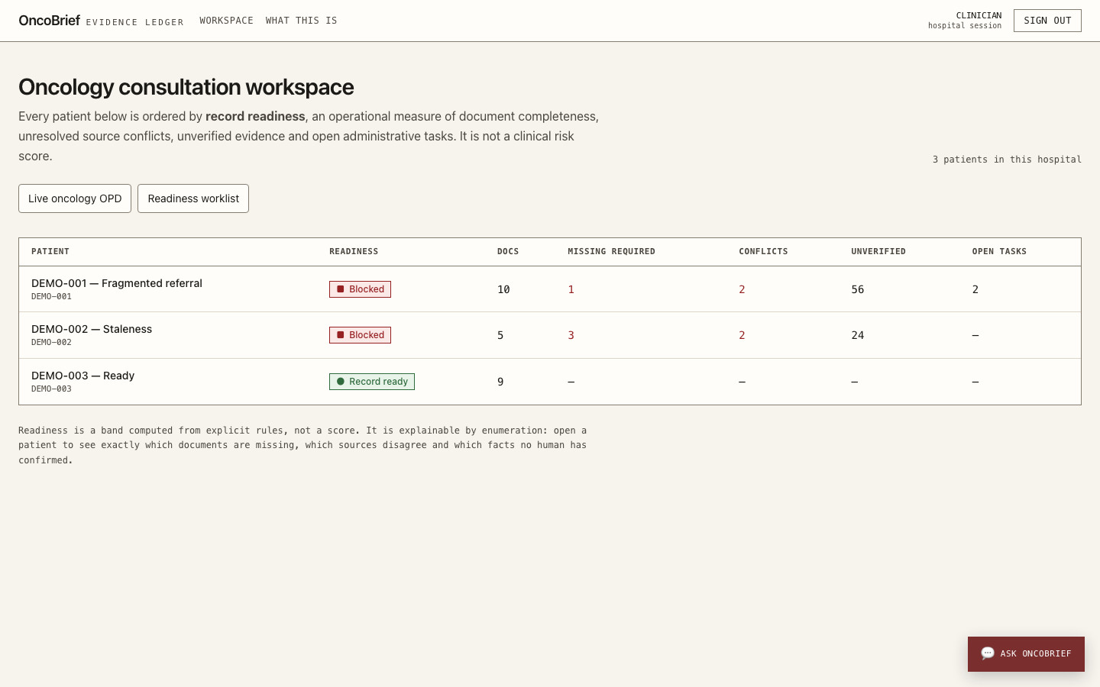
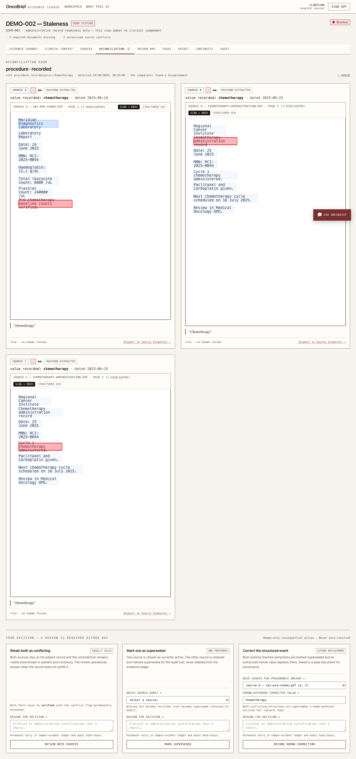
Solution Working MVP / Demo
Actual prototype screens using synthetic records
1 Find the preparation gap
2 Inspect both sources
The worklist shows document gaps and unresolved conflicts before review.
The reviewer sees highlighted source text and records an explicit decision.
HEALTH-A-THON 2026 • FINAL SUBMISSION
Notes:
Screenshots: apps/web/audit/screenshots/workspace-desktop-1440px.png and reconciliation-room-desktop.png. These are recorded local prototype screens using synthetic fixtures, not live hospital or patient data. Core workflow acceptance is documented in docs/v4-final-demo-validation.md, dated 24 October 2026.

Slide 7





Technology, Tools and AI Approach-
AI proposes evidence. Deterministic code controls the workflow.
Authorised input
Worker pipeline
Evidence Ledger
Human review
Approved outputs
Text PDFs, scans
FHIR-shaped bundles
OCR and extraction
Source-span validation
PostgreSQL
Page, span and version
Verify facts
Reconcile conflicts
Packets and tasks
Studio and continuity
Implementation
Configured AI adapters
Deterministic safeguards
Next.js and TypeScript
PostgreSQL and file storage
Typed ports and provider adapters
Sarvam Vision / Textract OCR
Amazon Bedrock extraction
Source-span validation gate
Tenant access and consent
Readiness and stale-packet checks
Append-only audit history
Local acceptance used rule-based extraction. Live AI, ABDM and message-delivery integrations still need external acceptance.
HEALTH-A-THON 2026 • FINAL SUBMISSION
Notes:
Architecture reflects inspected source: packages/adapters/src/ocr-routing.ts, bedrock-llm.ts, packages/db/src/services/ledger.ts, studio.ts and apps/worker. Provider configuration supports Sarvam Vision or Amazon Textract for OCR and Amazon Bedrock via the configured model ID. Do not claim a particular Bedrock model or current live provider deployment without acceptance. Local synthetic acceptance used OCR_DRIVER=local-pdf, EXTRACTION_DRIVER=rule, LLM_PROVIDER=rule and ABDM_DRIVER=simulated. Scanned pages without usable OCR require manual transcription. FHIR-shaped prototype mappings are not ABDM/mCODE certification. Native editable diagram. Icons from original team deck.

Slide 8
Build Sprint Journey and Progress
The original record-preparation idea grew into a connected workflow
1 FOUNDATION
2 READINESS
3 HANDOFFS
4 OPERATIONS
Records and provenance
Verification and reconciliation
OPD, Studio and continuity
A broader care-team workflow
Document intake, extraction, evidence states and an auditable ledger.
Source inspection, conflicting records, dated labs and packet freshness.
Named task owners, slot offers, cited drafts and consented reminders.
Patient registry, staff roles, scheduling, encounter notes and tumour boards.
Challenges that changed the build
Still ahead
Different dates on serial labs need separate observations. Consent withdrawal must block access without erasing audit history.
Hospital workflow validation, live gateway acceptance and a permission-scoped EHR launch layer.
HEALTH-A-THON 2026 • FINAL SUBMISSION
Notes:
Four build milestones are shown in sequence rather than inventing calendar weeks. Current source and git history establish progression, but do not establish one milestone per week. Original concept: supplied 8-slide deck. V4 acceptance: docs/v4-final-test-report.md and v4-final-demo-validation.md, 24 October 2026. Later additions: docs/milestone-a.md, docs/milestone-b.md and the operational modules added by 26 October. Their broader operational flows still require fresh end-to-end acceptance. Avoid production-grade claims from those planning documents.

Slide 9
Evaluation and User Validation
Health-a-thon 2026
Rigorous testing, AI evaluation and focused user feedback to validate OncoBrief’s safety, reliability and real-world usability.
Evaluation Approach
Key Results
User Validation (Pilot)
Multi-layer validation across the system and
AI components.
Hands-on use and feedback from the project team and
clinical partner.
120 / 120
AI Model Evaluation
AI
AI model test cases passed
(extraction, summarization & safeguards)
4 users
Overall
usability
rating
(3 engineering team
members + 1 doctor partner)
4.5 / 5
Source & Provenance Validation
1,304 / 1,304
Functional & End-to-End Tests
Automated system test cases passed
(units, integration, DB & E2E)
“
“Helps organize patient information quickly and
keeps the evidence easy to verify.”
Security & Access Control (RLS)
100%
Accessibility & Usability Checks
Clinical boundary tests passed
– Doctor Partner (Pilot)
(29 / 29)
Improvements from Feedback & Mentoring
Limitations & Further Validation
Based on feedback from our technology mentor, we streamlined key workflows to
make the system faster and easier to use.
Simplified multi-step tasks
Broader user validation
Serveo AI evaluation
Real-world deployment
≈45+ clicks
2 clicks
Include more clinicians
and care-team roles
across specialties
Assess extraction,
summarization and
multilingual performance
across more real-world cases
Pilot in a hospital setting
with larger, multi-centre
use and longitudinal feedback
Clearer navigation & task flow
(initial workflow)
(current workflow)
Faster chart/packet generation
HEALTH-A-THON 2026 • FINAL SUBMISSION
9
Notes:
Recorded engineering evidence, not a fresh acceptance run: docs/v4-final-test-report.md, 24 October 2026. pnpm verify: 886 automated tests, zero failed or skipped. Selected Chromium acceptance: 51 distinct tests across 12 files, not the full historical browser inventory. Tested on synthetic fixtures with controlled local/rule/simulated adapters. Usability repair evidence appears in docs/v4-final-demo-validation.md, including source jumps, reconciliation controls and responsive checks. No independent clinician usability study, live model benchmark, hospital pilot, certification or measured time saving is claimed. New operational modules inspected on 26 October are not covered by the 24 October snapshot.

Slide 10
Evaluation and User Validation
Health-a-thon 2026
Rigorous system evaluation, targeted AI testing and hands-on user validation to ensure a reliable, usable and impactful solution.
Evaluation Approach
AI
AI Model Testing
User Validation
Multi-layer testing
Targeted test cases to check model behavior,
reliability and safety for our cancer-care use cases.
Hands-on evaluation with project users
(engineering team & clinical partner).
Unit, integration, workflow & end-to-end
AI
AI model testing
4 users
4.6 / 5
Quality, safety & content-grounding checks
30/30
36/36
20/20
User validation
Clinical boundary
& safety tests
passed
Source-grounding
& evidence
checks passed
Output quality
& format
checks passed
(3 engineers, 1 oncologist)
overall usability
rating
Hands-on testing with project team &
clinical partner (n = 4)
Key Results
Improvements Based on Feedback
AI
45+ → 2
Streamlined consultation packet flow
1,304 / 1,304
86 / 86
100%
100%
100%
Added “Changes Since Last Visit” view
clicks
System & workflow
tests passed
(end-to-end)
AI model test
cases passed
(quality, safety, grounding)
Source-grounding &
provenance validation
(30/30)
Unsafe / diagnostic
prompts blocked
(29/29)
System quality
& reliability
(1,304/1,304)
Simplified review and task assignment
Mentor-guided improvement for a faster, more efficient workflow
Limitations &
Further Validation
Real-world validation
अ
Multi-use (Sarvam AI) validation
Expanded user testing
Larger, multi-centre clinical
use to assess real-world impact
A
Broader evaluation of all Sarvam AI
use cases (e.g., summarization, entity
extraction, multilingual communication)
Include more clinicians, nurses
and administrative staff for
diverse feedback
HEALTH-A-THON 2026 • FINAL SUBMISSION • ONCOBRIEF (CANCER CARE TRACK)
10
Notes:
Recorded engineering evidence, not a fresh acceptance run: docs/v4-final-test-report.md, 24 October 2026. pnpm verify: 886 automated tests, zero failed or skipped. Selected Chromium acceptance: 51 distinct tests across 12 files, not the full historical browser inventory. Tested on synthetic fixtures with controlled local/rule/simulated adapters. Usability repair evidence appears in docs/v4-final-demo-validation.md, including source jumps, reconciliation controls and responsive checks. No independent clinician usability study, live model benchmark, hospital pilot, certification or measured time saving is claimed. New operational modules inspected on 26 October are not covered by the 24 October snapshot.

Slide 11
Safety and Responsible AI
Health-a-thon 2026
A safety-first, source-grounded and human-supervised AI for cancer-care workflows.
Privacy, Consent & Security
AI Safety Gates
Consent-controlled access, hospital-level isolation (RLS) and tamper-evident audit trails.
Clinical boundary
Non-diagnostic AI
AI Reliability & Error Handling
Source & span validation
Human Review
Two-stage source validation rejects unsupported claims; uncertain or unreadable inputs require review.
Patient Records
Two-stage provenance checks
Authorized staff
verify facts
Approved
Outputs
Consent &
secure access
Evidence Ledger
Conflicts require
human resolution
Clinician-approved
packets & messages
Append-only, traceable records
Human Oversight
Authorized staff verify evidence; clinicians approve packets and patient communications.
17/17
36/36
51
Bias, Accessibility & Inclusion
Clinical boundary
unit tests passed
Source-span and value
validation tests passed
RLS-protected
tenant tables
11-locale communication support, accessible interfaces and responsive mobile workflows.
Current Limitation: Real-world hospital validation, broader multilingual benchmarks and multi-centre user testing remain pending.
HEALTH-A-THON 2026 • FINAL SUBMISSION
Notes:
Sources: CLAUDE.md, packages/domain/src/policy/rbac.ts; packages/db migrations; packages/db/src/services/studio.ts, caregivers.ts, encounters.ts and tumor-board.ts; docs/v4-codex-independent-review.md. The source-span gate checks quotation anchoring, not medical truth or semantic entailment. Human review remains necessary. The clinician can author encounter assessments and consensus notes, but AI does not generate a diagnosis or treatment recommendation. Voice locale selection does not translate the approved text. Accessibility checks are partial, not WCAG certification. No legal or regulatory certification is claimed.

Slide 12
Deployment, Cost and Sustainability Plan
Health-a-thon 2026
OncoBrief • Cost-optimized AWS pilot in Mumbai • Scale safely from one hospital to many
Proposed deployment architecture
100-user hospital
Secure access → modular compute → protected records
MODELED MONTHLY COST
₹12,606
/ month
Hospital users
CloudFront + ALB
ECS + SQS/Lambda
RDS + S3
₹14,875 including 18% GST
Authorized staff
and clinicians
HTTPS edge &
internal origin
Web platform &
async document jobs
PostgreSQL 16 &
encrypted storage
2,500 docs / month
₹5.04 / doc
10,000 pages • 100 registered users
SMART AI / OCR ROUTING
Local PDFs • AWS Textract • Sarvam Vision • Amazon Bedrock
Use low-cost parsing first; route complex documents to specialist services
Planning estimate, not an actual AWS bill
Pilot → multi-hospital scale
Setup & pre-pilot readiness
Sustainability by design
25-user pilot
₹6,008/mo
One-time setup: not yet costed
Lower idle cost
Depends on hospital integration scope
NAT-free networking + ARM64 Fargate
100-user hospital
₹12,606/mo
EHR / FHIR / ABDM gateway setup
Pay for the right OCR
5 hospitals
₹10,462 each/mo
plus required approvals and agreements
Local first; Textract / Sarvam as needed
Resolve pre-launch engineering blockers
Scale on demand
All estimates exclude GST unless stated
Migrations, upload races, TLS & credentials
SQS/Lambda jobs, caching & S3 lifecycle
HEALTH-A-THON 2026 • FINAL SUBMISSION
Source: AWS deployment ZIP (5 Nov 2026) • ₹84.50/USD • no credits assumed
11
Notes:
All amounts are team planning assumptions, not provider quotes, actual operating costs, a commercial offer or validated willingness to pay. Setup 75 hours × ₹500 = ₹37,500. Monthly budget: hosting/storage/backups ₹3,000 + support ₹2,000 + OCR/AI allowance ₹4 × 1,000 packets = ₹9,000. At 1,000 ten-page packets, the variable processing allowance is ₹4/packet (₹0.40/page) and total operating budget is ₹9/packet. Proposed facility subscription ₹12,000/month divided across five doctors = ₹2,400/doctor/month. Allowances need vendor quotes and workload benchmarking. Tax, hospital hardware, integration work, governance/legal review, telecom and unusual support demand are excluded. No live cloud infrastructure is asserted. Expansion depends on a funded, approved pilot rather than an assumed NCG partnership.

Slide 13



What Next? Plans to take initiative forward (if any)
A 90-day plan to earn evidence in a real care setting
DAYS 1–30
DAYS 31–60
DAYS 61–90
Agree the pilot
Run supervised review
Compare and decide
Seek hospital approval. Define record scope, local checklists, reviewers and baseline preparation time.
Use approved records in a shadow workflow. Log corrections, gaps and source-check failures.
Measure preparation time and readiness. Review user feedback, cost and integration acceptance before expansion.
Primary pilot KPI
Make solution information publicly available?
Median record-preparation time per referral, measured on comparable cases before and during the pilot.
Answer: __________________ (Yes / No)
HEALTH-A-THON 2026 • FINAL SUBMISSION
Notes:
This is a proposed 90-day pilot plan, not an approved hospital partnership or committed programme timeline. Seek institutional approval before real records. Primary outcome is an operational KPI: median active record-preparation minutes per referral. Secondary measures can include record-ready share at scheduled visit, unresolved conflicts, verified task closure and cost per packet. Use comparable case types and report denominators and exclusions. Official guide: https://healthathon.reskilll.com/guide .

Slide 14
Thank you
ICONIX • 6FQ4CN
240186.cs@rmkec.ac.in | MVP: __________ | Video: __________
Source-verified records. Human-approved handoffs.
Health-a-thon 2026
Code: github.com/dhaanish597/OncoBrief
HEALTH-A-THON 2026
Notes:
Code repository: https://github.com/dhaanish597/OncoBrief . Main contact is the team leader’s provided college email. No current AWS availability is claimed.

