Slide 1





FINAL SUBMISSION • CANCER CARE TRACK
OncoBrief
The consult starts before the patient walks in: source-linked record readiness, smart OPD flow, and caregiver voice continuity.
EVIDENCE LEDGER
Every fact links to page, span & bounding box
RECONCILIATION ROOM
Conflicting dates shown side by side for doctors
SMART OPD & STUDIO
Readiness-gated slot backfill & 4 cited drafts
11-LOCALE CONTINUITY
Consented caregiver sync & Sarvam Bulbul v3
TEAM NAME: ICONIX (R.M.K. Engineering College)
TRACK & USE CASES: Cancer Care (UC 02, 04, 05, 01)
HEALTH-A-THON 2026 • TITLE • ASSISTIVE, NOT DIAGNOSTIC

Slide 2




Team Overview & Background
Built by R.M.K. Engineering College technologists alongside an Oncology Clinical Lead for the National Cancer Grid ecosystem.
ENGINEERING TEAM • ICONIX
DOCTOR PARTNER & CLINICAL LEAD
INSTITUTION & ECOSYSTEM FIT
• Dhaanish Ahamed & ICONIX Team: R.M.K. Engineering College, Chennai
• Full-Stack & Ledger Architecture: Built the 6-package TypeScript monorepo, Next.js 15 App Router, and PostgreSQL 16 append-only Evidence Ledger with 42 forced-RLS tables.
• AI & Cryptographic Pipeline: Engineered the deterministic span validation gate (validateQuoteInSpans), X25519 ECDH Fidelius decryption, and AWS ap-south-1 Fargate stack.
• Verification Rigor: Authored 886 passing unit/integration tests and 51 Chromium E2E tests across 15 SQL migrations.
• Clinical Lead, Oncology: Practising Oncology Specialist Partner
• NCG Workflow & Checklist Design: Authored the 3 oncology document readiness templates: NCG Referral Intake, Multidisciplinary Tumour Board Prep, and Oncology Follow-Up.
• Strict Non-Diagnostic Boundary: Defined the 17 forbidden clinical concepts enforced in code: zero staging inference, zero treatment advice, and zero risk scoring.
• Human-in-the-Loop Governance: Designed the side-by-side Reconciliation Room so conflicting surgical or lab dates require clinician sign-off.
• R.M.K. Engineering College: Department of Computer Science & Engineering
• NCG & Koita Centre Alignment: Designed around the National Cancer Grid (370+ hospitals treating 60% of India cancer cases) and IIT Bombay KCDH operational standards.
• Built for Real Indian OPDs: Operates on plastic-bag paper referrals, scanned lab PDFs, re-faxed reports, and low-literacy family caregiver workflows across 11 locales.
• Zero-EMR Disruption: Runs as a pre-EMR readiness layer alongside hospital HIS systems without requiring custom database write-back.
HOW ENGINEERING AND ONCOLOGY CO-DESIGNED ONCOBRIEF V4
1. Clinical Problem Discovery: Mapped why consultations stall when patients bring records from 4 to 6 outside facilities, and why serial CBC blood counts must form dated flowsheets instead of false contradictions.
2. Multi-Role Expansion: Expanded the initial intake prototype to cover Consultation Readiness (UC 02), Smart OPD Queue & Waitlist Backfill (UC 04), Grounded Clinician Studio (UC 05), and 11-Locale Caregiver Voice Continuity (UC 01).
HEALTH-A-THON 2026 • FINAL SUBMISSION

Slide 3



Problem Statement and Supporting Evidence
LIMITATION IN EXISTING TOOLS
Summaries show what is available, not what was planned, completed, or missed.
Referral trackers show referrals, but not whether the required report returned or is current.
Readiness is not tracked, so departments cannot see why a consultation could not proceed.
Serial lab counts get misread as conflicts, and OPD slots stall on missing reports.
No unified ledger connects source spans, readiness checklists, OPD slots, and caregivers.
Next visit
6 sources
14% to 30%
is when reports typically become available, in a large Indian cancer centre's own description of its OPD
surgery, pathology, imaging, chemotherapy, radiation and outside centres feed one oncology record
of Indian breast cancer patients are lost to follow-up by five years
HEALTH-A-THON 2026 • FINAL SUBMISSION

Slide 4




Target Users and Use Case
Four oncology care roles working off one append-only Evidence Ledger across tertiary cancer centres and district spokes.
1. ONCOLOGISTS (MEDICAL, SURGICAL, RADIATION)
Use Case 02 & Use Case 05 • Tertiary OPDs & Tumour Boards
2. OPD & TUMOUR BOARD COORDINATORS
Use Case 04 • Clinic Front Desks & Coordination Rooms
• Healthcare Setting: High-volume oncology outpatient clinics (30 to 50 patients/day) and multidisciplinary tumour boards.
• Core Workflow Challenge: Rebuilding a timeline from 6+ outside reports takes consultation time away from the patient.
• How OncoBrief Fits: Opens with the "Changes Since Last Consultation" banner, dated serial lab flowsheets, 2-click batch verification, side-by-side Reconciliation Room, and 4 source-cited Studio drafts.
• Healthcare Setting: Outpatient waiting areas, scheduling counters, and tumour board prep teams.
• Core Workflow Challenge: Cancelled slots or delayed investigations leave specialist rooms idle while ready patients wait.
• How OncoBrief Fits: Provides a live OPD Slot & Queue Board, identifies record-ready waitlist backfill candidates in 9.49 ms, and assigns document retrieval tasks to named staff with deadlines.
3. RECORDS OFFICERS & INTAKE STAFF
Use Case 02 • Medical Records & Referral Counters
4. CANCER PATIENTS & FAMILY CAREGIVERS
Use Case 01 • Home Preparation & Inter-City Travel
• Healthcare Setting: Hospital intake desks receiving paper files, lab PDFs, and external hospital referrals.
• Core Workflow Challenge: Duplicate faxes, unindexed scans, and missing histopathology or IHC reports slip into clinic.
• How OncoBrief Fits: Ingests PDFs, mobile photos, HL7 mCODE STU4, and ABDM v6.5.0 bundles; flags near-duplicate faxes; and tracks NCG-aligned intake checklists.
• Healthcare Setting: Patients and consented family caregivers travelling across states for multi-cycle therapy.
• Core Workflow Challenge: English discharge notes and missed pre-visit instructions cause avoidable travel delays and drop-offs.
• How OncoBrief Fits: Synchronizes clinician-approved reminders to consented caregivers with 11-locale voice note previews (Sarvam Bulbul v3 / browser fallback) and two-way attendance logging.
HEALTH-A-THON 2026 • FINAL SUBMISSION

Slide 5
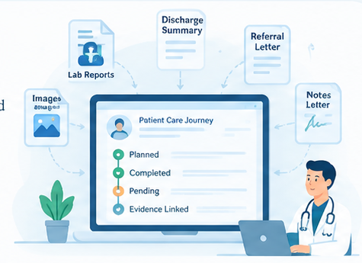

Solution Overview & Key Features (1/2)
One ledger of source-linked facts. The timeline is only a view over it.
NOVELTY
THE SOLUTION
Evidence Ledger - Every fact is linked to its original source, sentence, and page.
2-Click Batch Verification & Delta Brief: Highlights changes since last visit, serial lab flowsheets, and batch-verifies >=90% OCR facts.
Reconciliation Room - Conflicting documents are shown side by side for review and resolution.
Smart OPD, Studio & 11-Locale Caregivers: Readiness-gated OPD slot backfill, 4 cited Studio drafts, and Sarvam Bulbul v3 voice notes.
OncoBrief ingests fragmented patient documents from multiple sources, analyses them with AI, and converts them into a structured, evidence-linked care journey
It gives clinicians a complete, up-to-date view of what was planned, what happened, what is missing, and who is responsible for the next action.
READS
Scans and understands fragmented records such as lab reports, discharge summaries, referral letters, photographs and handwritten notes.
HEALTH-A-THON 2026 • FINAL SUBMISSION

Slide 6


Solution Overview: User Journey & Impact (2/2)
End-to-end journey: Ingest (PDF/ABDM/mCODE) -> Span Gate -> 2-Click Verify & Reconcile -> Smart OPD, Studio & Caregiver Audio.
370+
~8.5 lakh
Zero
cancer centres in the National Cancer Grid, treating close to 60% of India's patients
new cancer cases a year pass through those member centres
of them can currently report what share of their consults were ready to proceed
Before: Care journeys can become fragmented when patients move between hospitals.
OncoBrief: Preserves the administrative care state so the journey can continue without resetting.
Before: Facts may lack a clear link to their original document and source.
OncoBrief : Maintains Document → Phrase → Fact → Task provenance for traceable and verifiable evidence.
Before: Tasks can have unclear ownership and ambiguous closure.
OncoBrief : Assigns responsibility, tracks accountability, and records human-confirmed closure.
Before: Missing, duplicate, or conflicting documents can cause delays and rework.
OncoBrief : Identifies evidence gaps, duplicates, and conflicts so coordinators can reconcile them before closure.
CONTINUITY
EVIDENCE TRUST
COORDINATION
OPERATIONAL EFFICIENCY
HEALTH-A-THON 2026 • FINAL SUBMISSION

Slide 7

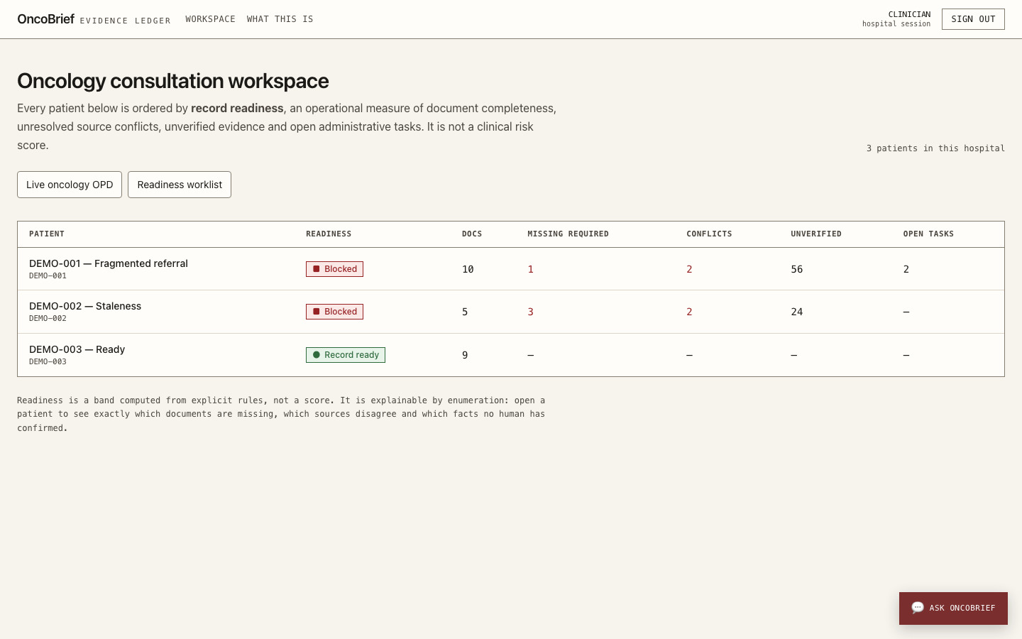
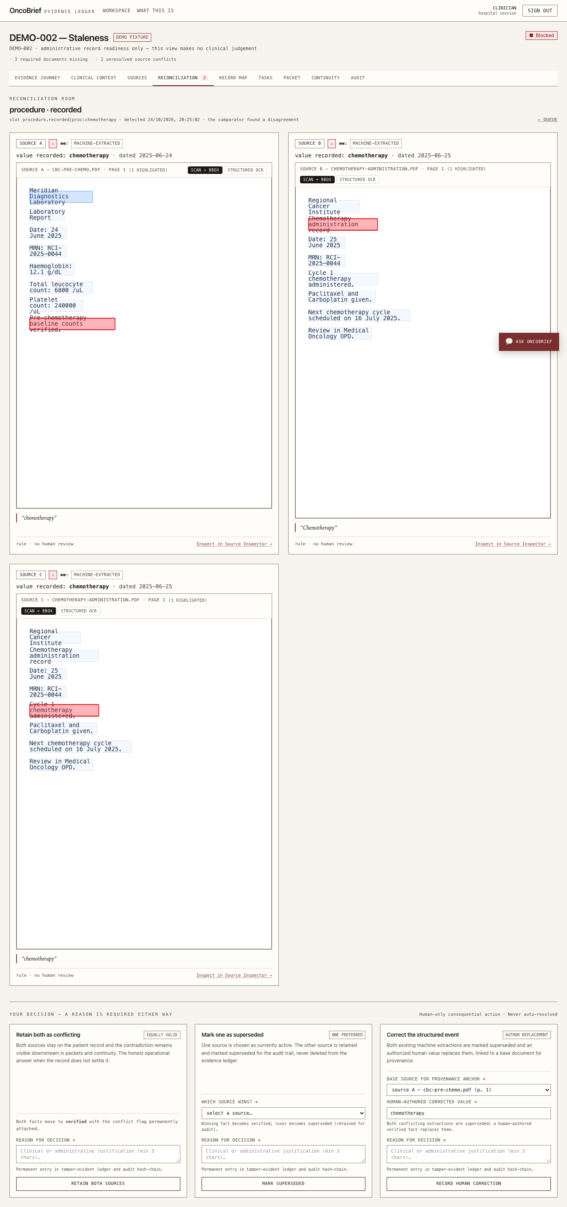
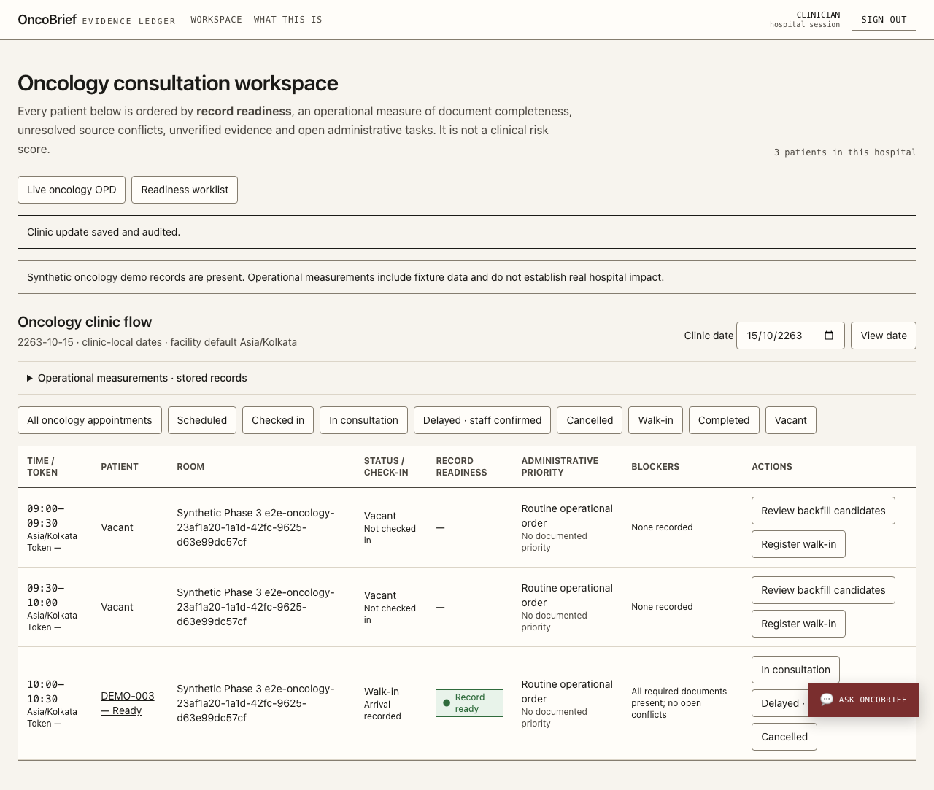
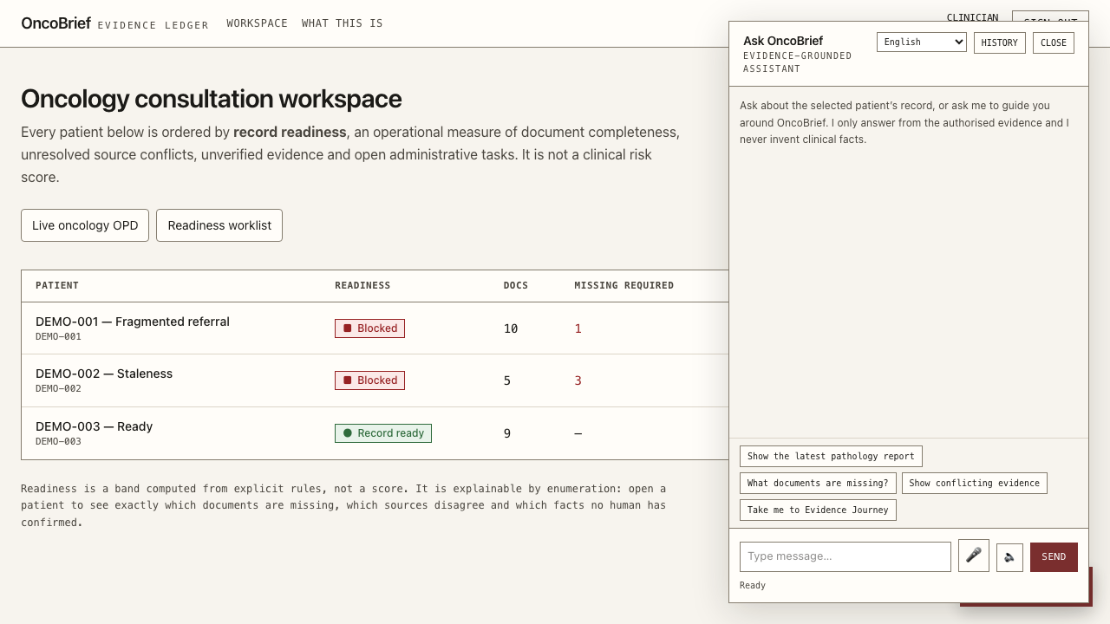
Solution Working MVP / Demo
LIVE AWS MUMBAI MVP: https://dsc1vmsr4q09g.cloudfront.net | GITHUB: github.com/dhaanish597/OncoBrief | DEMO LOGINS: dr.rao@rci.demo • coord.anita@rci.demo • auditor.k@rci.demo
1. Consultation Readiness Worklist (/workspace)
Orders oncology referrals by deterministic Readiness Band (DEMO-001 & DEMO-002 Blocked, DEMO-003 Record Ready) with missing-document and conflict counts.
2. Side-by-Side Reconciliation Room (/conflicts)
Displays competing source PDFs with highlighted bounding-box spans (12 Jun 2025 vs. 3 Jul 2025 mastectomy) for clinician sign-off.
3. Smart Oncology OPD Slot & Backfill Board
Tracks scheduled, checked-in, delayed-lab, and vacant slots; ranks record-ready waitlisted patients in 9.49 ms for human-confirmed backfill.
4. Grounded Co-Pilot, Studio & 11-Locale Audio
Retrieves [E#] patient spans & [G#] SOP references, compiles 4 cited Studio drafts (SHA-256 frozen), and previews 11-locale caregiver voice notes.
DEMO-001: Fragmented Referral (Blocked)
10 docs across 4 centres, duplicate CT chest fax, serial Hb delta (-1.2 g/dL), 2 open conflicts, 1 missing insurance auth.
DEMO-002: Staleness Re-Opening (Blocked)
5 docs showing how a new contradictory report re-opens a verified appointment fact and marks an earlier packet stale.
DEMO-003: Verified & Ready (Green)
9 verified docs, 0 conflicts: ready for packet freeze, 4-format Studio export (ABDM/mCODE), OPD walk-in, and caregiver audio.
HEALTH-A-THON 2026 • FINAL SUBMISSION

Slide 8















































Technology, Tools & V4 System Architecture
6-Package TypeScript Monorepo & Agentic Pipeline on AWS ap-south-1. Deterministic span validation gates every AI extraction before PostgreSQL 16 RLS persistence.
DATA SOURCES
AGENTIC AI ORCHESTRATION LAYER
multi-agent system: process documents, extract, verify, prepare consultation packets
OUTPUTS & USERS
multi-channel ingestion
FHIR API
(HTTPS)
Orchestrator Agent (Planner)
role-based surfaces
Hospital EHR / HIS
Understands the task, breaks it into sub-tasks, assigns work to specialised agents, tracks progress, handles errors
Clinician Web App
ABDM M1-M3 & mCODE
React / Next.js
Secure upload
(HTTPS)
· Patient dashboard
· Timeline view
· Source-linked facts
· Missing documents
· OPD Flow & Task State Engine
· 4-Format Studio & Lab Flowsheet
Diagnostic Labs
PDF, DICOM, FHIR R4
Ingestion Agent
Document Processing Agent
Information Extraction Agent
Reconciliation Agent
Task & Workflow Agent
Timeline & Brief Generation Agent
Scanned Documents
Extension
(authorised)
· Validate files
· Detect document type
· Check duplicates
· Route to processing
· Sarvam Vision & Textract OCR
· Extract text & tables
· Structuring
· Layout analysis
· Bedrock Nova Pro & Rules
· Identify dates, procedures
· Map to schema
· Span Gate (validateQuoteInSpans)
· Date-Aware Lab Comparator
· Merge multiple documents
· Version handling
· 2-Click Batch Verification
·Smart OPD Slot Optimizer
·Create administrative tasks
·Waitlist Backfill & Task Owner
·Track completion
· Changes Since Last Visit Delta
· 4-Format Productivity Studio
· Ensure source verification
· Use only verified facts
Care Team Dashboard
Reports, discharge summaries, images
Nurses / coordinators
· Document review
· Task queue
· Team collaboration
· Live OPD Queue & Slot Backfill
Browser Extension
Launched from the open EHR record
KNOWLEDGE & EVIDENCE LAYER
single source of truth
GUARDRAILS & SAFETY LAYER
Patient / Caregiver Portal
External Referrals
Files
(PDF, images)
· Only extract from source documents
· No medical diagnosis or treatment advice
· Fact verification before display
· Confidence scoring
· Human-in-the-loop for all critical actions
· Audit logs and traceability
· Policy and content filtering (Amazon Bedrock)
Optional
Other hospitals
Document Storage
(Amazon S3)
Document Index
(Amazon OpenSearch)
Evidence Ledger
(PostgreSQL)
Vector Store
(OpenSearch / Bedrock KB)
· Verified follow-up reminders
· Document requests
· Appointment information
· 11-Locale Voice & Attendance Log
Paper Records
Original files, immutable and versioned
Full-text search over extracted content and metadata
Structured facts with source: page, span, document, version, confidence, review status
Semantic search for retrieval, source-grounded
Scan / upload
Notification Services
APPLICATION & WORKFLOW LAYER
deterministic code writes the ledger and the audit trail
· Email (Amazon SES)
· SMS (Amazon SNS)
· Sarvam Bulbul v3 11-Locale TTS
· In-app notifications
Backend APIs
Workflow Engine
Agent Tools & Services
Consultation Readiness
Next.js 15 & Worker on Fargate
OPD Flow & Task State Engine
Retrieve, search, CRUD, notifications, integrations
SHA-256 Frozen Packet & Studio
EXTERNAL INTEGRATIONS
MONITORING & OBSERVABILITY
SECURITY & COMPLIANCE
Hospital EHR / HIS
Diagnostic Labs
Identity Provider
Calendar Systems
CloudWatch
X-Ray
Audit Logs
IAM
KMS
Secrets Manager
VPC
ABDM M1-M3 & mCODE, OAuth2
API / SFTP
SSO, SAML, OAuth
For appointments
Logs, metrics, alarms
Tracing
User actions, API calls
Access control
Encryption at rest
API keys, credentials
Private subnets
AWS CLOUD INFRASTRUCTURE REGION ap-south-1 (MUMBAI)
Auto Scaling · Load Balancer · VPC · Security Groups · HIPAA-aligned
Route 53 DNS
CloudFront CDN
WAF Security
ECS Fargate Compute
RDS PostgreSQL Database
S3 Storage
OpenSearch Search
ElastiCache Redis Cache
Lambda Event processing
HEALTH-A-THON 2026 • FINAL SUBMISSION

Slide 9
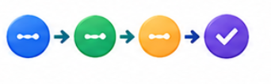
Build Sprint Journey and Progress
Four-week build sprint evolving OncoBrief from a new-patient intake ledger into a 4-use-case oncology operations platform.
WEEK 1 • FOUNDATION
Core Evidence Ledger & AWS Stack
WEEK 2 • READINESS (UC 02)
Longitudinal Deltas & Reconciliation
WEEK 3 • OPD & STUDIO (UC 04/05)
Smart Slot Backfill & 4 Drafts
WEEK 4 • CONTINUITY & AUDIT
11-Locale Audio & Security Locks
• Built 6-package TypeScript monorepo & PostgreSQL 16 schema.
• Enforced append-only ledger_entry & audit_event SHA-256 chains.
• Wired deterministic span gate (validateQuoteInSpans).
• Deployed live stack on AWS Mumbai (Fargate, RDS, S3, Textract, Bedrock).
• Built "Changes Since Last Consultation" interval delta banner.
• Added date-aware serial CBC/lab flowsheets (-1.2 g/dL delta).
• Added 2-click atomic batch verification (>=90% OCR filter).
• Fixed Reconciliation Room state machine to supersede or correct conflicts.
• Built OPD slot state machine & 9.49 ms waitlist backfill engine.
• Added 1-click task ownership & coordinator assignment controls.
• Added [G#] institutional SOP lookup with bounding-box preview.
• Built 4-format Clinician Studio with 64-char SHA-256 freeze.
• Built consented caregiver registry & immediate revocation lock.
• Added 11-locale audio player (Sarvam Bulbul v3 + Web Speech fallback).
• Added two-way attendance logging & 15-key PHI audit redaction.
• Passed 886 unit/integration & 51 Chromium E2E acceptance tests.
MAJOR CHALLENGES ENCOUNTERED & RESOLVED
• False Conflicts on Serial Labs: Scoped comparators by observed_on date so June vs. July CBCs form a flowsheet while same-date disagreements open a conflict.
• Consent Withdrawal vs. Immutable Ledger: Applied RESTRICTIVE RLS policies to mask withdrawn ABDM sources and block exports (409) without breaking historical SHA-256 chains.
PLANNED CAPABILITIES REMAINING FOR PILOT
• EHR Browser Extension Overlay: Permission-scoped browser launch layer (apps/extension) is planned for phase-2 hospital rollout.
• Live Carrier & NHA Sandbox Gateways: SMS/WhatsApp delivery and ABDM M3 callbacks run via badged local simulation until TRAI DLT and NHA production keys are issued.
HEALTH-A-THON 2026 • FINAL SUBMISSION

Slide 10
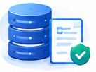
Evaluation and User Validation
886 Passed
51 E2E Passed
45+ -> 2 Clicks
9.49 ms
Automated unit & integration tests (0 failed) across domain, db, adapters, worker & web
Chromium Playwright browser tests across 12 specs including 10-scene judge journey (4.81s)
Clinician chart verification effort reduced via >=90% OCR atomic batch verification
Readiness-gated OPD waitlist backfill search latency (0.88 ms on occupied-slot fast path)
AUTOMATED VERIFICATION & MODEL GROUNDING RESULTS
USABILITY TESTING & CLINICAL WORKFLOW IMPROVEMENTS
• Package Breakdown (pnpm verify): domain (415), db (183), web (173), adapters (86), worker (29) = 886 passed, 0 failed.
• 100% Span Entailment Gate: 0 unanchored AI facts enter PostgreSQL; validateQuoteInSpans rejects any hallucinated quote or altered lab unit.
• Cryptographic Hash Chain Audit: 159 ledger entries and 147 audit events independently recomputed from genesis with 100% SHA-256 payload match.
• Security & RLS Regressions: Verified cross-tenant 404 isolation across 51 RLS tables, Fidelius X25519 key wiping, and 409 lock after source revocation.
• Reconciliation Room Deadlock Fixed: Added provenance base selector and human replacement value input directly in Outcome 3 so clinicians can resolve or supersede conflicts in one screen.
• Direct Page & Bbox Source Jump: Upgraded serial lab flowsheet and medication links to route directly to /sources/[docId]?fact=[id]&page=[p] with A4 highlight geometry.
• WCAG 2.2 AA & 375px Mobile Polish: Remediated contrast tokens (6.12:1 extracted, 5.10:1 conflict) and added pb-24 clearance across 375px, 768px, 1024px, and 1440px viewports.
EPISTEMIC HONESTY: LOCALLY VERIFIED EXECUTION VS. AREAS REQUIRING HOSPITAL PILOT VALIDATION
• Working Locally Today: PostgreSQL 16 RLS, SHA-256 hash chains, local PDF/FHIR/DICOM/vCard parsing, Fidelius X25519 ECDH decryption, OPD optimizer, and Studio generators.
• Simulated / Pilot Validation Needed: SMS/WhatsApp outbox and ABDM gateway callbacks are simulated locally; spoken regional TTS requires Sarvam API keys or installed OS voices; real-world consultation minutes saved will be measured in an ethics-approved hospital shadow pilot.
HEALTH-A-THON 2026 • FINAL SUBMISSION

Slide 11






Safety and Responsible AI
Deterministic code owns state transitions, RLS privacy, and consent locks; AI models only propose span-checked candidates.
!
DATA INGESTION
IDENTITY & CONSENT
DOCUMENT PROCESSING
EVIDENCE EXTRACTION
CARE STATE ENGINE
RECONCILIATION
•
EHR / HIS
•
Patient ID
•
Secure Upload
•
Administrative Facts
•
Planned
•
Contradictions
•
Referrals
•
RBAC
•
OCR
•
Source Phrase
•
Scheduled
•
Missing Evidence
•
Lab & Imaging
•
Consent Verification
•
Document Versioning
•
Page / Location
•
Evidence Received
•
Packet Freshness
•
Patient Uploads
•
SHA-256 Hash
•
Confidence
•
Human Reviewed
•
Duplicate Detection
•
Closed
17 FORBIDDEN CLINICAL CONCEPTS ENFORCED BY SCHEMA & CI SCANNER (clinical-boundary.ts)
Diagnosis & staging
Treatment advice
Decision support
no diagnosis, stage or severity field exists
only repeats what a named clinician wrote
reports what was asked, never what to do
Risk scoring
Data interpretation
Autonomous action
OPD queue uses readiness & admin tags only
lab flowsheets show arithmetic deltas only
409 lock on revoked sources; 15-key PHI redaction
HEALTH-A-THON 2026 • FINAL SUBMISSION

Slide 12

Deployment, Cost and Sustainability Plan
How OncoBrief reaches 370 cancer centres and keeps running after the hackathon.
COST STRUCTURE
REVENUE STREAMS
One-time setup: ₹40k to ₹75k/facility. Per 10-page packet: ₹1.50 to ₹4.00 (₹0 on local PDF fallback).
Hosting: one container host, near zero at pilot scale.
Annual per-centre SaaS licence tiered by OPD volume (spokes vs. tertiary cancer hubs).
Cross-subsidized public spokes via CSR & NCG-Koita digital oncology grants.
SUSTAINABILITY
Fewer wasted journeys for the patients who travel furthest · no new hardware, it runs on the paper already in the room · an open-source core keeps the cost per document near zero · one engine serves diabetes and maternal health by swapping a checklist file
HEALTH-A-THON 2026 • FINAL SUBMISSION

Slide 13

What Next? Plans to Take Initiative Forward
A concrete 90-day post-hackathon roadmap from observational shadow pilot to National Cancer Grid ecosystem rollout.
PHASE 1 • DAYS 1 TO 30
Observational Shadow Pilot & Baseline
PHASE 2 • DAYS 31 TO 60
Gateway Certification & Edge Hardening
PHASE 3 • DAYS 61 TO 90+
Browser Extension & Multi-Centre Scale
• Hospital Shadow Pilot: Deploy alongside existing EMRs in a partner oncology OPD under institutional ethics approval using de-identified and consented records.
• Baseline Telemetry: Measure real-world chart prep time, % of consults starting with complete checklists, and contradiction catch rates.
• Clinician Co-Design: Refine NCG intake, tumour board, and follow-up checklist packs with surgical, medical, and radiation oncology leads.
• NHA ABDM Certification: Complete official NHA ABDM Sandbox M1/M2/M3 compliance testing and X.509 production gateway onboarding.
• Live Telecom & Voice: Wire TRAI DLT-registered WhatsApp/SMS aggregators and live Sarvam Bulbul v3 / Saaras v3 voice pipelines for regional caregivers.
• Security Hardening: Enable KMS key rotation, AWS WAF rules, and off-box cryptographic audit anchoring.
• EHR Browser Launch Layer: Ship the permission-scoped browser extension (apps/extension) for 1-click chart context handoff without silent scraping.
• NCG Spoke Expansion: Scale across NCG tertiary hubs and district cancer spokes via hub-and-spoke SaaS licensing.
• Grant & Funding Pathway: Apply for Koita Foundation, BIRAC, and NCG-KCDO digital oncology deployment grants.
PUBLIC AVAILABILITY CONFIRMATION (TEMPLATE QUESTION)
Question: Would you like to make all the solution information publicly available (e.g., shared on Health-a-thon or other websites)?
Answer: YES. We are glad to share our solution overview, non-diagnostic Evidence Ledger architecture, and open technical documentation publicly on Health-a-thon and partner platforms to support safe oncology operations across India.
HEALTH-A-THON 2026 • FINAL SUBMISSION

Slide 14
Thank you
TEAM ICONIX (R.M.K. Engineering College) • CANCER CARE TRACK
clashanimations597@gmail.com | MVP: https://dsc1vmsr4q09g.cloudfront.net | GitHub: github.com/dhaanish597/OncoBrief
The consult starts before the patient walks in. • Evidence First, Human Verified.
886 Unit & DB Tests
100% pass across 6 packages
51 Browser E2E Tests
10-scene live demo verified
17 Boundary Guards
Zero diagnosis or risk scoring
AWS Mumbai Live
ECS Fargate, RDS, S3, Bedrock
HEALTH-A-THON 2026 • FINAL SUBMISSION

