Slide 1





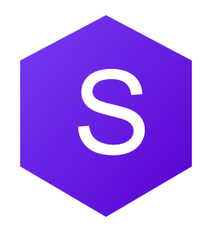

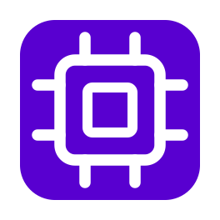


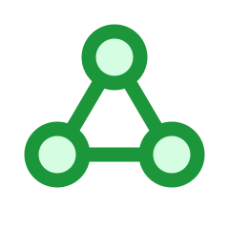

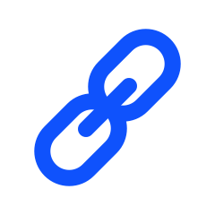
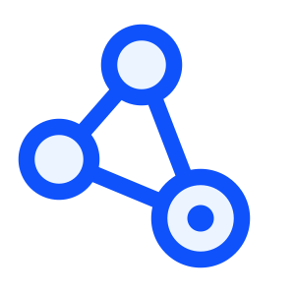
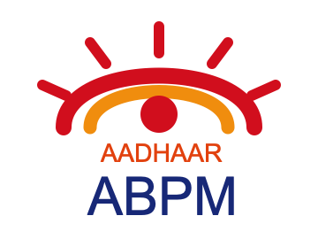




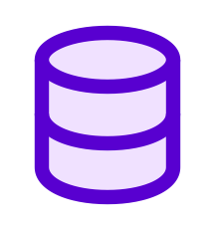

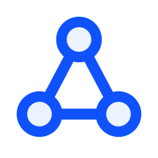











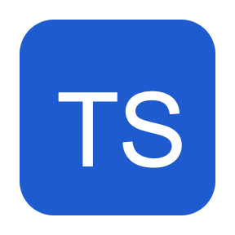

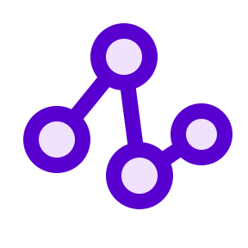
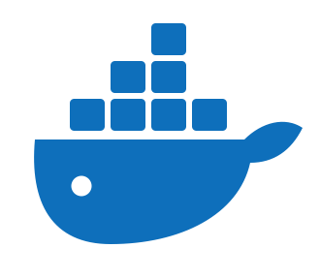


Technology, Tools and AI Approach
Health–a–thon 2026
Source-verified oncology records → safer, faster consultation preparation and care coordination.
OUR AI APPROACH
SOLUTION ARCHITECTURE
AI MODELS (How We Use AI)
RECORDS · Secure upload | EHR/HIS (FHIR) | Oncology PDFs & scans
Sarvam AI
Sarvam (doc-digitise,
saaras:v3, bulbul:v3)
OCR, structuring, Indic voice
01
Digitize
OCR scans, PDFs
and FHIR records
Amazon
Bedrock
Amazon (Nova Pro)
Grounded understanding & drafts
(briefs, letters, decks)
1. OCR + Classify
2. Extract + Link
3. Validate + Reconcile
4. HUMAN REVIEW
Sarvam
(doc-digitise)
Bedrock
(structured facts,
dates, page spans)
Source-span gate
(duplicate / version /
conflict checks)
Approve /
Correct /
Reject
KEY INTEGRATIONS
02
Structure
ABDM (NRCeS v6.5 / FHIR R4)
Patient record access & exchange
Extract dated facts
and source spans
FHIR
HL7® FHIR® + mCODE (STU4)
Oncology data standards & interoperability
Review & correction loop
NCG-KCDO / Hospital HIS
Oncology workflows & guideline references
03
Verify
SOURCE OF TRUTH — VERSIONED EVIDENCE LEDGER
Detect conflicts;
clinician reviews
PostgreSQL 16 · Immutable citations (doc, page, span) · Audit trail · RLS
OUTPUTS & USERS
Deterministic State-Graph: Intake → Extract → Validate → Review → Publish
Outputs
Users
04
Assist
Consultation
Timeline + changes
since last visit
Clinic Operations
Readiness +
OPD slot backfill
Grounded Assistant
Patient evidence [E#] +
SOPs [G#] (non-clinical)
Consultation brief
Clinician (Oncologist)
Briefs, OPD workflow
and reminders
“What changed” view
Clinic / OPD Staff
Checklists & SOP drafts
Patient & Caregiver
Human-approved actions only · Non-diagnostic by design
Reminders (Indic voice)
Knowledge Admin
TECHNOLOGY
STACK
Next.js 15
TypeScript
PostgreSQL 16
Agentic State-Graph
Docker
AWS (Bedrock)
HEALTH-A-THON 2026 • FINAL SUBMISSION • ONCOBRIEF
Pilot metrics (60–90 days): packet readiness · preparation time · follow-up confirmation
7

