Slide 1

FINAL SUBMISSION
OncoBrief
Source-verified oncology records, ready for the next consultation
Cancer Care · Consultation Readiness · Care Continuity
TEAM NAME ICONIX
TEAM CODE 6FQ4CN
HEALTH-A-THON 2026 • TITLE
Notes:
OncoBrief helps oncology teams prepare source-verified records before the consultation. Every consequential action stays with a named person. ICONIX, team code 6FQ4CN.

Slide 2

Team Overview & Background
ICONIX
R.M.K. Engineering College
DHAANISH AHAMED B
Team leader and technical lead
Brindha A S
Technology team member
What the team has built
Aishwarya K
Technology team member
A shared evidence workflow spanning record intake, human review, consultation preparation and care coordination.
Bhoomi Goel
Doctor partner
Engineering and clinical workflow review in one team
HEALTH-A-THON 2026 • FINAL SUBMISSION
Notes:
Team names and roles confirmed by the team leader on 26 October 2026. Team output is supported by the current source tree and documented local acceptance. No NCG affiliation, hospital partnership or clinical deployment is claimed.

Slide 3

Problem Statement and Supporting Evidence
The records exist. The care team still has to piece them together.
Outside reports can remain outside the EMR
Tata Memorial Hospital’s 2026 patient booklet says outside investigations do not appear in its EMR. Patients must bring previous reports when registering.
That leaves practical work before each visit
Locate missing documents. Check which version is current. Compare conflicting dates. Find who owns the unfinished request.
8 lakh+ annual OPD footfalls at TMH in 2024 show why small preparation delays matter at scale.
Source: Tata Memorial Hospital, Patient Information Booklet 2026, pp. 2, 17 and 40. Hospital context, not an OncoBrief impact result.
HEALTH-A-THON 2026 • FINAL SUBMISSION
Notes:
Primary source: https://tmc.gov.in/assets/PDF/TMH_Patient_Booklet_2026_Low%20Res.pdf . Printed p. 2 reports over 8 lakh OPD footfalls in 2024. Printed p. 17 requests previous/outside reports. Printed p. 40 states that outside investigation reports are not available in TMH EMR. This establishes a documented information boundary and operational workload. It does not establish a measured delay, prevalence of fragmentation, or treatment benefit attributable to this prototype. Illustration reused from the supplied original team deck.

Slide 4




Target Users and Use Case
Built around the people preparing an oncology visit
Oncologists
Coordinators and records staff
Inspect exact source pages, verify facts and approve the consultation packet.
Retrieve missing records, resolve ownership and prepare the next handoff.
Reception and clinic operations
Patients and caregivers
Book appointments, track arrivals and review eligible waitlist candidates.
Receive approved administrative reminders and confirm attendance with consent.
Primary setting: oncology OPDs and tumour-board preparation. Secure document upload supports a first pilot alongside existing hospital systems.
HEALTH-A-THON 2026 • FINAL SUBMISSION
Notes:
Use cases align with consultation readiness, clinic operations, doctor productivity and patient continuity in the supplied Cancer Care material. Role capabilities inspected in the current app and RBAC policy. Patient and caregiver communications require approval and consent. No hospital integration or pilot acceptance is implied. Icons and illustrations reused from the original team deck.

Slide 5





Solution Overview, Key Features & Impact - Max 2 Slides
A fact keeps its source through every handoff
Records
Evidence
Human review
Ready packet
Continuity
PDFs and scans
Page and exact text
Verify or reconcile
Gaps and owners
Approved reminders
What makes the workflow different
What the newer build adds
The Evidence Ledger stores facts before a narrative. Conflicting sources stay visible until a human records a decision. New evidence can reopen readiness.
Lab history and batch verification.
Four cited draft formats in Studio.
Scheduling, encounters and tumour boards.
Named task owners and caregiver consent.
Expected impact: less record hunting and clearer handoffs. A hospital pilot must measure the change.
HEALTH-A-THON 2026 • FINAL SUBMISSION
Notes:
Source: CLAUDE.md; packages/db/src/services/ledger.ts; packages/domain/src/review/longitudinal-review.ts; packages/db/src/services/studio.ts; packages/db/src/services/appointments.ts; packages/db/src/services/encounters.ts; packages/db/src/services/tumor-board.ts. Timeline and packets are views of the Evidence Ledger. AI proposes source-grounded candidates, humans approve evidence and consequential actions. Expected effects are hypotheses, not measured hospital outcomes. Icons are reused from the supplied original deck.

Slide 6
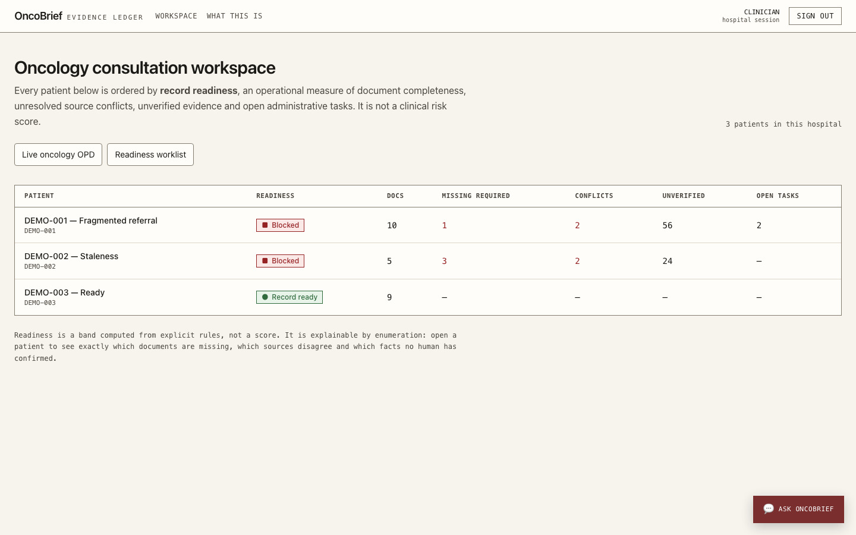
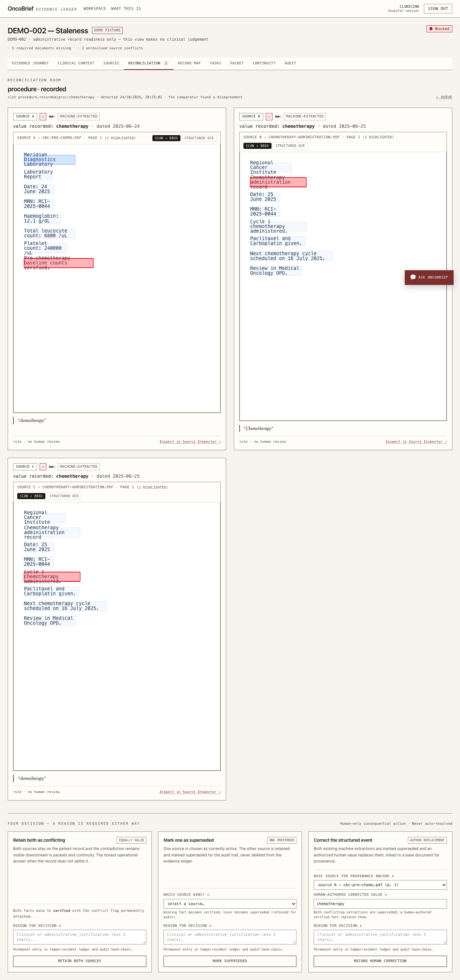
Solution Working MVP / Demo
Actual prototype screens using synthetic records
1 Find the preparation gap
2 Inspect both sources
The worklist shows document gaps and unresolved conflicts before review.
The reviewer sees highlighted source text and records an explicit decision.
HEALTH-A-THON 2026 • FINAL SUBMISSION
Notes:
Screenshots: apps/web/audit/screenshots/workspace-desktop-1440px.png and reconciliation-room-desktop.png. These are recorded local prototype screens using synthetic fixtures, not live hospital or patient data. Core workflow acceptance is documented in docs/v4-final-demo-validation.md, dated 24 October 2026.

Slide 7





Technology, Tools and AI Approach-
AI proposes evidence. Deterministic code controls the workflow.
Authorised input
Worker pipeline
Evidence Ledger
Human review
Approved outputs
Text PDFs, scans
FHIR-shaped bundles
OCR and extraction
Source-span validation
PostgreSQL
Page, span and version
Verify facts
Reconcile conflicts
Packets and tasks
Studio and continuity
Implementation
Configured AI adapters
Deterministic safeguards
Next.js and TypeScript
PostgreSQL and file storage
Typed ports and provider adapters
Sarvam Vision / Textract OCR
Amazon Bedrock extraction
Source-span validation gate
Tenant access and consent
Readiness and stale-packet checks
Append-only audit history
Local acceptance used rule-based extraction. Live AI, ABDM and message-delivery integrations still need external acceptance.
HEALTH-A-THON 2026 • FINAL SUBMISSION
Notes:
Architecture reflects inspected source: packages/adapters/src/ocr-routing.ts, bedrock-llm.ts, packages/db/src/services/ledger.ts, studio.ts and apps/worker. Provider configuration supports Sarvam Vision or Amazon Textract for OCR and Amazon Bedrock via the configured model ID. Do not claim a particular Bedrock model or current live provider deployment without acceptance. Local synthetic acceptance used OCR_DRIVER=local-pdf, EXTRACTION_DRIVER=rule, LLM_PROVIDER=rule and ABDM_DRIVER=simulated. Scanned pages without usable OCR require manual transcription. FHIR-shaped prototype mappings are not ABDM/mCODE certification. Native editable diagram. Icons from original team deck.

Slide 8
Build Sprint Journey and Progress
The original record-preparation idea grew into a connected workflow
1 FOUNDATION
2 READINESS
3 HANDOFFS
4 OPERATIONS
Records and provenance
Verification and reconciliation
OPD, Studio and continuity
A broader care-team workflow
Document intake, extraction, evidence states and an auditable ledger.
Source inspection, conflicting records, dated labs and packet freshness.
Named task owners, slot offers, cited drafts and consented reminders.
Patient registry, staff roles, scheduling, encounter notes and tumour boards.
Challenges that changed the build
Still ahead
Different dates on serial labs need separate observations. Consent withdrawal must block access without erasing audit history.
Hospital workflow validation, live gateway acceptance and a permission-scoped EHR launch layer.
HEALTH-A-THON 2026 • FINAL SUBMISSION
Notes:
Four build milestones are shown in sequence rather than inventing calendar weeks. Current source and git history establish progression, but do not establish one milestone per week. Original concept: supplied 8-slide deck. V4 acceptance: docs/v4-final-test-report.md and v4-final-demo-validation.md, 24 October 2026. Later additions: docs/milestone-a.md, docs/milestone-b.md and the operational modules added by 26 October. Their broader operational flows still require fresh end-to-end acceptance. Avoid production-grade claims from those planning documents.

Slide 9

Evaluation and User Validation
Local engineering evidence, with hospital impact still to test
886
51
automated tests passed
selected browser tests passed
Unit and database integration
24 October 2026 snapshot
Recorded synthetic workflow
24 October 2026 snapshot
No real-patient pilot results yet
What the checks exercised
What needs further validation
Source links, human review, conflict decisions, packet approval, consent withdrawal and cross-tenant denial.
Real-document OCR accuracy, multilingual speech, clinician usability and the newer scheduling / encounter workflows.
Recorded usability repairs: direct page links, clearer reconciliation controls and responsive layouts. Clinical benefit and model accuracy are unmeasured.
HEALTH-A-THON 2026 • FINAL SUBMISSION
Notes:
Recorded engineering evidence, not a fresh acceptance run: docs/v4-final-test-report.md, 24 October 2026. pnpm verify: 886 automated tests, zero failed or skipped. Selected Chromium acceptance: 51 distinct tests across 12 files, not the full historical browser inventory. Tested on synthetic fixtures with controlled local/rule/simulated adapters. Usability repair evidence appears in docs/v4-final-demo-validation.md, including source jumps, reconciliation controls and responsive checks. No independent clinician usability study, live model benchmark, hospital pilot, certification or measured time saving is claimed. New operational modules inspected on 26 October are not covered by the 24 October snapshot.

Slide 10




Safety and Responsible AI
A source citation helps. A review decision makes it accountable.
Privacy and access
AI uncertainty
Tenant isolation, role permissions and explicit record scope. Consent withdrawal blocks downstream access.
Keep extraction separate from verification. Reject unanchored output and route unreadable scans for transcription.
Human oversight
Inclusion and clinical boundaries
People verify, reconcile, assign, approve and send. Decisions keep an actor, time and reason.
Caregiver consent and 11 selectable voice locales support access. AI does not diagnose, stage, prescribe or interpret labs.
Clinical assessments and tumour-board decisions remain clinician-authored. Voice depends on a configured provider or installed voice and does not translate text.
HEALTH-A-THON 2026 • FINAL SUBMISSION
Notes:
Sources: CLAUDE.md, packages/domain/src/policy/rbac.ts; packages/db migrations; packages/db/src/services/studio.ts, caregivers.ts, encounters.ts and tumor-board.ts; docs/v4-codex-independent-review.md. The source-span gate checks quotation anchoring, not medical truth or semantic entailment. Human review remains necessary. The clinician can author encounter assessments and consensus notes, but AI does not generate a diagnosis or treatment recommendation. Voice locale selection does not translate the approved text. Accessibility checks are partial, not WCAG certification. No legal or regulatory certification is claimed.

Slide 11
Deployment, Cost and Sustainability Plan
Start with one oncology OPD and secure document upload
Illustrative pilot budget: one facility, five doctors, 1,000 ten-page packets per month
Budget item | Assumption | Estimate
One-time setup and training | 75 hours × ₹500/hour | ₹37,500
Hosting, storage and backups | Monthly budget allowance | ₹3,000/month
Support and operations | Monthly budget allowance | ₹2,000/month
OCR / AI processing | 1,000 packets × ₹4 budget | ₹4,000/month
Total ongoing operating budget | ₹3,000 + ₹2,000 + ₹4,000 | ₹9,000/month
Proposed facility subscription
Deployment and sustainability
₹12,000/month, or ₹2,400 per doctor at five doctors. Test affordability and support demand in the pilot.
Hospital approval, local checklists, trained reviewers and secure backups first. Add EHR APIs after pilot evidence.
HEALTH-A-THON 2026 • FINAL SUBMISSION
Notes:
All amounts are team planning assumptions, not provider quotes, actual operating costs, a commercial offer or validated willingness to pay. Setup 75 hours × ₹500 = ₹37,500. Monthly budget: hosting/storage/backups ₹3,000 + support ₹2,000 + OCR/AI allowance ₹4 × 1,000 packets = ₹9,000. At 1,000 ten-page packets, the variable processing allowance is ₹4/packet (₹0.40/page) and total operating budget is ₹9/packet. Proposed facility subscription ₹12,000/month divided across five doctors = ₹2,400/doctor/month. Allowances need vendor quotes and workload benchmarking. Tax, hospital hardware, integration work, governance/legal review, telecom and unusual support demand are excluded. No live cloud infrastructure is asserted. Expansion depends on a funded, approved pilot rather than an assumed NCG partnership.

Slide 12



What Next? Plans to take initiative forward (if any)
A 90-day plan to earn evidence in a real care setting
DAYS 1–30
DAYS 31–60
DAYS 61–90
Agree the pilot
Run supervised review
Compare and decide
Seek hospital approval. Define record scope, local checklists, reviewers and baseline preparation time.
Use approved records in a shadow workflow. Log corrections, gaps and source-check failures.
Measure preparation time and readiness. Review user feedback, cost and integration acceptance before expansion.
Primary pilot KPI
Make solution information publicly available?
Median record-preparation time per referral, measured on comparable cases before and during the pilot.
Answer: __________________ (Yes / No)
HEALTH-A-THON 2026 • FINAL SUBMISSION
Notes:
This is a proposed 90-day pilot plan, not an approved hospital partnership or committed programme timeline. Seek institutional approval before real records. Primary outcome is an operational KPI: median active record-preparation minutes per referral. Secondary measures can include record-ready share at scheduled visit, unresolved conflicts, verified task closure and cost per packet. Use comparable case types and report denominators and exclusions. Official guide: https://healthathon.reskilll.com/guide .

Slide 13
Thank you
ICONIX • 6FQ4CN
240186.cs@rmkec.ac.in | MVP: __________ | Video: __________
Source-verified records. Human-approved handoffs.
Health-a-thon 2026
Code: github.com/dhaanish597/OncoBrief
HEALTH-A-THON 2026
Notes:
Code repository: https://github.com/dhaanish597/OncoBrief . Main contact is the team leader’s provided college email. No current AWS availability is claimed.

