Slide 1


NodeJS Security Using PassportJS and HelmetJS:
Securing backend routes and preventing XSS attacks

Slide 2
Preface: What is Middleware?

Slide 3
PassportJS
Passport is Express middleware for Authentication
Authentication vs Authorization
Authentication:
Do the credentials match what the user has provided?
Authorization
Can this Authenticated user access this resource?
Provides multiple Authentication “Strategies”
Social Media Authentication (e.g. Facebook, Google, etc.)
Oauth support
Local Strategy
PassportJS is used in conjunction with a session library to store the Authenticated user which I will cover later
For the purposes of this tutorial I am going to cover Local Strategy

Slide 4
Local Strategy
Local Strategy assumes that you have some method internal to the application to verify the users.
E.g. User credentials stored in a DB
<Code Review>

Slide 5
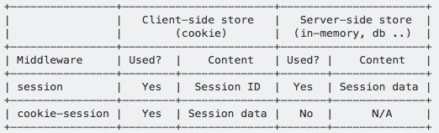
Session Storage
Once Authenticated, the user will be stored into the session
Session data, is data relating to your logged in user such as id, username, role, etc. Either the data itself or a corresponding ID is stored in a cookie
Two library options:
Express-session
The standard Node library to be used for Storing Session data
Can stores data server side in memory (Not to be used in production)
Cookie-session
Security concerns (To be addressed)
Cookie Size constraints: 4096 bytes

Slide 6
Overview: HTTPS

Slide 7
Oveview: Man in the Middle

Slide 8
Cookie Session Example
Security Concern | Mitigation
Man in the middle attacks | “secure: true” Cookie will only be transmitted via HTTPS connection
Cross site scripting attacks (XSS) | “httpOnly: true” Cookie data will not be accessible by client side javascript
Bluemix Specific concerns
Bluemix offers SSL Termination at the Datapower layer of Bluemix, therefore any traffic making it’s way to your application is technically HTTP
“secureProxy: true” and app.set('trust proxy', 1) to signal to cookie-session the application is actually getting HTTPS traffic
Datapower when forwarding traffic to your application will add the header “$wsis” which will be false if the request used HTTP. Use this to redirect traffic to use HTTPS.
<Demo>

Slide 9
Helmetjs
Helmetjs provides a variety of methods to add security to your application
Enable “frameguard” to prevent clickjacking attacks
Turning on “No sniff” which can prevent issues caused by browsers MIME Content sniffing
The most important aspect CSPs

Slide 10
Content Security Policies (CSPs)
Added layer of security against XSS and data injection attacks
Allows you to:
Restrict domain of scripts being executed on the site.
Restrict inline javascript or eval functions from being executed.
According to Github (Paraphrasing) “Our ever evolving use of Content Security Policy (CSP), is our single most effective mitigation strategy against Content Injection attacks such as XSS.”
Source: http://githubengineering.com/githubs-csp-journey/
CSP’s work via whitelisting allowed domains / code execution methods
<Demo>

Slide 11
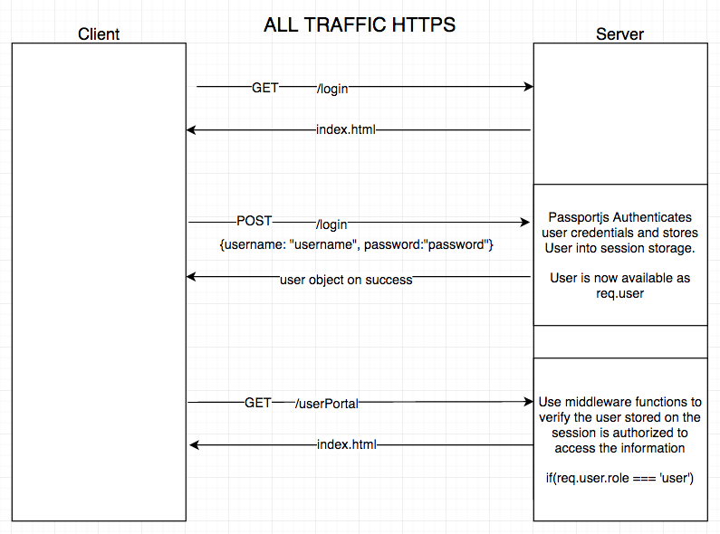

Slide 12
App Demo
https://securitylunchandlearn.mybluemix.net/login
<Code Review>

