Slide 1
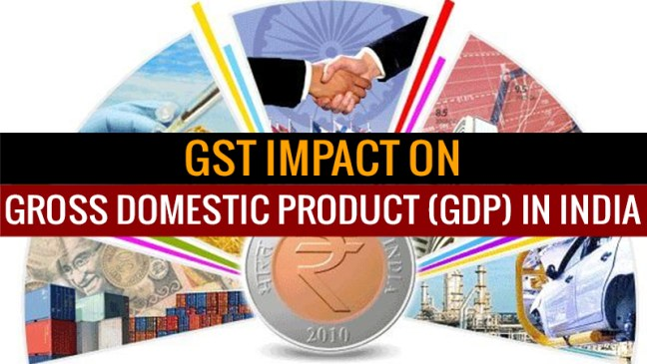

Slide 2
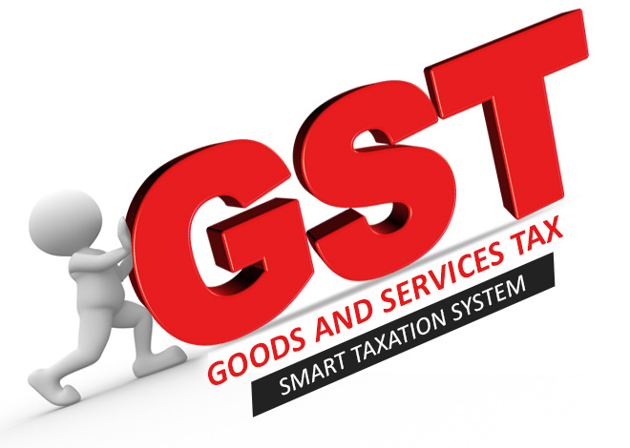
What is GST ?
GST is a single indirect tax that combines many indirect taxes as service tax, central Excise tax, customs tax, VAT tax etc. GST rates in india are 5%,12%,18%,28%.
It is Biggest indirect tax reform since independence.
It will be levied when a customer will purchase a good or a service .
The GST Bill will create a single market for more than a dozen state levies.
The tax system is the backbone of any developing nation.
More than 140 Countries have already introduced GST.
France was the first country to introduce GST system in 1954.

Slide 3
GST
Economy
Industry
Consumers
Service Provider
Manufacturer

Slide 4
What is GDP ?
Gross domestic product (GDP) is the market value of all last goods and services produced in a time period (quarterly or yearly).
The GDP estimates are generally used to Determine the Economic performance of whole country or a particular sector, just to make international comparisons.
GDP is a Measure of Economy of country.
The GDP Estimates are based on Agriculture, forestry and fishing, Mining, Manufacturing, Electricity, Gas, water supply, hotels and Transport & communication and services Financial, insurance, real estate.
Financial & Real estate Manufacturing Service Related & Broadcasting
Utility services Agriculture Construction Public administration Mining

Slide 5
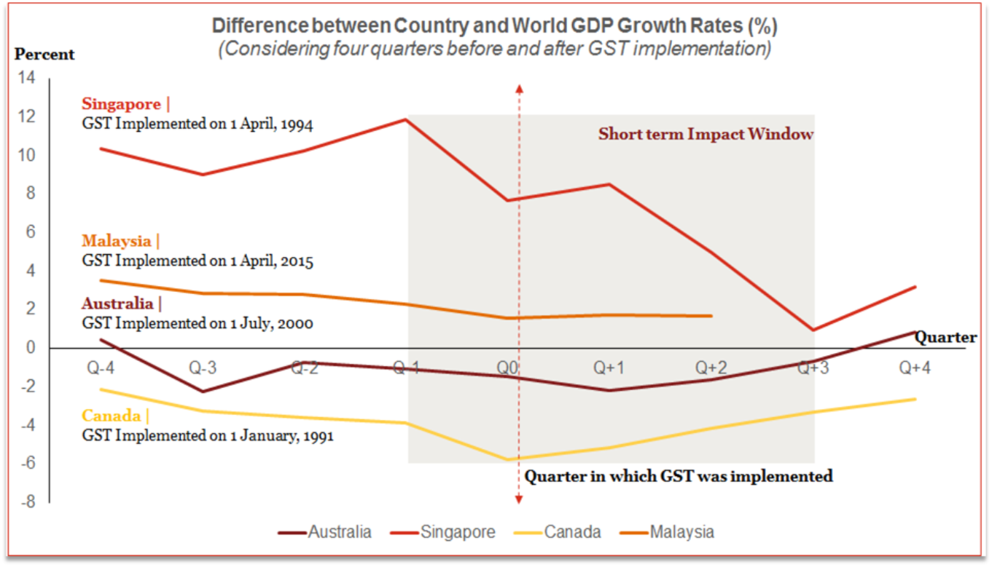
Here we have studied short time impact of GST on GDP growth ratefor four countries.

Slide 6
The details of the estimates of GDP for Q2(July - sep) of 2017-18 are presented below. The next release of quarterly GDP estimate for the quarter October-December, 2017 (Q3 of 2017-18) will be on 28.02.2018.
Quarter2(July - September) | 2016-17 | 2017-18 | Growth
GDP | 29.79 lakh crore | 31.66 lakh crore | 6.3 %
GVA (Gross value added) | 27.51 lakh crore | 29.18 lakh crore | 6.1 %
Quarter wise Pie Charts For Various Sectors of GDP
1.agriculture,forestry&fishing
2.mining & quarrying
3.manufacturing
4.electricity,gas,water supply & other utility services
5.construction
6. trade, hotel, transport, communication & services related to broadcasting
7.financial, insurance, real estate &professional services
8.Public administration, defence & other services

Slide 7
From The Above Time series Model the Estimates of GDP for Next Three Years Are Given in this Table
YEAR | GDP Estimates
2017 | 2.45676
2018 | 2.49886
2019 | 2.74095

Slide 8
Positive Impact
GDP growth hit a three-year low of 5.7 % in the first quarter of the fiscal. And in Second Quarter GDP has growth of 6.3 % .
GST is Helpful to reduce transportation cost which has make a unified market in terms of tax-implementation.
After GST implementation the export of goods and services have become competitive because of a null impact of cascading effects of taxes on goods and products.
GST has make business Easier than before. India’s Ease of doing business rank became 100 which has a jump of 30 points first time in Indian History.
Increase in currency value.
The Currency Value of India is 1USD=64.08 INR which was three months ago 68.3.
the transaction of goods and services will be seamless across the states.

Slide 9
Negative Impact
As we know that there is currently only one GST software in Market which is provided by software company Webtel.
Due Registration of GST IN(GST identification number) for Merchant’s market was Slowed down for a month.
India’s Industrial production growth slowed in September from a nine-month high in August although IIP rose 3.8% in September, compared with upward revised 4.5% in August. .

Slide 10
Conclusion
As every coin has two faces if it is not unbiased in the same way we tried here to familiarize the things related to GST with both perspective. So it can be seen that there is increase in Growth rate of GDP in the second Quarter of 2017-18. But Since we have only three month data cannot be sure too about the Influence of GST.
We can have a study on Activities like GST which are implemented in developed nations which will help India to become a developed country.

Slide 11
