Slide 1
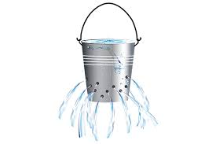
Churn project
Submitted by: Dana Hadar 029617057,
Mazal Gonen,
Inna Rozner

Slide 2
The challenge
Our challenge: to predict whether a customer will churn.
Our information: Churn database: includes 19 features based on customer’s demographics, service and contract information and 1 label, churn (Yes/No)
Our motivation: to minimize the churn rate and enabling the Company to grow.
Prediction methods: Decision tree, Random Forest, KNN.

Slide 3
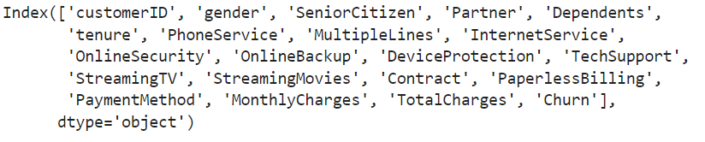
Data description
The dataset has 7043 records. In order to predict churn rate, the dataset was randomly split into two sets , 80% train set and 20% test set. Each one of the predictive models applied to the training set and the quality of the predictions was assessed by running the model on the test set and checking accuracy of churn prediction vs. the actual value.
The original dataset includes 19 features. ‘Churn is the label’.
Missing values: there are 11 rows missing in the ‘Total charges’ feature. Missing values were dealt with in the data cleaning sections (see also model assumptions section).

Slide 4
Model assumptions
If a customer doesn’t use an internet service, he wouldn’t use online security.
If a customer doesn’t use phone services, he wouldn't have multiple lines.
Technical support is available for all customers for no additional charges.
‘CustomerID’ is not considered a feature since we did not find a pattern or a descriptive character while looking at its values.
Total charges feature doesn't add additional data to the model, since this feature is a function of two other features (monthly charges, tenure).

Slide 5
Data engineering
Cleaning
All columns' headers were converted to lower case letters.
‘Yes/no’ features/label were replaced with numeric values (1/0).
Categorical values were converted to numeric values (1/0) using ‘ get_dummies’ function.
Monthly charges and total charges were categorized to 3 categories : low, medium and high according to the 25th, 50th and 75th percentile of distribution for the descriptive part of the model.
After having only numeric values in the data frame (DF), the type of all features in the DF was converted to float.
Unnecessary features were dropped: Male (gender), Total charges.
Features were added: ‘has_internetservice’ – gets 1 if he has internet, num_of_services – sum of all service the customer has, see table next page.
Missing values of the ‘Total Charges’ feature were replaced with the mean of the total charges for the descriptive part, however, this feature was removed from the model.

Slide 6
Distribution of the SAMPLE Features
Feature | N (% of feature's total) | N - Feature's total
Demographics
gender: |  | 7043
Female | 3488 (49.5%)
Male | 3555 (50.5%)
Senior Citizen: | 1142 (16.2%) | 7043
Has Partner: | 3402 (48.3%) | 7043
Has Dependents: | 2110 (30.0%) | 7043
Tenure months, M(SD) | 32.4 (24.6) | 7043
Multiple Lines: |  | 7043
No | 3390 (48.1%)
No phone service | 682 (9.68%)
Yes | 2971 (42.2%)
Feature | N (% of feature's total) | N - Feature's total
Services
Has Phone Service: | 6361 (90.3%) | 7043
Internet Service: |  | 7043
DSL | 2421 (34.4%)
Fiber optic | 3096 (44.0%)
No | 1526 (21.7%)
Has Online Security: | 2019 (28.7%) | 7043
Has Online Backup: | 2429 (34.5%) | 7043
Has Device Protection: | 2422 (34.4%) | 7043
Has Tech Support: | 2044 (29.0%) | 7043
Has Streaming TV: | 2707 (38.4%) | 7043
Has Streaming Movies: | 2732 (38.8%) | 7043
Total sum of services |  | 7043
<= 3 services | 3329 (47.0%)
4-6 | 2930 (32.0%)
7-8 | 784 (11%)

Slide 7
Distribution of the SAMPLE Features and LABEl (continued)
Feature | N (% of feature's total) | N - Feature's total
Business Info
Contract type: |  | 7043
Month-to-month | 3875 (55.0%)
One year | 1473 (20.9%)
Two year | 1695 (24.1%)
Paperless Billing: | 4171 (59.2%) | 7043
Payment Method: |  | 7043
Bank transfer (automatic) | 1544 (21.9%)
Credit card (automatic) | 1522 (21.6%)
Electronic check | 2365 (33.6%)
Mailed check | 1612 (22.9%)
Monthly Charges, M(SD) | 64.8 (30.1) | 7043
Low: < 36 | 1781 (25.0%)
Medium: 36-90 | 3523 (50.0%)
High:>90 | 1739 (25.0%)
Total Charges | 2283 (2267) | 7043
Low: < 403 | 1765 (25.0%)
Medium: 403-3787 | 3506 (50.0%)
High:>3787 | 1761 (25.0%)
Label
Churn: | 1869 (26.5%) | 7043
Total Records:
7,043
Churn percentage:
26.5%
2 features added
2 features dropped
11 missing values replaced

Slide 8
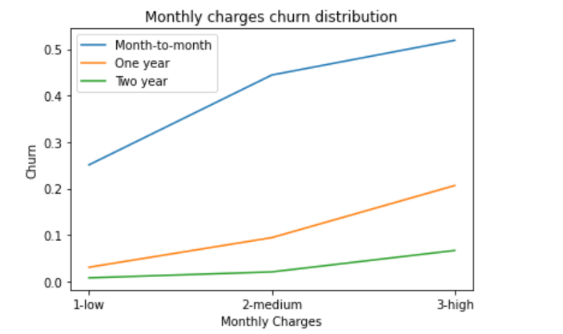
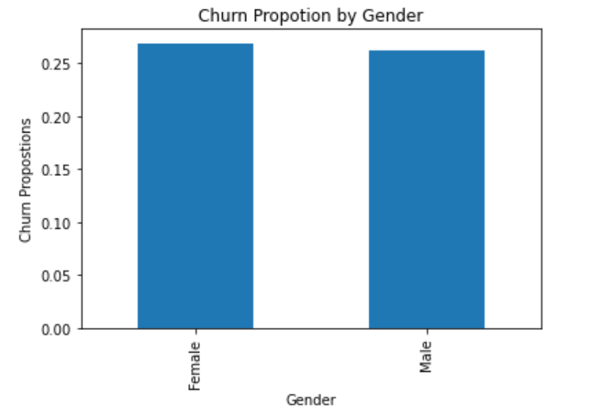
Data insights
This line chart shows the churn percentage by contract types and monthly charges. We can learn that the longer the contract is (green line), the lower is the churn percentage (loyal customers). Also, all king of contracts churn more as the monthly charges increase.
This bar chart shows the distribution of the gender on our label. We can see that gender has no impact on the label.

Slide 9
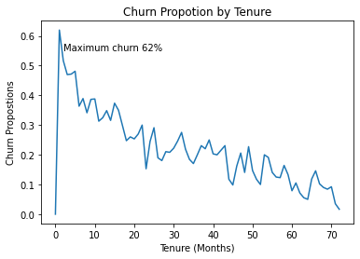
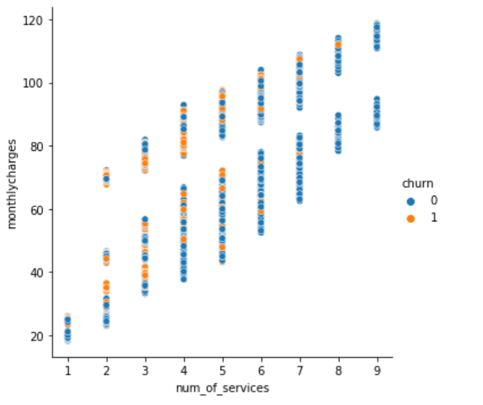
Data insights (continued)
This line chart shows that churn proportion decreases as tenure increases, namely, the longer a customer has been with the Company, the less likely they will churn.
This scatter chart shows that monthly charges increase as the number of services increase, however, customers are less likely to churn as the number of services increase.

Slide 10
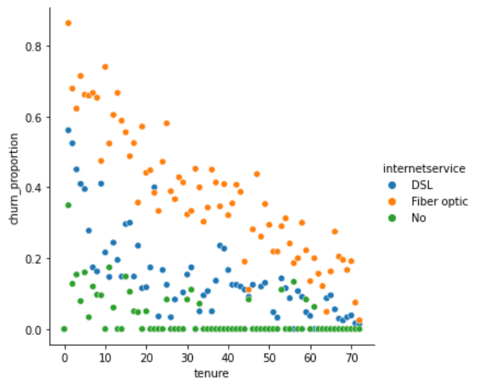
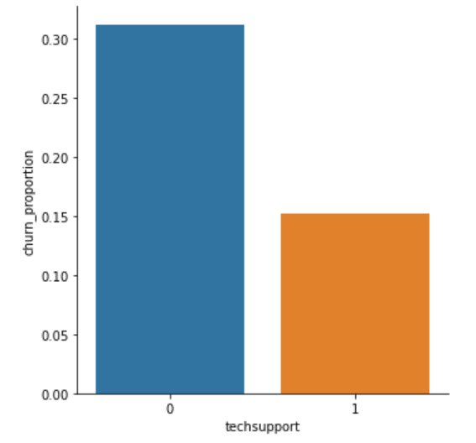
Data insights (continued)
This scatter chart shows that fiber optic customers are more likely to churn than DSL customers. Customers loyalty increase as tenure increases for all kind of services
This bar chart shows that customers who use technical support are 50% less likely to churn than customers who don’t. Technical support is an essential service for the Company’s customer relations.

Slide 11
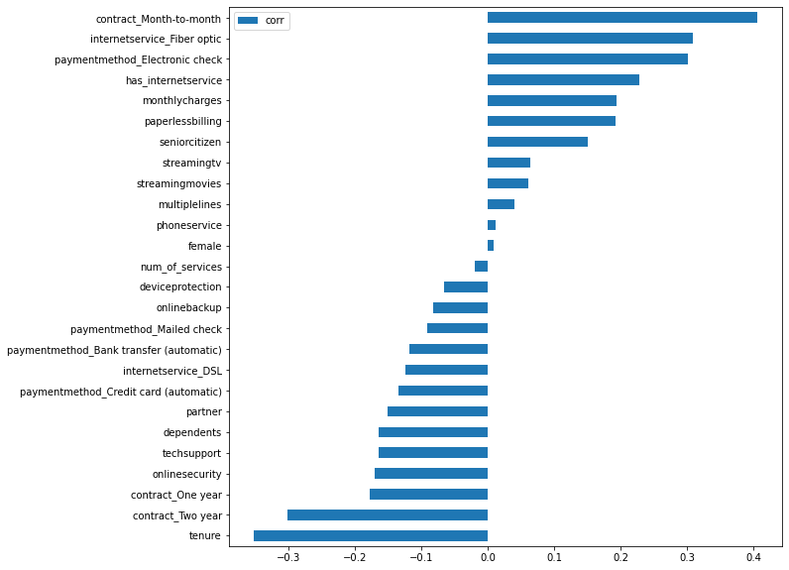
correlations
From the correlation coefficients plot we learn that churn is likely to be from the following customers:
1. Have Month to month contract
2. Have fiber optic internet service
3. Pays with electronic check
Not-churn is likely to be from the following customers:
Has services as: online security, tech support.
2. having one/two-year contract

Slide 12
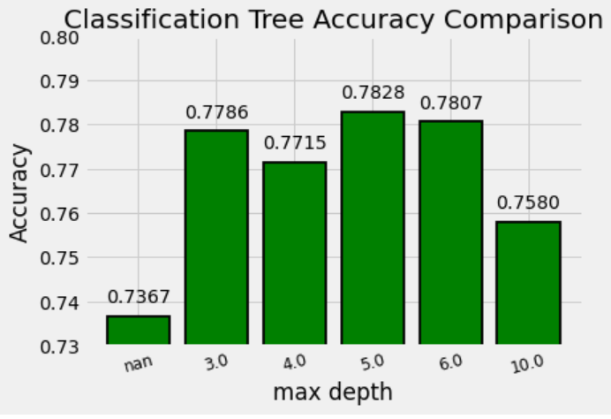
ML prediction algorithms- decision tree
We used a loop on a range of max-depth hyper parameter in order to examine what is the optimal depth for the best prediction accuracy. The following chart shows the result of the examination:
We can see, that our model is most accurate (78.3%)when we use a max depth of 5.
The decision tree is visible at the notebook.

Slide 13
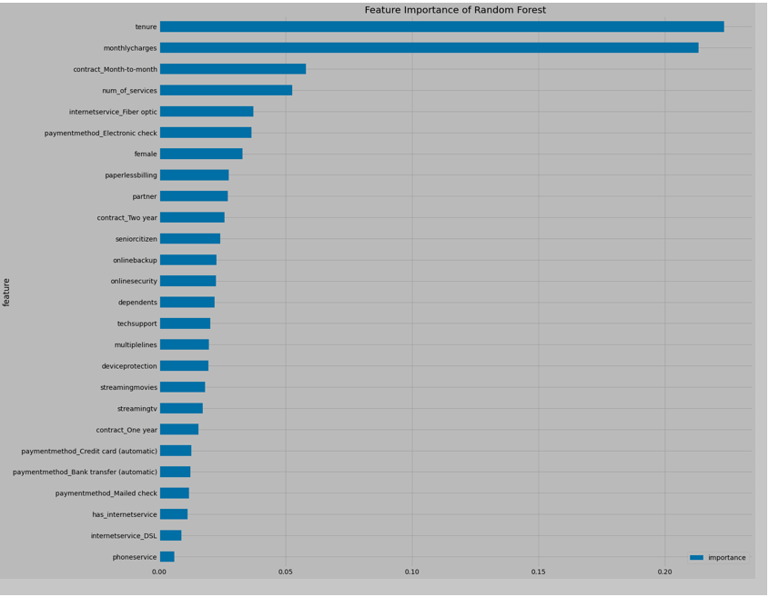
ML algorithms- random forest
First, let’s take a look at the importance of the features. It looks like the tenure and the monthly charges are the most important for this model. It is quite expected based on the descriptive part of the project.

Slide 14
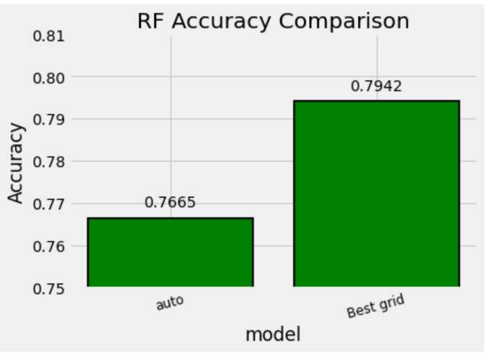
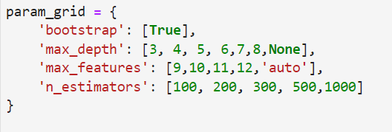
ML algorithms- random forest (continued)
We used grid search procedure in order to determine the best hyper parameters for this model. We tried different depth, max features and ‘n’ estimations. Our best result was with: max_depth=6, max_features=9, n_estimators=1000
Our best result generated an accuracy of 79.4%, which is significantly better than using the default rf parameters (Auto: 76.6%)

Slide 15
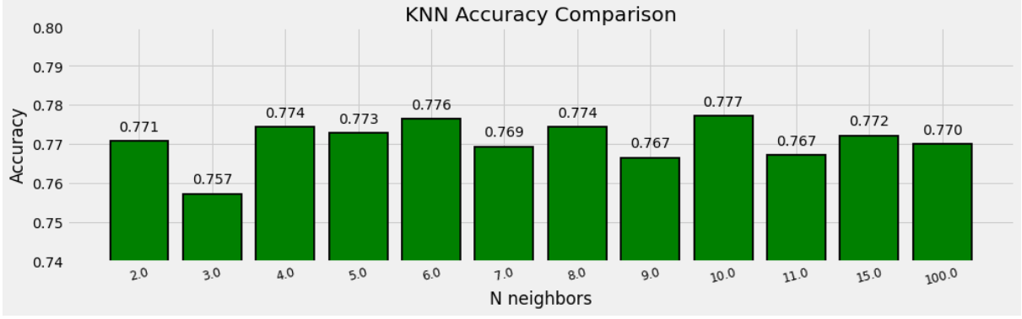
ML algorithms- knn
We examined 12 different k-neighbors values to determine the best accuracy of the model. Our best result was with 10 values.

Slide 16
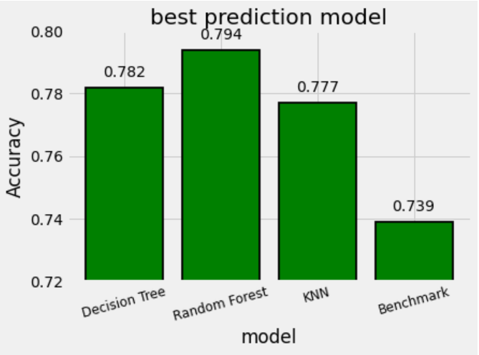
Evaluation & benchmark
We collected from each one of the prediction models the one that had the best accuracy and compared between the models. The highest accuracy achieved in random forest. When comparing our models’ accuracy to benchmark (all test values of label were set to 0)we got accuracy of 73.9%. We can see that any of our prediction models generate a more accurate result.

Slide 17
Business insight
Month to month contract – customers who are checking out different service providers on a monthly basis are more likely to churn. “Customer loyalty” is achieved after approximately 17 months.
Monthly charges seem to play a larger part in customer’s decision who has a month to month contract than other type of contracts.
Customers who use less than 5 services are more likely to churn.
Customers who use tech support are significantly less likely to churn.
DSL services are most successful within internet services. Customers who use fiber optic internet are more likely to churn than customers who use DSL or customers who use no internet services at all. However, customers who use DSL are less likely to churn than a customer who doesn’t use internet services at all.

