Slide 1
Cache & Locality
Registers
<1 KB · ~0.3 ns
L1 Cache
Performance Lab
32 KB · ~1 ns
L2 Cache
256 KB · ~4 ns
Mid-term Project Technical Presentation
L3 Cache
Computer Systems | Istanbul Atlas University | April 2026
6 MB · ~12 ns
DRAM
>8 GB · ~60–80 ns
Team 11
Ebru Inci Dhafer Hamza Sfaxi
Memory Hierarchy
Kasra Nikdel Fadi Ibrahim Basha

Slide 2
Project Overview & Agenda
Overview
01
Methodology
02
Stride Access
Timer infrastructure · measure_ns<Fn>() · platform notes for Apple Silicon
How cache-line granularity controls per-access latency
03
Working Set Size
04
Matrix Traversal
Latency step transitions across L1 → L2 → L3 → DRAM
Row-major vs column-major: spatial locality and slowdown ratio
05
Pointer Chasing
06
Memory Bandwidth
Random linked-list hops that defeat hardware prefetching
Copy vs sum kernels · peak GB/s by cache level · serial dependency bottleneck
07
Key Findings
Five practical rules derived from measured data
Five benchmark modules · C++17 · g++ -O2 · Apple Silicon M-series

Slide 3
Methodology — Timer & Benchmark Architecture
Methodology
Core Timing Primitive — src/timer.h
Why best-of-5?
template<typename Fn>
double measure_ns(Fn&& f,
long long n_accesses,
int iterations = 5) {
using clk = chrono::high_resolution_clock;
double best = 1e18;
for (int i = 0; i < iterations; ++i) {
auto t0 = clk::now();
f(); // benchmark kernel
auto t1 = clk::now();
double ns = (double)
duration_cast<nanoseconds>(t1-t0)
.count() / (double)n_accesses;
if (ns < best) best = ns; // best of 5
}
return best;
}
OS scheduling, page faults, and thermal events produce upward outliers. The minimum timer value represents the hardware latency floor without software noise.
Why divide by n_accesses?
Measures per-operation cost, not total elapsed time. Allows fair comparison across experiments with different loop counts.
Platform: Apple Silicon
UMA architecture, ~8-16 MB System Level Cache, LPDDR bandwidth >100 GB/s, aggressive hardware prefetcher. Results differ predictably from x86 textbooks.
Project Source Layout
Build & Run
src/ timer.h config.h main.cpp
stride_bench.cpp workingset_bench.cpp
matrix_bench.cpp linkedlist_bench.cpp bandwidth_bench.cpp
$ make # builds all five benchmarks
$ make run # runs + writes results/*.csv
$ g++ -O2 -std=c++17 -Wall -Wextra src/*.cpp -o bench
Compiler: g++ -O2 -std=c++17 -Wall -Wextra · BENCH_ITERS=5 · MIN_ACCESSES=4,000,000

Slide 4
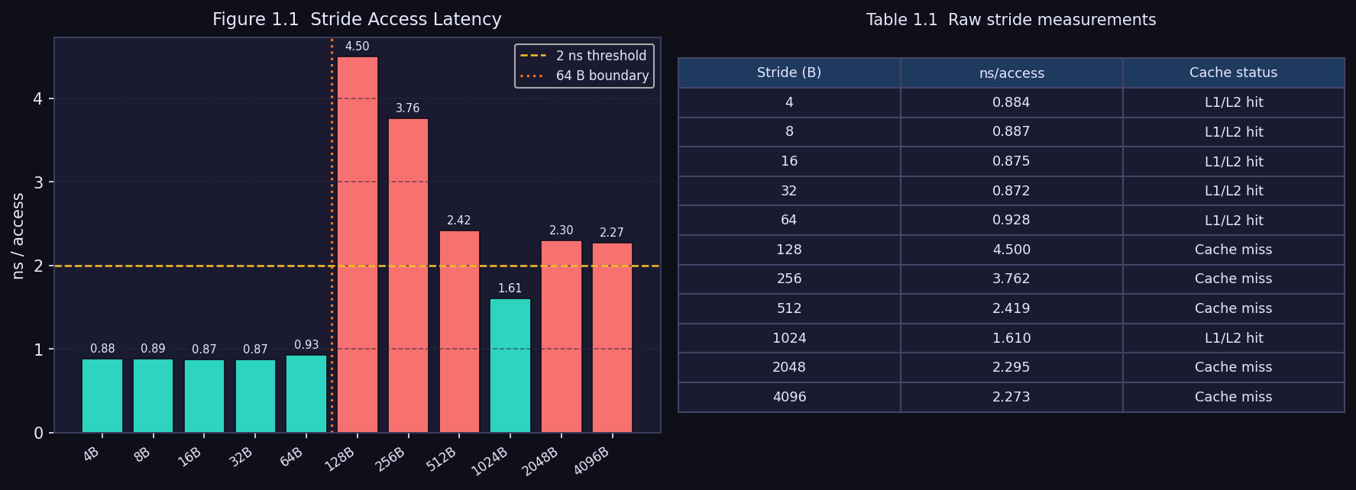
Experiment 1 — Stride Access Pattern
Stride
Cache-Line Boundary
64-byte cache lines are the atomic unit of data transfer. On Apple Silicon the prefetcher hides the 64B boundary — the latency spike appears at 128 bytes (two consecutive lines).
Measured Results
4–64 B stride: ~0.88 ns (L1 hit)
128 B stride: 4.50 ns ★ spike!
256+ B: 1.6–3.8 ns (stream)
Benchmark Kernel — stride_bench.cpp
Hardware: What Triggers a Cache Miss?
for (long long i = 0; i < SIZE; i += stride_elems)
sum += arr[i]; // touches a new 64-B cache line
// whenever stride_bytes >= 64
// volatile sink prevents dead-code elimination:
volatile long long _sink = sum;
The CPU loads memory in 64-byte blocks (cache lines). Two accesses to the same line cost only one fetch. Apple M-series prefetches pairs of lines (128 B window), so the spike shifts from the expected 64 B to 128 B — only a stride that crosses both lines in the prefetch pair causes a guaranteed miss. Padding hot structs to 64-byte boundaries prevents false sharing across cores.
Experiment 1: 64 MB int array · strides swept 1–1024 elements · ~0.88 ns (hit) vs ~4.5 ns (miss)

Slide 5
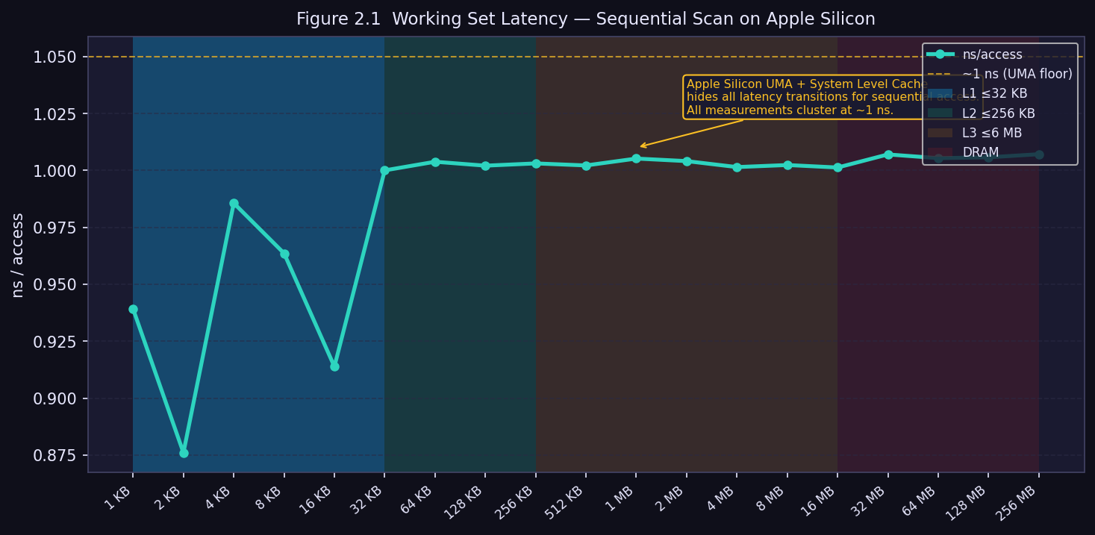
Experiment 2 — Working Set Size
Working Set
Expected vs Observed
Expected (x86):
4-step latency profile
L1→L2→L3→DRAM
Observed (M-series):
Flat ~1 ns across
all array sizes
Why the flat curve?
① Aggressive HW prefetcher recognises sequential scans
② ~8-16 MB System Level Cache absorbs medium arrays
③ LPDDR bandwidth >100 GB/s serves large arrays fast
Sequential Scan Kernel — workingset_bench.cpp
x86 vs Apple Silicon — Why the Curve Differs
// Scan the entire working set once per iteration
long long sum = 0;
for (long long i = 0; i < n_elems; ++i)
sum += arr[i]; // stride = 4 B (int)
// HW prefetcher detects stride=1 and issues
// the NEXT cache line BEFORE the CPU asks for it
x86 (Intel/AMD): prefetcher covers only L1/L2. Arrays larger than L2 still show a step increase at the L3/DRAM boundary because the prefetcher cannot hide L3 misses.
Apple M-series: the System Level Cache (SLC, ~8–16 MB) is private to the CPU cluster and sits between L3 and DRAM. It absorbs medium-size sequential arrays entirely, collapsing the expected 4-step profile to a flat ~1 ns line.
Experiment 2: array sizes 1 KB – 256 MB · sequential scan · Apple Silicon hides all transitions

Slide 6
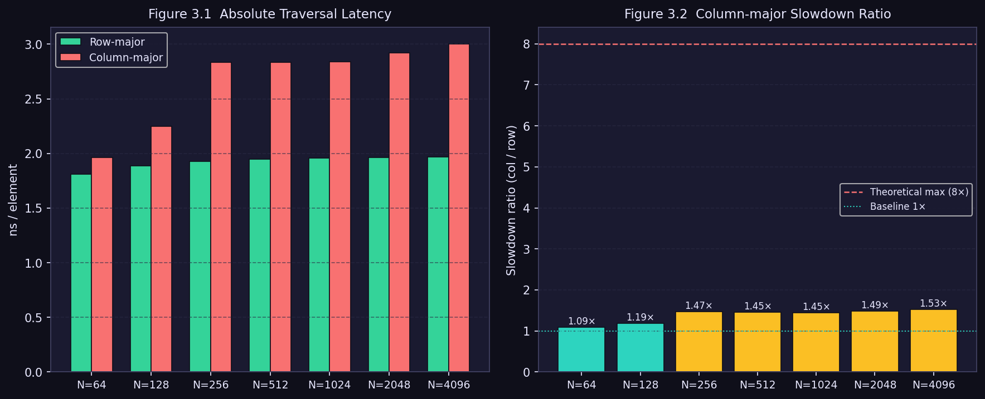
Experiment 3 — Matrix Traversal Order
Matrix
Slowdown Summary
Matrix Size Slowdown
N=64 32 KB 1.09×
N=256 512 KB 1.47×
N=1024 8 MB 1.45×
N=4096 128 MB 1.53×
Key Insight
Observed 1.5× vs theoretical 8× max. The hardware prefetcher detects the regular column stride and partially compensates — but the penalty remains real and consistent.
The Critical Difference — matrix_bench.cpp
Spatial Locality & C++ Memory Layout
// ✓ Row-major — cache-friendly (stride = 8 B / double)
for (int i=0;i<N;++i)
for (int j=0;j<N;++j) s += m[i][j];
// ✗ Col-major — cache-hostile (stride = N×8 B)
for (int j=0;j<N;++j)
for (int i=0;i<N;++i) s += m[i][j]; // 1.5× slower!
C++ stores 2-D arrays in row-major order: m[0][0], m[0][1], m[0][2] … are adjacent bytes in memory. Row-major access walks through contiguous memory — each 64-byte cache line holds 8 doubles and all 8 are used.
Column-major access jumps N×8 bytes between iterations. For N=1024 that is 8 KB per step — one cache miss per element. The theoretical max slowdown is 8× (one double per line); we measured 1.5× because the HW prefetcher partially compensates.
Experiment 3: N×N double matrices, N=64–4096 · col-major is always slower · write cache-friendly loops

Slide 7
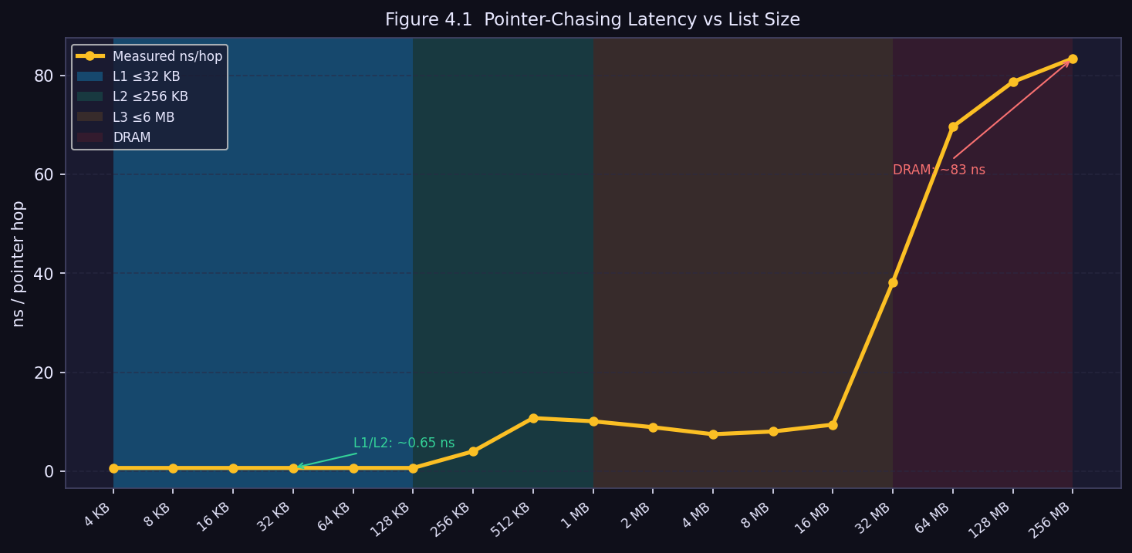
Experiment 4 — Pointer Chasing (Linked List)
Pointer Chasing
Latency by Cache Level
≤128 KB ~0.65 ns
L1/L2
256 KB ~4 ns
L2→L3
512K–16MB ~8–11 ns
L3
32 MB ~38 ns
→DRAM
≥64 MB ~70–83 ns
DRAM
128× latency range from L1 to DRAM. Pointer chasing serialises loads — the CPU cannot prefetch the next address until the current load completes.
Node Struct & Chase Loop — linkedlist_bench.cpp
Why Hardware Prefetching Cannot Help
struct alignas(64) Node { Node* next; }; // 1 node = 1 cache line
// Fisher-Yates randomly shuffles pointer chain
__attribute__((noinline))
void chase(Node* head, long long n) {
for (Node* p = head; p; p = p->next);
asm volatile("" ::: "memory"); // prevent opt-out
}
The address of the next node is stored inside the current node — which has not been loaded yet. This creates a load-use dependency: the CPU cannot issue the next memory request until the current one completes. Each hop is a fully serialised cache miss.
alignas(64) guarantees that every node occupies exactly one cache line, so each hop always fetches a fresh 64-byte block. The __attribute__((noinline)) + asm volatile barrier was essential to prevent the compiler from eliminating the loop at -O2.
Experiment 4: Fisher-Yates shuffled list · alignas(64) nodes · __attribute__((noinline)) + asm volatile barrier

Slide 8
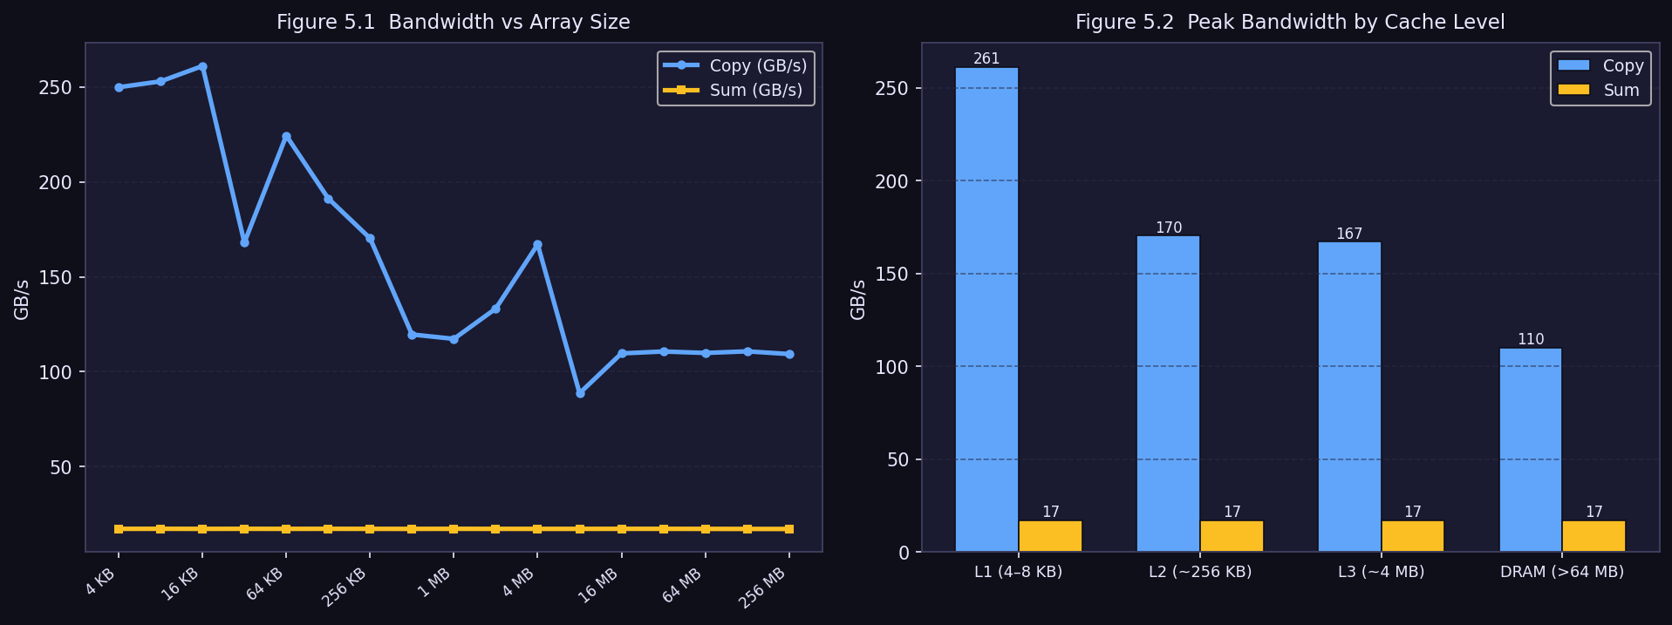
Experiment 5 — Memory Bandwidth
Bandwidth
Peak Copy Bandwidth
Level Copy Sum
L1 (~8 KB)
253 GB/s
17.2 GB/s
L2 (~256 KB)
168 GB/s
17.2 GB/s
L3 (~8 MB)
89 GB/s
17.2 GB/s
DRAM (>64MB)
109 GB/s
17.1 GB/s
Why is sum always ~17 GB/s?
Serial FP-add dependency chain: each iteration s += src[i] must wait for the previous addition (~5 cycle latency at 3.5 GHz). Memory bandwidth is completely irrelevant.
Two Kernels, Two Bottlenecks — bandwidth_bench.cpp
The Serial Dependency Bottleneck Explained
// Copy — independent, bandwidth-limited:
for (long long i=0; i<n; ++i) dst[i]=src[i];
// Sum — SERIAL dependency on 's' (compute-limited):
double s = 0;
for (long long i=0; i<n; ++i) s += src[i];
// each iter WAITS for prev FP-add to finish (~5 cyc)
Copy issues independent load/store pairs — the CPU can pipeline many at once and the bottleneck is purely memory bandwidth (>100 GB/s on Apple Silicon).
Sum carries a loop-carried dependency: s_{i+1} = s_i + src[i]. The FP-add unit has ~5-cycle latency, so only one addition completes per 5 cycles. At 3.2 GHz: 4 B ÷ (5 cycles ÷ 3.2 GHz) ≈ 2.6 GB/s theoretical ceiling. Measured 17 GB/s means the compiler auto-vectorised with partial unrolling — but it still cannot reach memory-speed.
Experiment 5: copy (read+write) vs sum (read-only) · DRAM copy 109 GB/s · sum bottlenecked by compute, not memory

Slide 9
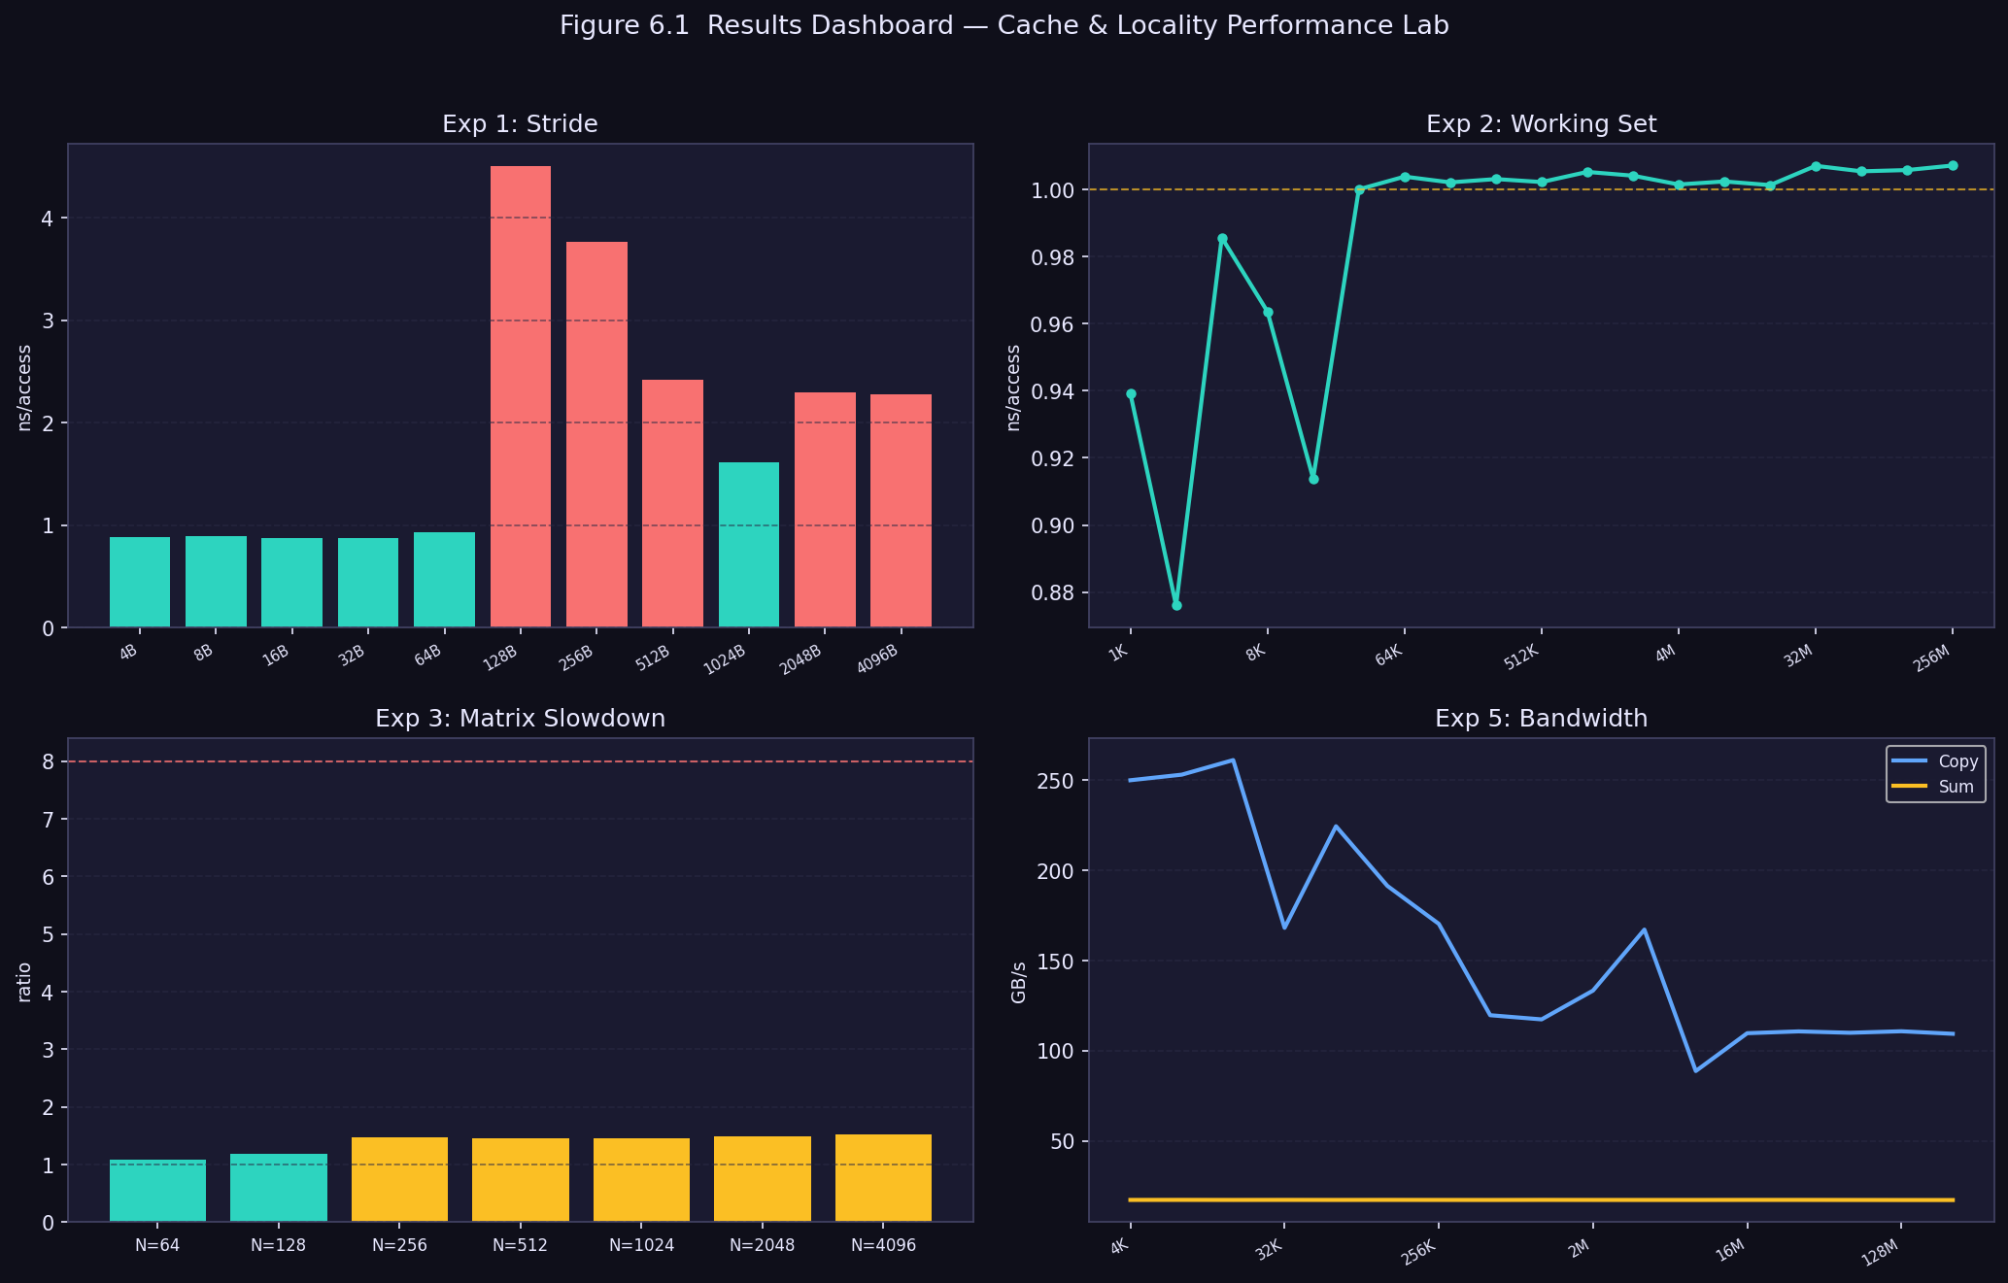
Results Dashboard — All Experiments at a Glance
Dashboard
Dashboard: Stride · Working Set · Matrix Slowdown · Bandwidth · all data from live benchmarks on Apple Silicon

Slide 10
Key Findings — Five Practical Rules
Findings
1
Cache-line granularity is real
2
Sequential access is nearly free on Apple Silicon
3
Write row-major loops
Accesses spaced >64 bytes apart each require a new 64-byte fetch. Pad hot data structures to align with cache-line boundaries to avoid wasting bandwidth.
Prefetching + SLC hides the memory hierarchy for sequential scans. On x86 the 4-tier latency penalty is fully visible at each cache boundary.
Column-major traversal is 1.5× slower on M-series and up to 8× on x86. Always let the innermost loop index advance the last (column) dimension.
struct alignas(64) HotData { int x, y, z, pad[13]; };
for (size_t i=0; i<n; ++i) sum+=arr[i]; // stride=1 → prefetch wins
for(i) for(j) s+=m[i][j]; // ✓ vs for(j) for(i) s+=m[i][j]; // ✗
4
Pointer chasing forces full memory latency
5
High bandwidth ≠ high performance
128× gap between L1 (0.65 ns) and DRAM (83 ns). Each hop is serialised — the CPU cannot prefetch the next address until the current load completes.
Serial loop-carried dependencies (prefix-sum, reductions) are CPU-latency-bound. Breaking the chain with multiple accumulators recovers throughput.
// Prefer arr[idx[i]] over p=p->next when list fits in cache
double s0=0,s1=0; s0+=a[2*i]; s1+=a[2*i+1]; // break dep chain
All findings supported by live benchmark data collected on Apple Silicon M-series · C++17 · g++ -O2

Slide 11
Conclusions
Memory access pattern is a first-order performance variable — often more impactful than algorithm choice.
Thank You
Platform architecture determines which memory hierarchy effects are visible. Apple Silicon hides effects that x86 exposes.
Cache & Locality Performance Lab
Computer Systems · Istanbul Atlas University · April 2026
Benchmarking requires careful implementation: noinline, volatile sinks, and compiler barriers prevent dead-code elimination.
Team 11
Ebru Inci Dhafer Hamza Sfaxi
The 128× latency range from L1 to DRAM underlines the value of keeping hot data in cache.
Kasra Nikdel Fadi Ibrahim Basha
Memory bandwidth only helps when the algorithm structure can exploit it; serial dependencies override it.
Questions?

