Slide 1
ShardCFO
Fractional advisory enabling builders to build.
Dave Hafford · dave@shardcfo.com
SHARDCFO.COM
SHARDCFO · 2026

Slide 2
INTRODUCTION
What We Do
ShardCFO delivers fractional CFO services to seed-through-Series B technology companies. We build investor-ready financial models, KPI dashboards, fundraising data rooms, and board materials. Our founders have deployed capital at Prosperity7, Kleiner Perkins, TPG, and Thomvest — we know exactly what investors want to see because we used to be the ones asking for it.
SHARDCFO.COM
SHARDCFO · 2026

Slide 3
INTRODUCTION
The Problem
Most seed-stage startups have zero finance infrastructure. Founders rely on bookkeepers who produce tax-ready books — not investor-ready financials. When a VC asks for cohort analysis, burn multiples, or a 13-week cash forecast, the founder scrambles. Deals stall. Term sheets evaporate. 82% of startup failures trace back to cash flow mismanagement.
82%
of startup
failures: cash flow
SHARDCFO.COM
SHARDCFO · 2026

Slide 4
INTRODUCTION
The Status Quo
01
02
03
Tax-Ready Books
The VC Question
ShardCFO Embedded
Founder raises seed, hires a bookkeeper. Books are compliant but backward-looking. No models, no forecasts, no KPIs.
Investor asks for unit economics, runway analysis, or board-ready financials. Bookkeeper cannot deliver. Founder builds a spreadsheet at 2am.
Fractional CFO plugs in pre-fundraise. Institutional-grade models from day one. Founders build product, we build the financial story.
SHARDCFO.COM
SHARDCFO · 2026

Slide 5
MARKET
Market Opportunity
TAM
SAM
SOM
$3B+
$1.2B
$5M
50K funded startups/yr x $60K finance spend
SaaS/tech, seed to Series B
80-100 clients within 24 months
SHARDCFO.COM
SHARDCFO · 2026

Slide 6
SOLUTION
The Platform
We embed directly into founding teams as a fractional finance function. Every engagement is led by operators who have sat on both sides of the table — as VCs evaluating deals and as founders building companies. Core deliverables: three-statement financial models, unit economics and KPI architecture, fundraising prep and data room buildout, 13-week cash forecasts, and board materials. Clients also access our partner network for bookkeeping, HR, tax, audit, and treasury.
[Dashboard
Preview]
SHARDCFO.COM
SHARDCFO · 2026

Slide 7
TRACTION
Traction & Metrics
$50M+
Client Capital Raised
9 mo.
Faster Close
60-80%
Cost Savings vs FT CFO
YC+
Backed Founders Served
SHARDCFO.COM
SHARDCFO · 2026

Slide 8
BUSINESS MODEL
How We Scale
Land with a project engagement ($5K-$8K/month): financial model build, data room prep, or fundraise support. Expand into ongoing fractional CFO retainers ($8K-$15K/month) post-close. A full-time CFO costs $300K-$450K/year — we deliver comparable strategic value at 60-80% less. AI-augmented workflows compress month-end close from 8 days to 3, enabling each partner to manage more clients without sacrificing depth. Natural expansion as clients scale from Seed to A to B.
SHARDCFO.COM
SHARDCFO · 2026

Slide 9
TEAM
The Team
[Photo]
[Photo]
Dave Hafford
Your Name Here
Wharton MBA. Prosperity7 ($5B), Thomvest, Platform Ventures. Interim CFO: $4M to $10M.
We are hiring our next partner. Reach out.
SHARDCFO.COM
SHARDCFO · 2026

Slide 10
The Ask
$1.5M Seed
USE OF FUNDS
40% Product & Tooling
35% Sales & Growth
25% Operations & Hiring
Seed · SAFE · Post-money cap TBD
dave@shardcfo.com · shardcfo.com
SHARDCFO.COM
SHARDCFO · 2026

Slide 11
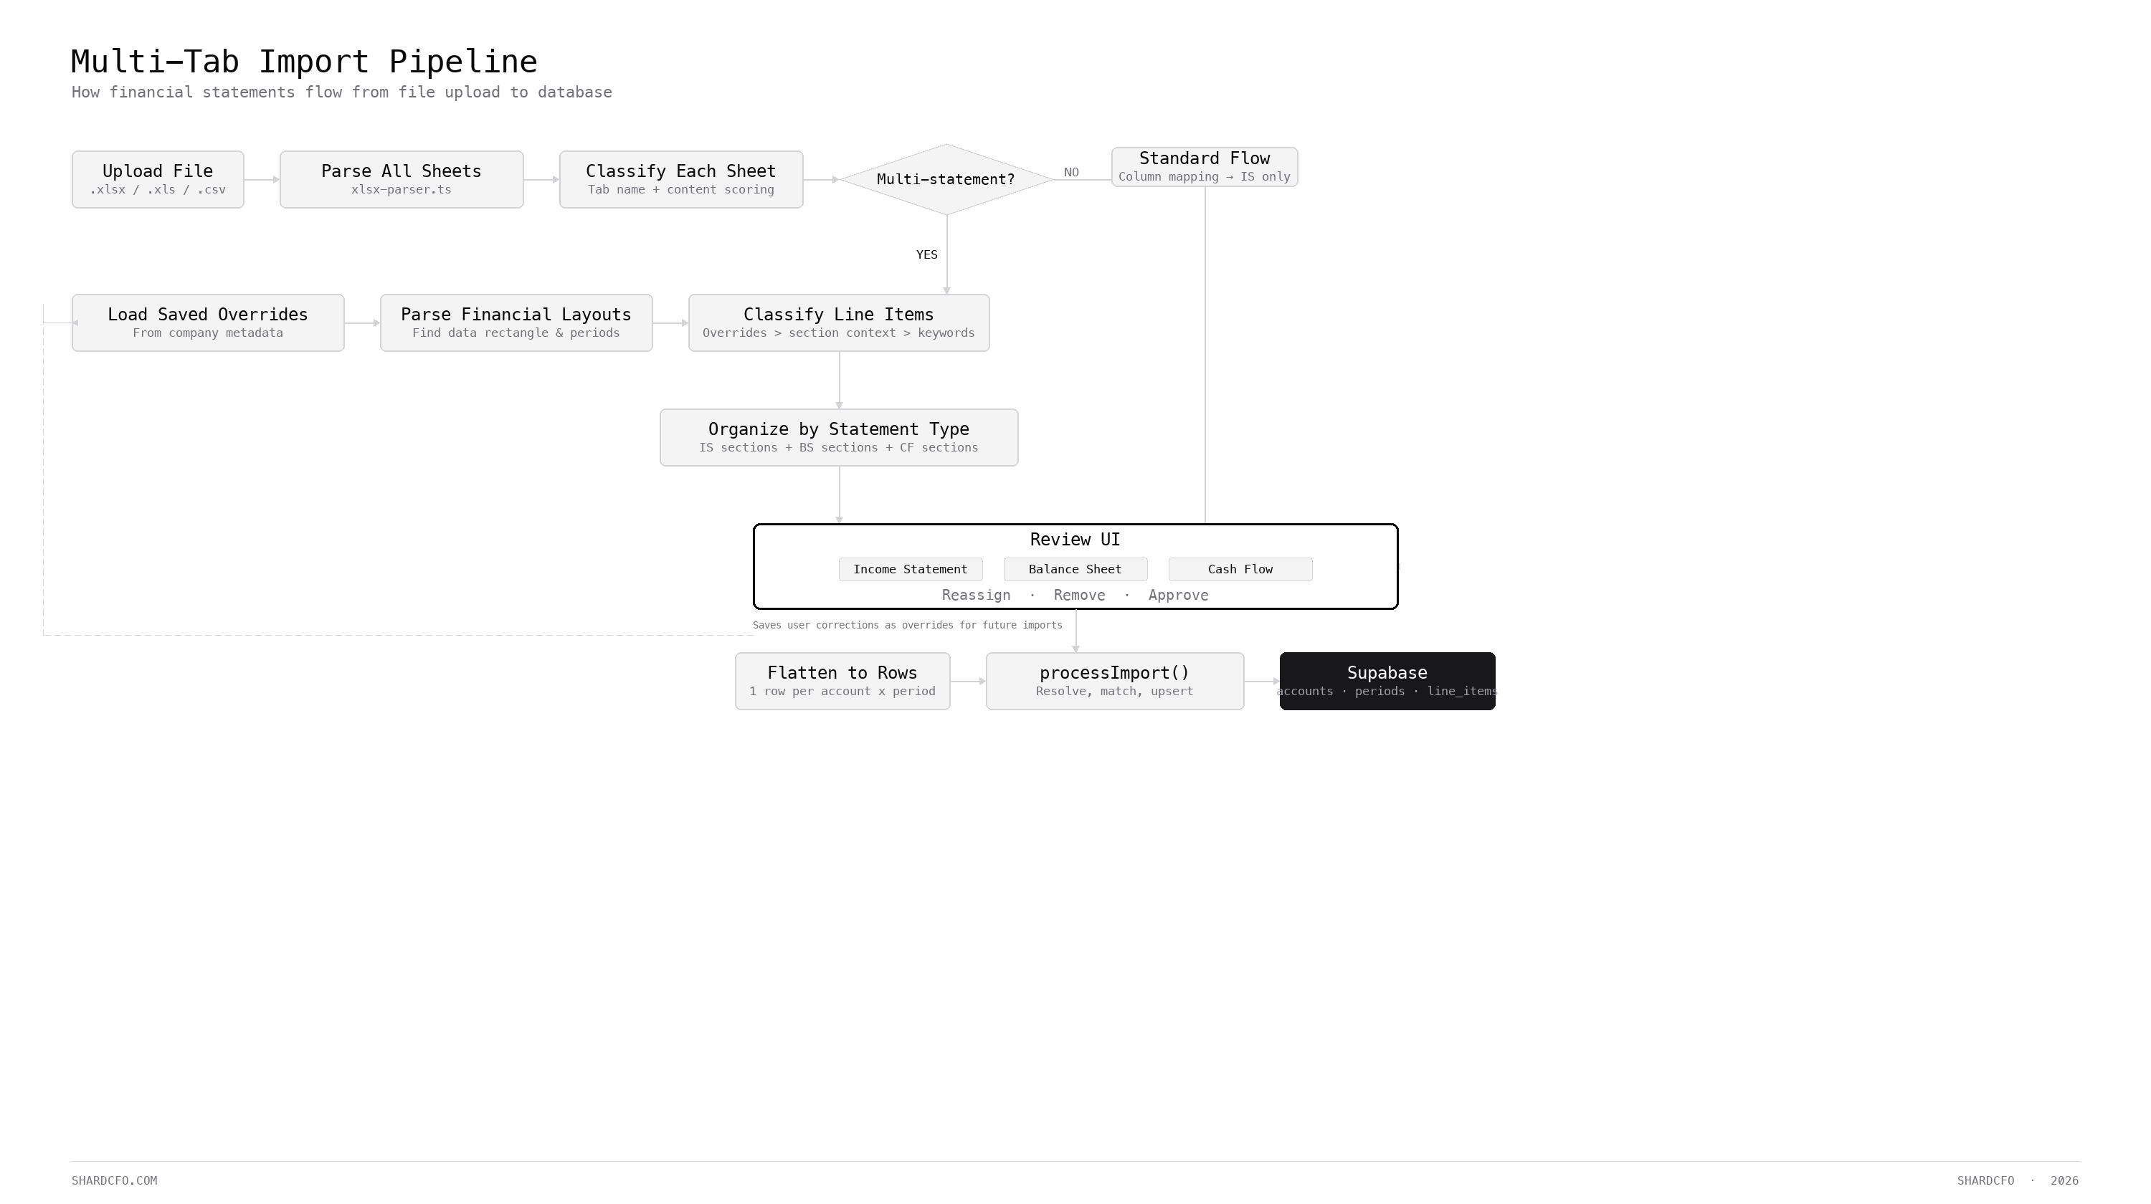
SOLUTION
SHARDCFO.COM
SHARDCFO · 2026

