Slide 1
CSE541 Computer Vision
Landing Error Scoring System for Basketball: A Computer Vision Approach
Aayushi Shah AU2140159
Dhairya Shah AU2140133
Raj Dave AU2140163
Vanaja Agarwal AU2140213
Btech. CSE, School of Engineering and Applied Sciences
Btech. CSE, School of Engineering and Applied Sciences
Btech. CSE, School of Engineering and Applied Sciences
Btech. CSE, School of Engineering and Applied Sciences

Slide 2
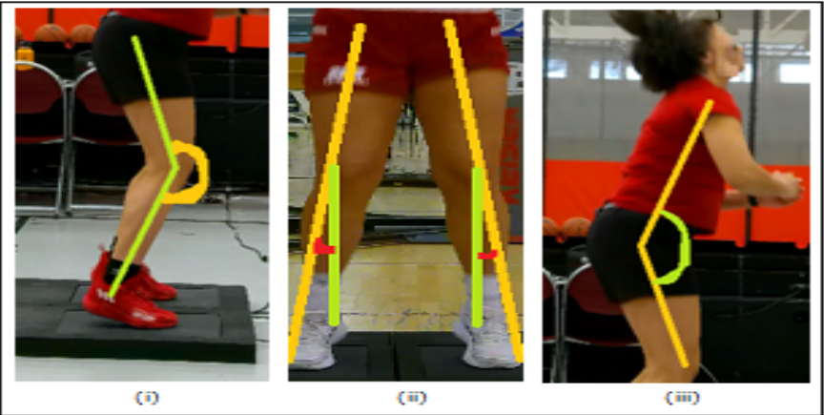
Problem Statement
Landing Error Scoring System for
Basketball: A Computer Vision Approach
Objective
Utilize computer vision techniques to identify irregular movements and incorrect postures (errors).
Provide coaches with valuable insights for training improvements.
Fig. 1 [1]
[1] S. Sharma, S. Divakaran, T. Kaya, C. Taber and M. S. Raval, "A Framework for Biomechanical Analysis of Jump Landings for Injury Risk Assessment," 2023 IEEE 28th Pacific Rim International Symposium on Dependable Computing (PRDC), Singapore, Singapore, 2023, pp. 327-331, https://doi.org/10.1109/prdc59308.2023.00052

Slide 3
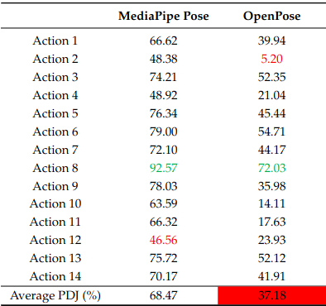
Methodology (1/2)
The athlete’s video is rotated such that the force plate in the frame is parallel to the ground.
Frame extraction: Frame rate 6.02 fps, 211 frames generated. (After fixing orientation)
Key Point extraction: MediaPipe Pose to get the required key points.
Calculation and annotation: Key points are used to calculate angles and distances to get the values for Lateral Trunk Flexion and Stance Width.
[5] Chung, J.-L., Ong, L.-Y., & Leow, M.-C. (2022). Comparative Analysis of Skeleton-Based Human Pose Estimation. Future Internet, 14(12), 380. https://doi.org/10.3390/fi14120380
Fig. 2 [5]
Notes:
We were given NCAA Division 1 female basketball athletes counterjump video. We first have rotated the video to align the plate at 0 degrees. We extracted 211 frames at the rate of 6.02 fps.
Then using media pipe we annotated 6 keypoints. Then calculated lateral flexion and stance width. We used media pipe instead of openPose because it had better PDJ (Percentage of detected joints). PDJ - Percentage of Detected Joints. PDJ is another metric that mitigates the short-limb problem. This metric considers a key point correct if the distance between the true and predicted joint is within a fraction of their torso's diameter.

Slide 4
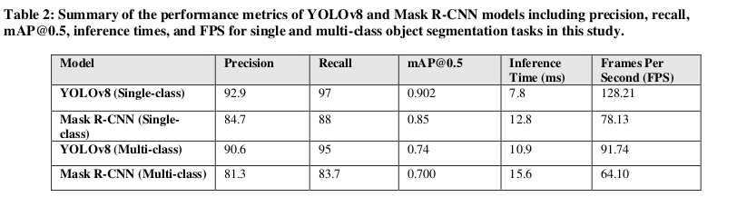
Methodology (2/2)
Model Selection: Comparison of YOLO v8 with Mask R-CNN for segmentation tasks.
YOLO v8 pre-trained on MS COCO dataset was chosen due to its better performance.
68 layers. 111 million Parameters.
Training: 70:20:10 Train:validate:test dataset
Fig. 3 [6] performance metrics of YOLOv8 and Mask R-CNN models for single and multi-class object segmentation
[6] R. Sapkota, D. Ahmed, and M. Karkee, ”Comparing YOLOv8 and Mask RCNN for object segmentation in complex orchard environments,” 2023. [Online]. Available: https://doi.org/10.32388/ZB9SB0.
Notes:
In order to automate this calculation using keypoints, we decided to train a model for doing the same. We compared YOLO v8 and MAsk R-CNN for segmentation tasks. This table compares different models over precision, recall, mAP,Inference time and FPS.
So we have used YOLO v8 for error detection. It was pretrained on MS COCO dataset that consists of 328K images. Yolov8 consists of 68 layers with 111 million parameters. Ratio of training, validation and test dataset is 70:20:10.

Slide 5
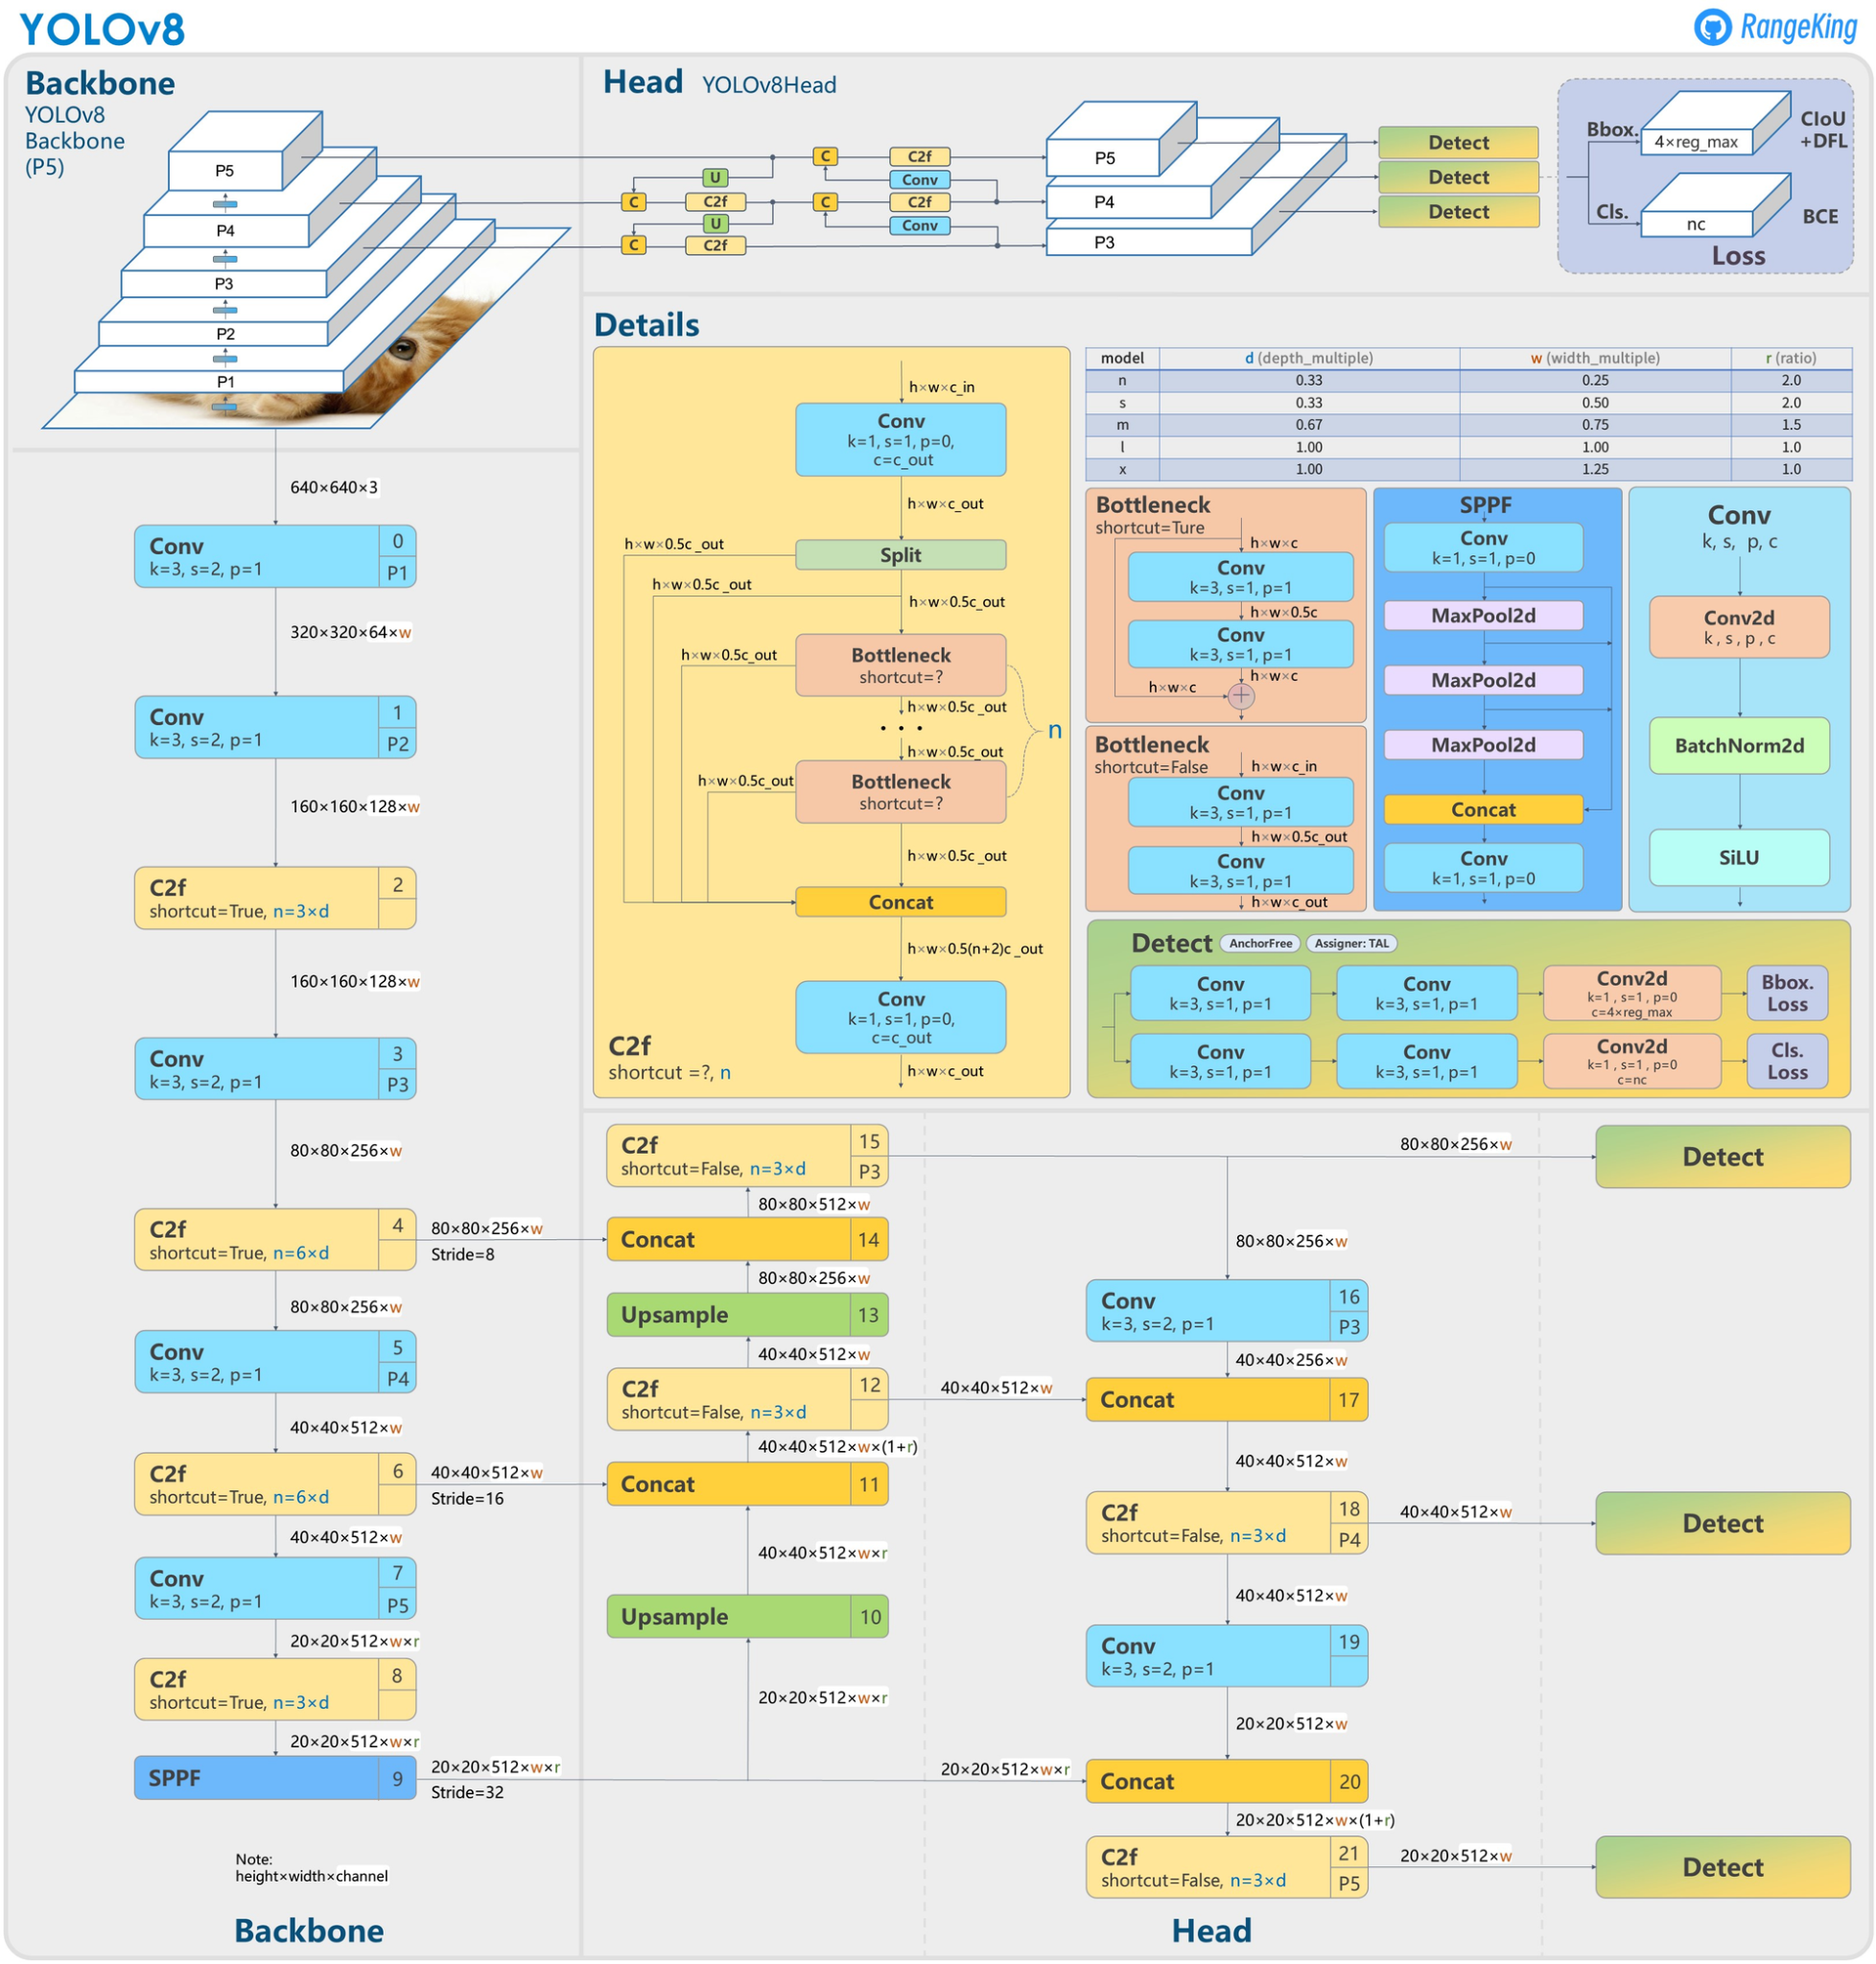
Model Architecture
Fig. 4 [8] YOLO v8 Model architecture
[8] J. Solawetz and Francesco, "What is YOLOv8? The Ultimate Guide. [2024]," Roboflow Blog, 11-Jan-2023. [Online]. Available: https://blog.roboflow.com/whats-new-in-yolov8/.
Notes:
In order to automate this calculation using keypoints, we decided to train a model for doing the same. We compared YOLO v8 and MAsk R-CNN for segmentation tasks. This table compares different models over precision, recall, mAP,Inference time and FPS.
So we have used YOLO v8 for error detection. It was pretrained on MS COCO dataset that consists of 328K images. Yolov8 consists of 68 layers with 111 million parameters. Ratio of training, validation and test dataset is 70:20:10.

Slide 6
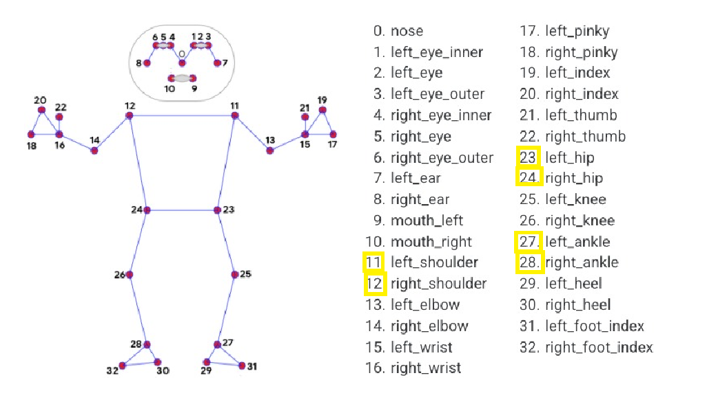
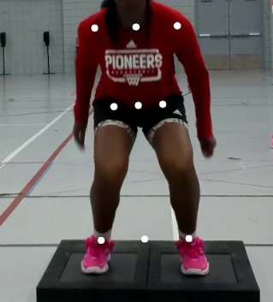
Methodology
Key Point extraction
Fig. 5 [1]
Fig. 6 [7]
We considered the joint locations( ankle, shoulder, hip) and their midpoints which provide insights into the symmetry and the movement of the athlete to calculate the errors.
[1] S. Sharma, S. Divakaran, T. Kaya, C. Taber and M. S. Raval, "A Framework for Biomechanical Analysis of Jump Landings for Injury Risk Assessment," 2023 IEEE 28th Pacific Rim International Symposium on Dependable Computing (PRDC), Singapore, Singapore, 2023, pp. 327-331, https://doi.org/10.1109/prdc59308.2023.00052

Slide 7
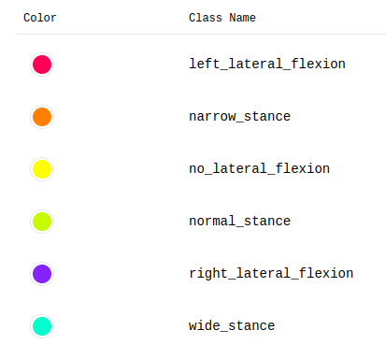
Methodology
Classes used in Roboflow
Calculation and Annotation
Points to note while labelling using Roboflow
Tight bounding boxes
Labelling two errors: stance_width and lateral_flexion using different colours and labels.
The idea behind bounding the key points in the frame for further training of the model.
Fig. 7 [7]
[7] Dwyer, B., Nelson, J., Hansen, T., et. al. (2024). Roboflow (Version 1.0) [Software]

Slide 8
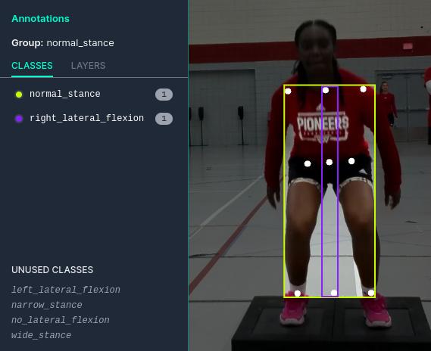
Methodology
Calculation and Annotation
Lateral flexion
The angle between the line connecting the shoulder midpoint and the hip midpoint and the line connecting hip midpoint and top of the frame.
Stance width
The ratio of shoulder distance to ankle width is the stance width ratio of the athlete.
ratio < 0.8 : wide stance
0.8 ≤ ratio ≤ 1.2 : normal stance
ratio > 1.2 : narrow stance
Fig. 8 [7]
[7] Dwyer, B., Nelson, J., Hansen, T., et. al. (2024). Roboflow (Version 1.0) [Software]

Slide 9
Methodology
Model Selection
YOLO v8
Mask R-CNN
Train YOLO v8 on a custom dataset
(images, labels)
show_labels = True, pretrained = True
Validate
(images, labels)
show_labels = True
Predict with a custom model (show_labels = False)

Slide 10
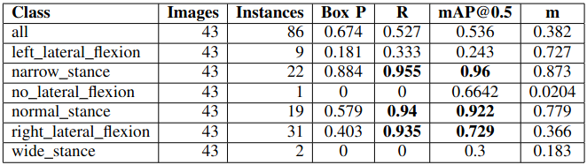
Results (1/3)
Fig. 9 mAP results
right_lateral_flexion, narrow_stance and normal_stance were the most significantly present in the dataset
This is reflected in the results.
Notes:
43 images, 86 bounding boxes (instances) Recall = TP/TP+FN mAP - mean Average Precision IOU >= 0.5 mean of all the average precision
Box Precision = TP/TP+FP

Slide 11
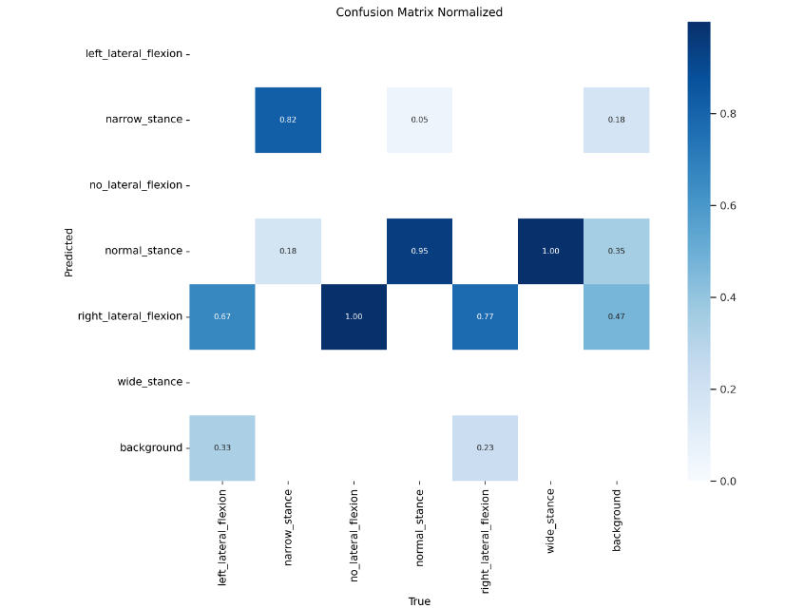
Results (2/3)
More instances of normal and narrow stance gave 0.95 and 0.82 of precision respectively.
More instances of right lateral flexion overfitted our model.
Fig. 10 Confusion matrix
Notes:
This is the confusion matrix of our model. We had more instances of some classes like normal stance, narrow stance and right lateral flexion. On the other hand frames of classes like wide stance, no lateral flexion and left lateral flexion. So our model overfitted for classes having more instances. We need more data frames for the classes having low instances like there was only 5 frames having no lateral flexion, in order to improve our model.

Slide 12
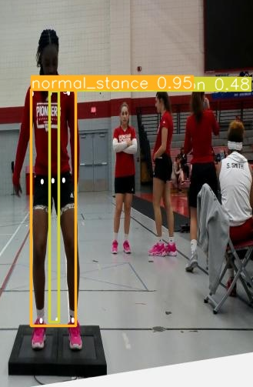
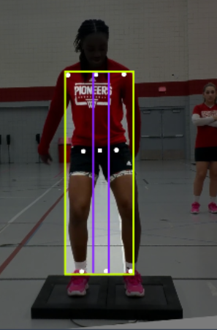

Results (3/3)
Predicted
Training set

Slide 13
Conclusion & Future Work
Proposed framework helps identify errors without the need of overhead of calculating the key points.
We can improve the performance of the model with more data to address the data imbalance.
A real time end to end dashboard for scoring.

Slide 14
References
S. Sharma, S. Divakaran, T. Kaya, C. Taber and M. S. Raval, "A Framework for Biomechanical Analysis of Jump Landings for Injury Risk Assessment," 2023 IEEE 28th Pacific Rim International Symposium on Dependable Computing (PRDC), Singapore, Singapore, 2023, pp. 327-331, https://doi.org/10.1109/prdc59308.2023.00052
Hébert-Losier, K.; Hanzlíková, I.; Zheng, C.; Streeter, L.; Mayo, M. The ‘DEEP’ Landing Error Scoring System. Appl. Sci. 2020, 10, 892. https://doi.org/10.3390/app10030892
Zheng, C., Wu, W., Chen, C., Yang, T., Zhu, S., Shen, J., Kehtarnavaz, N., & Shah, M. (2020). Deep Learning-Based Human Pose Estimation: A Survey. https://arxiv.org/abs/2012.13392
N. Blanchard, K. Skinner, A. Kemp, W. Scheirer and P. Flynn, ""Keep Me In, Coach!": A Computer Vision Perspective on Assessing ACL Injury Risk in Female Athletes," 2019 IEEE Winter Conference on Applications of Computer Vision (WACV), Waikoloa, HI, USA, 2019, pp. 1366-1374, https://doi.org/10.1109/wacv.2019.00150
Chung, J.-L., Ong, L.-Y., & Leow, M.-C. (2022). Comparative Analysis of Skeleton-Based Human Pose Estimation. Future Internet, 14(12), 380. https://doi.org/10.3390/fi14120380
R. Sapkota, D. Ahmed, and M. Karkee, ”Comparing YOLOv8 and Mask RCNN for object segmentation in complex orchard environments,” 2023. [Online]. Available: https://doi.org/10.32388/ZB9SB0.

Slide 15
References
Dwyer, B., Nelson, J., Hansen, T., et. al. (2024). Roboflow (Version 1.0) [Software]
J. Solawetz and Francesco, "What is YOLOv8? The Ultimate Guide. [2024]," Roboflow Blog, 11-Jan-2023. [Online]. Available: https://blog.roboflow.com/whats-new-in-yolov8/.

Slide 16
Thank You
aayushi.s3@ahduni.edu.in
dhairya.s4@ahduni.edu.in raj.d@ahduni.edu.in
vanaja.a@ahduni.edu.in

