Slide 1
CSE541 Computer Vision
Landing Error Scoring System for Basketball: A Computer Vision Approach
Aayushi Shah AU2140159
Dhairya Shah AU2140133
Raj Dave AU2140163
Vanaja Agarwal AU2140213
Btech. CSE, School of Engineering and Applied Sciences
Btech. CSE, School of Engineering and Applied Sciences
Btech. CSE, School of Engineering and Applied Sciences
Btech. CSE, School of Engineering and Applied Sciences

Slide 2
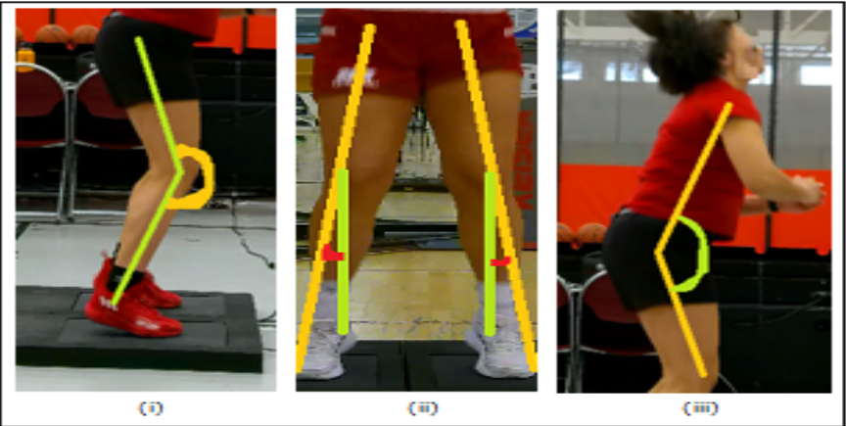
Problem Statement
Landing Error Scoring System for
Basketball: A Computer Vision Approach
Objective
Utilize computer vision techniques to identify irregular movements and incorrect postures.
Provide coaches with valuable insights for injury prediction and training improvements.
Fig. 1 [1]
[1] S. Sharma, S. Divakaran, T. Kaya, C. Taber and M. S. Raval, "A Framework for Biomechanical Analysis of Jump Landings for Injury Risk Assessment," 2023 IEEE 28th Pacific Rim International Symposium on Dependable Computing (PRDC), Singapore, Singapore, 2023, pp. 327-331, https://doi.org/10.1109/prdc59308.2023.00052

Slide 3
Literature Survey
Study Title | Authors | Year | Methodology | Main Findings
A Framework for Biomechanical Analysis of Jump Landings for Injury Risk Assessment [1] | S. Sharma et al. | 2023 | Evaluation and analysis of a framework based on Computer vision techniques. | An extremely robust framework to give the injury-risk score with accurate predictions.
The ‘DEEP’ Landing Error Scoring System [2] | Hébert-Losier et al. | 2020 | Evaluation, Analysis, and comparison. | LESS can be automated using deep learning methods with promising results.
Deep Learning-Based Human Pose Estimation: A Survey [3] | Zheng et al. | 2020 | Survey and analysis, literature review and comparison. | Comparison of 260 papers surrounding the topic of human pose estimation and exploration of different challenges as well as constraints.
"Keep Me In, Coach!": A Computer Vision Perspective on Assessing ACL Injury Risk in Female Athletes [4] | N. Blanchard et al. | 2019 | Experimental, modeling, data collection, 3D reconstruction. | Accuracy in tracking of movement features using body modeling and 3D reconstruction techniques aiding ACL injury risk evaluation.

Slide 4
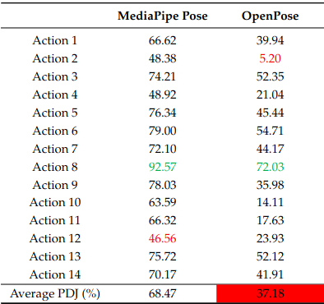
Methodology
The athlete’s video is rotated such that the force plate in the frame is parallel to the ground.
Frame extraction: Frame rate 6.02 fps, 211 frames generated.
Key Point extraction: MediaPipe Pose to get the required key points.
Calculation and annotation: Key points are used to calculate angles and distances to get the values for Lateral Trunk Flexion and Stance Width.
[5] Chung, J.-L., Ong, L.-Y., & Leow, M.-C. (2022). Comparative Analysis of Skeleton-Based Human Pose Estimation. Future Internet, 14(12), 380. https://doi.org/10.3390/fi14120380
Fig. 2 [5]

Slide 5
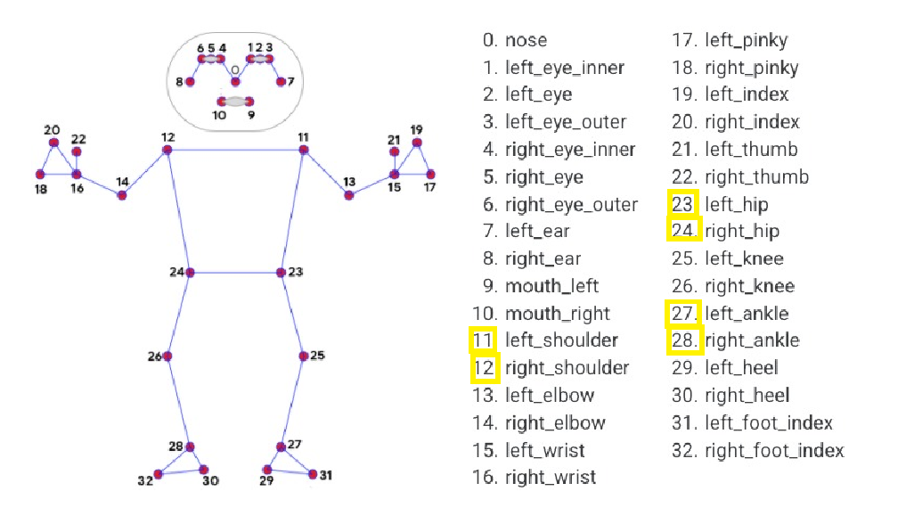
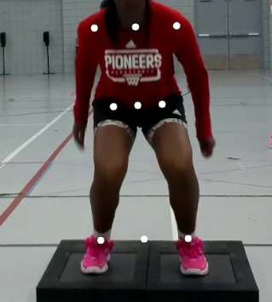
Methodology
Key Point extraction
Fig. 3 [1]
We are considering the joint locations( ankle, shoulder, hip) and their midpoints which provide insights into the symmetry and the movement of the athlete to calculate the errors.
[1] S. Sharma, S. Divakaran, T. Kaya, C. Taber and M. S. Raval, "A Framework for Biomechanical Analysis of Jump Landings for Injury Risk Assessment," 2023 IEEE 28th Pacific Rim International Symposium on Dependable Computing (PRDC), Singapore, Singapore, 2023, pp. 327-331, https://doi.org/10.1109/prdc59308.2023.00052

Slide 6
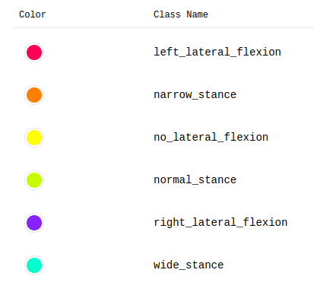
Methodology
Classes used in Roboflow
Points to note while labelling using Roboflow
Tight bounding boxes
Labelling two errors: stance_width and lateral_flexion using different colours and labels
The idea behind bounding the key points in the frame for further training of the model.

Slide 7
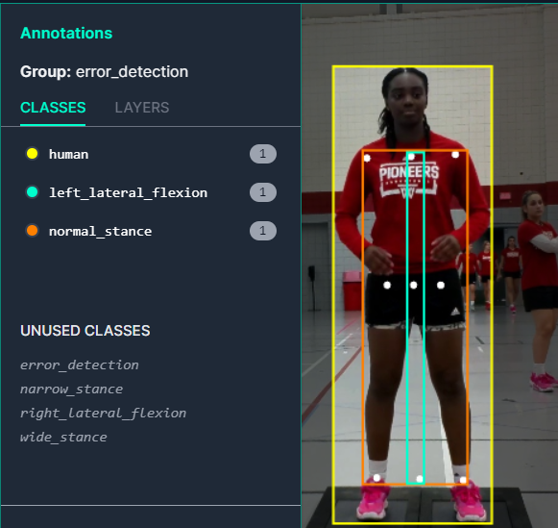
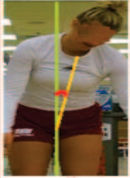
Methodology
Calculation and Annotation
Lateral flexion
The angle between the line connecting the shoulder midpoint and the hip midpoint and the line connecting hip midpoint and top of the frame.
Stance width
The ratio of shoulder distance to ankle width is the stance width ratio of the athlete.

Slide 8
Results
If the ratio is between 0.8 to 1.2 then it is normal stance, whereas a ratio greater than 1.2 is narrow stance and less than 0.8 is wide stance.
Frame_Number | Lateral Flexion |  |  | Stance
 | Present (yes or no)? | right/left/no | Angle | Type(normal/wide/narrow) | Ratio
7 | yes | right | -0.05337 | narrow | 1.380669
56 | yes | left | 0.177554 | normal | 0.1079483
200 | yes | left | 2.413297 | wide | 0.774038

Slide 9
Future Work
Deep Learning Model: Using the annotated images as ground truth for our own deep learning model.
Incorporating XAI and Dashboard: Incorporation of an XAI component would help us identify the significant errors, and generalize this model with reliability.

Slide 10
References
S. Sharma, S. Divakaran, T. Kaya, C. Taber and M. S. Raval, "A Framework for Biomechanical Analysis of Jump Landings for Injury Risk Assessment," 2023 IEEE 28th Pacific Rim International Symposium on Dependable Computing (PRDC), Singapore, Singapore, 2023, pp. 327-331, https://doi.org/10.1109/prdc59308.2023.00052
Hébert-Losier, K.; Hanzlíková, I.; Zheng, C.; Streeter, L.; Mayo, M. The ‘DEEP’ Landing Error Scoring System. Appl. Sci. 2020, 10, 892. https://doi.org/10.3390/app10030892
Zheng, C., Wu, W., Chen, C., Yang, T., Zhu, S., Shen, J., Kehtarnavaz, N., & Shah, M. (2020). Deep Learning-Based Human Pose Estimation: A Survey. https://arxiv.org/abs/2012.13392
N. Blanchard, K. Skinner, A. Kemp, W. Scheirer and P. Flynn, ""Keep Me In, Coach!": A Computer Vision Perspective on Assessing ACL Injury Risk in Female Athletes," 2019 IEEE Winter Conference on Applications of Computer Vision (WACV), Waikoloa, HI, USA, 2019, pp. 1366-1374, https://doi.org/10.1109/wacv.2019.00150
Chung, J.-L., Ong, L.-Y., & Leow, M.-C. (2022). Comparative Analysis of Skeleton-Based Human Pose Estimation. Future Internet, 14(12), 380. https://doi.org/10.3390/fi14120380

Slide 11
Thank You
aayushi.s3@ahduni.edu.in
dhairya.s4@ahduni.edu.in raj.d@ahduni.edu.in
vanaja.a@ahduni.edu.in

