Slide 1
CSE523 Machine Learning Code Crafters
Athlete profiling based on similar characteristics
Aagam Shah AU2140024
Dhairya Shah AU2140133
Aayushi Shah AU2140159
Aanal Dobariya AU2140182
Btech. CSE, School of Engineering and Applied Sciences
Btech. CSE, School of Engineering and Applied Sciences
Btech. CSE, School of Engineering and Applied Sciences
Btech. CSE, School of Engineering and Applied Sciences

Slide 2
Content
Problem Statement
Approach
Methodology
Feature Engineering
Exploratory Data Analysis (EDA)
Clustering
Key Performance Metrics
XAI
References
Notes:
This table of content gives a glimpse of our study.

Slide 3
Problem Statement
Athlete Profiling for Division I Basketball Players using Multimodal Dataset
Objectives
Identify important features from a high dimensional multimodal dataset
Cluster athletes based on similar characteristics
Integrate explainable AI (X AI), justify and interpret the clustering results

Slide 4
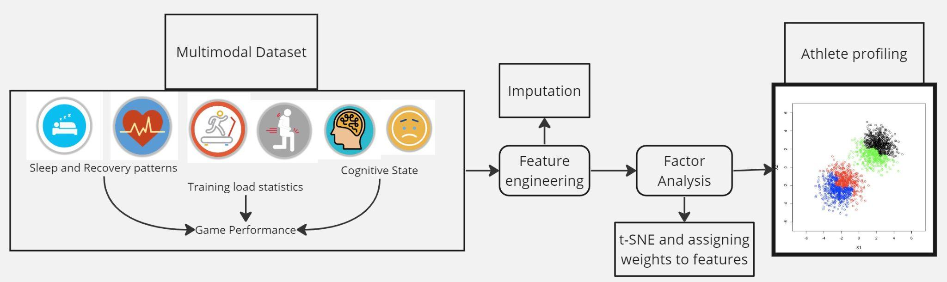
Approach
Fig. 1 [4]
[4] Sharma, S. U., Divakaran, S., Kaya, T., & Raval, M. (2022, July). A Hybrid Approach for Interpretable Game Performance Prediction in Basketball. In 2022 International Joint Conference on Neural Networks (IJCNN) (pp. 01-08). IEEE.
Notes:
Using the multimodal dataset, we did feature engineering that included structuring, imputing and combining two season’s data. Then we performed factor analysis using t-SNE and factor loadings. With the help of new factors, we did K-Means clustering to get final Athlete profiling.

Slide 5
Methodology
Feature Engineering
Exploratory Data Analysis (EDA)
Elbow Method
Clustering
Key Performance metrics

Slide 6
Feature Engineering
Raw unstructured data collected from WHOOP device is structured for every athlete across 115 features for 2 seasons.
To deal with null values we used Multivariate Imputation by Chained Equations (MICE). MICE
preserves complex relationships,
reduces biases, and
can handle a large amount of missing values.
Merged season 2 and season 3 data over common features
Notes:
The goal of MICE is to preserve the relationship between variables in the original data and to reduce the bias introduced by imputing missing values.

Slide 7
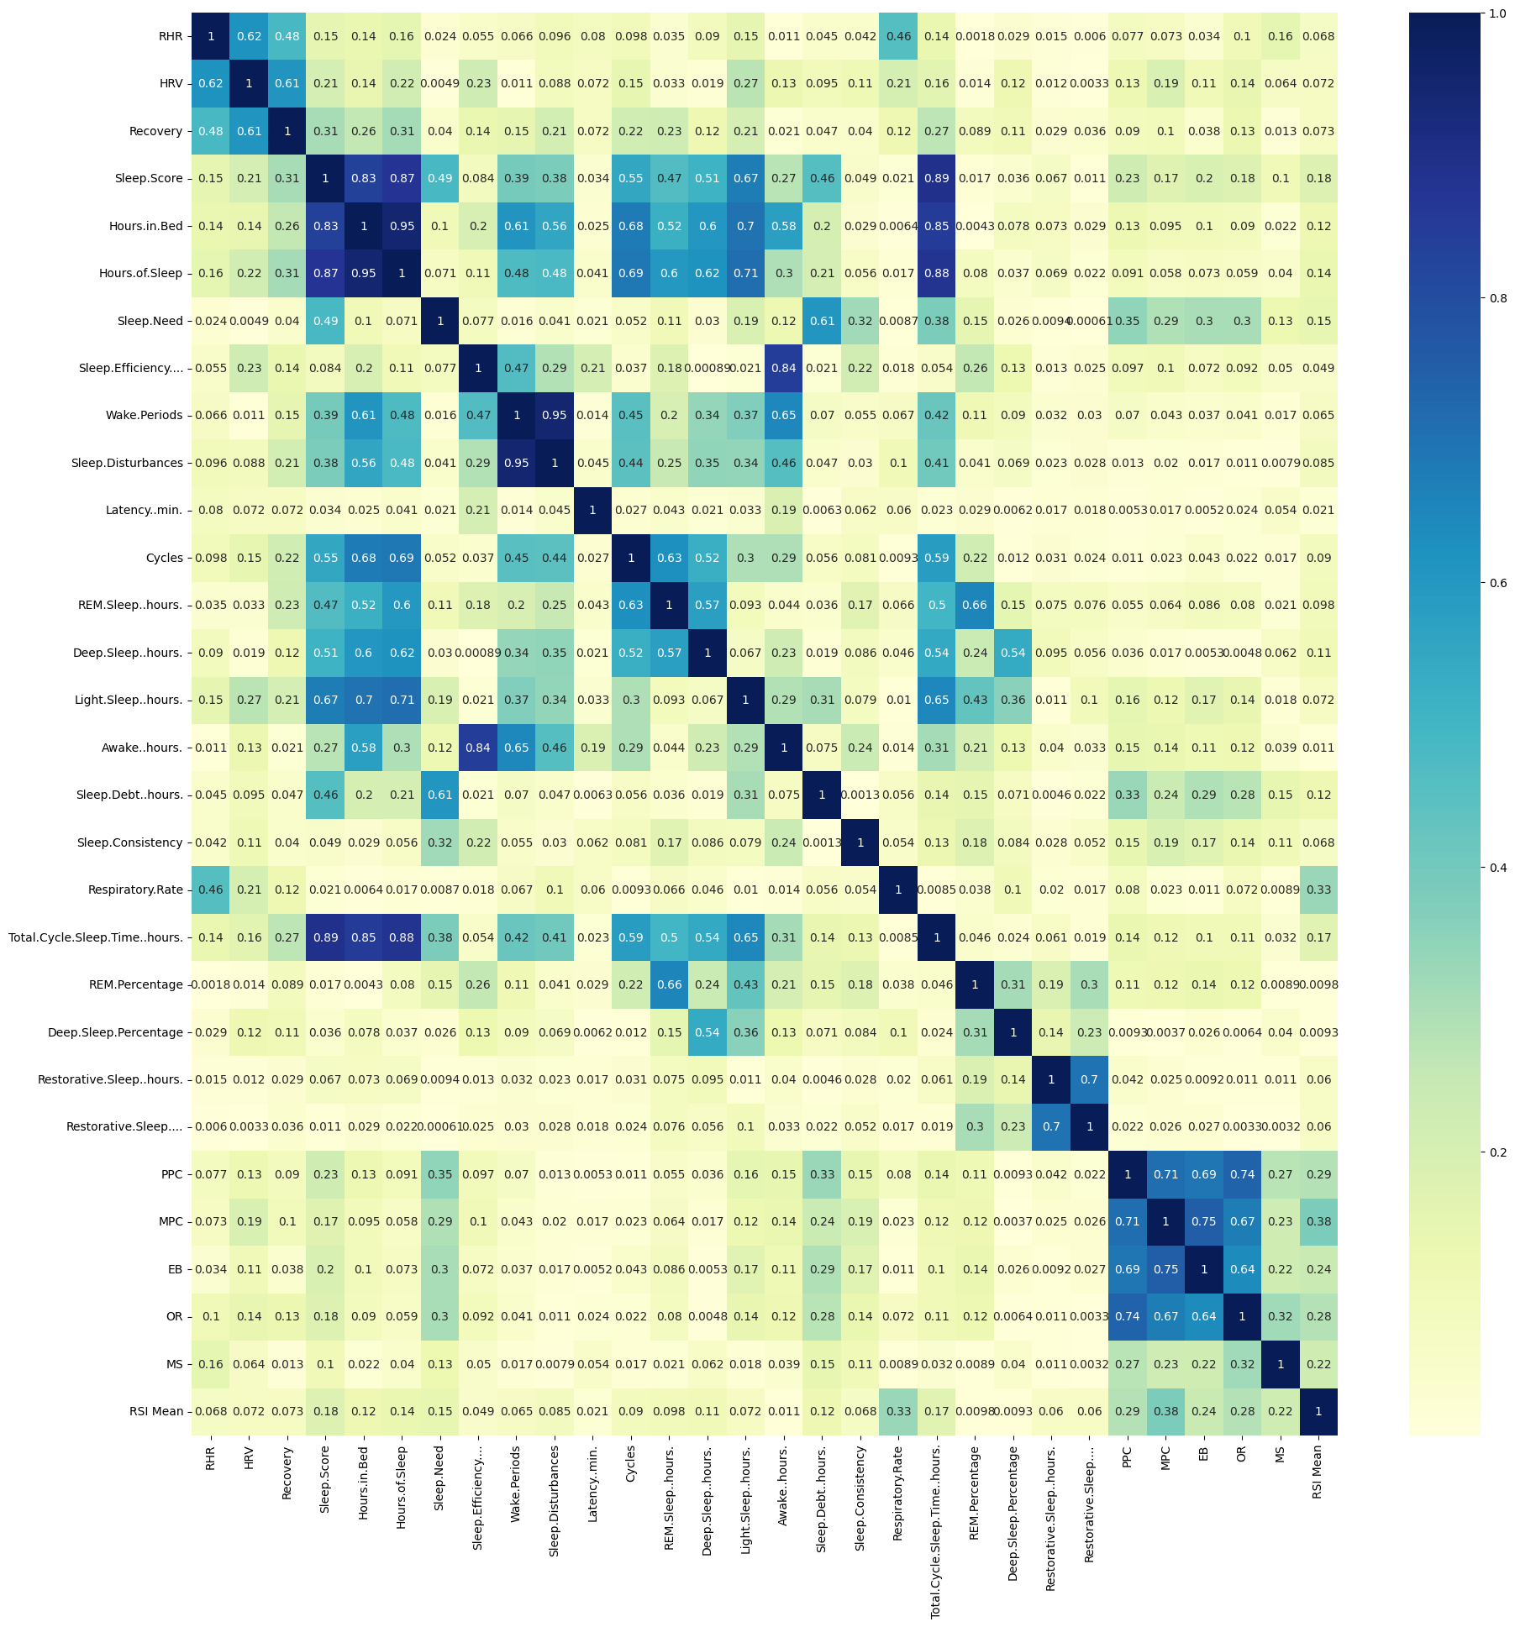
Correlation Heat Map
Notes:
So as to preprocess the data, multi-collinearity analysis was performed on the dataset It could only retain features some features as independent features (rest were all subject to multi-collinearity). This suggested that the dataset contained features that shared common variance. Latent factors were hence discovered for a lossless compact.

Slide 8
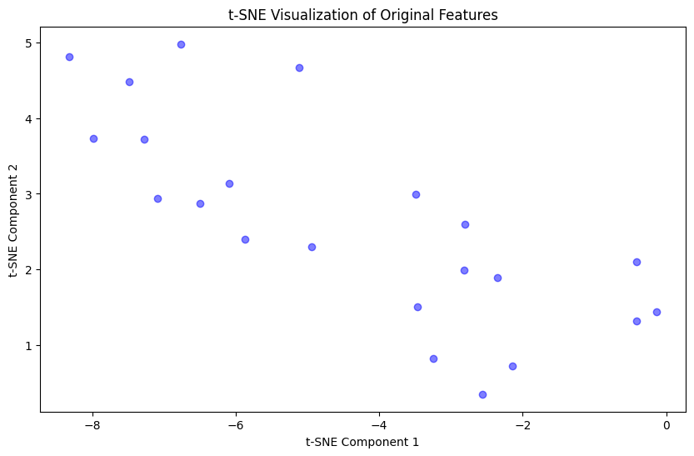
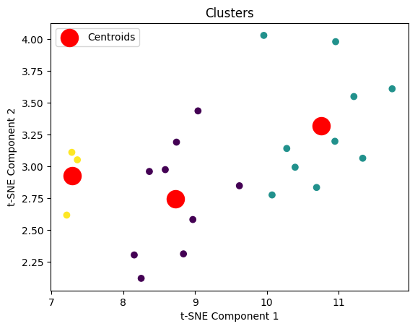
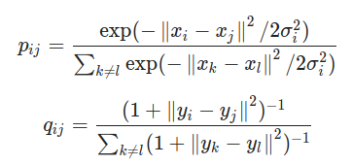
Feature Engineering
t-SNE(t-distributed Stochastic Neighbor Embedding) a non-linear dimensionality reduction technique is applied to find similar probability distribution in a lower-dimensional space

Slide 9
Factor Analysis
Each of these latent factors is a weighted function of a subset of input features sharing common variance, obtained through factor analysis.
With the help of trial and error approach method and factor loadings we found two new features with following weights:
Feature1_weights = {'Sleep.Disturbances': 1}
Feature2_weights = {'Awake..hours.':0.55, 'Deep.Sleep..hours.':0.1, 'Sleep.Need':0.05, 'RSI Mean': 0.30}
Notes:
As discussed before, there is high multicollinearity in the features. Despite of directly dropping the interdependent features, de decided to combine such features to prevent the loss of information. The latent features is simply the weighted sum of original features with common variance. With the help of factor loading(based on collinearity with other features) scores and trial and error approach method, we found these features with the shown weights using the factor loadings and trial and error for different weights.

Slide 10
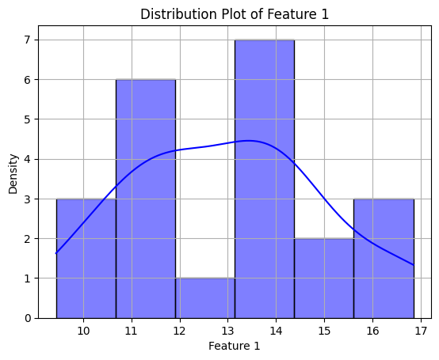
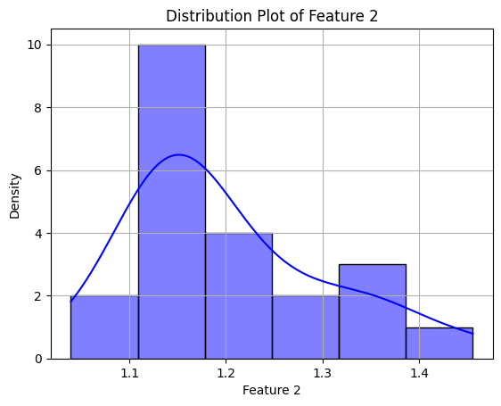
Exploratory Data Analysis
The distribution of Feature 1 appeared to be bimodal, with two distinct peaks around values 11 and 14, indicating the presence of two major different subgroups or clusters in the data.
The distribution of Feature 2 appeared to be unimodal, with a single, well-defined peak around the value 1.1 to 1.2, indicating that most of the data points are clustered around this central value.

Slide 11
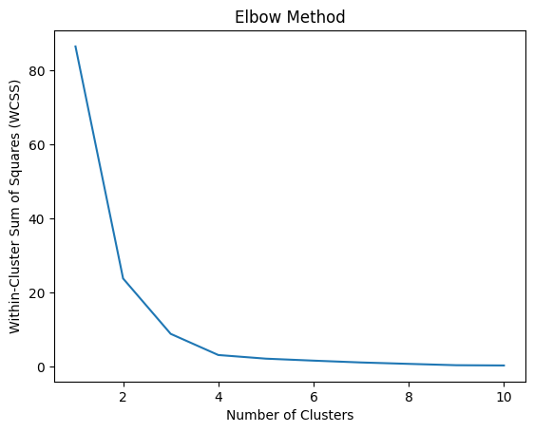
Elbow Method
Inertia/WCSS: Metric that measure the compactness of the clusters. It quantifies the variance within clusters.
It indicates that the optimal number of clusters for the Elbow Method is around 3.
As the within-cluster sum of squares decreases sharply until around 3 clusters, after which the rate of decrease slows down, forming an "elbow" shape in the plot.
Notes:
WCSS - It is defined as the sum of square distances between the centroids and
each points.

Slide 12
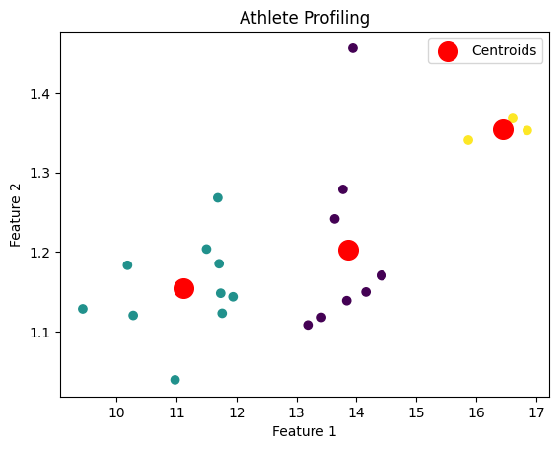
K- Means Clustering
Algorithm | Silhouette Score
DBSCAN | 0.3883
K Means | 0.7044
Ensemble Clustering | 0.7044
>>num_clusters = 3
>>kmeans = KMeans(n_clusters=num_clusters, init='k-means++', random_state=90)
Notes:
eps, Minpts, Feature 1: Sleep Disturbance, Feature 2: Awake Hours, Deep Sleep Hours, Sleep Need, RSI Mean (Sleep & Recovery Pattern, Training Load Statistics) Density-Based Spatial Clustering Of Applications With Noise (DBSCAN)
The clustering analysis suggests that athletes can be divided into three performance groups based on their sleep patterns and training load metrics:
Grp1 (yellow cluster): These athletes have high Reactive Strength Index (RSI) mean and adequate deep sleep hours despite some sleep disturbance.
Grp2 (purple cluster): These athletes have similar RSI mean and deep sleep hours, despite moderate sleep disturbance.
Grp3 (green cluster): These athletes have lower RSI mean and less deep sleep hours compared to the other two groups, indicating their performance may be impacted by suboptimal sleep and training load.
The analysis highlights the importance of monitoring and optimizing both sleep patterns and training load metrics to support athlete performance and reduce injury risk, with the yellow cluster representing the ideal combination of these factors.

Slide 13



Silhouette Score
The silhouette value of a point x is:
where,
ai = mean(distance between a point and all other points in same cluster)
bi = mean(distance between a point and all other points of the nearest cluster with respect to the current cluster)
Range: [-1,1]
Close to 1: Clearly distinguished and well separated clusters
Close to 0: Clusters are indifferent
Close to -1: Clusters are not well distinguishable

Slide 14
Conclusion & Explainable AI
Multicollinearity Analysis / Feature Importance Analysis
Features were intercorrelated and sharing common variance.
From correlation heatmap, we justified retaining the independent features.
Visual Interpretation:
Visualized clusters in high-dimensional feature space using techniques like t-SNE (t-distributed Stochastic Neighbor Embedding)
Model interpretation:
Using factor analysis, we found feature importance loadings/scores and explained how specific features contribute to the model's decisions.
Notes:
factor loading, feature score

Slide 15
Future Approach
With the help of more number of season(s) data, we can further do time-series clustering using time-series k Means (Dynamic Time Warping and euclidean distance).
Notes:
dynamic time warping - distance between two lines

Slide 16
References
Senbel, S., Sharma, S., Raval, M. S., Taber, C., Nolan, J., Artan, N. S., ... & Kaya, T. (2022). Impact of sleep and training on game performance and injury in division-1 women’s Basketball Amidst the Pandemic. Ieee Access, 10, 15516-15527. https://ieeexplore.ieee.org/abstract/document/9690164/
Taber, C.B., Sharma, S., Raval, M.S. et al. A holistic approach to performance prediction in collegiate athletics: player, team, and conference perspectives. Sci Rep 14, 1162 (2024). https://doi.org/10.1038/s41598-024-51658-8
Sharma, S., Divakaran, S., Kaya, T., Taber, C., & Raval, M. S. (2023, October). A Framework for Biomechanical Analysis of Jump Landings for Injury Risk Assessment. In 2023 IEEE 28th Pacific Rim International Symposium on Dependable Computing (PRDC) (pp. 327-331). IEEE. https://ieeexplore.ieee.org/abstract/document/10356423/?casa_token=yM-1J2vMKG8AAAAA:QnMMyph1mKa6BfvljAqSSABrReChb5hvsEvxFUEv3z5Fiiv1daHpTdbG2oXllJYQ-WQPUijJ6wZr
Sharma, S. U., Divakaran, S., Kaya, T., & Raval, M. (2022, July). A Hybrid Approach for Interpretable Game Performance Prediction in Basketball. In 2022 International Joint Conference on Neural Networks (IJCNN) (pp. 01-08). IEEE. https://ieeexplore.ieee.org/abstract/document/9892583/?casa_token=Ye3GQJ1JpD0AAAAA:GSlyds24pIa__7Od6UBSNs8nugbEwLvCbI8vG6w-YMYrFX2O-TUlUDo4xej3ulJUAvmO_4ij0J36
Cluster SILHOUETTES.pptx. (2023, April 10). SlideShare. https://www.slideshare.net/agnivapradhan1/cluster-silhouettespptx

